Slide 1
Pancreatic cystic disease
Jonathan Rees
Bristol Royal Infirmary

Slide 2
Overview
Current controversies
Cyst types
Presentations
Assessment
Management
Challenges of management
Summary

Slide 3
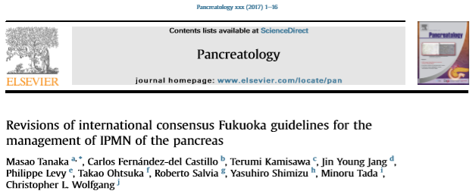
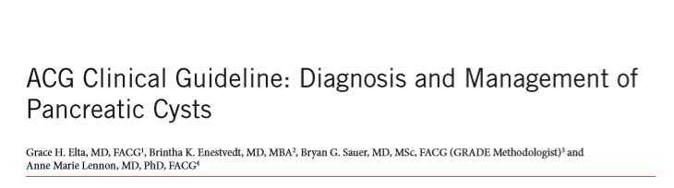
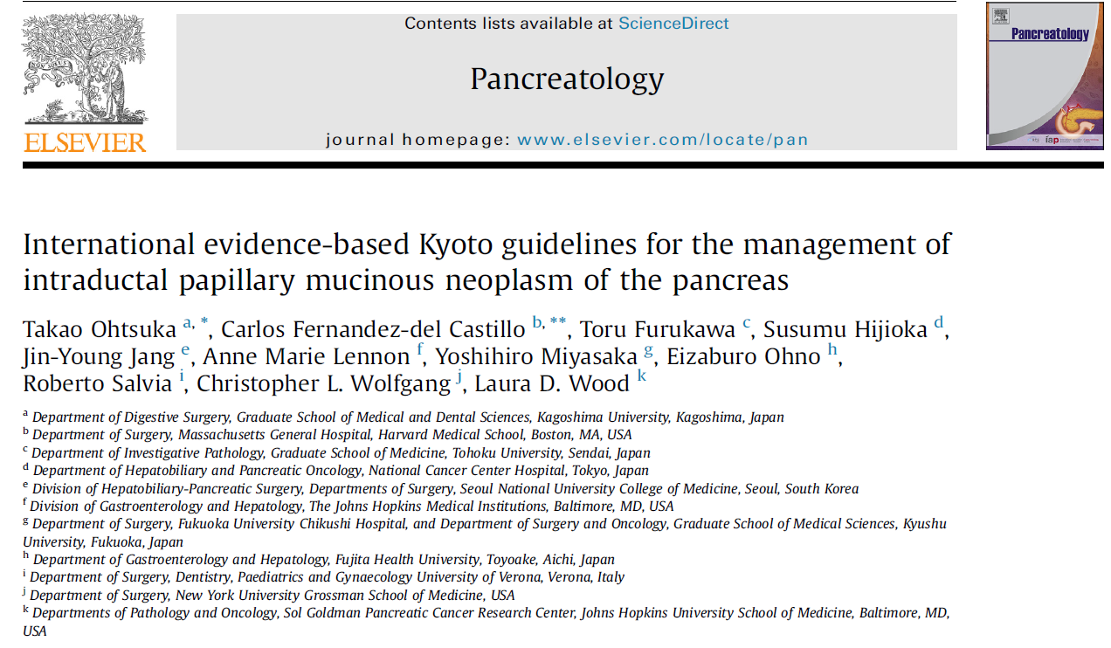

Current controversies

Slide 4
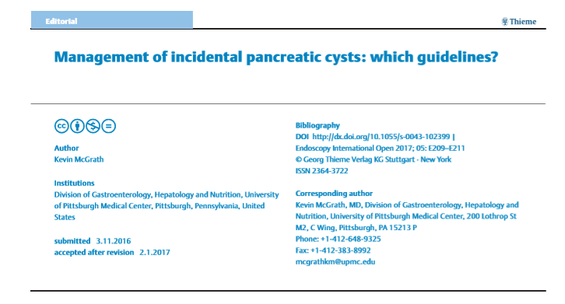
Editorials suggest discordance

Slide 5

Currently units can select their guideline of choice
Evidence to support each guideline
But this is an evolving field – so medicolegally safe to use any of guidance
Part of the choice may be driven by local availability of investigation modalities

Slide 6

Select a guidance to use in your unit and stick to it but keep watching for new evidence in the field

Slide 8
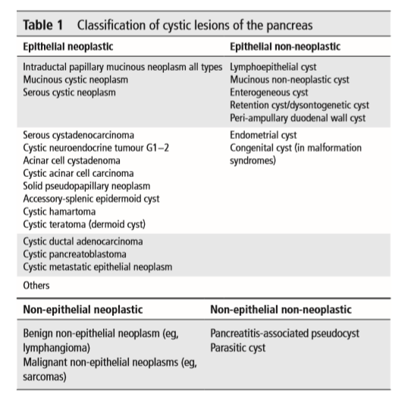
Cyst Types

Slide 9
Main focus of cyst types
Common Pancreatic Cystic Lesions
Four main lesions
IPMN - Intraductal Mucinous Papillary Neoplasm
Post pancreatitis cystic lesions
Excluded from this presentation
MCN – Mucinous Cystic Neoplasm
SCA/ SCN – Serous Cystic Adenoma or Serous Cystic Neoplasm
Malignancy risk
All cysts - 5 yrs 2.9% 10 yrs 5.9% 15 yrs 14%
Small cysts <15mm - 5 yrs 2.2% 10 yrs 4.6% 15 yrs 7.4%

Slide 10
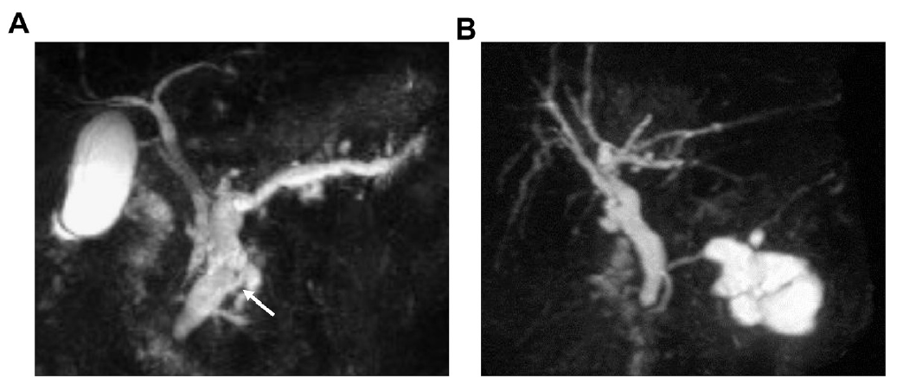
Cyst types
IPMN - Intraductal Mucinous Papillary Neoplasm
Three types
  Main duct
  Side branch – called Branch Duct IPMN
  Mixed

Slide 11
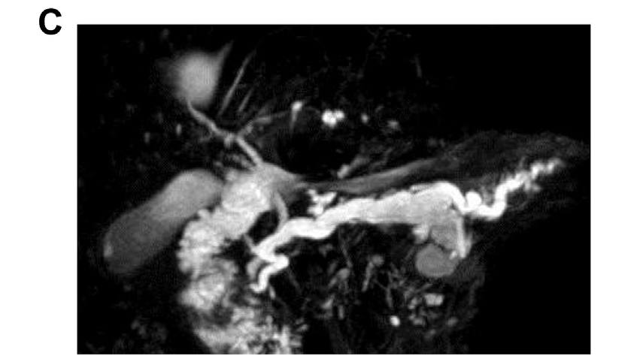
Cyst types
IPMN - Intraductal Mucinous Papillary Neoplasm
Mixed type

Slide 12
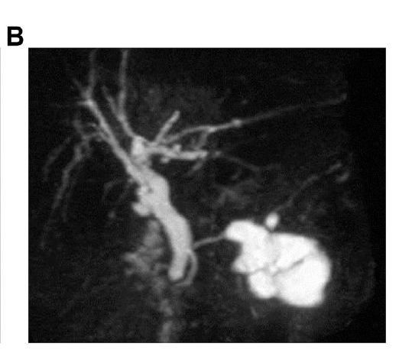
BD-IPMN
55% female
Usually older 60’s plus
Usu. Few symptoms
70% head, no calcium
Grape like and multifocal
Cyst next to cyst
MPD communication
MPD Normal
Cyst - Mucin

Slide 13
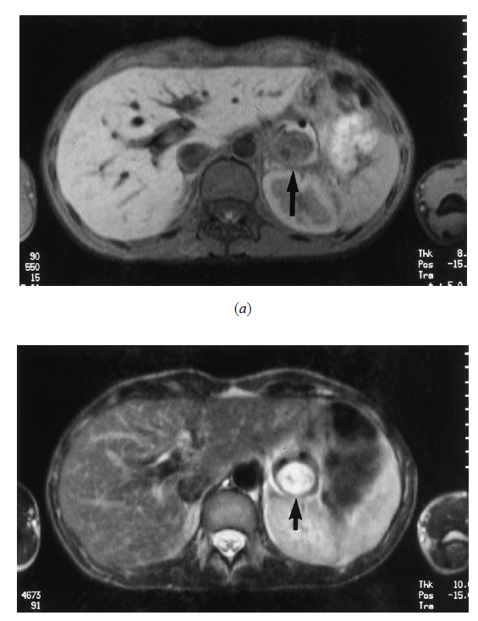
Cyst types
MCN – Mucinous Cystic Neoplasm
95% female
40 – 50 years
Half symptomatic
95% body tail, rare cyst wall Calcium
Ball / Orange like – single lesion
Cyst within a cyst
PD Normal or deviated – not dilated

Slide 14
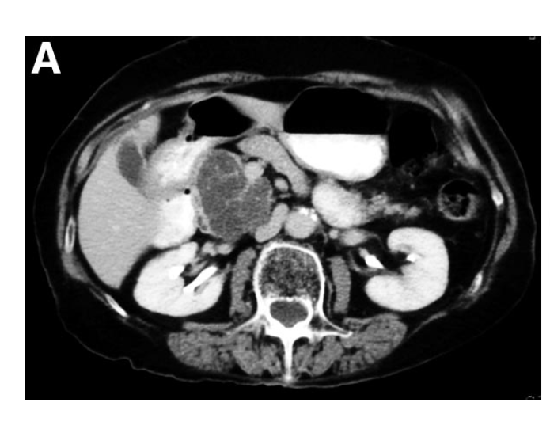
Cyst types
SCA / SCN – Serous Cystic Adenoma or Serous Cystic Neoplasm
70% Female
60 -70 years
Half symptomatic
30-40% central calcification (Central scar)
Single expanding lesion –
  micro/macro or mixed cyst internal structure
PD normal or deviated
Ann Surg 2005;242: 413–421
NO Malignancy risk

Slide 15
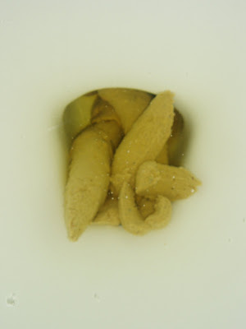
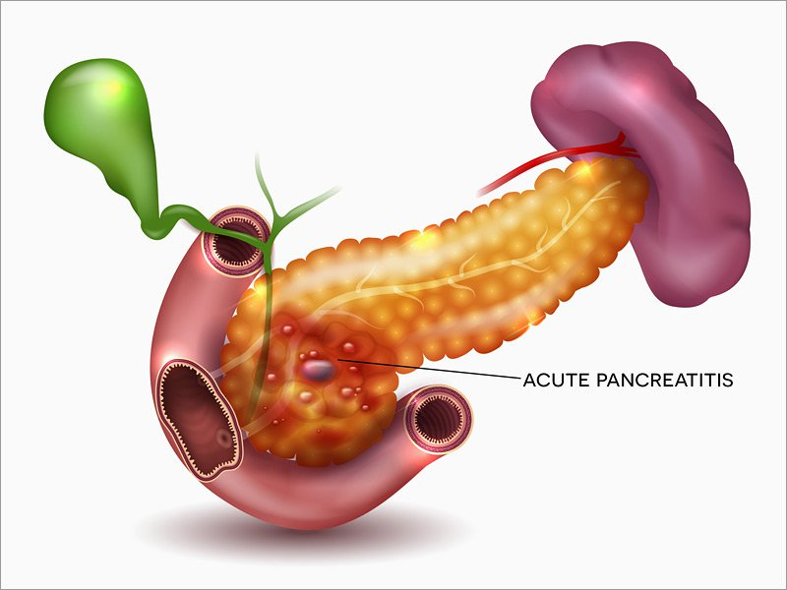
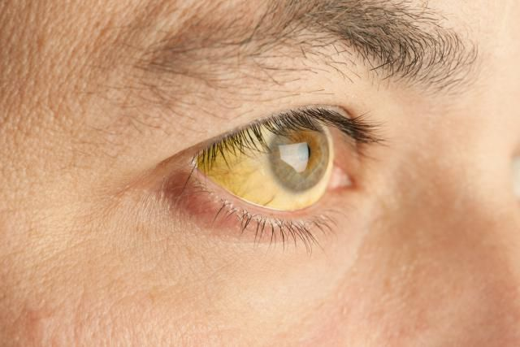
Presentation
Most presentations incidental
Non-specific symptoms
  abdominal pain, altered bowel habit
  symptoms of pancreatic insufficiency – abn. stool, bloating, weight loss
  Jaundice
  Pancreatitis

Slide 16
Assessment
Cysts may be assessed using CT, EUS or MRI
PREVALENCE
  MRI 19.9%
  CT 1.2 – 2.6% (Mid 2000’s)

Slide 17
Assessment
EUS assessment – selected cases
Alone only 50% accuracy for determining nature of lesions
Adding in fluid analysis and FNA/Histol of aspirates +/- wall biopsy
    82% Sensitivity, 100% Specificity, PPV 100%
    CEA analysis > 192-200 80% accuracy for mucinous lesion
    Glucose analysis – Low glucose < 0.1 supportive of mucinous origin
    Cyst fluid DNA analysis – research GNAS gene, VHL gene and RNF43 gene analysis

Slide 18
EUS Examples

Slide 19
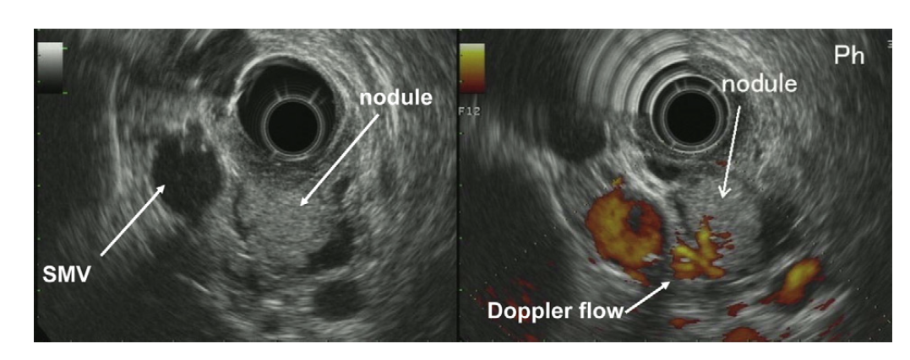
World J Gastroenterol 2014 June 28; 20(24): 7785-7793

Slide 20
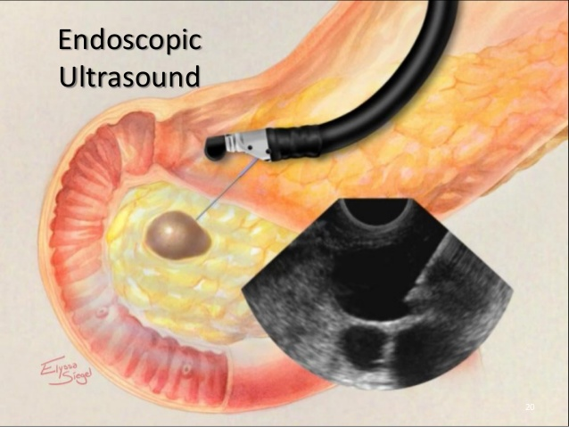
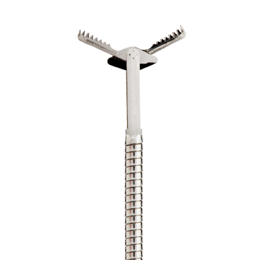
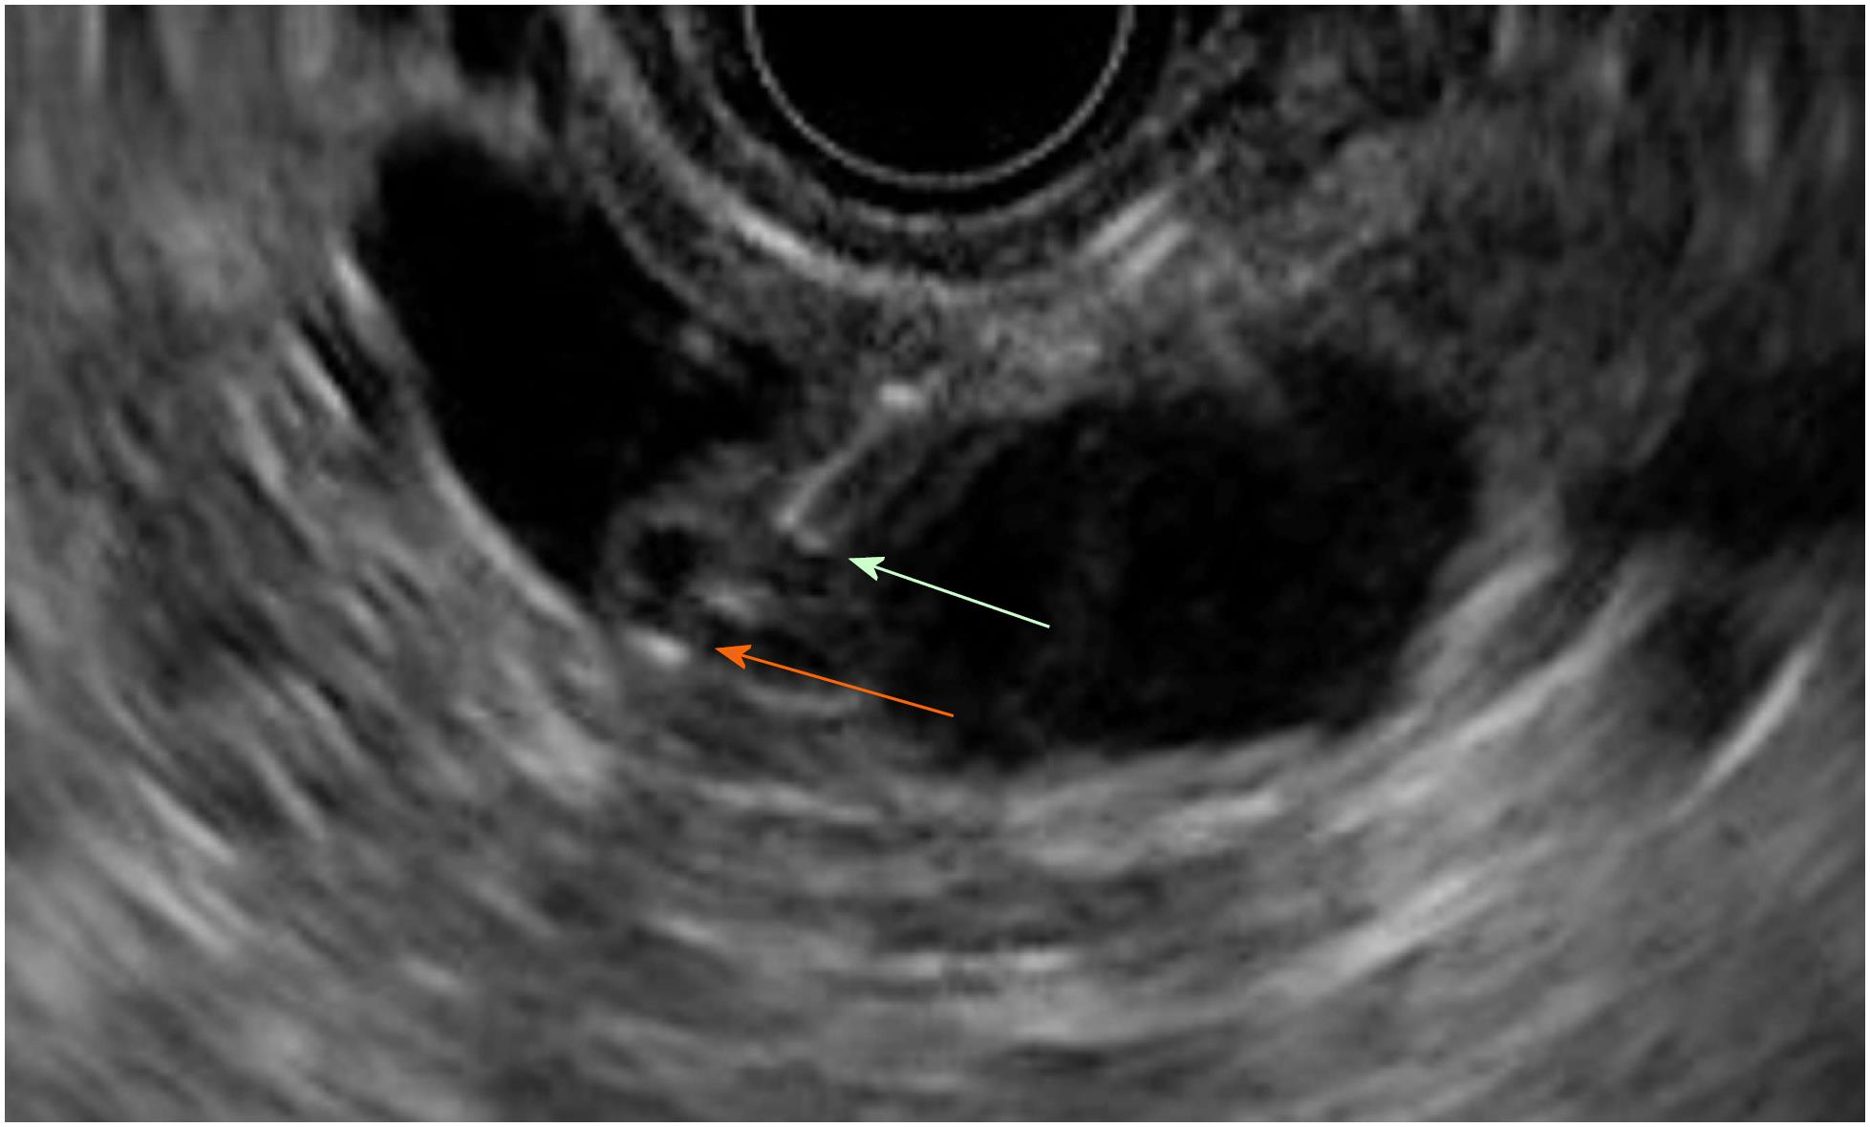
World J Gastroenterol. Jul 14, 2018; 24(26): 2853-2866

Slide 21
Cyst Fluid Analysis

Slide 22
World J Gastroenterol. Jul 14, 2018; 24(26): 2853-2866

Slide 23
EUS Biochemistry
 | IPMN | MCN | SCN / SCA
CEA
Amylase
Glucose

Slide 24
EUS Biochemistry
 | IPMN | MCN | SCN / SCA
CEA | High
Amylase | High
Glucose | Low

Slide 25
EUS Biochemistry
 | IPMN | MCN | SCN / SCA
CEA | High | High
Amylase | High | Low (Mainly)
Glucose | Low | Low

Slide 26
EUS Biochemistry
 | IPMN | MCN | SCN / SCA
CEA | High | High | Low
Amylase | High | Low | Low
Glucose | Low | Low | High

Slide 27
Cyst FNA / Histology

Slide 28
World J Gastroenterol. Jul 14, 2018; 24(26): 2853-2866

Slide 29
EUS FNA / Histology
 | IPMN | MCN | SCN / SCA
Mucin
Biopsy
IHC

Slide 30
EUS FNA / Histology
 | IPMN | MCN | SCN / SCA
Mucin | Neutral mucin
Biopsy | Pseudostratified columnar epithelium – goblet cells
IHC
World J Gastroenterol 2014 June 28; 20(24): 7785-7793
Cancer (Cancer Cytopathol) 2008;114:102–10
World J Meta-Anal. Apr 26, 2017; 5(2): 63-70
Arch Pathol Lab Med. 2011;135:264–267

Slide 31
EUS FNA / Histology
 | IPMN | MCN | SCN / SCA
Mucin | Neutral mucin | Neutral mucin
Biopsy | Pseudostratified columnar epithelium – goblet cells | Ovarian type stroma
IHC
World J Gastroenterol 2014 June 28; 20(24): 7785-7793
Cancer (Cancer Cytopathol) 2008;114:102–10
World J Meta-Anal. Apr 26, 2017; 5(2): 63-70
Arch Pathol Lab Med. 2011;135:264–267

Slide 32
EUS FNA / Histology
 | IPMN | MCN | SCN / SCA
Mucin | Neutral mucin | Neutral mucin | No mucin
Biopsy | Pseudostratified columnar epithelium – goblet cells | Ovarian type stroma | sheets and small groups of cuboidal epithelial cells with round nuclei and clear, non mucinous cytoplasm
IHC |  |  | Inhibin positive
World J Gastroenterol 2014 June 28; 20(24): 7785-7793
Cancer (Cancer Cytopathol) 2008;114:102–10
World J Meta-Anal. Apr 26, 2017; 5(2): 63-70
Arch Pathol Lab Med. 2011;135:264–267

Slide 33
EUS FNA / Histology
 | IPMN | MCN | SCN / SCA
Mucin | Neutral mucin | Neutral mucin | No mucin
Biopsy | Pseudostratified columnar epithelium – goblet cells | Ovarian type stroma | sheets and small groups of cuboidal epithelial cells with round nuclei and clear, nonmucinous cytoplasm
IHC |  |  | Inhibin positive
World J Gastroenterol 2014 June 28; 20(24): 7785-7793
Cancer (Cancer Cytopathol) 2008;114:102–10
World J Meta-Anal. Apr 26, 2017; 5(2): 63-70
Arch Pathol Lab Med. 2011;135:264–267

Slide 34
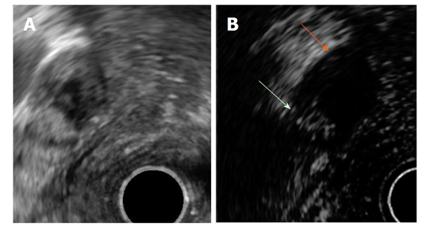
New Developments
Contrast enhanced EUS (Harmonics) - Sonovue
White arrow – contrast activity
Orange arrow – no contrast mucin
World J Gastroenterol. Jul 14, 2018; 24(26): 2853-2866

Slide 35
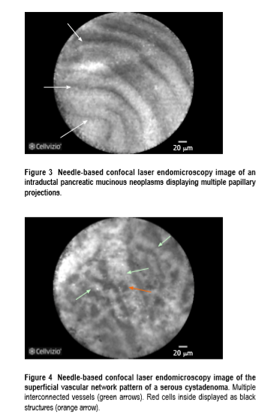
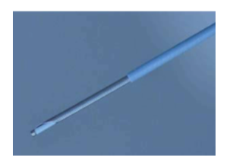
New Developments
Needle based Confocal endomicroscopy
World J Gastroenterol. Jul 14, 2018; 24(26): 2853-2866

Slide 36
International Guidance 2017 Update

Slide 37
International Guidance 2017 Update

Slide 39
What to actually do?

Slide 40
What to actually do?

Slide 41
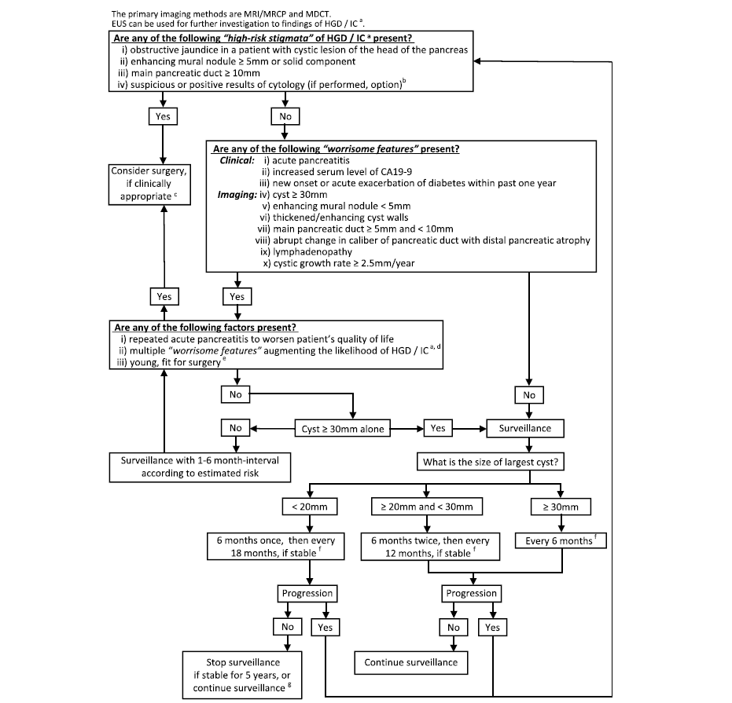

Slide 42
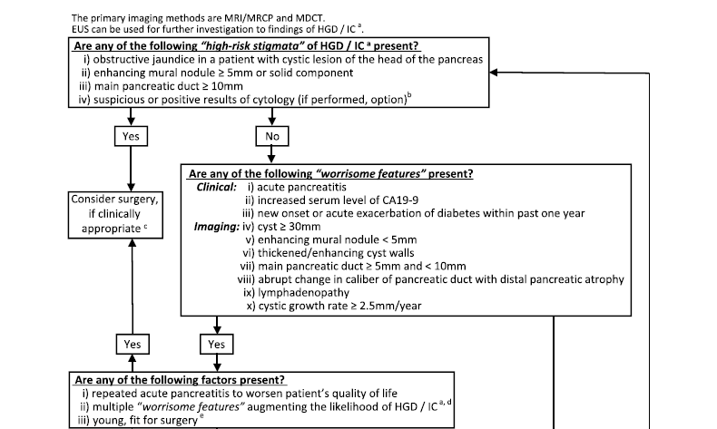

Slide 43
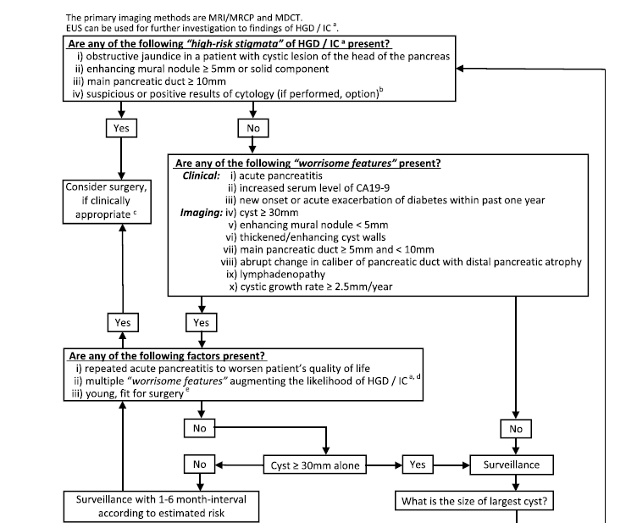

Slide 45
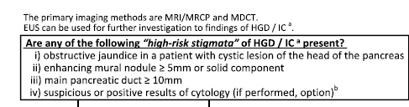
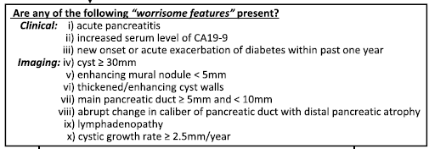
Challenges
Access to EUS

Slide 46
Challenges – multiple EUS’s
 | IPMN | MCN | SCN / SCA
CEA | High | High | Low
Amylase | High | Low | Low
Glucose | Low | Low | High
 | IPMN | MCN | SCN / SCA
Mucin | Neutral mucin | Neutral mucin | No mucin
Biopsy | Pseudostratified columnar epithelium – goblet cells | Ovarian type stroma | sheets and small groups of cuboidal epithelial cells with round nuclei and clear, non mucinous cytoplasm
IHC |  |  | Inhibin positive

Slide 47
Overview
Current controversies
Cyst types
Presentations
Assessment
Management
Challenges of management

Slide 48

Questions
https://emedicine.medscape.com/article/371197-overview

