Slide 1
HPB Cancer CAG
Update on Liver Transplant Indications
Dr Gau Appanna
Consultant Hepatologist
Bristol Royal Infirmary

Slide 2
Oncological indications for liver transplant
Hepatocellular Carcinoma
Cholangiocarcinoma
Neuroendocrine liver metastases
Colorectal liver metastases

Slide 3
HCC indication for liver transplantation
EASL/Modification of the Milan Criteria
Using size and number of HCC on pre-transplant imaging, these criteria aim to select at time of presentation patients that have HCC with favourable tumour biology and hence good outcome following liver transplantation.

Slide 4
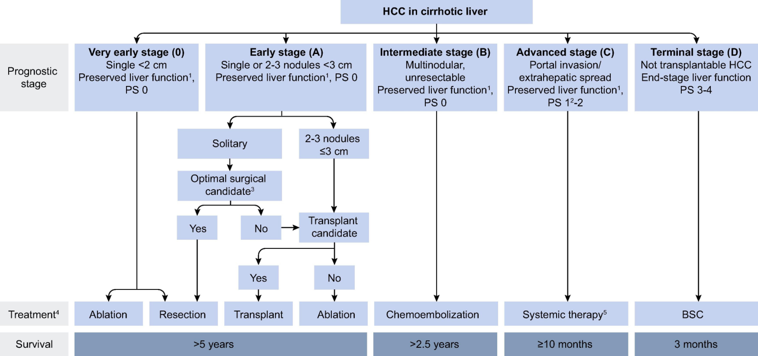
EASL Guidelines

Slide 5
Extended criteria

Slide 6
Outside of standard criteria: Down staging?
Inclusion criteria
  Not eligible for elective listing for under standard UK listing criteria for HCC
  Within Duvoux criteria for down-staged HCC
  Interval of ≥6 months from down-staging treatment to imaging upon which registration based
  Interval of ≥3 months from first imaging demonstrating patient within criteria to registration

Slide 7
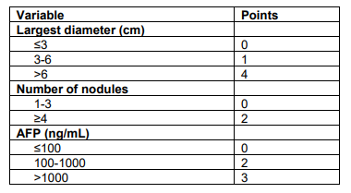
Duvoux criteria for listing for HCC

Slide 8
Liver Transplant Data: 2022/2023

Slide 9
Liver Transplant Data: 2022/2023

Slide 10
Are HCC patients disadvantaged?
2018: Introduction of the Transplant Benefit Score (TBS)
7 donor and 21 recipient parameters
Predict the difference in survival without transplantation (need) to that after transplantation (utility) for each potential recipient (TBS=utility–need)
First three years:
Patients with cancer → reduced allocation of livers by the TBS model
Waiting list removals for death or deterioration → considerably increased compared with patients with CLD alone

Slide 11
Discourse within the transplant community

Slide 12
Need for change?
October 2022: Algorithm weightings were revised
The effect of these changes is not yet clear
Anecdotally… there appears to be an improvement
DBD vs DCD and outcomes
Machine perfusion

Slide 13
Is this truly the case?

Slide 14
Liver Transplant Data: 2019/2020

Slide 15
The future direction?
Organ demand outstripping availability
Not quite the same in the USA
Adjuvant systemic treatment
Role of more aggressive liver directed therapies – combination therapies

Slide 16
Cholangiocarcinoma
Historically CCA associated with rapid recurrence and poor survival rates
  10% for intrahepatic CCA and 25% of extrahepatic CCA
Recent studies: 5-year survival of 70%
  Highly selected patient group; based on response to pre-transplant chemotherapy
  Perihilar CCA in the presence of CLD
BSG statement: There is a need for evaluation of novel neoadjuvant chemoradiation strategies and assessment of long-term outcomes with national protocols and multi-centre studies. Liver transplantation in the absence of background chronic liver disease remains an investigational treatment.

Slide 17
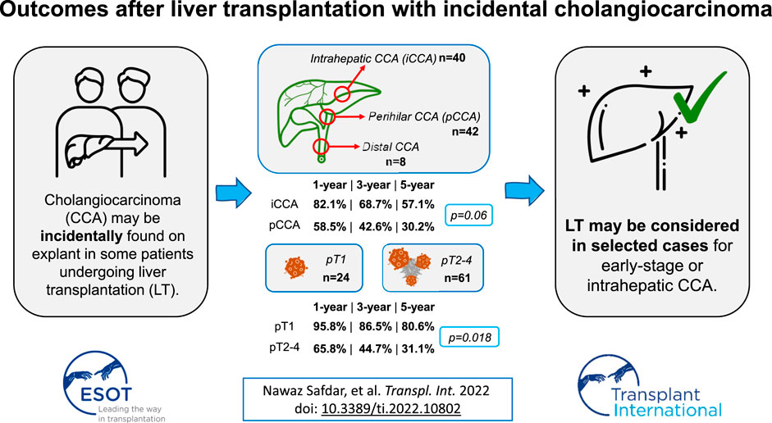
UK publication on incidental CCA

Slide 18
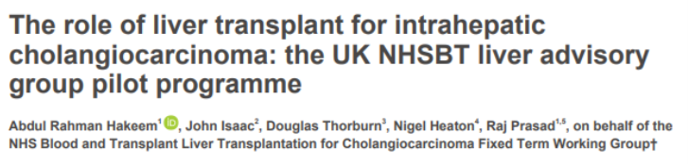
The future

Slide 19
Neuroendocrine metastases
Accepted indication for liver transplantation (LT): Europe
Despite strict patient selection, post-LT recurrence is observed in 30%–50% of cases.
Post recurrence survival is poorly investigated as well as factors influencing post recurrence outcomes.
Currently a pilot study in Birmingham: 3 patients transplanted to date

Slide 20
Summary
Patient selection is paramount
Growing concern about the fact that HCC patients are disadvantaged
Down staging not necessarily downsizing!
The aim is to avoid liver transplantation: Early detection programmes are key
Role of more aggressive combined therapies
CCA is evolving!
Aggressive surveillance – not in line with recommendations

Slide 21
Questions?

