Slide 1

NPaCA:
National Pancreatic Cancer Audit
James Skipworth
HPB Surgery Consultant
UHBW
22/2/24

Slide 2
Contents
Organisation/Structure
Background/Development
Current Format
Priorities for Quality Improvement

Slide 3
Organisation/Structure

Slide 4

NATCAN
NPaCA under auspices of NATCAN
  Clinical Effectiveness Unit of RCSEng
New national centre of excellence
  October 2022
  Bring national cancer audits together in one place
Commissioned for initial 3-yr period by HQIP on behalf of NHS England and Welsh government
Notes:
Healthcare Quality Improvement Partnership. Advisor to NHS England. As the UK’s largest national clinical audit commissioner, we are uniquely placed to support evidence-based clinical effectiveness and data-informed services as well as provide advice around innovation and opportunities to connect with the healthcare sector.

Slide 5
NATCAN
All pre-existing national audits moved to NATCAN Jun-Oct 2023
  O-G Ca (2006)
  Bowel Ca (2010)
  Prostate Ca (2013)
  Breast Ca in older pts (2016)
  Lung Ca (2022)
Six new audits
  NHS England and Welsh Government- £5.4m over 3 yrs
    Kidney Ca
    Non-Hodgkin Lymphoma
    Ovarian Ca
    Pancreatic Ca
    Primary and Metastatic Breast Ca

Slide 6
Development

Slide 7


Slide 8
Scoping Document
Describes:
  Development of the scope of the audit
  Identifies priority areas for quality improvement
Resources:
  Review of clinical guidelines/audits/registries/literature
    Ricochet study
    The Dutch pancreatic cancer audit
    The Swedish pancreatic cancer audit
    The German DGAV StuDoQ Pancreas registry
    The American College of Surgeons National Surgical Quality Improvement Program for pancreatic surgery
    NHS Scotland hepatobiliary and pancreatic cancer quality performance indicators (QPIs)
  Consultations with key stakeholders
    Clinical experts
    Allied health professionals
    Patient groups and charities
    Representatives from NHS England and NHS Wales
  Feasibility study conducted by NOGCA in 2022
    Stakeholder survey
    Review of potential quality indicators
Notes:
Patients are eligible if they have a radiologic or clinical diagnosis; eligibility is not limited to patients with a histological diagnosis because a large proportion of patients with pancreatic cancer are too unwell to undergo biopsy for histological diagnosis. We note that neuroendocrine tumours can be identified on imaging and so could be excluded.

Slide 9
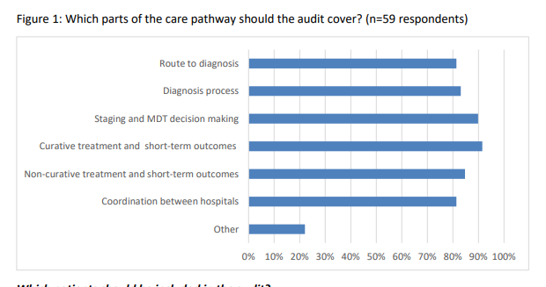
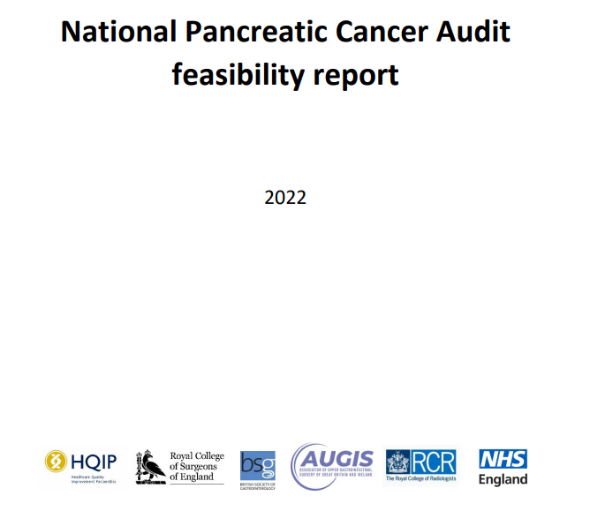
Feasibility Study

Slide 10
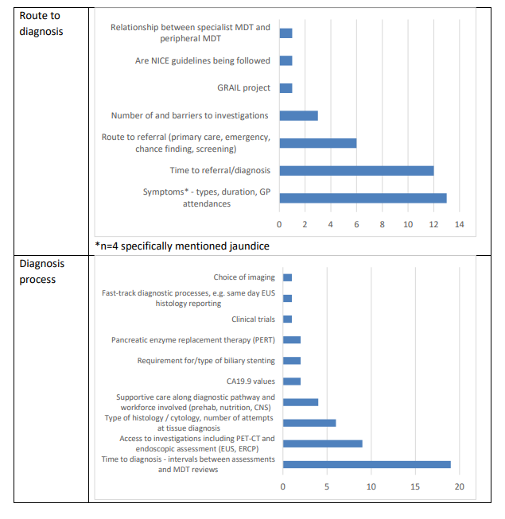
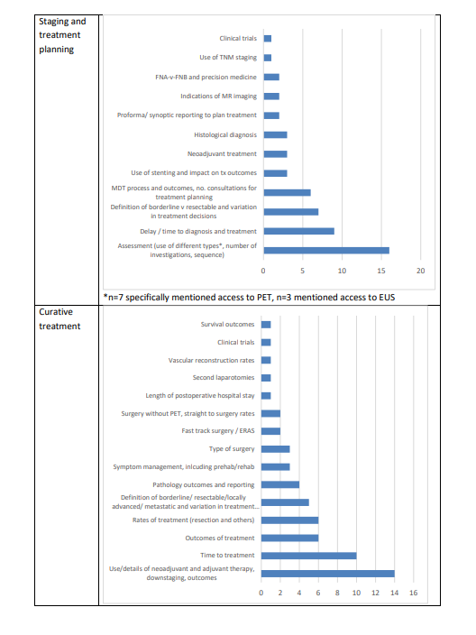
Feasibility Study

Slide 11
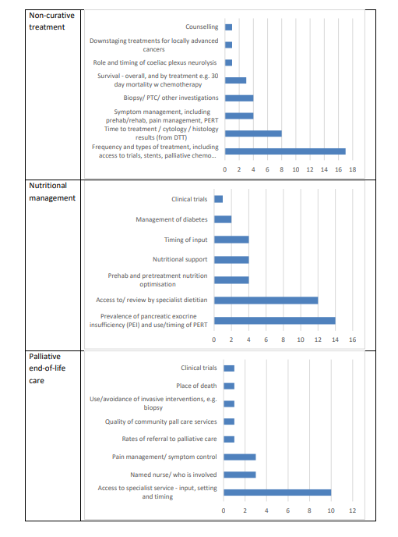
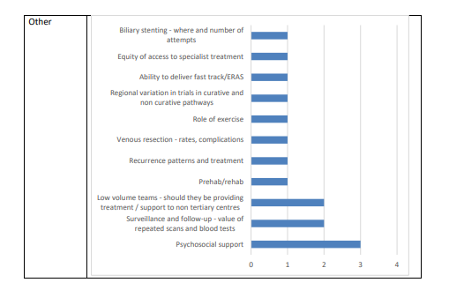
Feasibility Study

Slide 12
Current Format

Slide 13
Leadership & Aims
Clinical leads:
  Dr Nigel Trudgill
    Clinical Lead (Gastroenterology), representing British Society of Gastroenterology (BSG)
  Mr Andrew Smith
    Clinical Lead (Surgery), representing Association of Upper Gastrointestinal Surgery (AUGIS)
  Dr Ganesh Radhakrishna
    Clinical Lead (Clinical Oncology), representing Royal College of Radiologists(RCR)
Aims:
  Evaluate pancreatic cancer care delivered in NHS hospitals across England and Wales
  Help NHS organisations benchmark pancreatic ca care against measurable standards
  Identify unwarranted variation in care
  Provide tools to help services improve quality of care for people with pancreatic ca

Slide 14
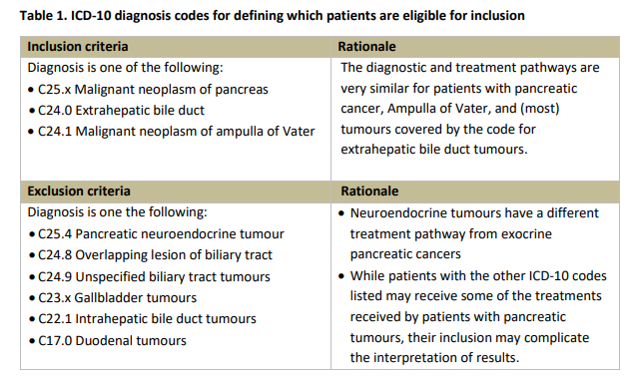
Inclusion Criteria
>18 yrs age
Radiologic, clinical or histological diagnosis

Slide 15
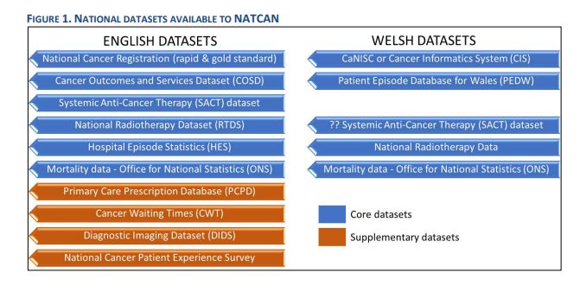
Available Datasets

Slide 16
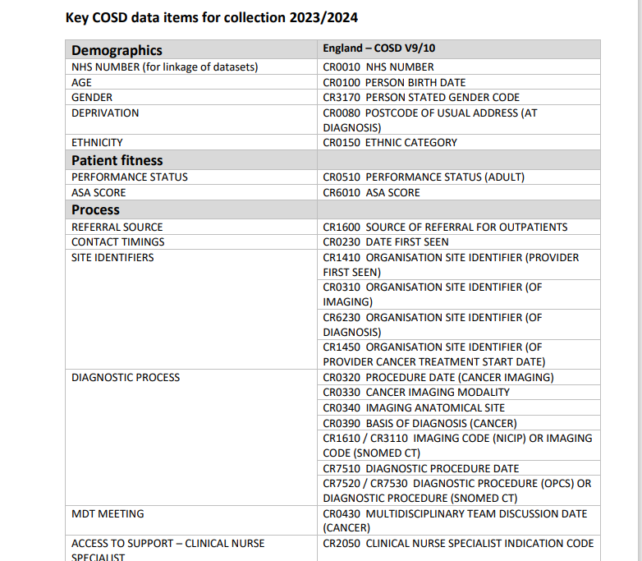
Key COSD Data

Slide 17
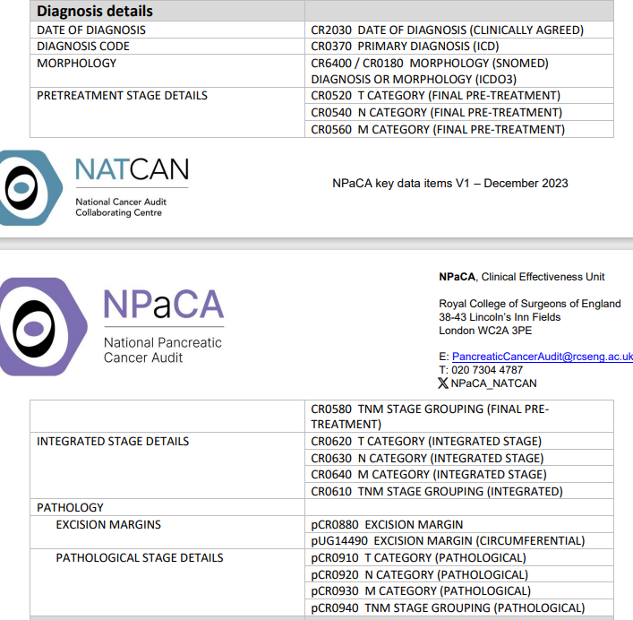
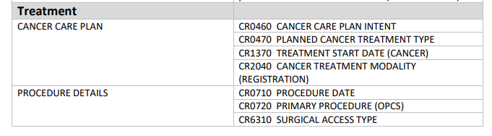
Key COSD Data

Slide 18
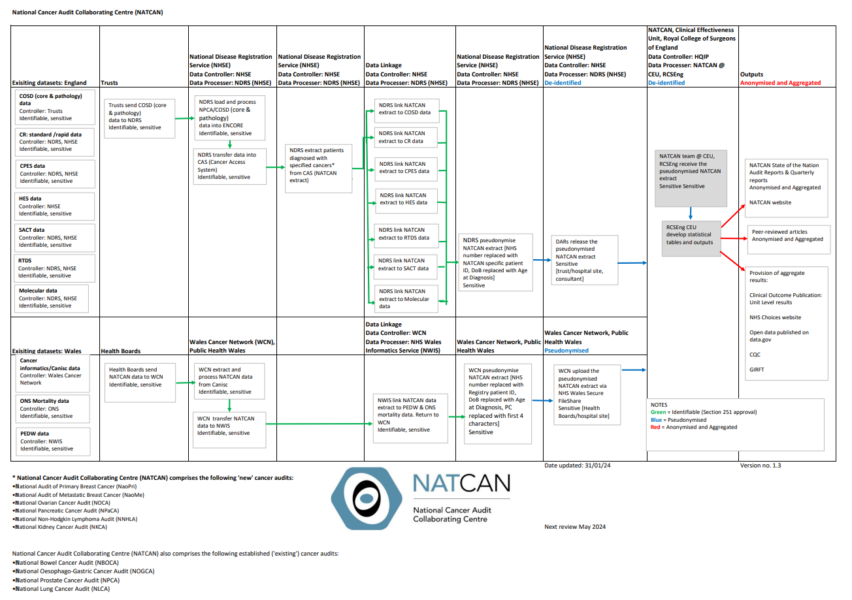
Notes:
COSD- The Cancer Outcomes and Services Data set (COSD) is a compiled data set which provides the standard for secondary uses information required to support national cancer registration and associated analysis (at local, regional, national, and international level), as well as other national cancer audit programmes.

Slide 19
Priorities for Quality Improvement

Slide 20
Quality Improvement Areas
Greater understanding of:
  High percentage diagnosed as emergency presentation
  Variation in diagnostic work-up
    Use of EUS
    Timing of / access to staging imaging (inc. PET)
    Timing of biliary drainage
    Tissue diagnosis
    No. of MDT meetings per pt
  Delays to diagnosis and treatment decision due:
    To access to diagnostic tests
    Procedures such as EUS
    Administrative processes (MDT meetings)
  Variation in the availability of treatment based on geography
  Inconsistency in supportive care, including variations in PERT prescriptions and specialist end of life support

Slide 21
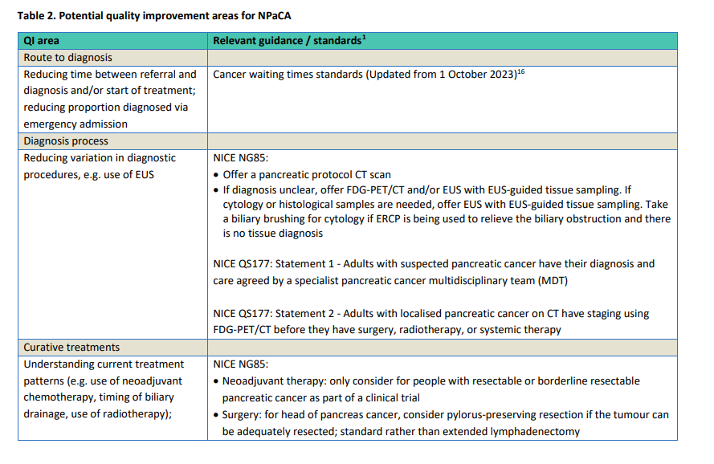
Quality Improvement Areas

Slide 22
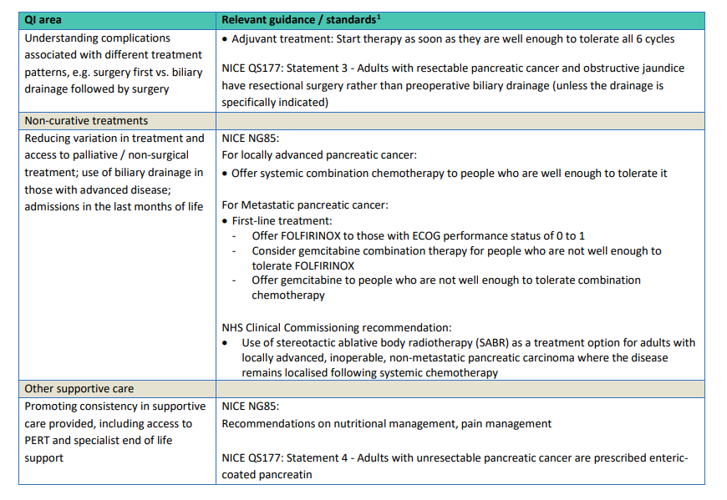
Quality Improvement Areas

Slide 23
Resources
  Pancreaticcanceraudit@rcseng.ac.uk
  https://www.natcan.org.uk/audits/pancreatic
  Sign up for Newsletters
Thankyou
Questions

Slide 24
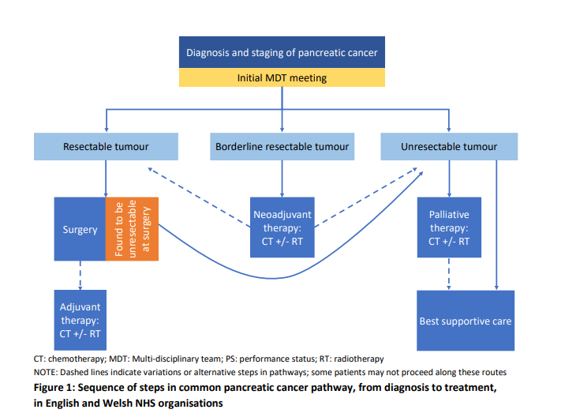

Slide 25
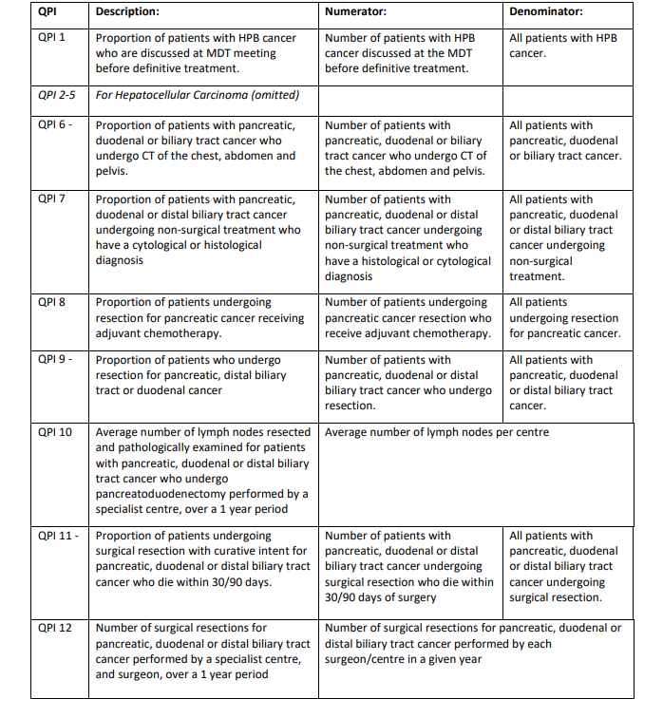
Table A3.1: The set of pancreatic cancer quality performance indicators (QPIs) that was proposed after a consultation by NHS Scotland. Some indicators had additional criteria to exclude specific patients (such as patients who died before first treatment). See report for full details

Slide 26
Key features of NATCAN’s audit approach The design and delivery of the audits in NATCAN has been informed by the CEU’s experience delivering national audits, built up since its inception in 1998. Key features of all audit projects within the CEU include: • Close clinical-methodological collaboration • Use of national existing linked datasets as much as possible • Close collaboration with data providers in England (National Disease Registration Service [NDRS, NHSE] and Wales (Wales Cancer Network [WCN], Public Health Wales [PHW]) • A clinical epidemiological approach, informing quality improvement activities. • “Audit” informed by “research”. All these features will support NATCAN’s focus on the three “Rs”, ensuring that all its activities are clinically relevant, methodologically robust, and technically rigorous

Slide 27
Panc Audit
It will gather real world information from databases across England and Wales, allowing better comparisons to be made, and revealing where shortfalls need to be addressed.
Pancreatic cancer is one the least survivable cancers, with virtually no improvement seen in survival rates in the UK over 40 years from the 1970s.
But the data that tells us that is ten years old. So, are new treatments having a positive impact?
Ganesh Radhakrishna, one of the clinical leads on the new audit, says pancreatic cancer is very difficult to diagnose and treat, but there is a lot to be optimistic about. And the more data that is gathered the better. You can listen to more of his thoughts here:

Slide 28
Patterns of care provided to patients with pancreatic cancer have been reported to vary across England and Wales. 10 The National Pancreatic Cancer Audit has been commissioned as part of NATCAN (Appendix 1) to support NHS organisations to benchmark their practice, identify underlying causes of variation, and plan ways to improve the quality of care received by patients with pancreatic cancer.

Slide 29
Stakeholder engagement
The scope of the audit was developed by the NPaCA team in consultation with a range of stakeholders. The following approaches were taken: • A feasibility study for an audit of pancreatic cancer was conducted in 2022 by the National Oesophago-gastric Cancer Audit (NOGCA) team.
The study comprised an online stakeholder survey and review of potential quality indicators.
Responses were received from a range of stakeholders including medical professionals and the charity Pancreatic Cancer UK. A summary of the results is provided in section 3.1. Full details can be found in Appendix 3. • Consultation meeting with the Clinical Reference Group (CRG). The group was formed for NPaCA, with representation from surgery, medical oncology, clinical oncology, radiology, gastroenterology, palliative care, cancer nurse specialists, HPB specialist dietitians, patient groups, NHS England, and NHS Wales. The first meeting of this group was held in July 2023 and formed part of the audit’s scoping exercise. The minutes of this scoping meeting can be seen in Appendix 4. • Consultation with the patient charity Pancreatic Cancer UK to hear about the experience of their members and understand their priorities.

Slide 30
Treatments may be multimodal and include any of surgery, chemotherapy (CT), radiotherapy (RT), or best supportive care. Interventions aimed at relief of symptoms, such as a stent or PERT, will not be considered primary treatment unless they are part of best supportive care. 11 Surgical and non-surgical treatment pathways will be reported separately. Non-surgical pathways may be further sub-categorised into 1) borderline resectable cancers treated with CT +/- RT and 2) metastatic disease treated with palliative CT +/- RT or best supportive care. Compared to some other tumour types, pancreatic cancer has relatively few known biomarkers and targeted therapies. However, the audit will monitor emerging personalised medicine approaches in pancreatic cancer and report on system factors that support personalisation.

Slide 31
Appendix 2 – The NPaCA project team The audit will be delivered by a team that combines clinical leadership, methodological expertise, and project management. The clinical leads are: • Dr Ganesh Radhakrishna, Clinical Lead (Clinical Oncology) • Mr Andrew Smith, Clinical Lead (Surgery) • Prof Nigel Trudgill, Clinical Lead (Gastroenterology) The other members of the audit team provide methodological, statistical, and project management expertise: Vikki Hart (Senior Project Manager), David Cromwell (Health Services Research), Min Hae Park (Health Services Research), and Amanda McDonell (Data Scientist). A Clinical Research Fellow will shortly join the team. The Clinical Reference Group (CRG) will provide advice to the project team. It will usually convene twice a year to advise on the direction of the audit and feedback on interpretation of audit findings. The CRG will also help in the dissemination of audit findings. The CRG members represent patient organisations and healthcare professional groups, including: Pancreatic Cancer UK, Pancreatic Cancer Action, the Association of Upper Gastrointestinal Surgery, the Royal College of Radiologists (RCR), the British Society of Gastroenterology, and the Royal College of Surgeons of England (RCSEng). The audit will also have a PPI forum whose members represent patients and carers with lived experience of pancreatic cancer

Slide 32
Ganesh Radhakrishna, Clinical Lead (Clinical Oncology), National Pancreatic Cancer Audit
Patient charities and support groups have been calling for a national pancreatic cancer audit for a long time. They will play a crucial role in helping us determine which questions need to be addressed most urgently, and what areas of new research might be most beneficial.

Slide 33
Data acquisition The NATCAN Executive Team is working closely with data providers in England (NDRS, NHSE) and in Wales (WCN, PHW) to establish efficient “common data channels” for timely and frequent access to datasets, combining data needs for all cancers into a single request in each Nation and only using routinely collected data, thereby minimising the burden of data collection on provider teams. Annual and quarterly data NATCAN will utilise two types of routinely collected data in England. First, an annual "gold-standard” cancer registration dataset, released on an annual basis with a considerable delay between the last recorded episode and the data being available for analysis, and second, a “rapid” cancer registration dataset (RCRD), released at least quarterly with much shorter delays (3 months following diagnosis). The CEU’s recent experience with English rapid cancer registration data, in response to the COVID pandemic has demonstrated the latter’s huge potential,2 despite a slightly lower case ascertainment and less complete staging information. NATCAN will utilise these data across all cancers linked to administrative hospital data (Hospital Episode Statistics/Systemic Anti-Cancer Therapy/Radiotherapy Data Set/Office for National Statistics among other routinely collected datasets, see Figure 1) for describing diagnostic pathway patterns, treatments received and clinical outcomes. An equivalent data request will be made to the Wales Cancer Network (WCN)/Public Health Wales (PHW).

Slide 34
Include
  All adults diagnosed with exocrine pancreatic cancer in England and Wales (including those with radiologic or clinical diagnoses)
  Tumours of the extrahepatic bile duct
  Ampulla of Vater
Cover the care pathway from first diagnosis of pancreatic cancer to the end of primary treatment, including treatments with and without curative intent
  Treatment pathways will be reported by intent, and type of treatment where appropriate.
The following were highlighted as potential priorities for the audit to address:
  Reducing variation in use of diagnostic procedures
  Reducing time between diagnosis and start of treatment
  Understanding current treatment patterns
  Reducing variation in access to palliative / non-surgical treatment
  Improving consistency in provision of supportive care.
  These QI priorities will inform the development of NPaCA’s Healthcare Improvement Plan, alongside further consultation with key stakeholders via the audit’s Clinical Reference Group and Patient & Public Involvement Forum

Slide 35
NATCAN
Focus on the three Rs:
clinically relevant (asking the right questions as a result of close collaboration between clinical and academic experts)
methodologically robust (using the best epidemiological and statistical approaches to carry out fair comparisons between hospitals)
technically rigorous (making sure data science is put to the best use, in order to drive quality improvement)

