Slide 1
SABR in pancreas cancer Steve Falk Consultant Clinical Oncologist Pancreas uncertain role for radiotherapy…….

Slide 2
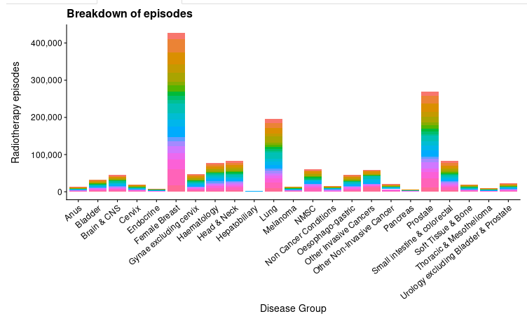
Who gets Radiotherapy in the UK

Slide 3
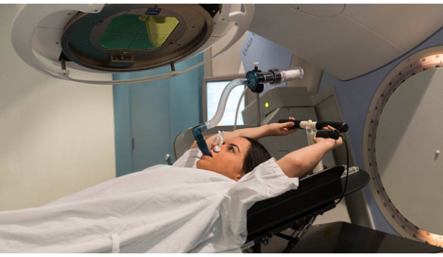
Motion control

Slide 4
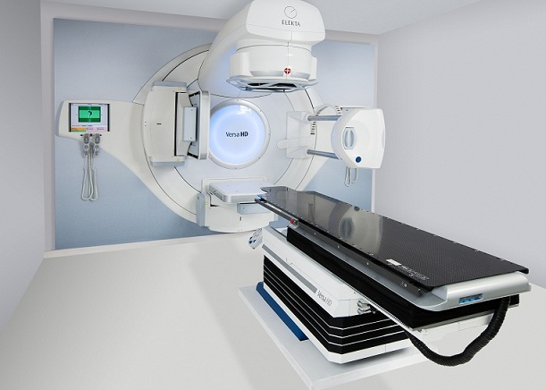
Linear Accelerator – imaging on set

Slide 5
The role of radiotherapy in pancreas cancer

Slide 6
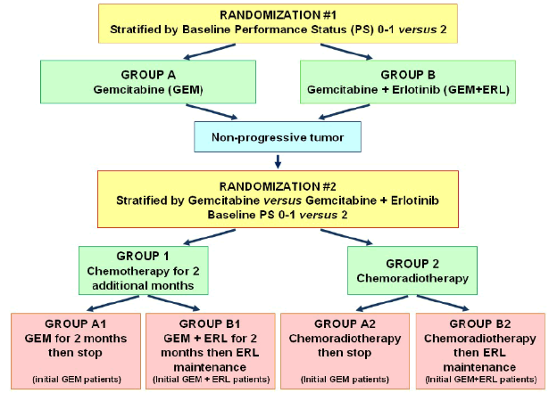
LAP 07

Slide 7
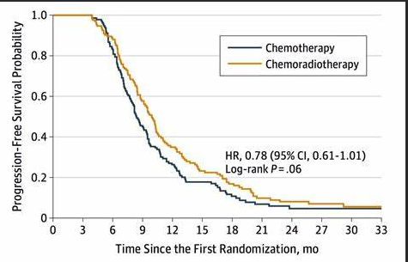
LAP 07

Slide 8
CONKO-07

Slide 9
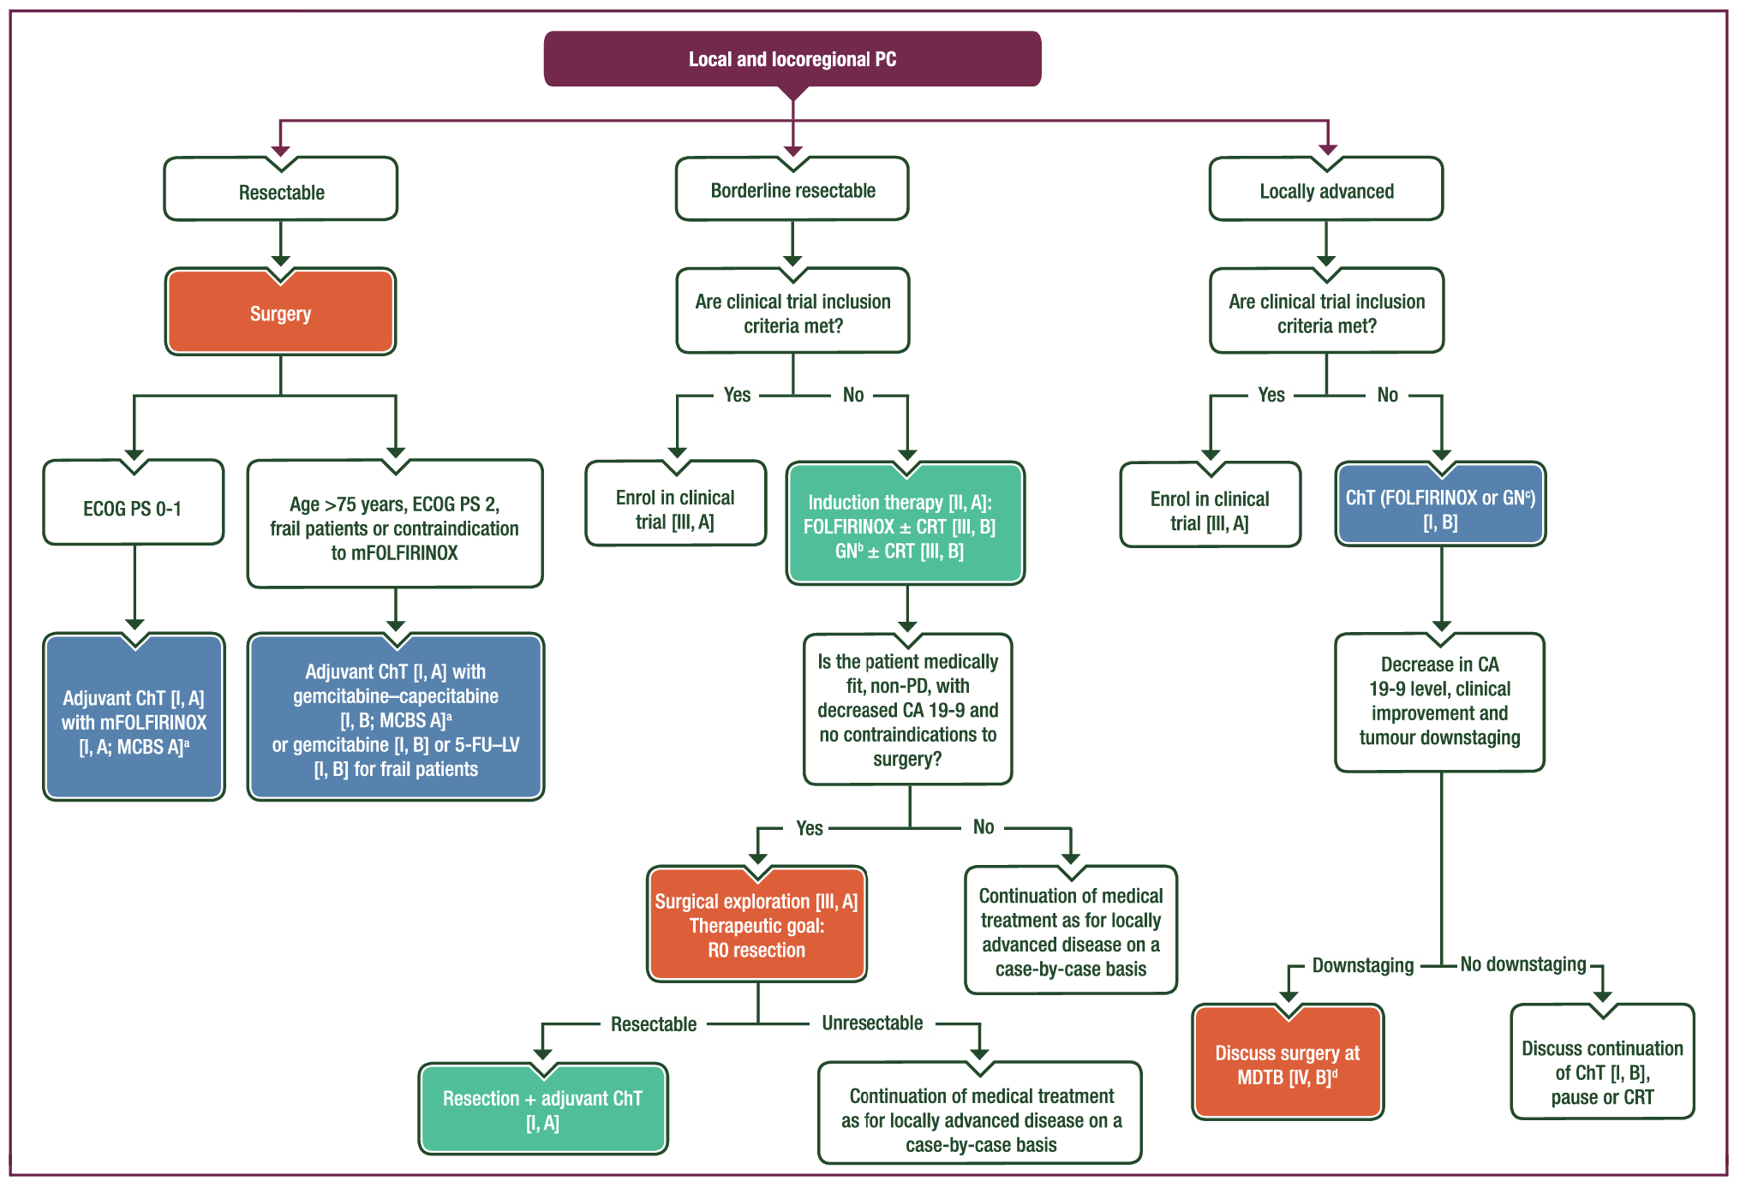

Slide 10
NICE guidance
When using chemoradiotherapy, consider capecitabine as the radiosensitiser

Slide 11
Reasonable practice – inoperable disease
SCALOP trials 50.4 Gy in 28 treatments
COVID treatment 45 Gy 15 treatments
SABR = 35-40 Gy in 5 treatments commissioned Oct 21
Indications
Locally advanced
Borderline resectable (-ve trial when added to Folfirinox)
Never resectable
+ palliative RT eg bone mets

Slide 12
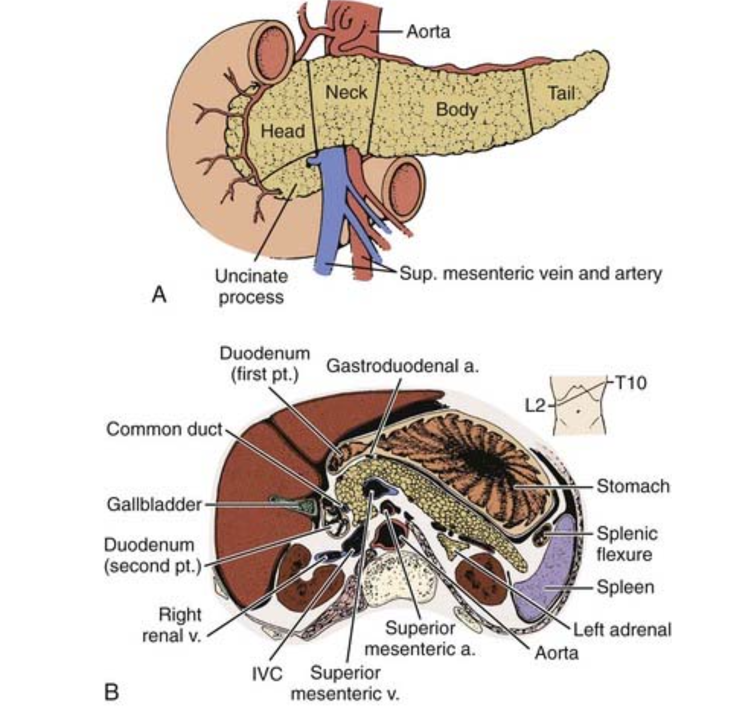
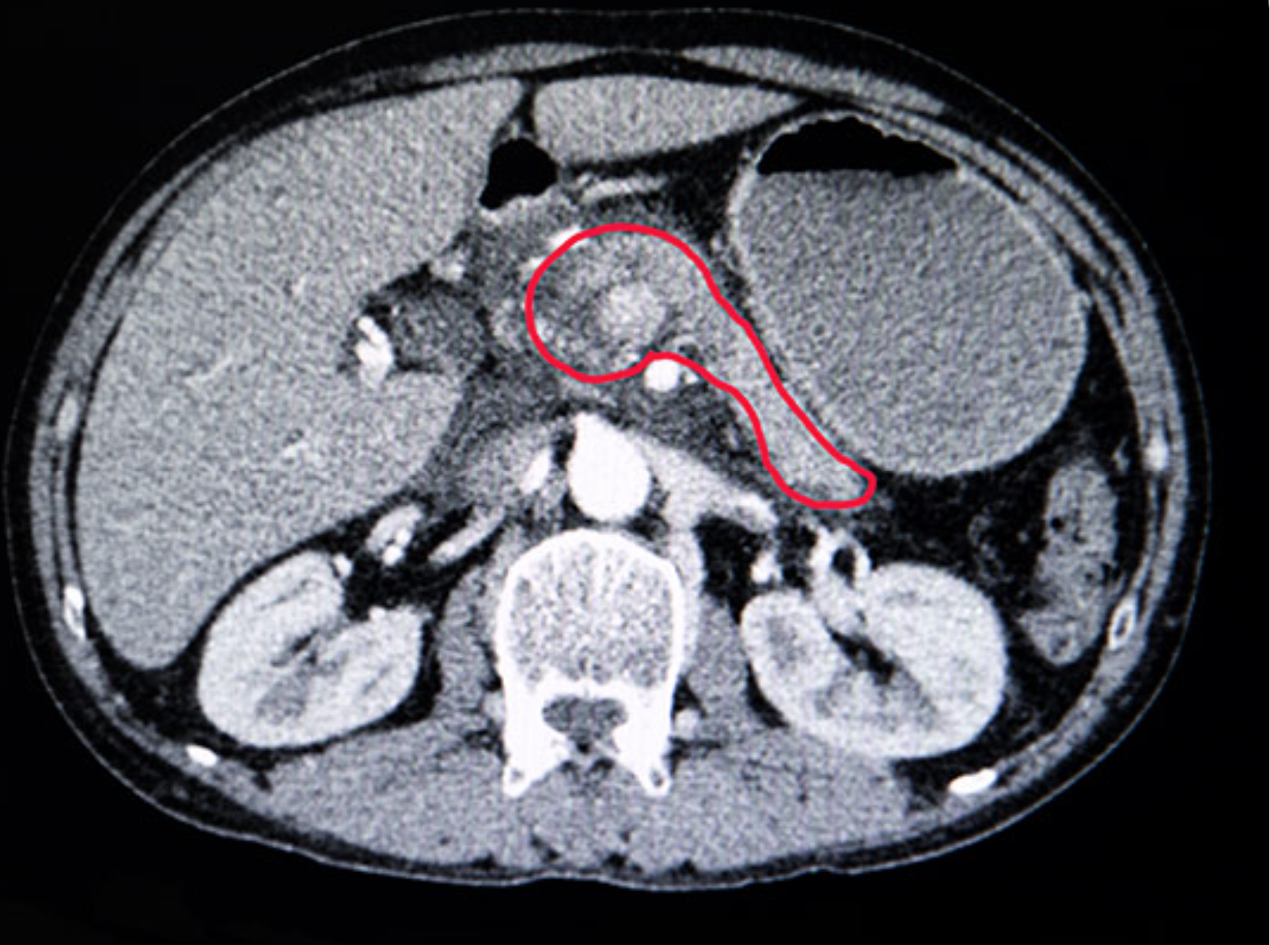
Problem: Surrounding structures don’t like radiotherapy

Slide 13
Evidence for SABR
30% of PDAC present as locally advanced, inoperable
75% of patients with LANPC are fit enough to receive active treatment.
Around 65% of patients that receive treatment for LANPC have disease that remains localised following chemotherapy (Hudson et al 2010).
700 cases per year in UK

Slide 14
Evidence for SABR
No randomized comparisons with conventional CRT
Pooled locoregional control rate of 72.3% (95%CI 58.5 to 79) at one year from 13 studies (n=889).
Total SABR dose delivered and higher number of fractions were statistically significantly associated with one-year locoregional control in multivariate analysis (p=0.03 and p=0.019 respectively).
Two-year overall survival
SABR 26.9% (95%CI 20.6 to 33.6)
CFRT 13.7% (95%CI 8.9 to 19.3) p=0.004.
Tchelebi et al Cancer. 2020;126(10):2120-2131
Petrelli F et al. IJROBP. 2017;97(2):313-322

Slide 15
Toxicity/Safety
First MD Anderson studies high GI toxicity rates
Meta analysis 16 studies (indirect comparisons-random effects estimates)
Acute grade ¾ toxicity :
SABR 5.6% (95%CI 0.0 to 20)
CFRT 37.7% (95%CI 24.0 to 52.5) (p=0.013)
Late grade ¾ toxicity:
SABR 9.0% (95%CI 3.3 to 17.1
CFRT 10.1% (95%CI 1.8 to 23.8) (p=0.85)
Tchelebi et al Cancer. 2020;126(10):2120-2131

Slide 16
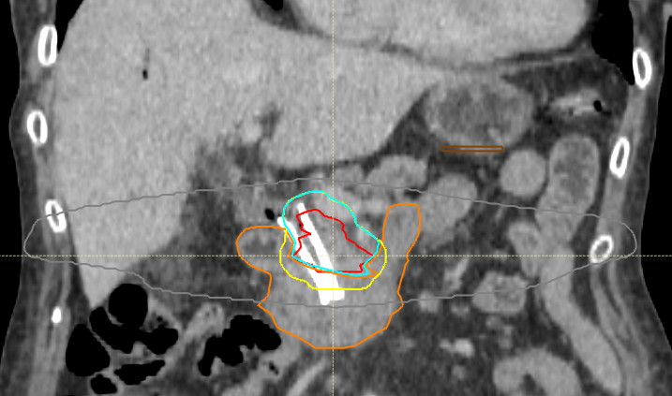

Slide 17
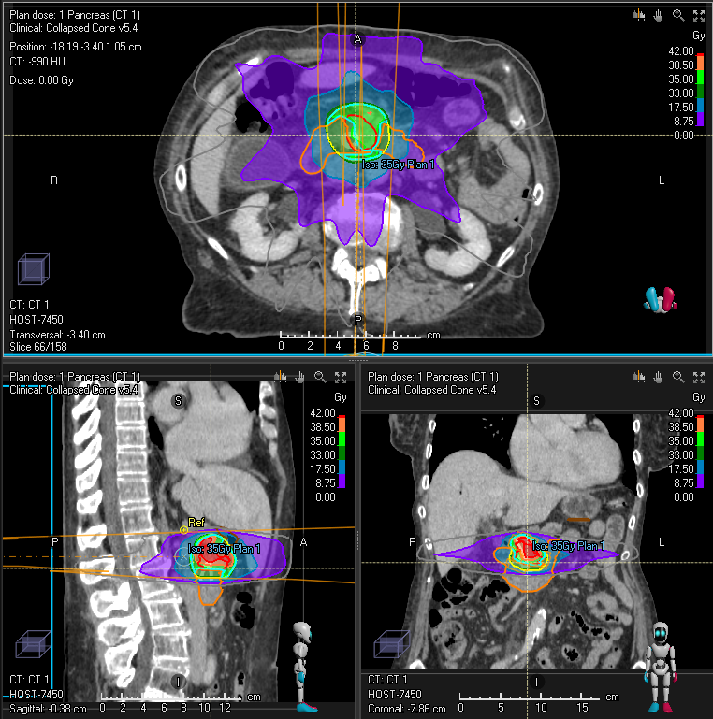

Slide 18
Commisioned criteria
Over 18 years;
Have a diagnosis of non-metastatic LANPC following a specialist HPB MDT and are unsuitable for surgery;
• Histology or cytology confirming adenocarcinoma; OR, if no tissue diagnosis, only where this has been agreed by the HPB MDT as appropriate i.e. radiology and clinical presentation strongly support a diagnosis of malignancy and repeated attempts at obtaining tissue have been unsuccessful;
• Have received at least 3 months of systemic chemotherapy and the disease has remained localised, OR, Patients where systemic therapy has had to be terminated early due to chemotherapy toxicity but where performance status remains ≤ 2 following HPB MDT discussion;
• Locoregional disease where the primary tumour +/- involved nodes are encompassable in a radiation volume;
• Adequate pancreatobiliary drainage (patent stent where present and bilirubin less than 1.5 times the upper limit of normal);
• Patients are suitable for pancreas SABR as determined by SABR and / or specialist HPB MDT;
WHO performance status ≤2.

Slide 19
Exclusion criteria
Are not considered candidates for chemotherapy, in whom radiotherapy may be offered up front primarily for symptom management;
Have received prior upper abdominal radiotherapy;
Have a tumour directly invading the gastrointestinal tract; Have evidence of metastatic disease

Slide 20
Summary
5 fraction SABR well tolerated and may be used as chemotherapy sparing
Role in borderline resectable disease uncertain in addition to FOLFIRINOX

Slide 21
Comedy of errors

Slide 22
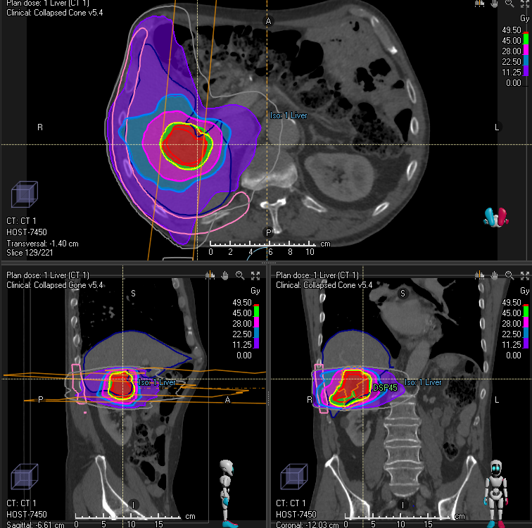
Oligo-metastatic pancreas cancer

Slide 23
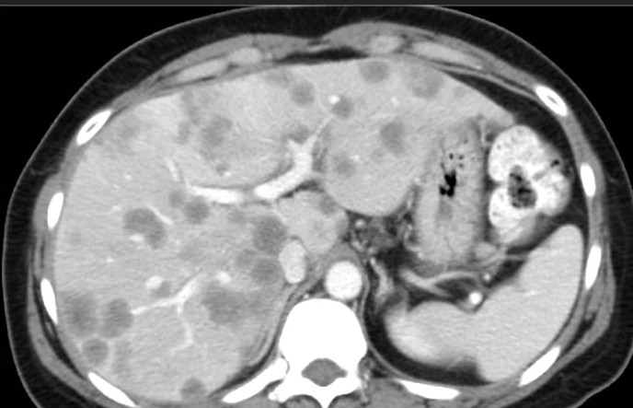
3 months later……

