Slide 1
Ricochet Study (and a reminder about PERT)
https://ricochetstudy.wixsite.com/ricochet
Jonathan Rees
Consultant HpB Surgeon

Slide 2
Introduction
Aim
The overall aim of this study is to deliver a snapshot of investigative and management practice for patients with newly identified pancreatic cancer and malignant biliary obstruction

Slide 3
Key Features
Hypothesis
There are wide variations in investigative and management practices for patients with hepaticopancreatobiliary (HPB) malignancy. These variations affect patient outcomes.
Primary Objective
Describe the management pathways and 90-day outcomes for patients who are investigated for resectable and un-resectable HPB malignancies.

Slide 4
Methods 1
Patient Selection
Any patient with a pancreatic lesion suspected of being malignant and/or those with malignant biliary obstruction caused by a malignancy of the extra-hepatic biliary tree will be included.
Patients will be excluded if they are under sixteen years of age or have suspected recurrent or secondary HPB malignancy.
Patients will be identified by cancer-specific MDT, clinical nurse specialists and biliary decompression lists.

Slide 5
Methods 2
Data Collection
Case identification will run for 90 days with a 90 day follow up for each patient from the date of their initial presentation.
Data will be collected via direct upload to secure, electronic database REDCap.
Collaborative Authorship

Slide 6
Results
Variation in times to Surgery between Centres
Variations in time to neo-adjuvant, adjuvant and palliative chemotherapy between Hospitals
Variation in proportions of patient completing any treatment between Hospitals
Variation in use of Pancreatic enzymes between hospitals and patient types

Slide 7
Results

Slide 8
Brief update on PERT from Ricochet and guidance

Slide 10
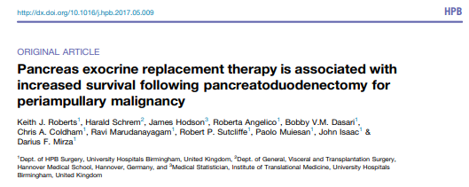
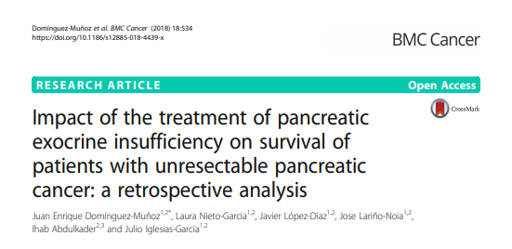
Impact of using Creon (PERT) Improves symptoms May impact survival

Slide 11
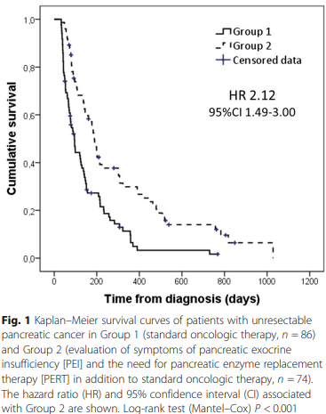
Why should we give PERT? 2

Slide 12
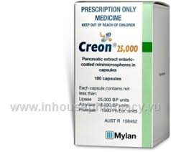
What should we give?
Use
Use pancreatic enzyme replacement therapy (PERT) liberally e.g Creon
Doses
As a starting point
75000iu with meals
25000iu – 50000iu with snacks
Combine
Combine with profound acid suppression
eg Omeprazole 20-40mg BD

Slide 13
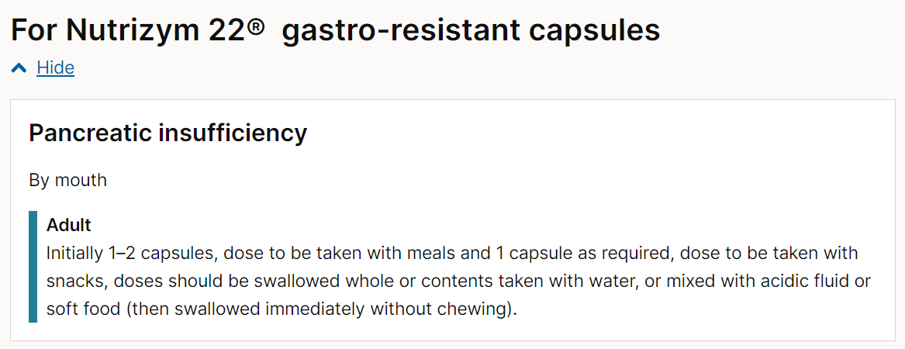
Specific recent challenges?
Supply issues
Options

Slide 14
Summary
As hypothesised wide variations
Proportions who are offered surgery
Resection rates for those having surgery
Time to surgery
MDT discussion frequency
Number of investigation (May be Good or Bad)
Receipt of chemotherapy
Receipt of PERT

Slide 15
What can we do?
Consistent referral pathways
Early consideration for surgery and rapid tissue acquisition
FastTrack surgery if appropriate
Very specific guidance from MDT
Consistent treatment strategies across networks

Slide 16
Questions?

