Slide 1
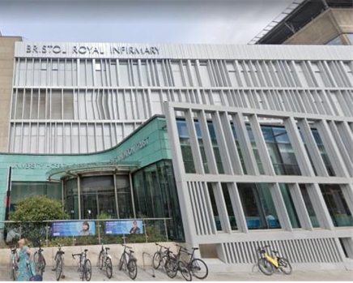
Is it possible to diagnose pancreatic cancer in early stage?
Hedvig Karteszi
University Hospitals Bristol and Weston NHS Foundation Trust
Bristol Royal Infirmary

Slide 2
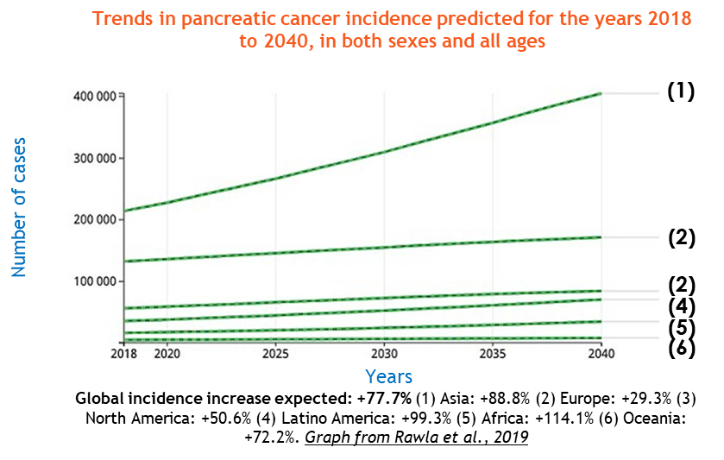
-Incidence in constant augmentation for the past 25 years.
-Pancreatic cancer is the 10th most common cancer in the UK, with approximately 10,500 people diagnosed each year.
-Only 25% of patients will survive for at least one year after they are diagnosed.

Slide 3
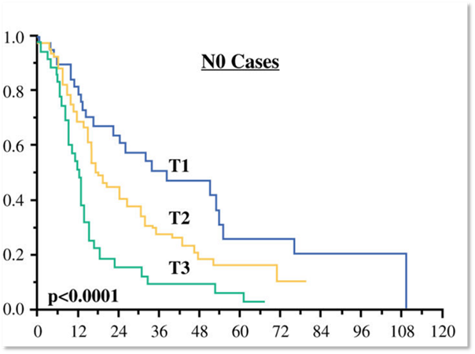
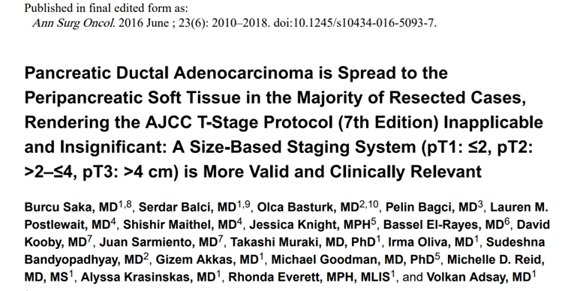
5-year survival:
T1a 80.4%
T1 N0 68.7%
Diagnostics 2023,13,215
Stage IA ( T1 N0 M0) patients account for only 4.1% of the total PDAC patients.

Slide 4
Pancreas Volume 44, Number 5, July 2015
Radical improvement in 5-year survival for pancreas cancer will require
advances in early detection to improve resectability rates
development of chemotherapeutic agents to prolong survival following resection.

Slide 5
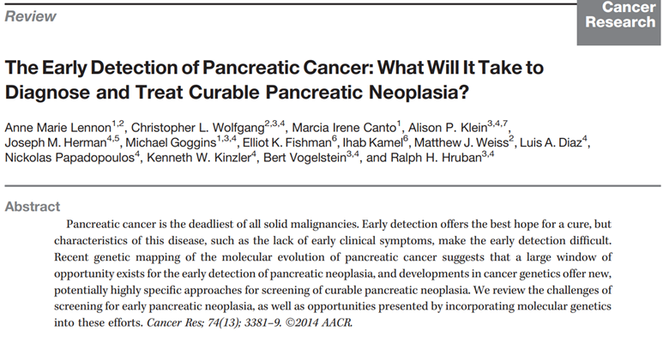
Key elements of early detection (optimally in pre-cancerous state):
-there is sufficient window of opportunity to detect curable lesion
-the precursor lesion or early cancer can be detected and characterized
-we have method(s) to detect curable lesion
-accurate differentiation between precursor lesions and benign mimickers
-patients at risk who benefit from screening can be identified

Slide 6
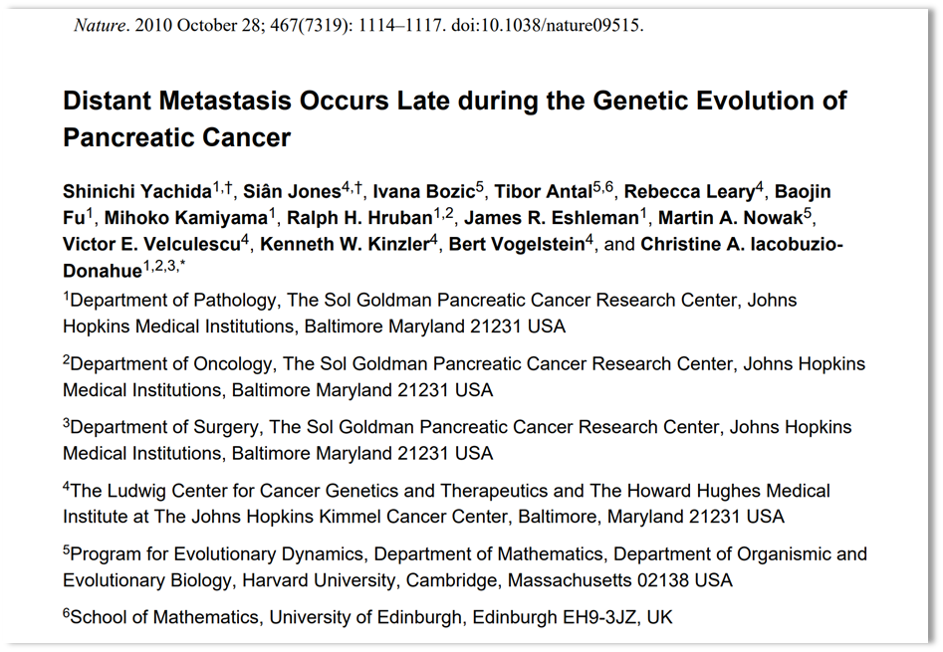
Window of opportunity to detect curable lesion
Genetical analysis of metastatic pancreas cancers suggested an average of 11.7 years before the first cancer cell develops within a high-grade pancreatic lesion, then an average of 6.8 years as the cancer grows and at least one cell has the potential to spread, and finally, an average of 2.7 years from then until a patient's death.

Slide 7
Precursor lesions of PDAC
PanIN
IPMN
MCN

Slide 8
Precursor lesions-PanIN

Slide 9
-non-invasive epithelial proliferations within the pancreatic ducts
-Progresses in a stepwise process (low-grade-> high-grade) at the end of which invasive pancreatic ductal adenocarcinoma develops.
-Most low-grade PanINs do not progress to invasive cancer.
Cancer Discov (2023) 13(6):1324-1345

Slide 10
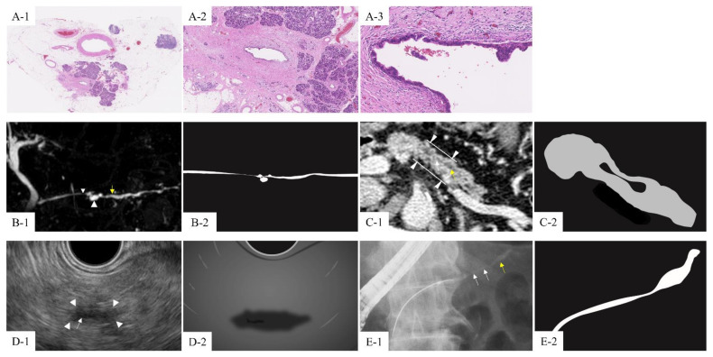
Cancers 2021,13,945
High-grade PanIN appears to be strongly associated with PDAC.
Most high-grade PanINs cannot be detected as obvious findings by any imaging modality.
Indirect signs of high-grade PanINs:
1.MPD stenosis with dilatation
2.retention cysts
3. focal parenchymal atrophy
4. hypoecho around MPD stenosis on EUS

Slide 11
Concerning features on imaging ( CT, MRI, EUS)
-PD dilatation and/or stenosis
-retention cysts ( BD dilatation)
-focal parenchymal atrophy
-hypoechoic changes around PD on EUS
consideration of ERCP
pancreatic juice cytology
surgical resection
positive
strong suspicion of high grade PanIN
close follow up
negative

Slide 12
Oct 2023
Jul 2022
Dec 2020

Slide 13
December 2022
December 2023

Slide 14
Precursor lesions-PanIN
-Long-term follow-up of patients with MPD stenosis with upstream dilation reports that 47% of cases are diagnosed with PDAC and/or high-grade PanIN.
BUT
-Differentiation from benign lesions - chronic pancreatitis and AIP - is difficult.
2011
2020
2024

Slide 15
Precursor lesions-IPMN

Slide 16
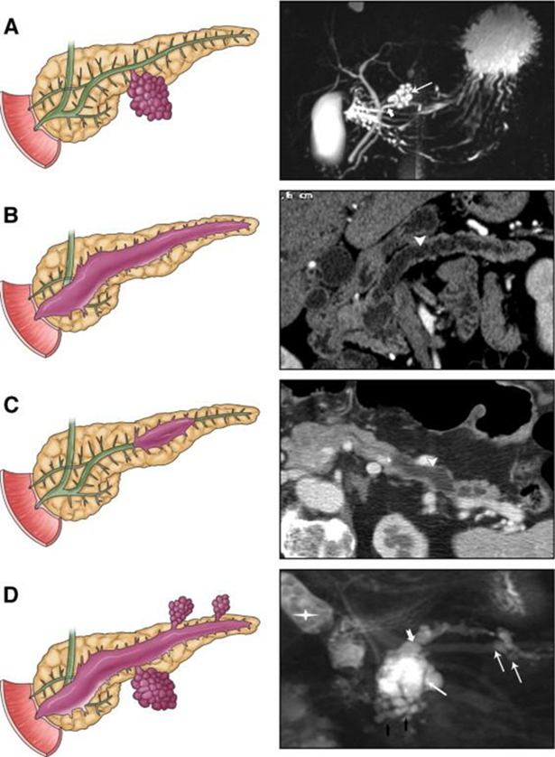
Intraductal papillary mucinous neoplasm/IPMN
Pathological subtypes: Morphological subtypes: Risk of malignancy:
gastric branch-duct IPMN ~24%
intestinal main-duct IPMN ~62%
pancreatobiliary
oncocytic
mixed-type IPMN ~57%

Slide 17
cyst with high-risk stigmata resection if patient is fit for surgery
cyst with worrisome features urgent EUS
asymptomatic cyst < 3cm and no worrisome features surveillance as per guidelines
Worrisome features:
-cyst> 3 cm
-enhancing nodule < 5 mm
-thickened enhancing cyst wall
-MPD size 5-9 mm
-abrupt change in MPD calibre
-lymphadenopathy
-elevated ca19-9
-rapid rate of cyst grow >5 mm/2 years
High risk stigmata:
-enhanced mural nodule > 5 mm
-jaundice in patient with cyst in HOP
-MPD size > 10 mm
IPMN with 5 mm focus of invasive carcinoma T1a

Slide 18
Cumulative risk of malignancy in side-branch IPMN is low.
Size and multiplicity could lead to overtreatment if resected.
Predictors for HGD/malignant transformation:
-enhancing mural nodule/component
- PD > 5mm
-growth >2.5mm per year
-raised CA19-9
Miller et al.
RadioGraphics 2022;42:87-105
IPMN may be an indicator of background parenchymal abnormality.
The presence of an IPMN may portend an increased risk of invasive pancreatic cancer at disparate sites within the pancreas.

Slide 19
Abbreviated MRI protocols
Many centres use abbreviated MRI protocols ( without postcontrast sequences).
Pros
Time- and cost effective.
No added value from contrast in characterization of cysts.
MRI with DWI seems accurate in the detection of mural nodules > 5mm.
No concern re gadolinium retention in patients for potentially lifelong follow-up.
Cons
?Accurate for detection of early stage synchronous or metachronous cancer.

Slide 20
-Retrospective studies have indicated that abbreviated MRI (omitting contrast-enhanced and DWI) may be used for CPL surveillance without any suspicious features or cases of malignancy being missed.
-Small number of cases may need to be recalled for additional MR sequences.
-There is still a significant overall timesaving.
-The suitability of abbreviated protocols for detecting synchronous cancer remote to CPL requires further study.

Slide 21
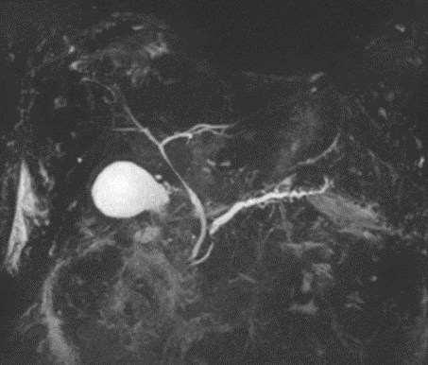
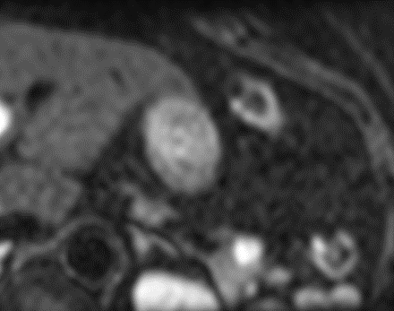
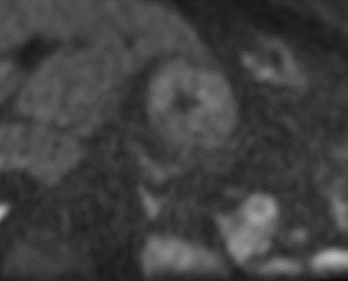
accurate measurement
3D MRCP sequence
PD > 5mm; growth >2.5mm per year
PD stricture
view of full length of PD
MIP
mural nodule in cyst, wall thickening
SFOV DWI
solid lesion in disparate site
T1 fat sat

Slide 22
Precursor lesions-MCN

Slide 23
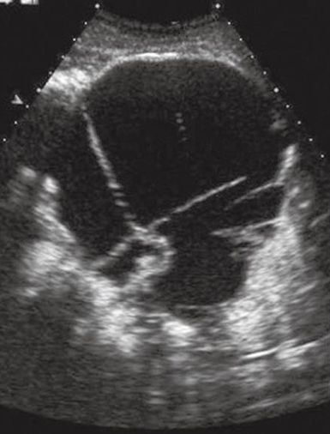
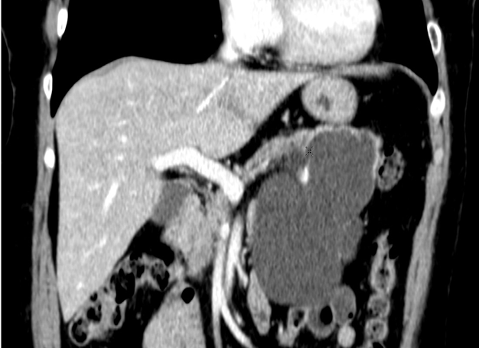
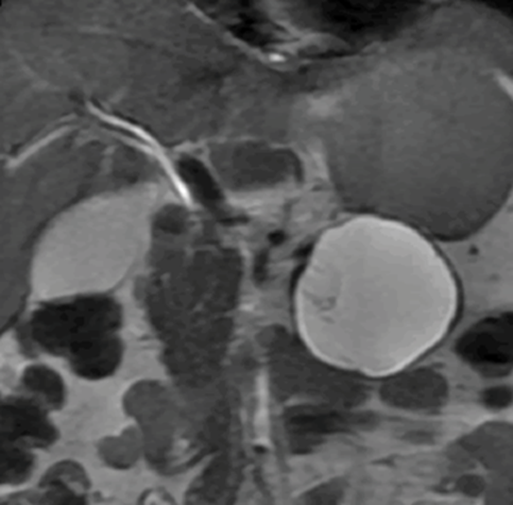
Mucinous cystic neoplasm/MCN
-nearly exclusively female patients, middle age
-body and tail of pancreas ( 95%)
-macrocystic with septation and septal/wall calcification
-solid component and/or thickened wall suggests malignant transformation ( malignancy rates range from 10% to 17%)

Slide 24
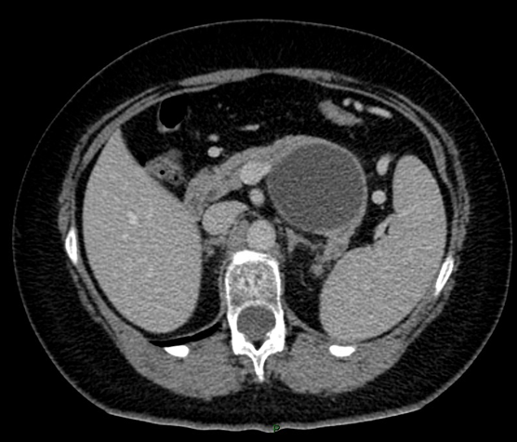
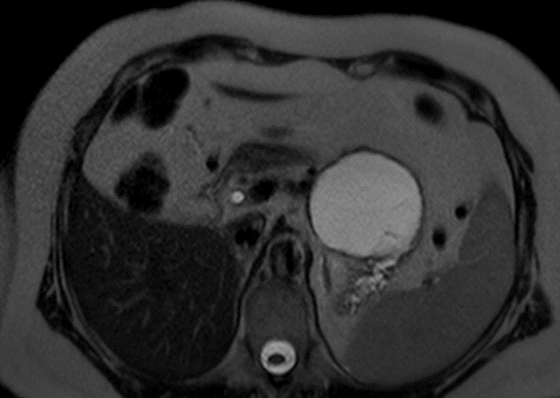
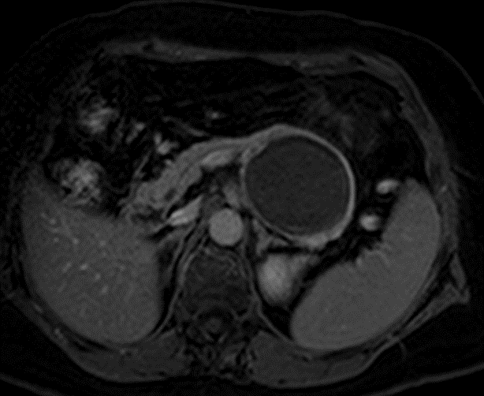
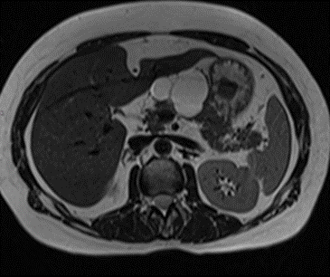
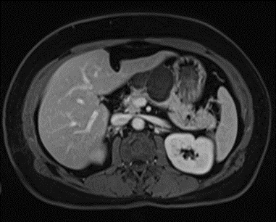
MCN- diagnostic challenges
-MCN may look unilocular and relatively thin-walled on CT – differential diagnosis: pseudocyst.
Oligoscystic SCA can mimic MCN.

Slide 25
Is it possible to diagnose T1 tumours on cross sectional imaging?

Slide 26
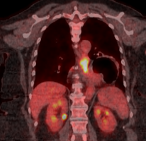
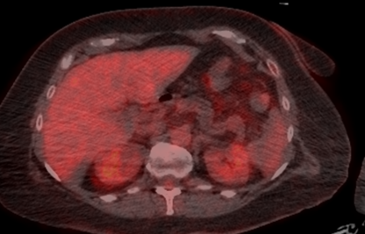
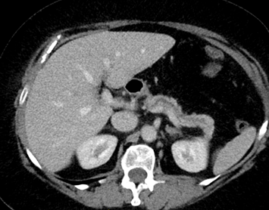
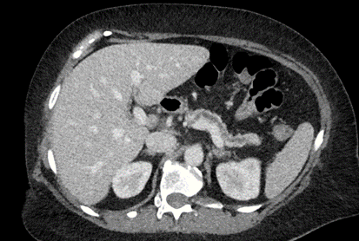
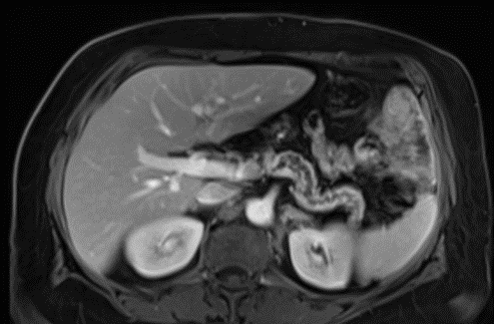
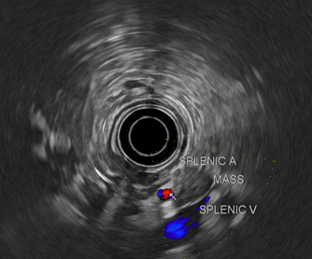
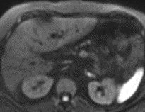
Patient with histologically proven oesophageal cancer
May 2021
September 2021
T1c
March 2022

Slide 27
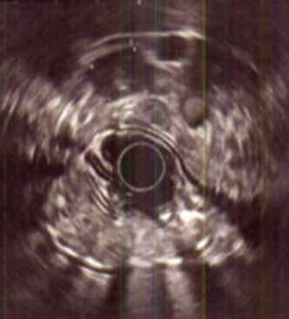
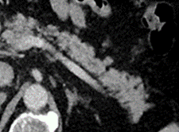
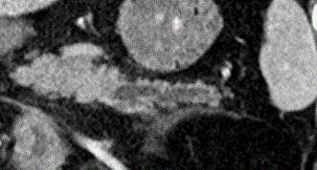
Patient under investigation for abdominal pain
T1b
Patient under surveillance after resection of CRC

Slide 28
Incidentally found pancreas cyst, EUS-FNA: mucinous cyst
T1b

Slide 29
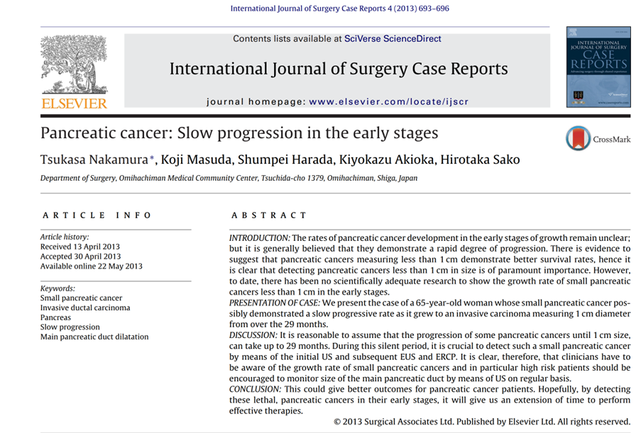
The volume doubling time of pancreatic cancer was estimated as 159 ± 67 ( median, 144) days.

Slide 30
Renal CT December 2022
MRCP (abbreviated cyst surveillance scan) December 2022
Renal MRI March 2023
August 2023

Slide 31
Screening of high-risk patients
AJR:219,December 2022

Slide 32
AJR2018;211:52-66
-Low-Tube-Voltage CT
-Dual-Energy CT
-Image biomarkers
-pancreas volumetry and attenuation
-CT perfusion
-texture analysis
-radiomics and radiogenomics
-machine learning
These are in research or clinical exploration stage.

Slide 33
Dual-energy CT
clinical exploration: further assessment of PDAC, pNET, AP
research stage: differential diagnosis PDAC vs mass forming pancreatitis
CT perfusion
research stage: AP, PDAC, pNET detection and monitoring treatment
Texture analysis
research stage: differential diagnosis PDAC vs mass forming pancreatitis
Radiomics, radiogenomics
research stage: association between genomic profiles in PDAC and tumour aggressiveness, therapy response
Machine learning
research stage: pancreatic lesion detection and interpretation

Slide 34
Radiology 2023;306:140-149
Radiology2023;306:172-182
In the test set of real-world CT studies the DL tool
-distinguished between malignant and control studies with 89.7% sensitivity and 92.8% specificity
-with 74.7% sensitivity for malignancies smaller than 2 cm

Slide 35
Invest Radiol 2023;58: 791-798
The proposed approach showed high quantitative performance to identify patients with pancreatic neoplasms.

Slide 36
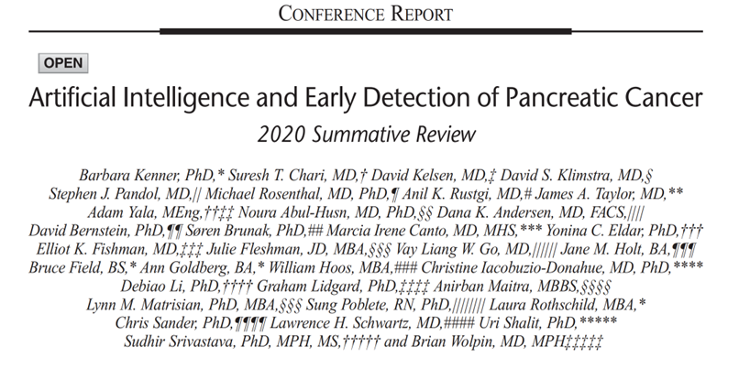
General population
Define high risk group
Clinical indicators
Enrich
Biomarkers
Find
Imaging
Confirm
Biopsy
Pancreas 2021;50:251-279
-development of novel biomarkers
-innovations in interpreting imaging findings
-innovations in biopsy techniques
-rapid onsite evaluation of cytology
-deep learning techniques to support cytological analysis
-exploration of the role of the microbiome in PDAC development
Biomedicines 2023,11,1687

Slide 37
Take home points
It is possible to diagnose pancreas cancer in early stage.
Innovations in identification of at-risk groups, imaging, biopsy technique, cytological analysis are expected to lead to higher rates of early stage PDAC diagnosis.

