Slide 1
Update on Hereditary Pancreas Cancer and the EUROPAC Registry
Meg Finch-Jones
Local PI for EUROPAC
Regional Project Team – Rosie Jarvis (Manager Surgical research Unit)
Trudy Gale - Project Manager – SWAG
Helen Winter – SWAG Clinical Director
Tracie Miles – Nationals Lead Nurse Lynch Transformation, Amanda Skinner - Lead Genomics Healthcare Professional NHS SW
Annabelle Boughey – Operation manager EUROPAC, Eleri Hughes - EUROPAC Navigator

Slide 7
Inherited Pancreas Cancer – 10 % of all pancreas cancer
Definitions
Familial Pancreas Cancer – 2 first degree relatives – no identified mutation
Pancreas cancer with inherited cancer genes/ Germline Familial Pancreas Cancer (ie genes that cause other cancer syndromes)
Surveillance
Increasing but not uniform – often relies on self referral
Unlike some other inherited cancer genes, testing resected tumours for mutations is not routine (unlike Lynch Syndrome)
No program (yet) for proactive formal family history taking
In the absence of a known familial mutation – existing germline mutations can be missed (egBRCA can be detected even without known familial breat CA)

Slide 9
EUROPAC
European Registry
Liverpool Team
Chris Halloran
Bill Greenhalf – Scientific Lead
Annabelle Boughey - Operations Manager
Phil Hopley – fellow
An increasing number of Navigators (we have Eleri Hughes)

Slide 10
Who is eligible?
The EUROPAC study has two cohorts, familial pancreatic cancer and Hereditary Pancreatitis.
Familial pancreatic cancer:
• Two or more relatives of first-degree kinship (e.g., sibling, parent and grandparent) affected by pancreatic cancer.
• Three or more relatives affected by pancreatic cancer (on the same side of the family i.e., maternal, or paternal).
• Carrier of a known genetic mutation and one family member affected by pancreatic cancer.
• Carrier of Peutz-Jeghers.
Hereditary Pancreatitis:
• Families with two or more relatives with idiopathic pancreatitis
• Families with at least one case of pancreatitis and a confirmed causative mutation in the PRSS1 gene
Please note this is our registry criteria and does not determine eligibility for surveillance. A risk assessment is conducted as part of registration to determine eligibility for surveillance.

Slide 11
How we Survey non-germline familial pancreas cancer

Slide 14
How we survey in Hereditary Pancreatitis

Slide 15
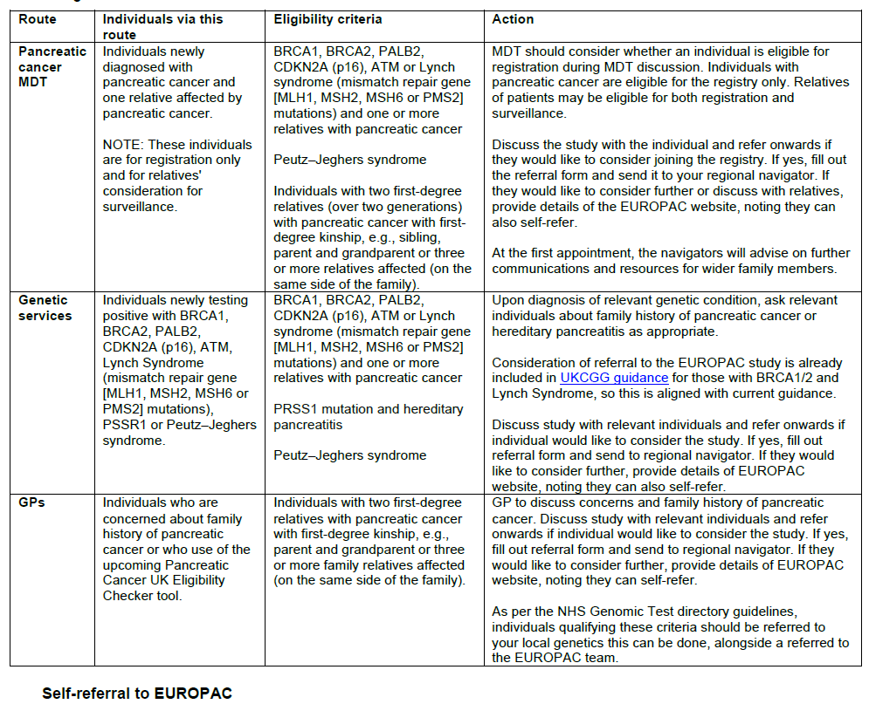

Slide 16
