Slide 1
SWAG Network Haematological Cancer
Clinical Advisory Group
Research Update - Claire Matthews
06/02/2024

Slide 2
National Haematological Cancer Research Recruitment
Apr 23 - Jan 24
Apr 22 - Mar 23
Source: ODP All Portfolio
Data cut: 25/01/2024

Slide 3
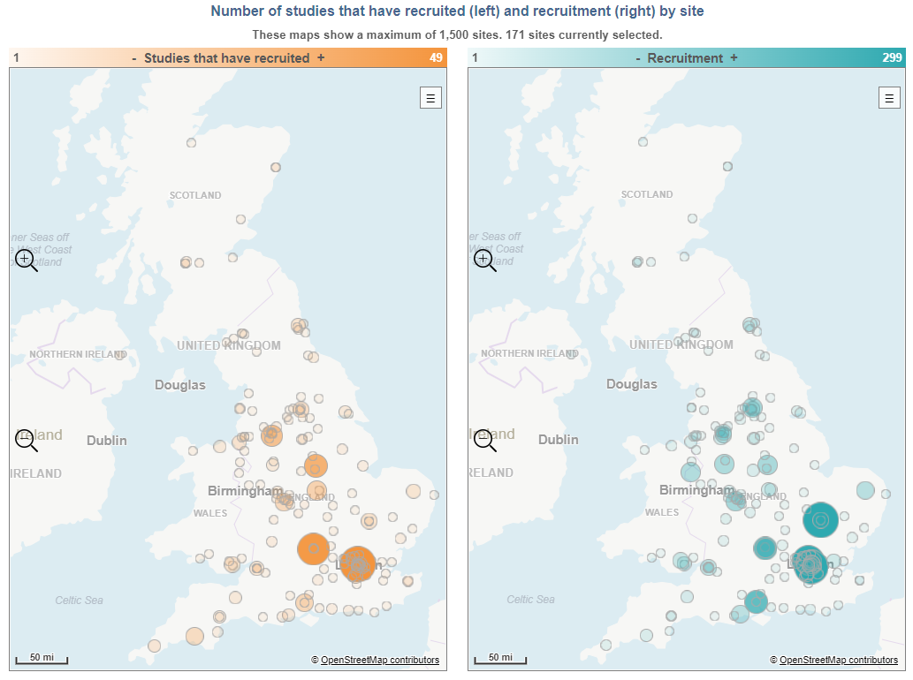
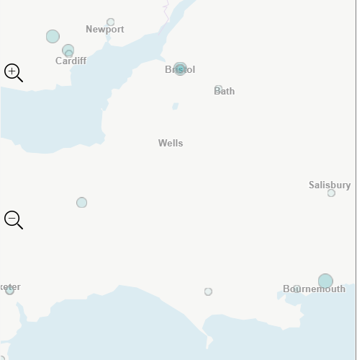

Slide 4
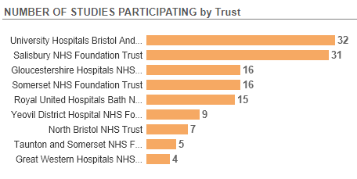
Open studies
66 Studies open in SWAG region
Full list:
Open Haem Onc studies SWAG Jan 24
Next slide shows studies open in the last 12 months - 14 studies

Slide 5
CPMS ID | Short Name | Sites | Opening | Closure | Sample Size Eng | Eng Recruits
54560 | IM048-022 | BHOC | 12/01/2024 | 09/08/2025 | UK 38 | 0
55421 | Chart review assessing venetoclax treatment outcomes for AML (ARC) v1 | Musgrove | 10/10/2023 | 08/02/2024 | 79 | 26
56018 | PROPEL | BHOC, GWH, Salisbury | 29/09/2023 | 31/08/2025 | 480 | 4
54044 | MK3543-004 | Glos | 25/09/2023 | 05/10/2024 | 5 | 3
50867 | MK-2140 | Chelt, Glos | 11/08/2023 | 16/04/2025 | 9 | 0
52411 | asciminib versus nilotinib in patients with Philadelphia Chromosome +ve Chronic Myelogenous Leukemia | Glos, RUH, Salisbury, Chelt | 27/06/2023 | 29/08/2025 | 16 | 4
53633 | EPCORE™ DLBCL-3 | BHOC | 19/06/2023 | 31/12/2024 | 16 | 4
54152 | SECURE | Yeovil, Musgrove | 05/05/2023 | 15/12/2025 | 2000 | 19
51751 | EFC15951 | Salisbury | 03/05/2023 | 29/03/2024 | 20 | 5
50622 | ZUMA-22 | Salisbury | 12/04/2023 | 14/06/2024 | 27 | 4
51771 | NS-018 versus Best Available Therapy in Subjects with Primary Myelofibrosis | RUH | 07/03/2023 | 01/08/2023 | 6 | 2
54516 | HALO-Trak | Musgrove, Yeovil | 27/02/2023 | 27/02/2025 | 200 | 18
52548 | CA057-008 - 480Kd vs Kd | Musgrove, Salisbury | 31/01/2023 | 30/01/2025 | 16 | 10
49183 | CA057-001 | Salisbury, Glos | 13/01/2023 | 15/02/2025 | 35 | 4

Slide 6
Studies in set-up in SWAG region
CPMS ID | Sites | Commercial Study | Short Name | Planned Opening | Planned Closure | Sample Size UK | Sponsor
59789 | BHOC | Commercial | MM32 - Ph3 C1071032 | 30/04/2024 | 13/03/2025 | 36 | Pfizer Inc.
57654 | Musgrove | Commercial | XPORT-MF-034 | 03/06/2024 | 30/06/2025 | 8 | Karyopharm Therapeutics, Inc.
56593 | BHOC, Musgrove, Salisbury | Commercial | OLYMPIA 5 | 05/02/2024 | 02/10/2025 | 9 | Regeneron Pharmaceuticals, Inc
56233 | Musgrove, Yeovil | Non-Comm | The Lupiae Study | 08/01/2024 | 01/05/2025 | 50 | EUROPEAN HEMATOLOGY ASSOCIATION
56030 | BHOC, Musgrove | Commercial | OLYMPIA-2 | 26/01/2024 | 27/09/2023 | 47 | Regeneron Pharmaceuticals, Inc
56023 | BHOC, Glos | Commercial | MK3543-006 | 01/04/2024 | 29/04/2025 | 32 | MERCK SHARP & DOHME CORP.
55786 | BHOC, Musgrove, Salisbury | Commercial | OLYMPIA-1 | 02/02/2024 | 20/05/2025 | 20 | Regeneron Pharmaceuticals, Inc
54942 | BHOC | Commercial | FT576-101-UK/EU | 31/03/2024 | 15/10/2024 | 10 | FATE THERAPEUTICS, INC.
54561 | BHOC | Non-Comm | ACT-AML-001 | 15/05/2024 | 07/12/2024 | 164 | DIDACT Foundation
50718 | BHOC, BRHC | Commercial | Relatlimab + Nivolumab in Pediatric and Young Adult Lymphomas (RELATIVITY-069) | 01/11/2023 | 01/04/2025 | 30 | Bristol-Myers Squibb International Corporation
49295 | BHOC | Commercial | A FIH study of KO-539 in patients with relapsed or refractory AML | 30/01/2024 | 06/05/2024 | 6 | KURA ONCOLOGY, INC
48215 | BHOC, Musgrove,Yeovil, Glos | Commercial | Epcoritamab in first line diffuse large B-cell lymphoma | 05/02/2024 | 30/04/2025 | 60 | ABBVIE INC.

Slide 7
Cancer PES survey results 2022 - Q58 research
National Results

Slide 8
Cancer PES survey results 2022 - Q58 research
SWAG regional results
SWAG region results PDF

Slide 9
https://bepartofresearch.nihr.ac.uk/

Slide 10
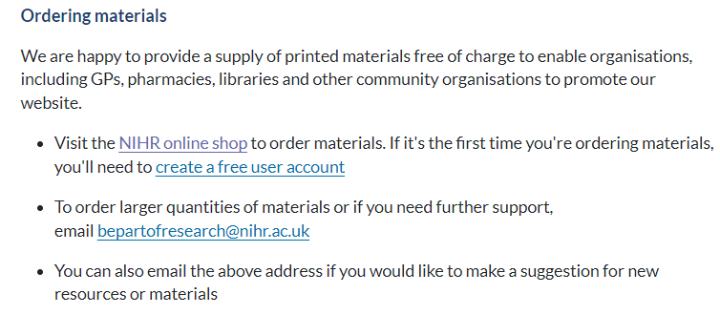
Resources and materials
https://bepartofresearch.nihr.ac.uk/promote-research/Resources/

Slide 11
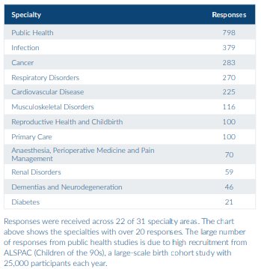
Link to full PRES report

Slide 12
What was positive about your research experience?
1,837 (70%) respondents left a comment explaining what made their
research experience positive. From these comments we identified the
following themes
• 864 comments mentioned the research delivery staff
• 537 comments related to contributing to improving healthcare
• 457 comments related to good communication
• 272 comments said the research study was easy to take part in
• 241 comments related to having a good experience
• 203 comments mentioned experiencing personal benefits
• 48 comments said "everything" was positive
• 41 comments related to where the research took place
• 35 comments mentioned gaining a feeling of hope
• 27 comments related to financial reimbursement
• 19 comments related to travel
Notes:
The same themes were identified in the 2021/22 PRES report, suggesting the positive aspects of taking part in research have remained the same. Comments related to good communication have increased from 21% to 25%, suggesting that studies may have improved how they communicate with participants.

Slide 13
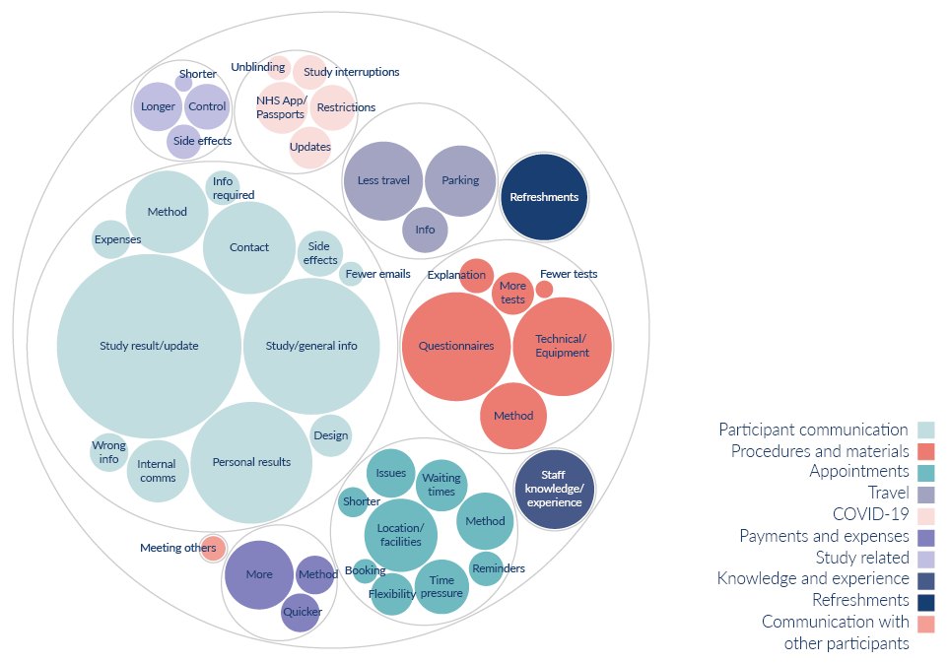
What would have made your research experience better?
603 respondents (23%) left a comment about what could have made their research experience better. From these comments we identified the following themes:
310 comments related to participant communication
98 comments related to procedures and materials
67 comments were about appointments
45 comments related to travel
28 comments were linked to COVID-19
26 comments were about payments and expenses
25 comments were about refreshments
20 comments were study related
20 comments were about knowledge and experience
2 comments mentioned they’d like to communicate with other participants
Notes:
Although fewer participants (23%) left comments about what would have made their experience better (compared to 32% in 2021/22), the themes identified are broadly the same as last year.
Whilst comments about participant communication remain the most common, these have decreased since last year (from 64% to 51%). This also aligns with an increase in positive comments around communication, indicating that studies have improved how they communicate with participants. There has also been a large decrease in the number of comments around appointments (from 27% to 11%), this is likely due to study teams being able to offer more flexibility around appointment times and methods.
Participant communication: Information about the study results/updates, general information about the study or condition, personal results, more contact from the study team, method of communication, information about side effects, internal communication, receiving incorrect information, information about what was required, information about expenses, design of communication, fewer emails.
Procedures and materials: Issues with questionnaires, technical issues with apps/equipment, method of procedures, more explanation about tests or how to use equipment, more or fewer tests
Appointments: Location, method, delays and waiting times, more time during appointments, flexibility over appointment times, issues with appointments, reminders, shorter appointments, booking of appointments
Travel: Less travel less for appointments, free or better parking, better travel information
COVID-19: Issues with travel/vaccine passports, restrictions, more information/updates, study interruptions, unblinding process
Payments and expenses: Wanting payment or to receive more money, time it took to receive payments, method of recognition
Study related: Wanting longer or shorter study, being in the control arm, side effects
Knowledge and experience: When people were approached about taking part in research, feeling like staff didn’t have the knowledge to answer questions or use required equipment. Comments under this theme also relate to awareness of Equity, Diversity, and Inclusion

Slide 14
Next steps
Feedback shared with research delivery staff, partner organisations and members of the public
PRES working group to form projects which aim to improve the participant experience based on the experience received

Slide 15
Associate PI Scheme
https://www.nihr.ac.uk/health-and-care-professionals/career-development/associate-principal-investigator-scheme.htm
A six month in-work training opportunity, providing practical experience for healthcare professionals starting their research career. People who would not normally have the opportunity to take part in clinical research in their day to day role have the chance to experience what it means to work on and deliver a NIHR portfolio trial under the mentorship of an enthusiastic Local PI.

Slide 16
Principal Investigator Pipeline Programme (PIPP)
https://www.nihr.ac.uk/documents/principal-investigator-pipeline-programme-pipp/33803
A new scheme support research delivery nurses and midwives by supporting them to become Principal Investigators (PIs)
Free of charge for eligible participants
Delivered through a variety of live virtual and on-line classroom environments, combined with real world hands-on experience.
COHORT 2 key dates: Applications open 1st March 2024
31st May 2024: Close to applications
End June 2024: Applicants notified of outcome of application
September 2024: COHORT 2 begins

Slide 17
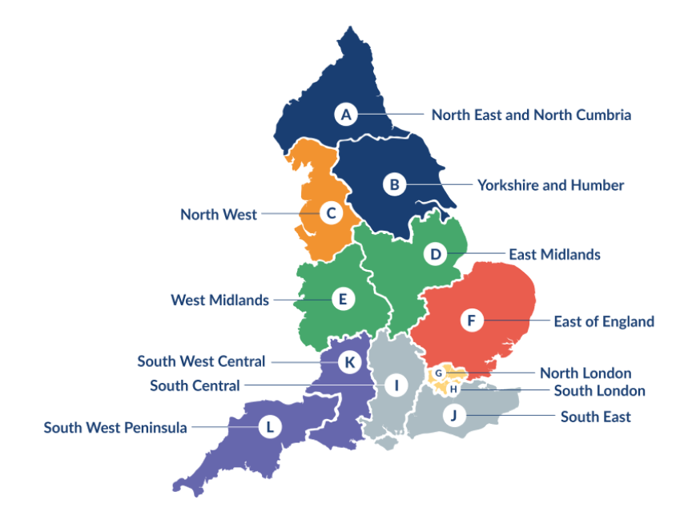
Clinical Research Network Transition to Research Delivery Network
Launching Oct 2024
The NIHR RDN has 2 primary purposes:
To support the successful delivery of high quality research, as an active partner in the research system
To increase capacity and capability of the research infrastructure for the future
Will operate as 1 organisation across England, through a network of 12 Regional Research Delivery Networks (RRDNs) and a central Coordinating Centre (RDNCC)

Slide 18
NIHR ODP
Open data platform. Data on performance across whole CRN,
including all specialty areas
NIHR Be Part of Research
See which studies are open across the country
National Cancer Research Institute Portfolio Maps
View current national portfolio of open, closed and ‘in set up’ cancer studies
Find a Clinical Research Study (ODP)
Search for a study to fit criteria. Good for horizon scanning, eligibility criteria

Slide 19
Research Delivery Manager
claire.matthews@nihr.ac.uk
Research Portfolio Facilitator
rebecca.pienaar@nihr.ac.uk
Sub-specialty Lead
sally.moore@uhbw.nhs.uk

Slide 20
DETERMINE
Determining Extended Therapeutic indications for Existing drugs in Rare Molecularly defined Indications using a National Evaluation platform trial
Aim:
Evaluate the efficacy of licensed targeted therapies in unlicensed indications, in rare adult, paediatric and TYA cancers with actionable genomic alterations (including common cancers with rare actionable alterations)
Identify genomic,transcriptomic and immune contextual influences on response to therapy
The ultimate aim is to transition positive findings to the NHS (Cancer Drugs Fund [CDF]) to provide new treatment options for patients with rare malignancies.
Arm 1 Alectinib
Arm 2 Atezolizumab
Arm 3 Entrectinib
Arm 4 Trastuzumab in combination with pertuzumab
Arm 5 Vemurafenib in combination with cobimetinib

Slide 21
Talking about research
https://learn.nihr.ac.uk/
You will:
Feel more confident having conversations with potential participants for a trial, through applying a simple evidence-based communication model.
Feel encouraged to deepen your knowledge of communication skills using resources provided for your personal development.

