Slide 1
Haem CAG Protocol Update
Feb 2024
Kate Gregory
Lead Pharmacist for SACT Protocols, SWAG Cancer Alliance

Slide 2
The SWAG SACT Protocols Team
Kate Gregory – Pharmacist, 0.2 wte
Dr Jeremy Braybrooke - Medical Oncology Consultant, 0.1 wte
Helen Dunderdale – Cancer Clinical Advisory Group Manager
‘Ideal’ Protocol process:
Protocol drafted by tumour site specialist
(usually consultant/registrar/
Specialist pharmacist)
Protocol checked by Kate
Protocol checked and approved by Jeremy
Approved protocol uploaded to SWAG website by Helen and email sent to SWAG pharmacist for dissemination

Slide 3
Protocols Progress Feb 23 - Feb 24
New protocols added:
Protocols updated:
Protocol Name | Author | Review date
Oral azacitidine (Onureg) | Emily Booth, Priyanka Mehta | Dec-25
Asciminib | Deepak Mannari, Becky Bagnall | Sep-26
POLA-R-CHP | Rachel Hingston, Alastair Whiteway | Apr-26
PBR - Polatuzumab vedotin, bendamustine & rituximab | Lisa Lowry | Feb-26
Dara-VTD | Alastair Whiteway, Becky Bagnall | May-26
DRd - Daratumumab, lenalidomide, dex | Sally Moore | Nov-26
Protocol Name | Update
R-CODOX-M/R-IVAC | Additional clarity re: IT dosing when given intraventricularly
Acalabrutinib | Capsules to tablet change and PPI/antacid interaction removed
Daratumumab, Bortezomib, Dexmethasone | NICE TA update
ABVD | Dose capping requirement removed, renal and hepatic impairment section updated in line with current guidance

Slide 4
Ongoing work – early 2024
Myeloma protocol updates
Following protocols meeting in November
Trialling new protocol format
BEACOPP/BEACOPDac updates
Renal/hepatic impairment updates in line with current practice
Updates to allow for OP administration
New Protocol template – more later!

Slide 5
Protocols outstanding
Date | NICE TA/Indication | Protocol Status/Plan
31st January 2024 | TA947 - Loncastuximab tesirine for treating relapsed or refractory diffuse large B-cell lymphoma and high-grade B-cell lymphoma after 2 or more systemic treatments | Needs draft - volunteer to review?
22nd November 2023 | TA931 - Zanubrutinib is recommended as an option for treating untreated CLL if there is a 17p deletion or TP53 mutation or there is no 17p deletion or TP53 mutation but FCR or bendamustine & rituximab are unsuitable or in relapsed or refractory CLL. | Needs draft. Haem CAG 2023 - Laura Percy
6th November 2023 | NHSE CCP: Sorafenib maintenance for adults with FLT3-internal tandem suplication (FLT3-ITD) acute myeloid leukaemia (AML) undergoing allogeneic stem cell trasnplantation | Needs draft - volunteer to review?
17th October 2023 | CDF - Glofitamab for previously treated DLBCL who have received 2 or more therapies. | Needs draft - volunteer to review?
31st May 2023 | TA891 - Ibrutinib plus venetoclax for untreated chronic lymphocytic leukaemia | Needs draft - volunteer to review?
19th October 2022 | TA833 - Zanubrutinib for treating Waldenstrom's macroglobulinaemia | Needs draft - Haem CAG 2023 - Laura Percy
27th April 2022 | TA787 - Venetoclax with low dose cytarabine for untreated acute myeloid leukaemia when intensive chemotherapy is unsuitable | Needs draft. Haem CAG 2023 - P Mehta to allocate to SpR
16th December 2021 | TA756 - Fedratinib for treating disease-related splenomegaly or symptoms in myelofibrosis | Drafted - with MPN group from approval (Rebecca Frewin)
22nd September 2021 | TA728 - Midostaurin for treating advanced systemic mastocytosis | Needs draft. Haem CAG 2023 - MPN forum to write?
28th April 2021 | TA695 - Carfilzomib with dexamethasone and lenalidomide for previously treated multiple myeloma | Needs draft. Haem CAG 2023 - Becky Bagnall/Alastair Whiteway
12th August 2020 | TA641 – Brentuximab vedotin with cyclophosphamide, doxorubicin and prednisolone (CHP) for untreated systemic anaplastic large cell lymphoma in adults | Drafted by KG, needs review. Haem CAG 2023 - Nik Chavda
24th April 2019 | TA577 – Brentuximab vedotin for treating CD30-positive cutaneous T-cell lymphoma after at least 1 systemic therapy | Drafted by KG to cover all BV indications, needs review. Haem CAG 2023 - Nik Chavda

Slide 6
Protocol Reviews
Protocol Area | Total number of Protocols | Protocols overdue review
ALL | 3 | 3
AML | 11 | 9
CML | 7 | 6
Hairy cell | 1 | 1
CLL | 12 | 10
CNS Lymphoma | 4 | 4
HL | 9 | 5
NHL | 26 | 20
Salvage | 3 | 3
Myeloma | 23 | 19
Stem cell mobilisation | 2 | 2
Myeloproliferative disorders | 4 | 4

Slide 7
Protocol update work
Different approaches to protocol updates:
Nominated individual to review all protocols in an area in meeting with Kate
Protocols split out amongst different CAG members to review then brought back to a meeting so all recommended updates can be approved
Group meeting to discuss protocols and suggested updates
Specific protocols identified to have issues due to being out of date updated with authors/site-specific consultant
What is needed?
Are all the available protocols still required? Can any be archived?
Does a protocol actually reflect what is happening in practice?
Are there any gaps for certain sites e.g. no DA protocols for AML currently

Slide 8
Protocol Template – what’s new?
Trialling new protocol template with the DRd protocol currently released to the website
Change to ordering of protocol with hyperlinks to jump to different sections
Additional information added:
Response rates from trial
Additional information re: investigations required
Toxicity/side effect profile more detailed
Additional information on management of drug specific toxicities

Slide 9
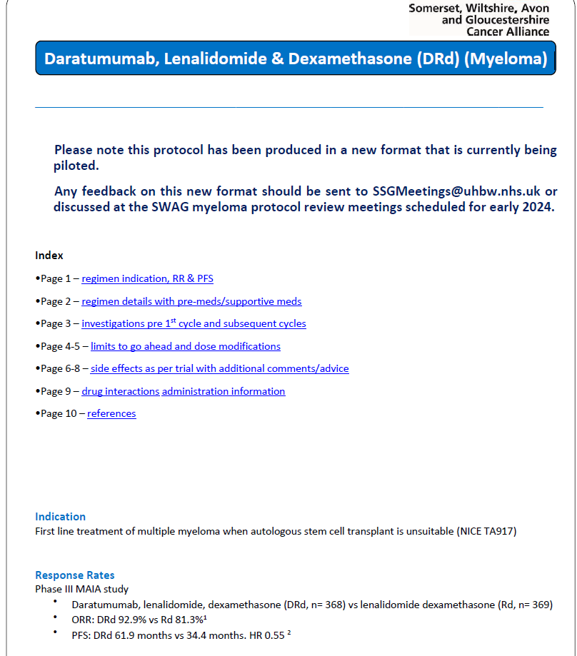
New Protocol Template

Slide 10
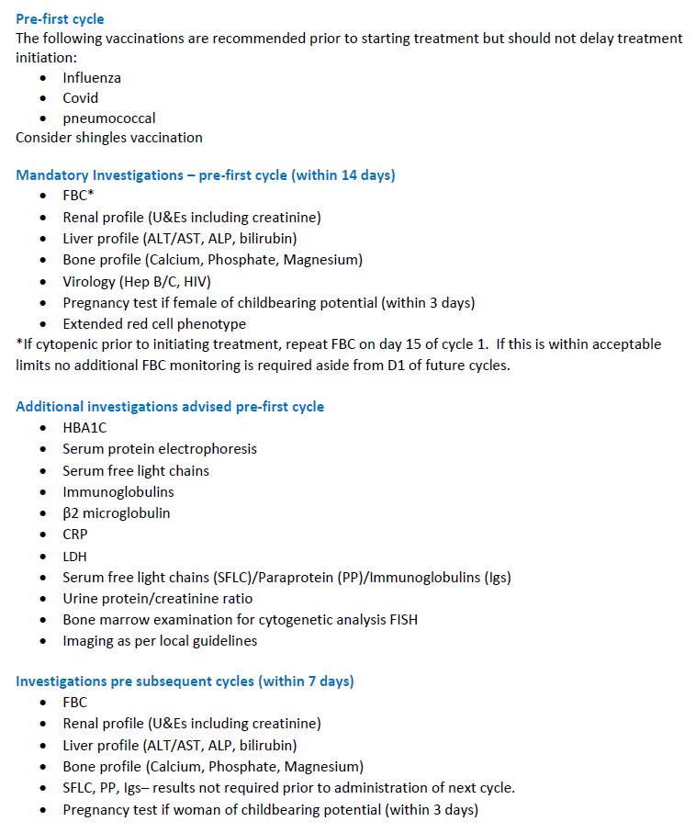
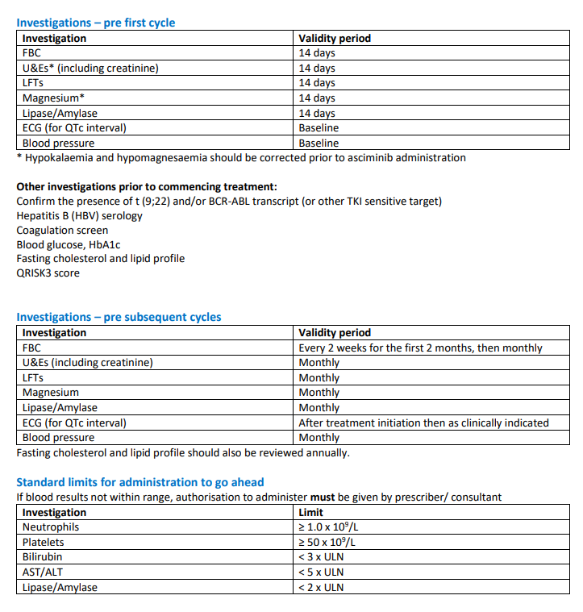
New Protocol Template

Slide 11
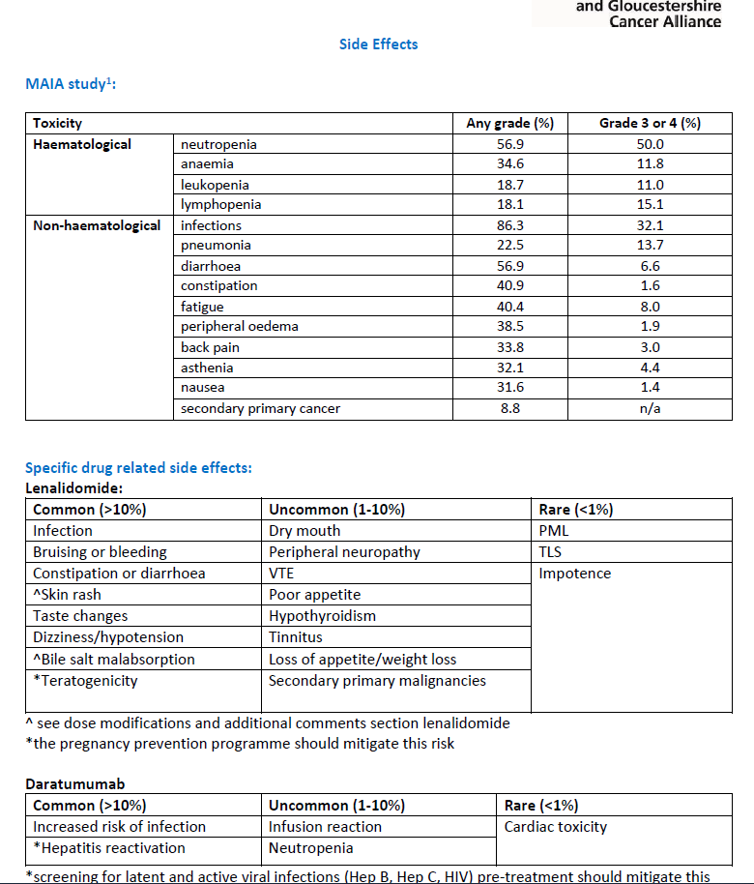
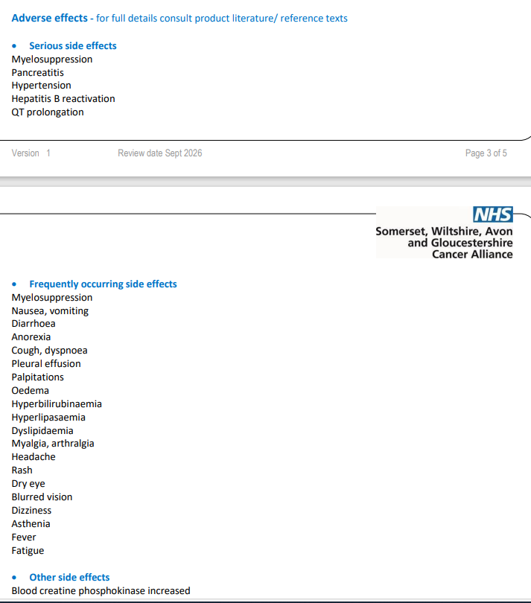
New Protocol Template

Slide 12
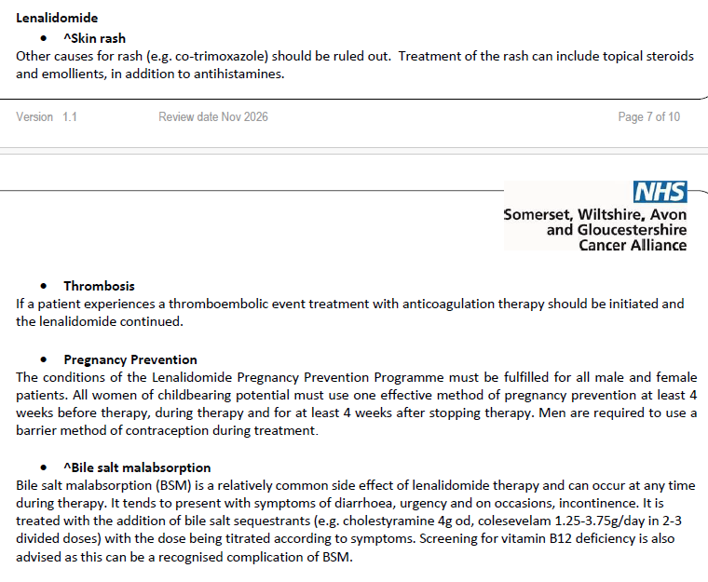
New Protocol Template

