Slide 1




Personalised Cancer Vaccines
SWAG Pancreatic Cancer Meeting
February 2024
Rob Jones
Consultant Liver Surgeon & Associate Professor of Surgery
UK Chief Investigator, BNT122-01
robjones@liv.ac.uk
@robjones1979

Slide 2
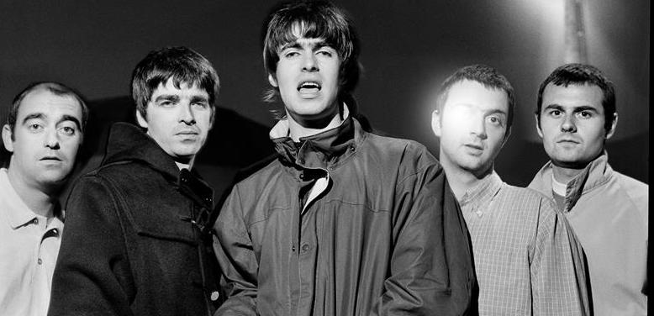
Declaration

Slide 3

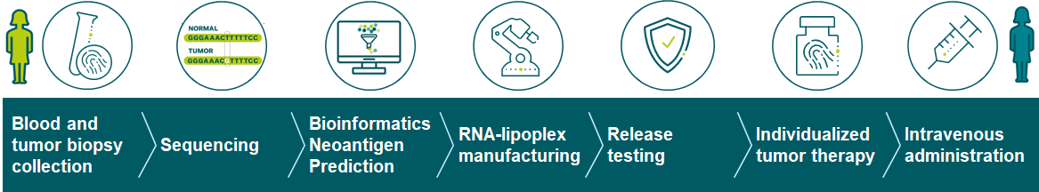





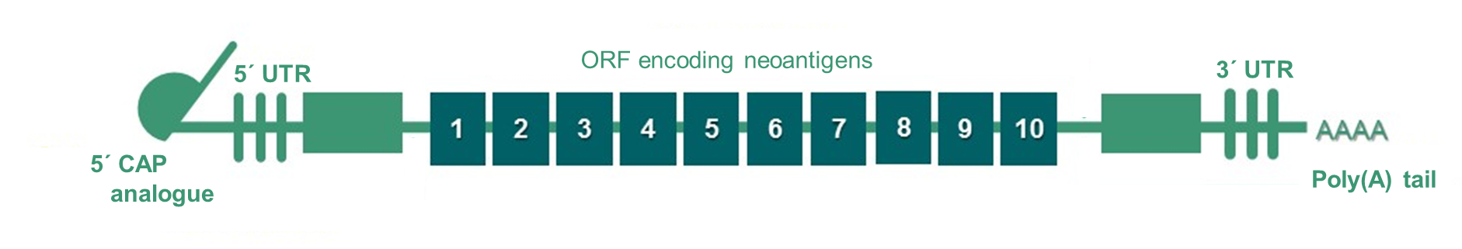
Autogene Cevuramen - an individualized mRNA cancer vaccine
Individualized neoantigen mRNA ^{1,2,3}
Innate Immune stimulation
Intrinsic TLR7/8 agonist
Antigen expression
Up to 20 neoantigens (2 decatopes)

Slide 4
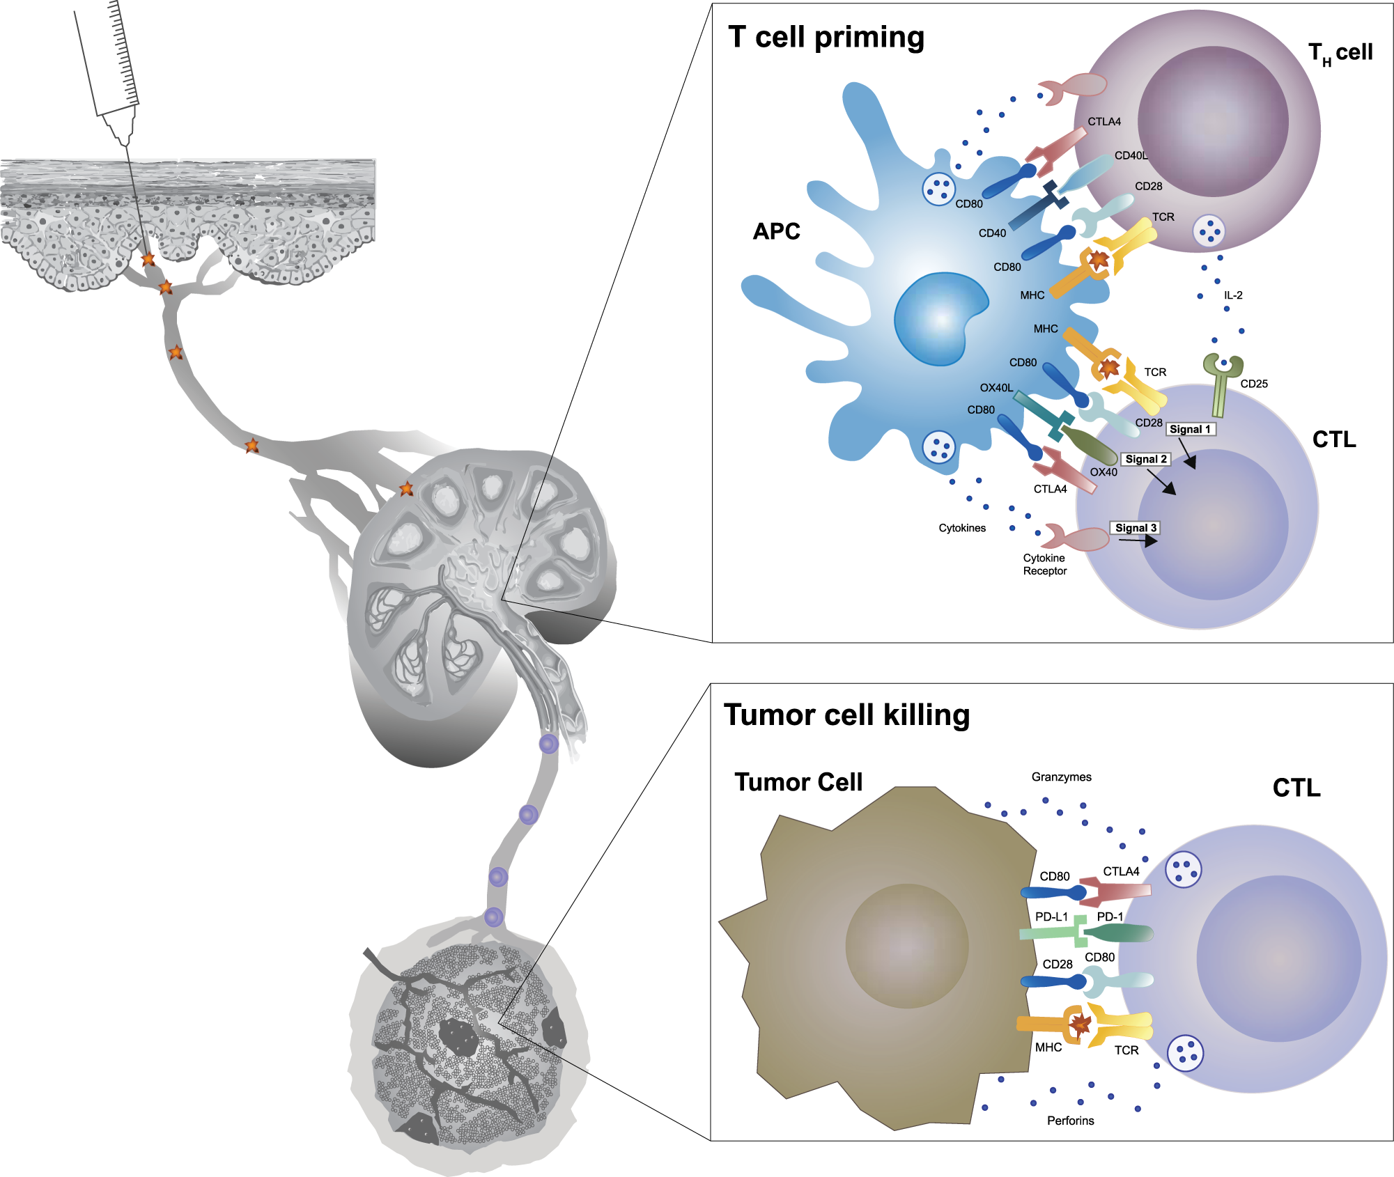
Innate Immune Stimulation and Neoantigen Presentation

Slide 5
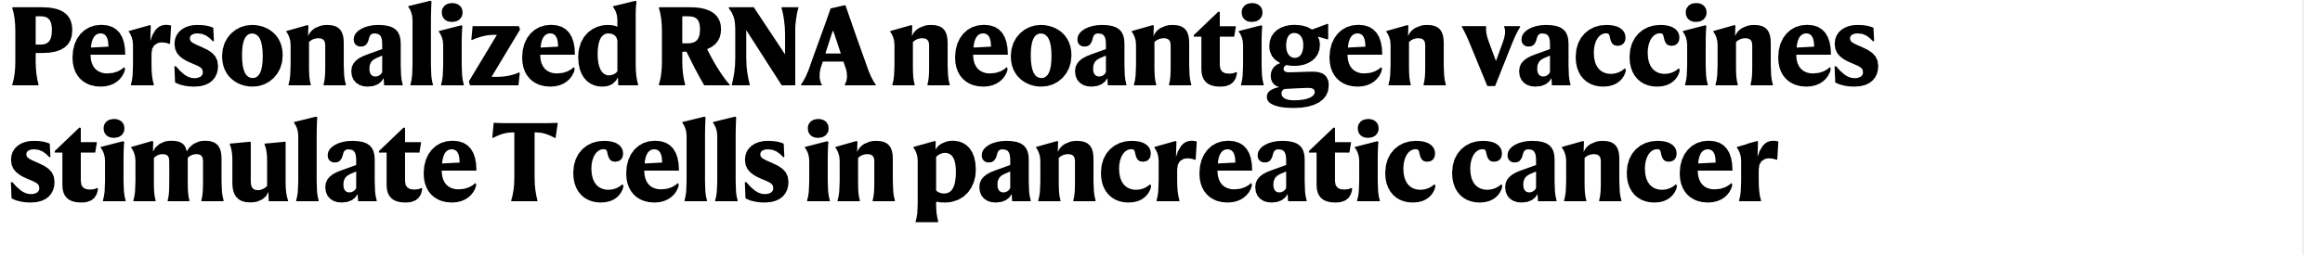
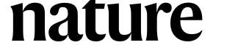
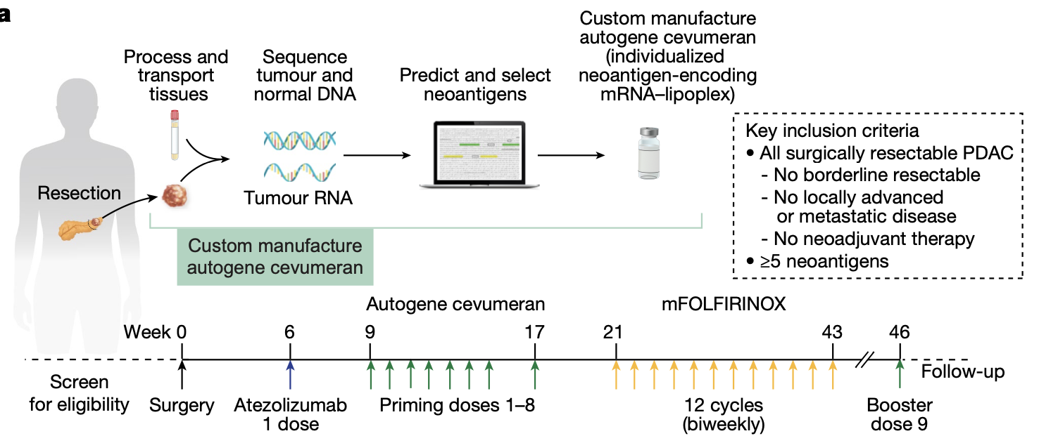
Rojas et al, Nature 2023

Slide 6
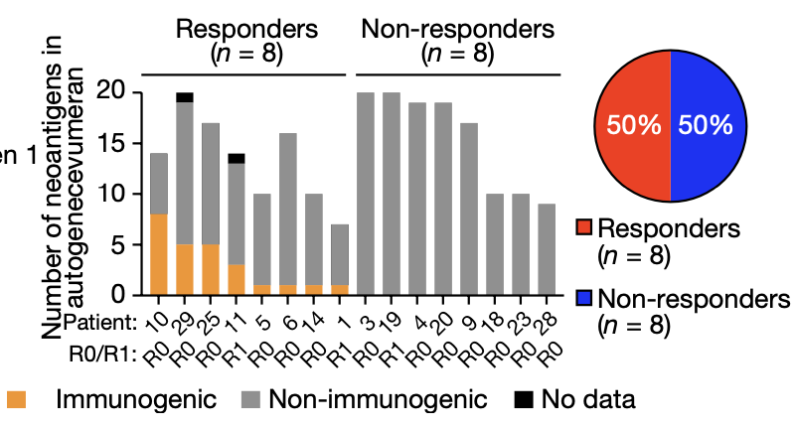
Vaccines trigger an immune response in half
Rojas et al, Nature 2023

Slide 7
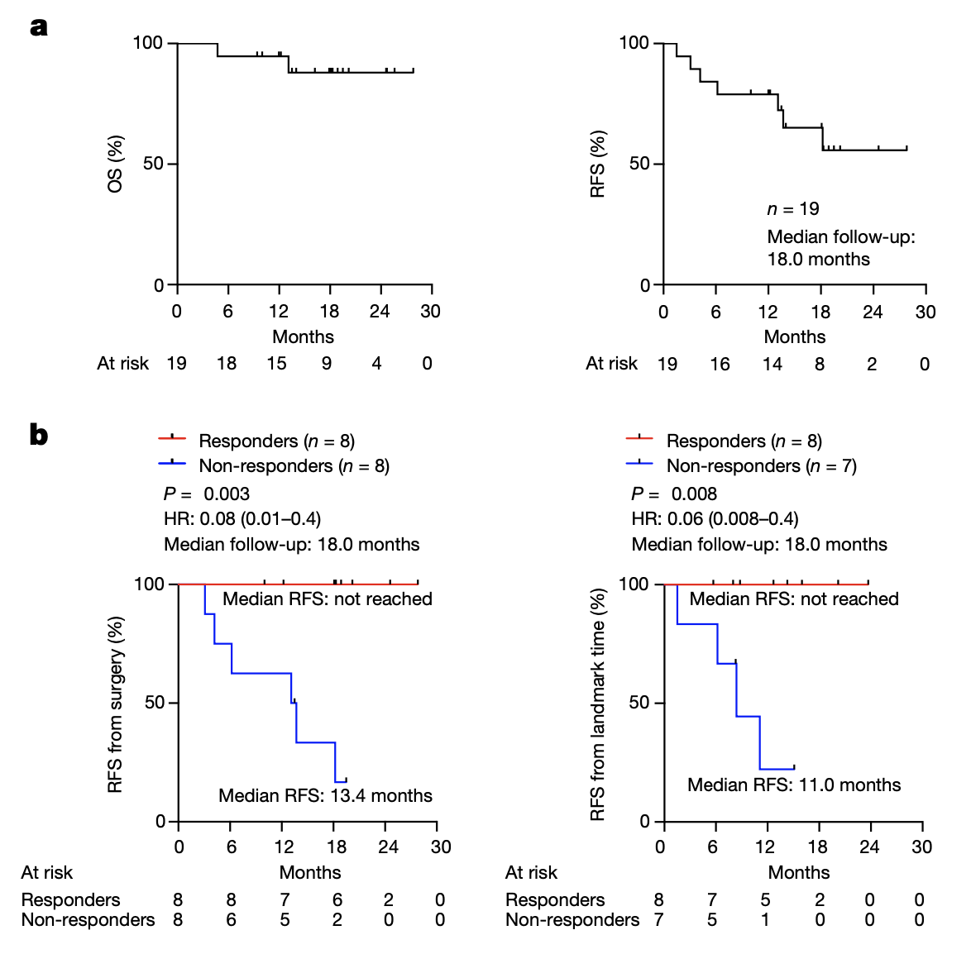
Impact of vaccine on survival
Rojas et al, Nature 2023

Slide 8
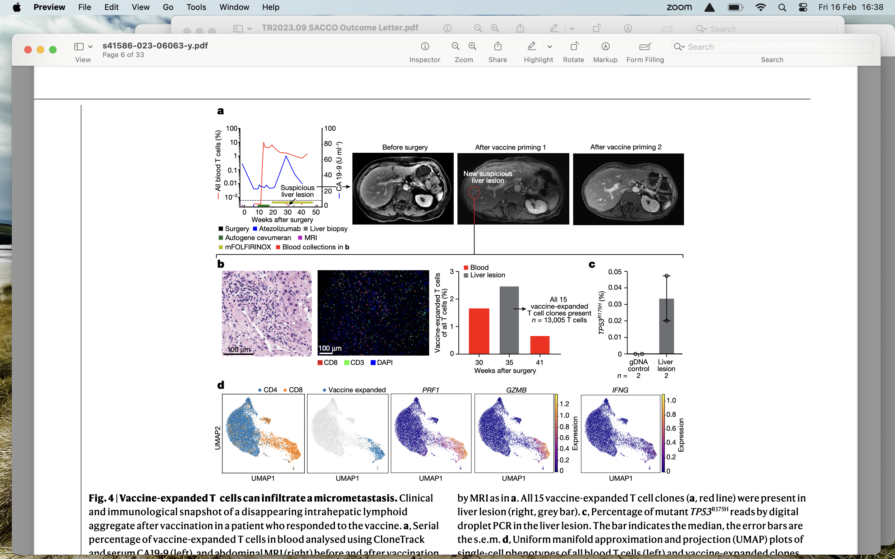
Vaccine clones & micrometastases
Rojas et al, Nature 2023

Slide 10
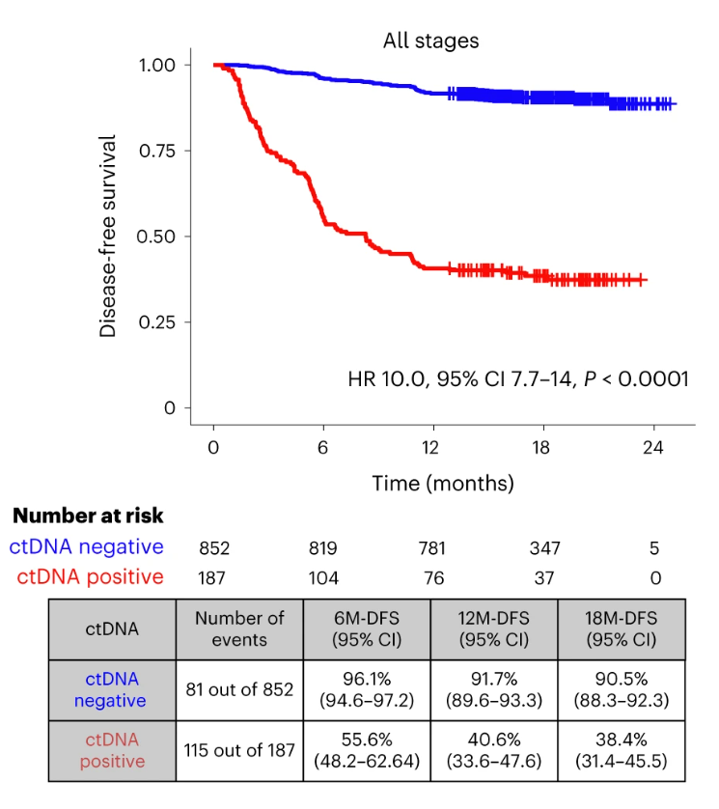
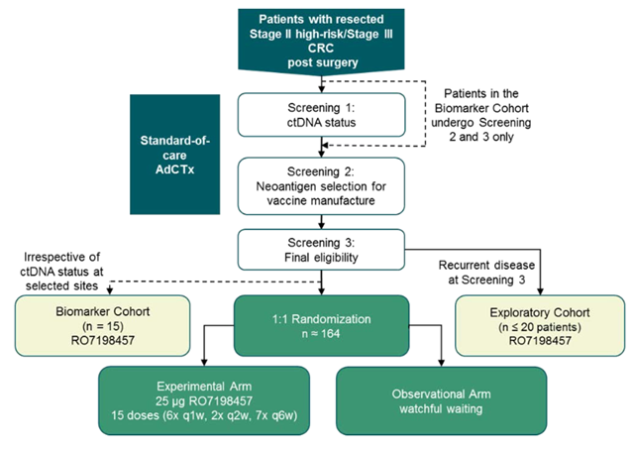
Q - Can we improve DFS for ctDNA positive CRC patients by adding vaccine to standard chemotherapy?
Screen to randomisation 6%
1:1 randomisation
n=164
Source: GALAXY study, Kotani et al. Nature Medicine 2023

Slide 11
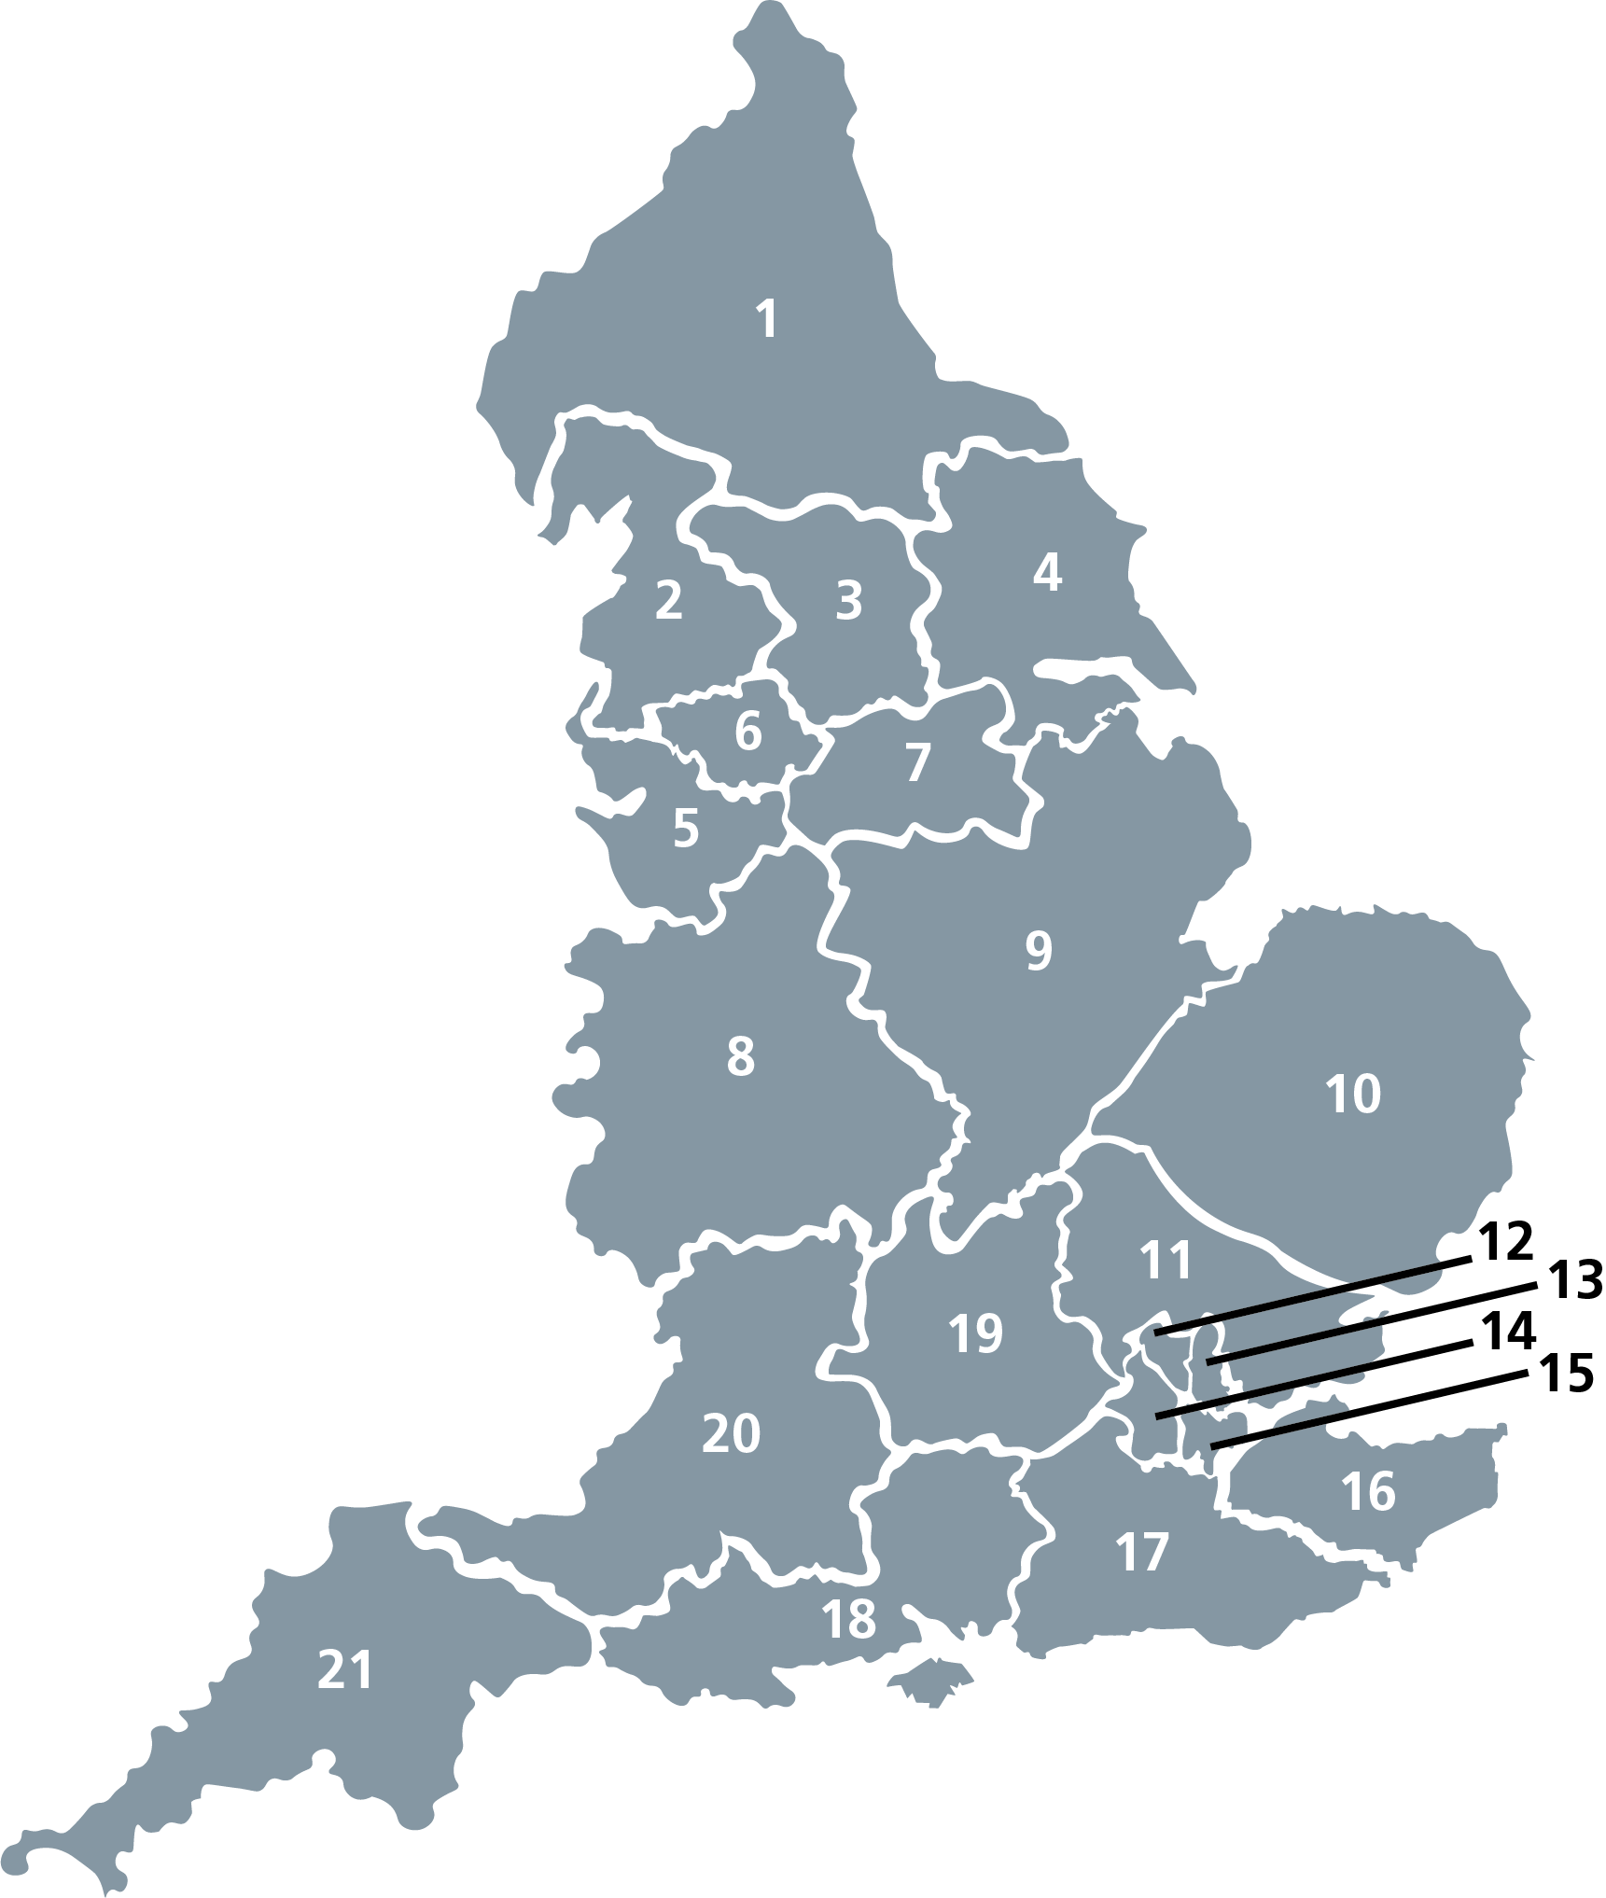

Where are the patients?
16, 000 CRC resections a year
    8000 get adjuvant chemotherapy
    15% ctDNA +ve
    = 1,200 eligible patients in UK each year
269 hospitals in the UK
  1200/269 = 5 patients per year per hospital

Slide 12
How can we recruit the patients we know are out there?
Open 269 sites
Leverage UK structural advantages to bring patients to our 14 sites
or

Slide 13

Optimising models for recruitment
  Hub & Spoke
  PIC-plus
  NHSE Cancer Vaccine Launchpad
  Mobile capacity

Slide 14
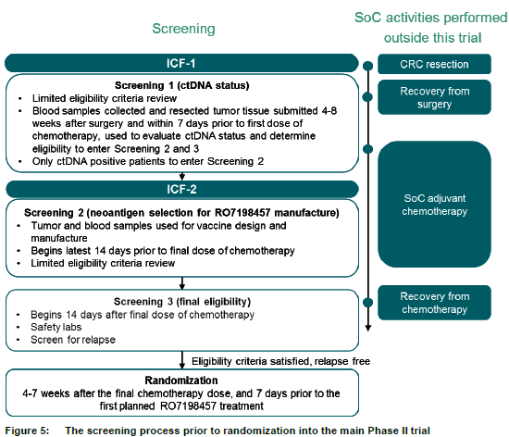
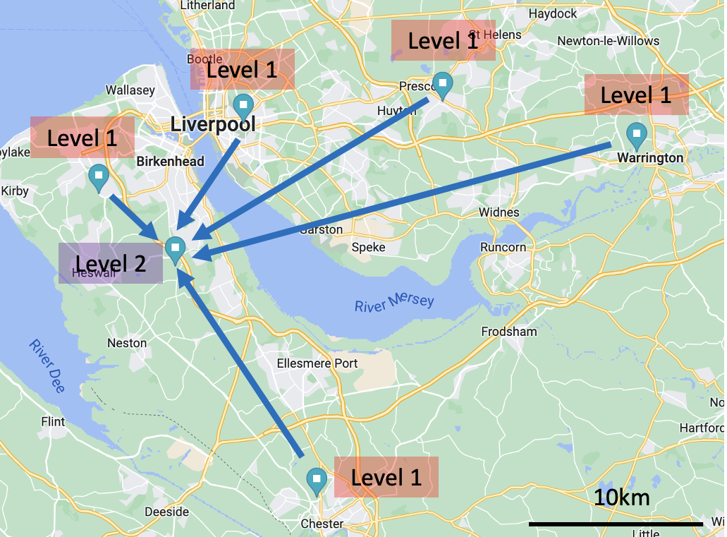
Model 1: Hub & Spoke
DGH (Level 1)
Trial Unit (Level 2)
Screening
SOC
ICF-1
Level 2 site functions solely as IMP focused site for patients randomized to IMP
Resection
SCR-1
Screening 1 (ctDNA post-surgery)
Limited eligibility review
ctDNA blood sample collection 4-8 weeks after surgery, but within 7 days prior first dose of ACT
Tumor tissue collection
Only ctDNA+ patients enter screening 2
Recovery from surgery
ACT
(start ≤8 weeks
post surgery)
ICF-2
SCR-2
Screening 2 (neoantigen selection)
Tumor + blood sample for vaccine manufacture
Screening beings latest 14 days prior to final ACT dose
Recovery from ACT
SCR-3
Screening 3 (Eligibility confirmation)
Begins 14 days after final ACT dose
Eligibility incl. CT scan
Safety labs
R (1:1)
Randomization
2-7 weeks after final ACT dose, and 7 days prior to planned first dose of RO7198457
Observation
Intervention

Slide 15
Model 2 –PIC Plus
Referring Site
Trial Site
Standard PIC
Colorectal surgery
Colorectal
OPD
Oncology
OPD
Adjuvant chemo
Mention trial
PIS
Contact
Consent
ctDNA
Colorectal surgery
Colorectal
OPD
Oncology
OPD
Adjuvant chemo
PIC Plus
Advert
PIS
Contact
Consent
ctDNA

Slide 16
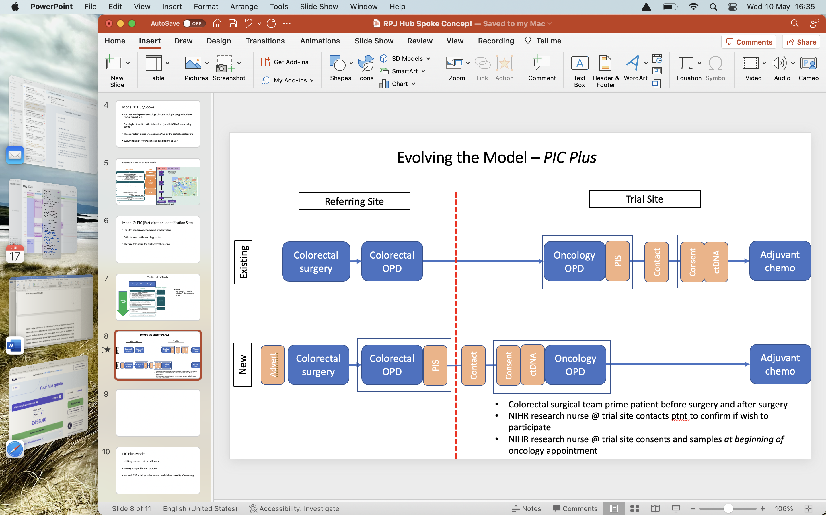
Model 2 – PIC Plus
Multiple sites across cancer network feed into trial site

Slide 17
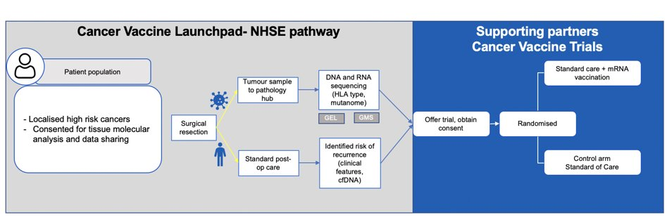
Model 3 – NHSE Cancer Vaccine Launchpad (CVLP)

Slide 18
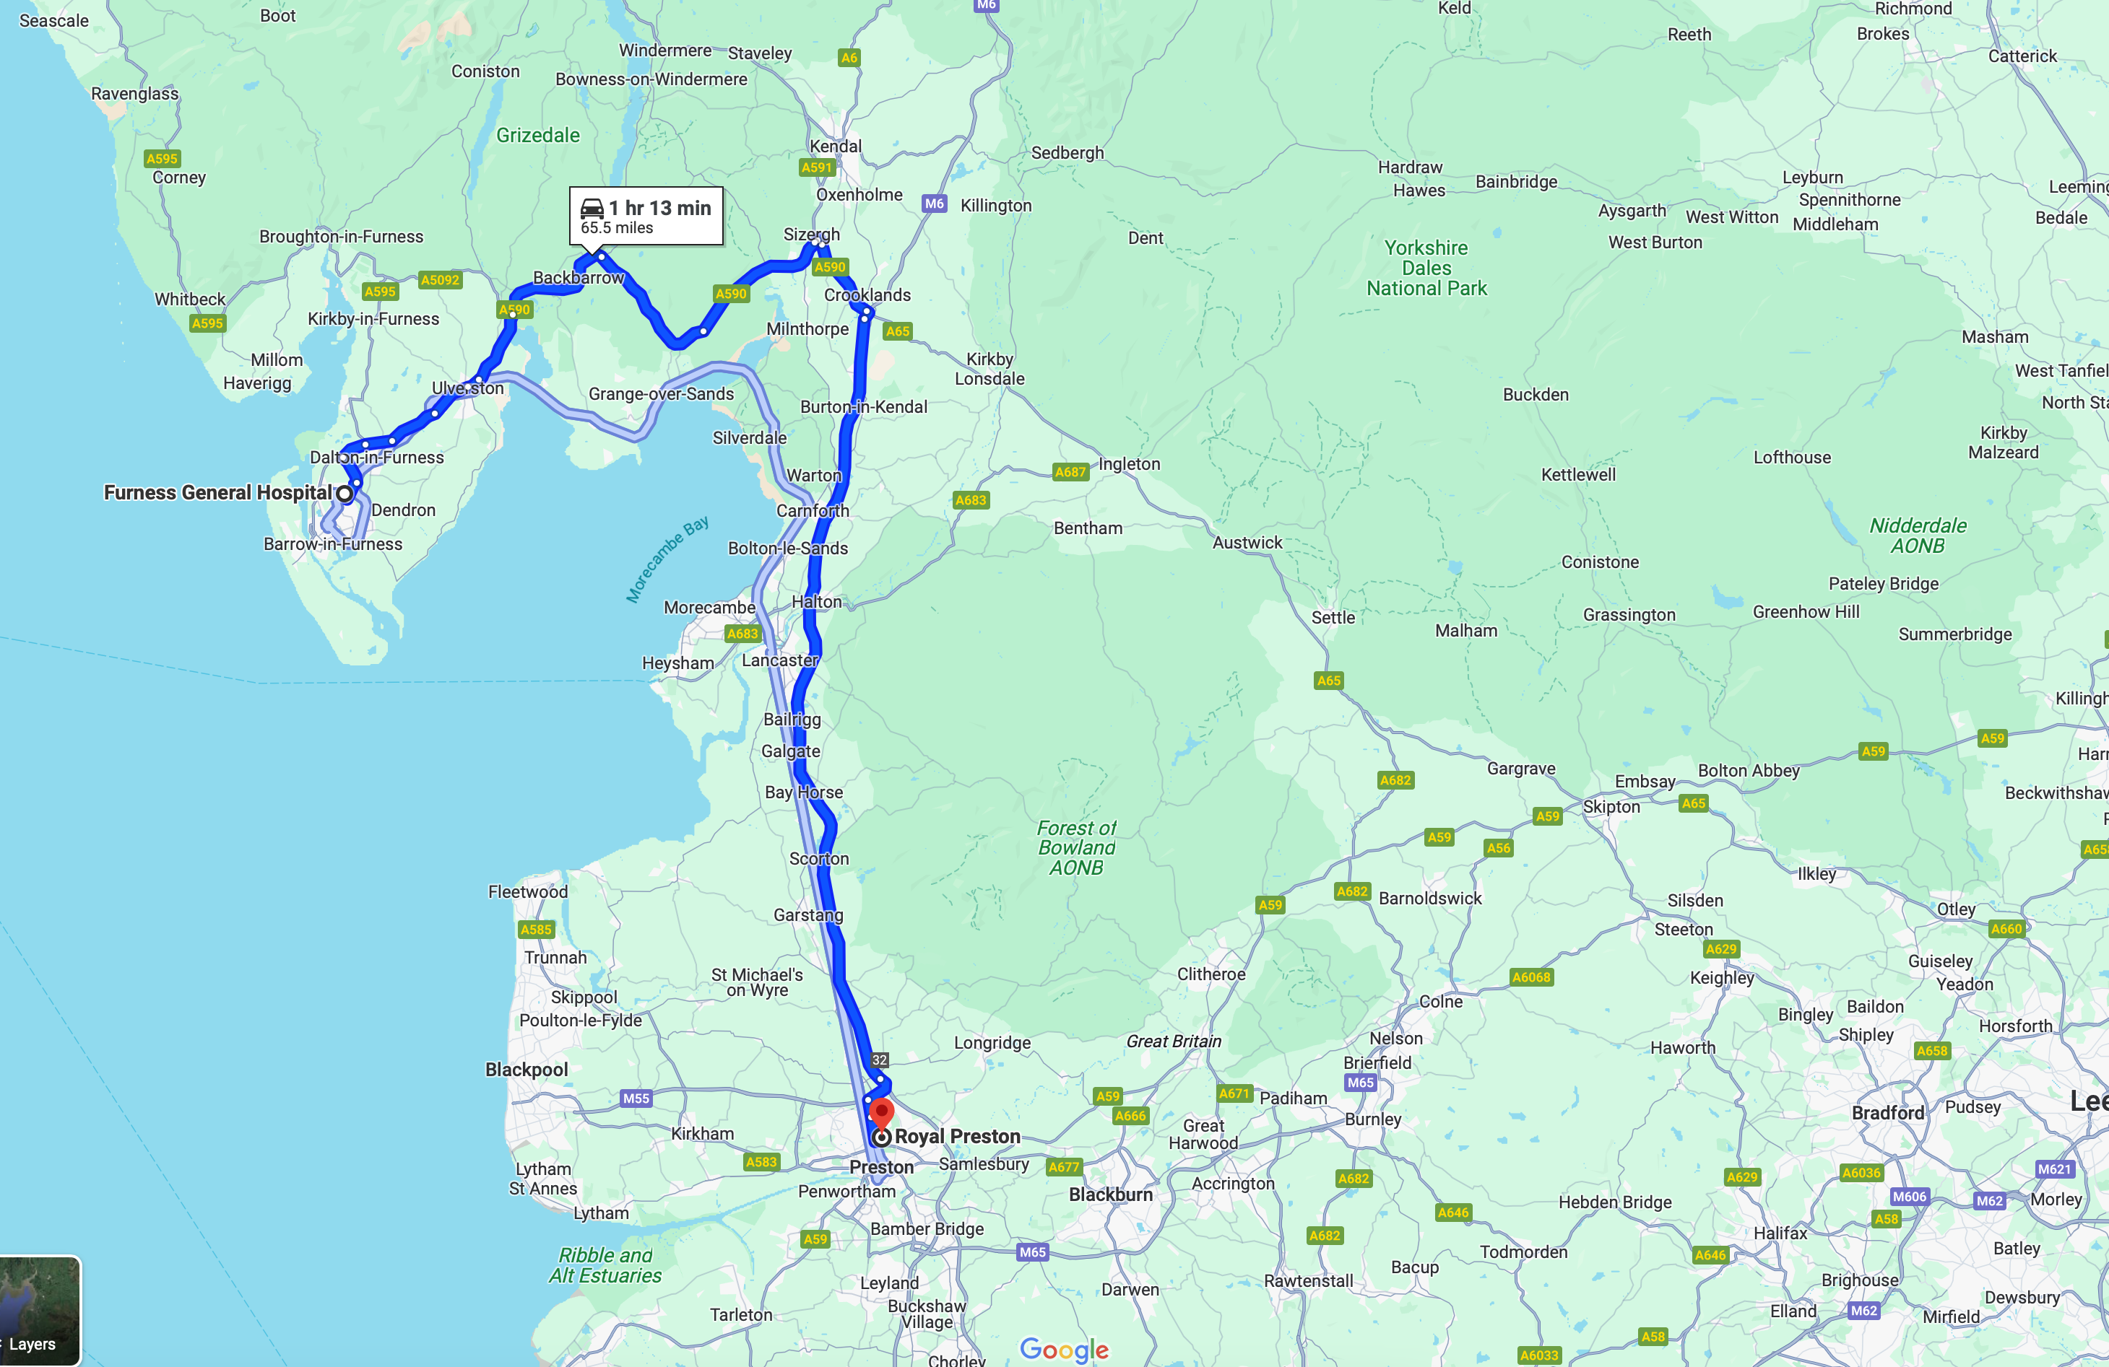
Model 4 – Mobile Capacity

Slide 19
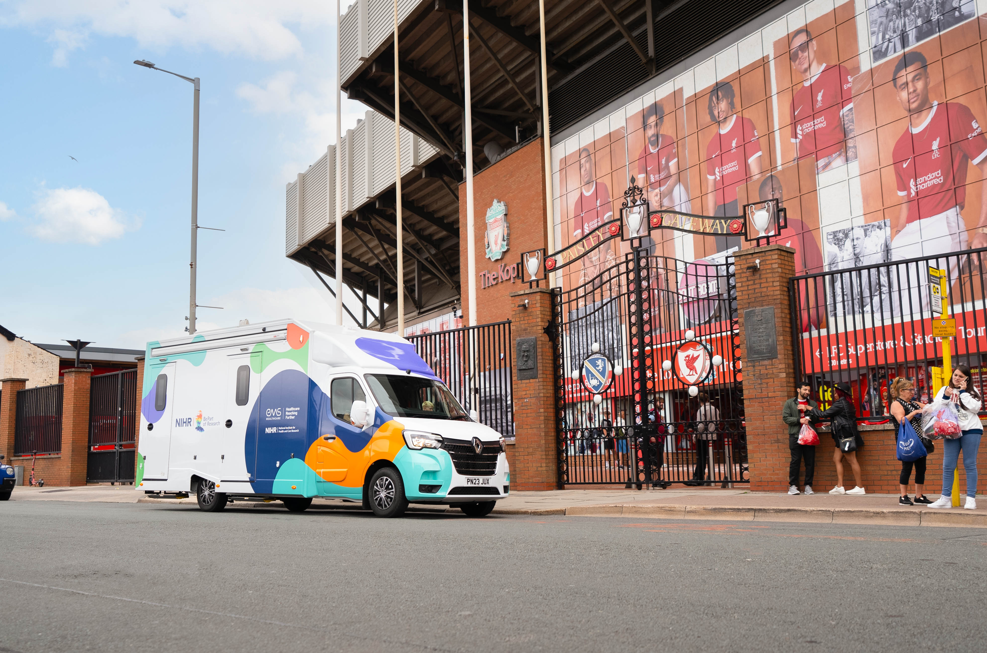
Model 4 – Mobile Capacity
Allows a trial site to move activity from the hospital to the patients
Van functions as a mobile part of the main trial site
Contracts & governance unchanged
Improves access to underserved populations

Slide 20
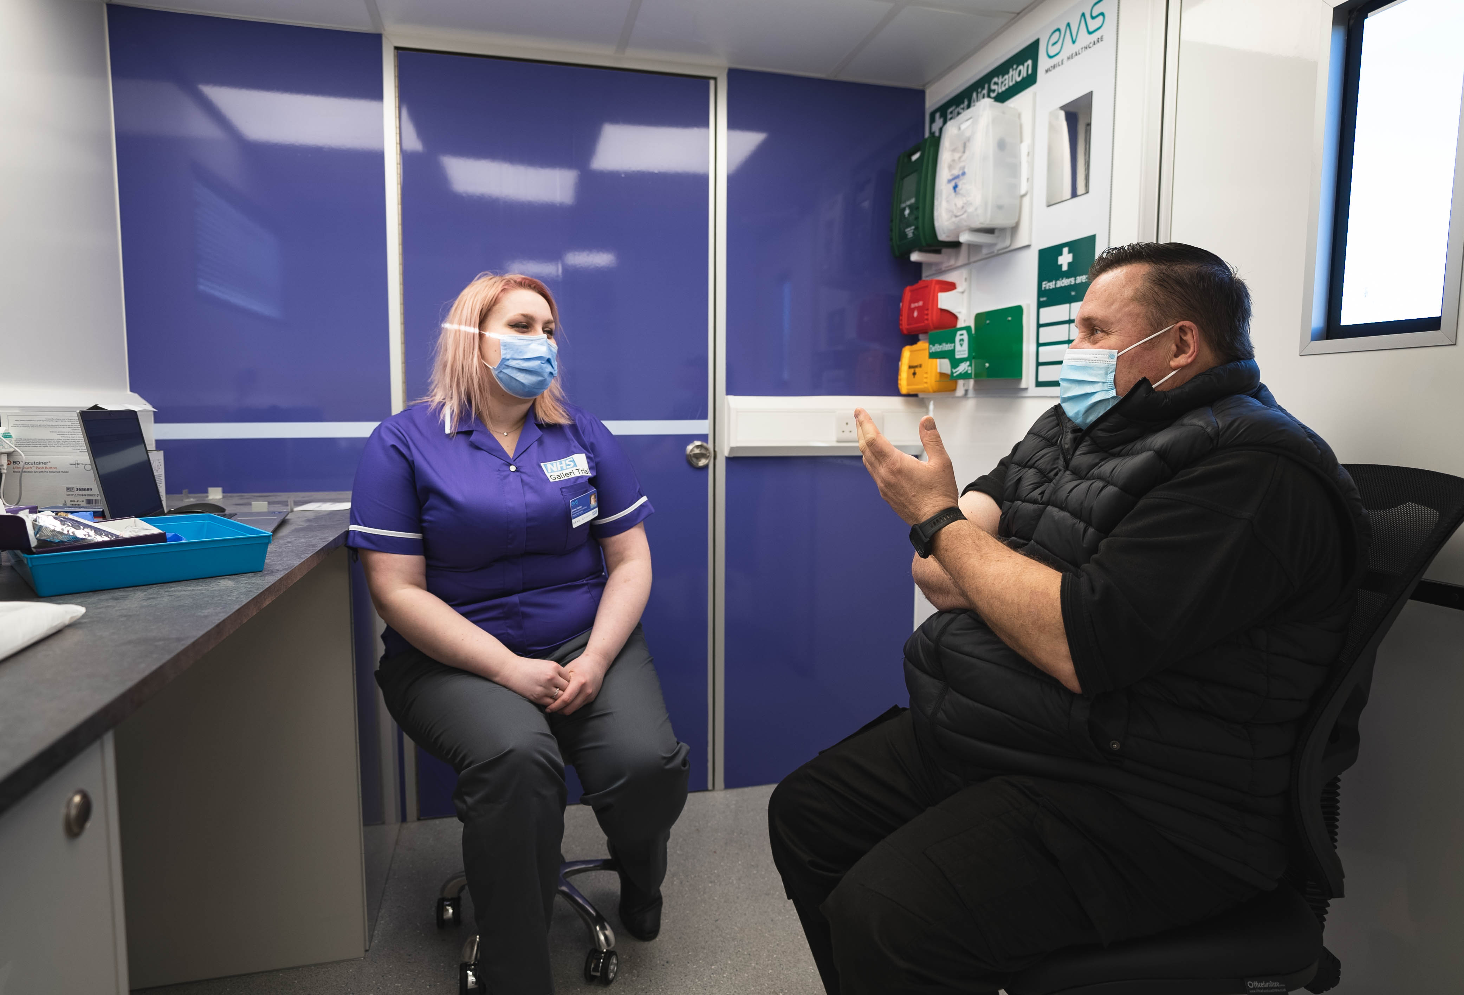
Model 4 – Mobile Capacity
Staff are research nurses with honorary contract at trial site & on study delegation log
Unit travels to remote location and patients visit the unit, consent and have ctDNA test

Slide 21
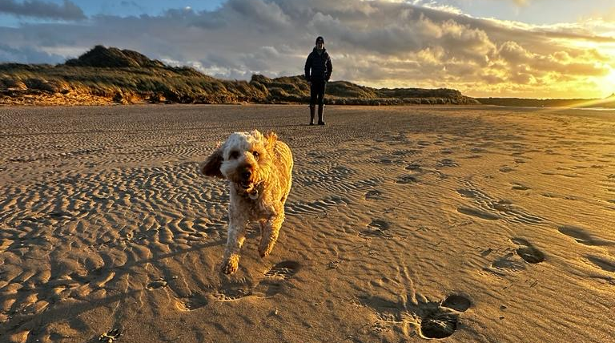
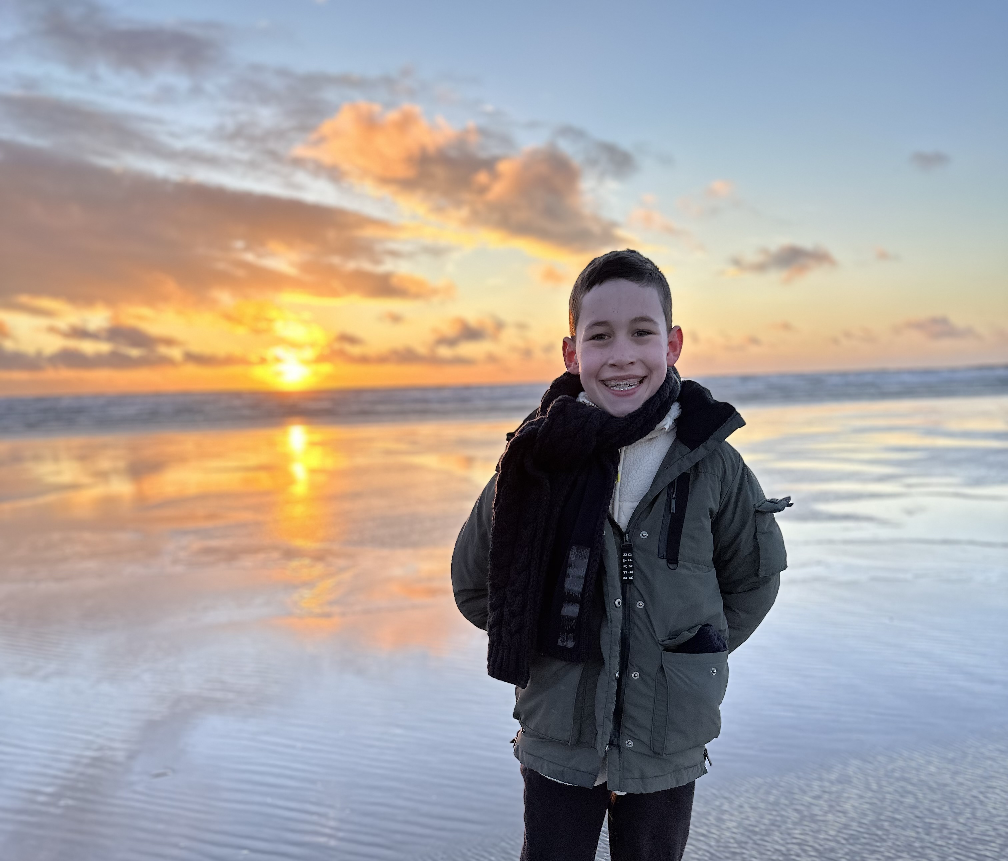
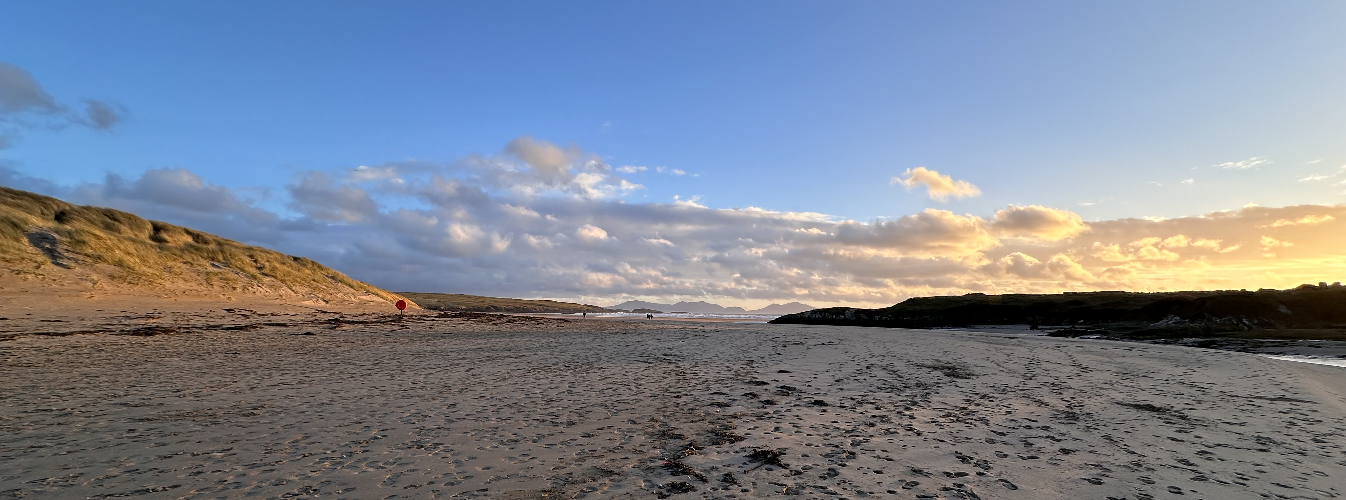
Increasing efficiency in screen heavy trials

Slide 22
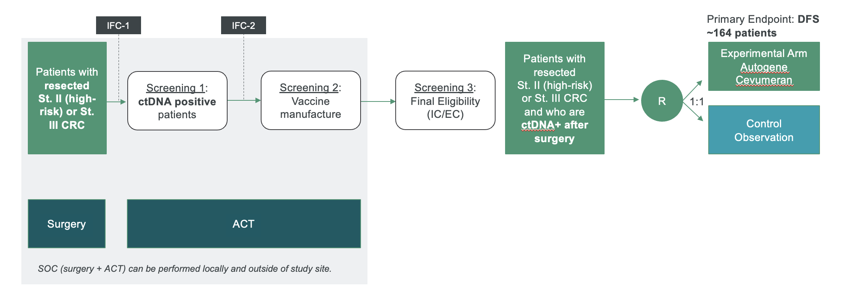
All the burden on the local PI = single point of failure
PI activity
Effort ∝ reward
  100 patient conversations & consents = 6 randomisations

Slide 23
Focus PI activity on PI skillsets
Devolved activity
PI activity
Effort ∝ reward
  15 patient conversations & consents = 6 randomisations

Slide 24


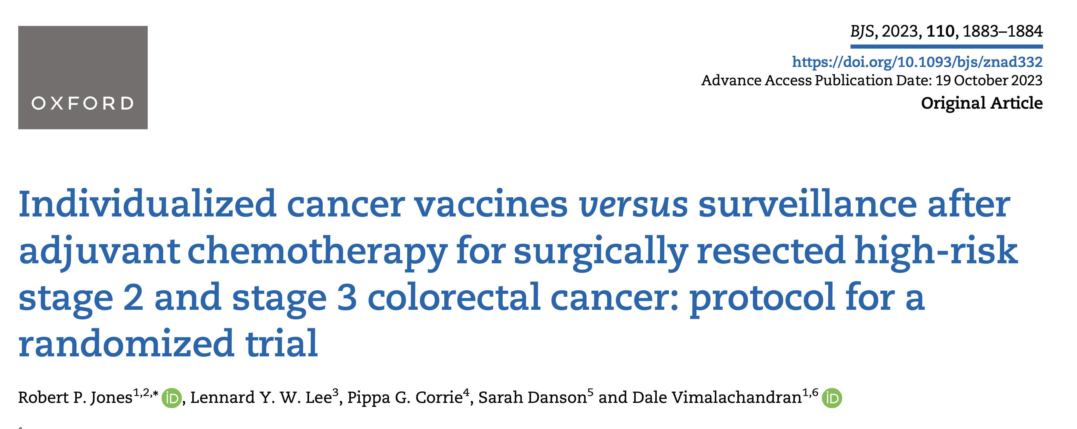
Devolved activity - use surgeons to identify patients
Surgical team A
Surgical team B
Surgical team C
Surgical team D
Surgical team E
Awareness in local MDT discussions
Record in MDT outcomes

Slide 25
Devolved activity - use surgeons to introduce trial
Referring Surgical Team
Trial Team
Colorectal surgery
Surgical
OPD
Oncology
OPD
Adjuvant chemo
Discussion
PIS
Contact
Consent
ctDNA

Slide 26
Focus PI Activity on PI Skillset
Referring Surgical Team
Trial Team
Associate PI
&
Research Nurse
Surgeons
PI Activity
Colorectal surgery
Surgical
OPD
Oncology
OPD
Adjuvant chemo
Discussion
PIS
Contact
Consent
ctDNA

Slide 27
e-PIS to drive screening
Referring Team
Trial Team
Associate PI
&
Research Nurse
Surgeons
PI Activity
Colorectal surgery
Surgical
OPD
Oncology
OPD
Adjuvant chemo
Discussion
e-PIS
Contact
Consent
ctDNA

Slide 28
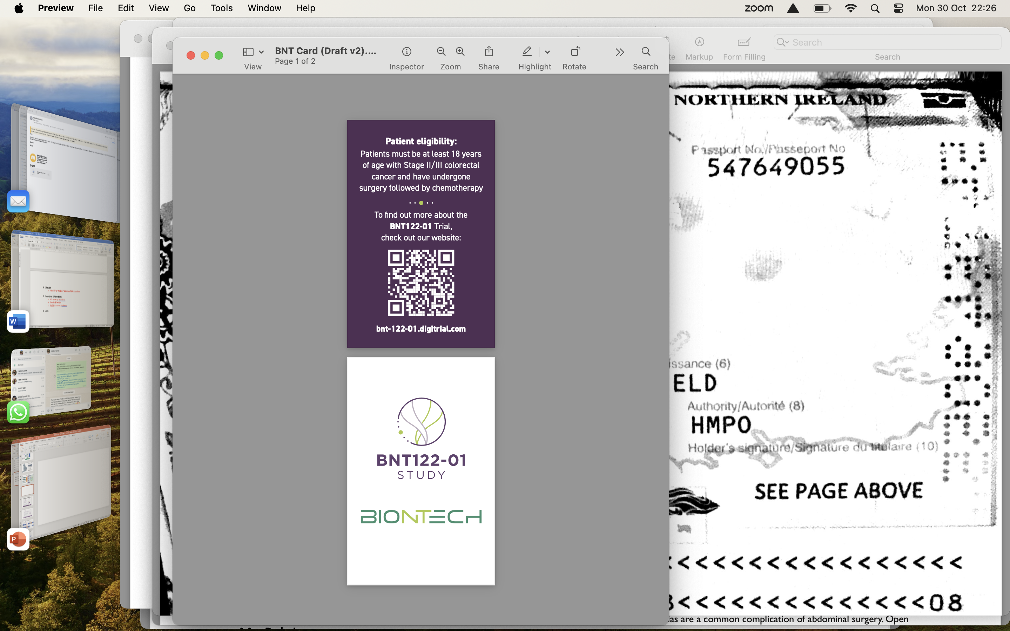
Devolving recruitment from the hub

Slide 29


Slide 30
Does it work?
Site Name | City | Date of Activation | # of Pts Screened
Velindre NHS Trust, Velindre Cancer Centre | Cardiff | 02MAY2023 | 39
Queen Elizabeth Hospital Birmingham-University Hospitals Birmingham NHS Foundation Trust | Birmingham | 31MAR2023 | 30
The Clatterbridge Cancer Centre NHS Foundation Trust | Bebington | 30MAY2023 | 29
The Christie NHS Foundation Trust | Manchester | 29JUN2023 | 6
University College London Hospitals NHS Foundation Trust | London | 19JUL2023 | 8
The Royal Marsden NHS Foundation Trust | Sutton | 29JUN2023 | 0
Royal Marsden Hospital | London | 30JUN2023 | 2
Barts Health NHS Trust/Queen Mary University of London | London | 24AUG2023 | 5
Guy’s and St Thomas’ NHS Foundation Trust | London | 11SEP2023 | 5
Torbay Hospital - South Devon Healthcare NHS Foundation Trust | Torquay | 12OCT2023 | 5
Royal Preston Hospital - Lancashire Teaching Hospitals NHS Foundation Trust | Preston | 30NOV2023 | 0
Gartnavel Royal Hospital – NHS Greater Glasgow and Clyde (selected in May 2023) | Glasgow | 30NOV2023 | 0
The Royal Free Hospital - Royal Free London NHS Foundation Trust | London | 31JAN2024 | 0
The Newcastle upon Tyne Hospitals NHS Foundation Trust - Freeman Hospital | Newcastle upon Tyne | 29JAN2024 | 0
129 recruited
15 ctDNA +ve
6 randomised
>80% since Oct 23

Slide 31
In summary
mRNA cancer vaccines are exciting – for many solid organ cancers!
BNT-122 first-in-class for mRNA vaccine studies
UK is a global leader
Adapting recruitment models to reflect standard of care brings huge benefits
Adapting trial design to leverage embedded skillsets reaps benefits

Slide 32

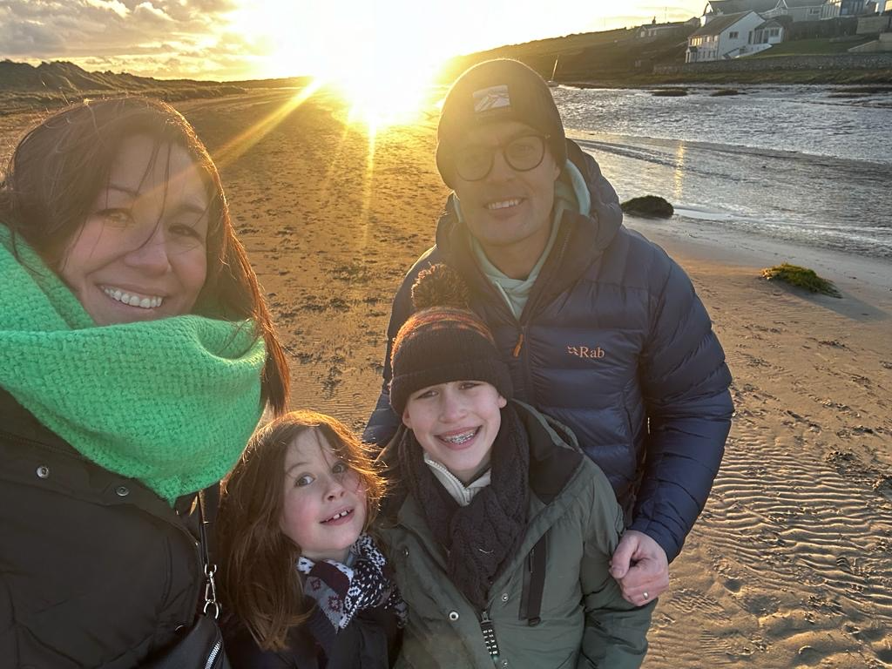




Thankyou
robjones@liv.ac.uk

