Slide 1
SWAG Urology Update
January 2024

Slide 2
Topics
Remote Monitoring System – Follow Up
Prostate Dashboard
Active Surveillance Module
MDT Efficiency
Notes:
Thank you for inviting us to your session today. We are going to give you an update of latest news/developments on SCR from a Urology perspective. To help me, I have Ben & Chris from our Requirements Analyst Team – these are the key areas we are going to cover…….
Ben is going to do a short demo of RMS and touch on the Active Surveillance work that has just started
Chris has been working on the Prostate Dashboard
Also participating in the audience today we have 2 prominent clinicians who we work with: Nick BC on the prostate dashboard, and Neil Trent, our Clinical Safety Officer……I am sure they will chip in as appropriate
As we don’t have much time I would be grateful if we could try and manage questions at the end?
For those of you who are on Teams, please feel free to add questions via the Chat facility

Slide 3
DataFlows
(2ww)
Diag 28 days
Ref/Tx 31/62 days
DTT 31 days
Personalised FU
Rapid Diagnostics
MDT Summary
Anticancer drugs
Follow Up Plan
Referral
Agree Diagnosis
Teletherapy
Test Results
Presentation
Brachytherapy
Review
Agree Tx Plan
Investigations
Surgery
Palliative
CNS Contacts
Diagnosis
Finalise Staging
CNS HNA
Treatment Plan
CNS Care Plans
eTertiary
Clinical
Diagnostics
Clinical
Treatments
SCR
Other Org
Patient
Portal
PAS/EPR
Macmillan
Notes:
This is a busy slide, which we will be coming back to again throughout the presentation. It represents the whole patient pathway from referral to followup. Like so many applications, you will be familiar with some aspects of the system, but not all, like using the MDT function or the CNS Module. How Trusts use our application will vary from site to site – but as a minimum it will be used for CWT, COSD and national audit reporting plus MDT.
The links at the bottom are where we have interfaces to pull data from other systems and utilize data from source

Slide 4
DataFlows – Remote Monitoring
(2ww)
Diag 28 days
Ref/Tx 31/62 days
DTT 31 days
Personalised FU
Rapid Diagnostics
MDT Summary
Anticancer drugs
Follow Up Plan
Referral
Agree Diagnosis
Teletherapy
Test Results
Presentation
Brachytherapy
Review
Agree Tx Plan
Investigations
Surgery
Palliative
CNS Contacts
Diagnosis
Finalise Staging
CNS HNA
Treatment Plan
CNS Care Plans
eTertiary
Clinical
Diagnostics
Clinical
Treatments
SCR
Other Org
Patient
Portal
PAS/EPR
Macmillan
Notes:
Firstly we are going to focus on the follow-up management of patients. This is done using our Remote Monitoring System – known as RMS and highlighted in the lovely pink!
Our RMS system has an interface to share data with a patient portal – we are still waiting for that momentus moment to happen!

Slide 5
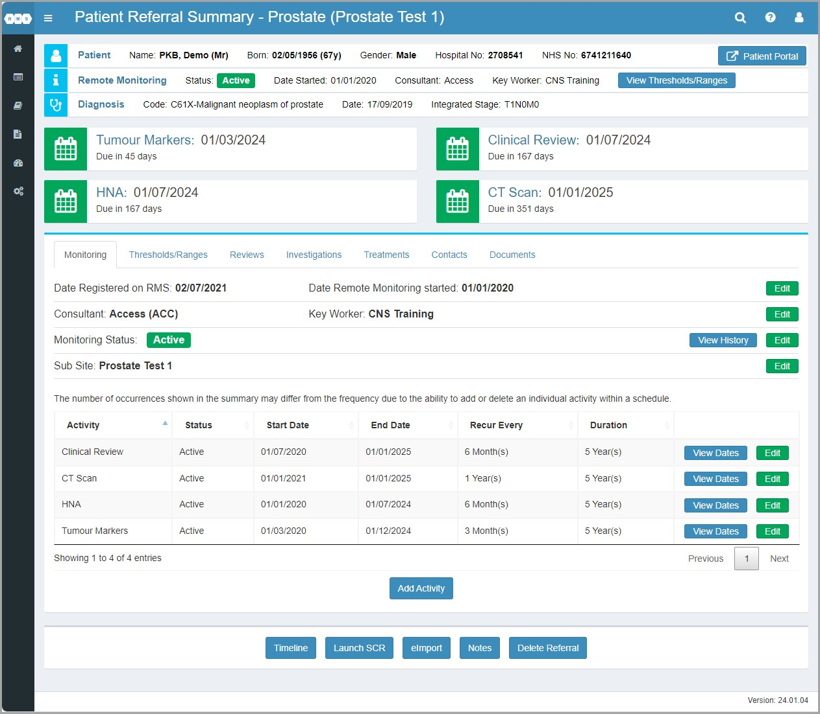
Patient Referral Summary
Notes:
RMS is used for patient followup following end of treatment and now covers ALL Urology cancer conditions.
The protocols you will have agreed for follow-up management are used to setup the templates in our system.
I am now going to hand you over to Ben, one of our Analysts, to give you a quick demo of the latest features

Slide 6
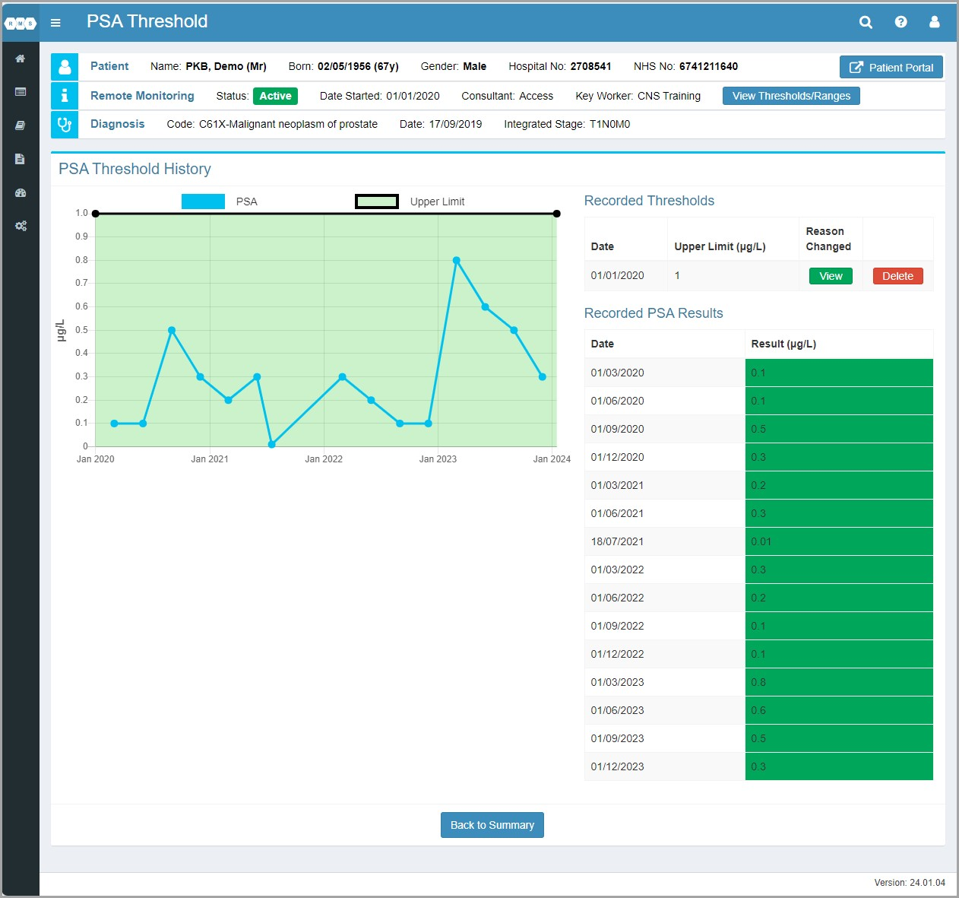
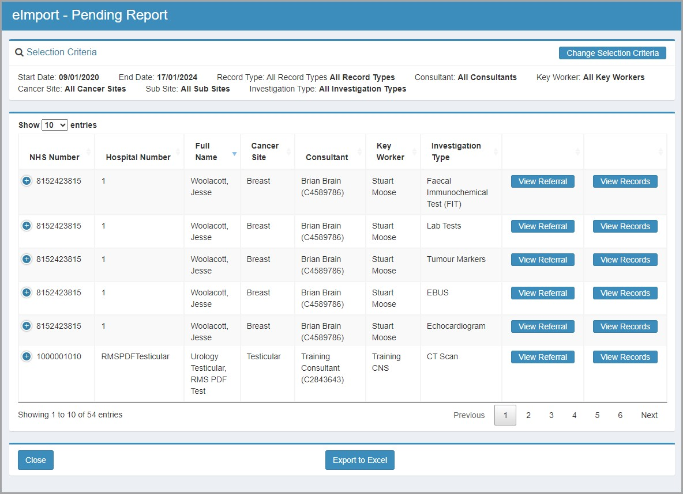
Notes:
As a discipline you will have agreed your follow-up protocols for prostate patients and this is how the system is setup to manage the type of activities, a patient would follow
The design of this allows CNSs and Support workers to effectively manage longterm followup and only refer patients back to MDT as clinical situations require intervention into that patients care
Trusts that work efficiently with this system have implemented our interfaces which bring over the tumour markers/blood results directly from the lab. Collecting of results has evolved and now requires upper and lower thresholds to be set for tests, which can be refined for individual patients.
The setting up of tests as part of the interfacing between systems has to be signed off by each trust.
To help manage the review of pending results not only do we have a patient level search but we have developed in a results pending report for all outstanding patient results to help speed up the review process.
New lab tests are introduced for each release and tumour site as the product develops
Ben is now going to give a short demo?

Slide 7
DataFlows – Prostate Dashboard
(2ww)
Diag 28 days
Ref/Tx 31/62 days
DTT 31 days
Personalised FU
Rapid Diagnostics
MDT Summary
Anticancer drugs
Follow Up Plan
Referral
Agree Diagnosis
Teletherapy
Test Results
Presentation
Brachytherapy
Review
Agree Tx Plan
Investigations
Surgery
Palliative
CNS Contacts
Diagnosis
Finalise Staging
CNS HNA
Treatment Plan
CNS Care Plans
eTertiary
Clinical
Diagnostics
Clinical
Treatments
SCR
Other Org
Patient
Portal
PAS/EPR
Macmillan
Notes:
Our next update is on the Prostate Dashboard.
Here we are looking at the referral, diagnosis & treatment data collected in SCR that will help populate the Prostate Dashboard

Slide 8
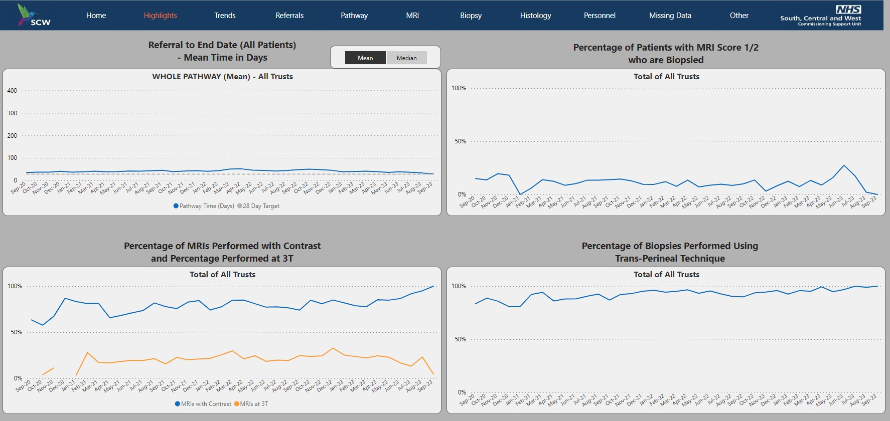
Highlights Overview
Notes:
Nick Burns Cox approached us in conjunction with SCW Commissioning group about a dashboard they had designed and were using across the SW to help discuss variations in clinical practice. Very exciting to see that this data was being of use to exam outcomes and clinical practice. However the method to capture is time consuming as it is being done as a separate data collection exercise.
Our team investigated the data requirements and found that the majority (75%) already existed in SCR. So wind forward 10 months, next week we hope to sign off on the data items and definitions and can start work on developing a script for SCR customers to enable electronic retrieval of these items for collation by SCW.
Chris/Nick can tell you more, or answer any question

Slide 9
DataFlows – Active Surveillance
(2ww)
Diag 28 days
Ref/Tx 31/62 days
DTT 31 days
Personalised FU
Rapid Diagnostics
MDT Summary
Anticancer drugs
Follow Up Plan
Referral
Agree Diagnosis
Teletherapy
Test Results
Presentation
Brachytherapy
Review
Agree Tx Plan
Investigations
Surgery
Palliative
CNS Contacts
Diagnosis
Finalise Staging
CNS HNA
Treatment Plan
CNS Care Plans
eTertiary
Clinical
Diagnostics
Clinical
Treatments
SCR
Other Org
Patient
Portal
PAS/EPR
Macmillan
Notes:
Now we are going to move onto Active Surveillance. This will cover pre-cancer, pre treatment and early diagnosis management. It will be a new module for our product.
One example is of patient presenting with a PSA that is rising, they have been diagnosed with cancer, but it isn’t the optimum time for treatment. Just like remote monitoring you would have a protocol in place to manage this until the right time for treatment. So you need to keep an eye on the situation.
Ben is leading this piece of work, can you tell us more about what you are doing?
(design group engagement, show page for sign up, specification end April, mock up designs)

Slide 10
Topics
Remote Monitoring – followup for all Urology cancer conditions
Prostate Dashboard – script to automate extraction of 75% data
Active Surveillance – new module being designed
MDT Efficiency
Notes:
The 3 areas we are covered are ………
Before we move to questions, I have a question for the audience, which I don’t necessarily need answers to now, but would be interested in hearing your views, about improving the efficiency of MDTs. We have worked on a 3 year project with GSTT and Deontics to prove integration of their software with ours. This is about streamlining MDTs and using Clinical Decision Support to triage out the standard of care pathways to allow for the more complex cases to be discussed. Against all the priorities we are dealing with, I would be interested in knowing whether this is something that would be useful to pursue and would prove to be a valuable component of our system?
Over to the audience for questions and or pick up questions in the Chat

