Slide 1
SWAG Cancer Patient Experience
NCPES Result 2022
LCNs and SWAG Transformation Project Manager
SWAG Delivery Group Meeting 13 Oct 2023
Winnie Lo

Slide 2
NCPES Introduction:
Annual survey, 12th iteration of the survey
First undertaken in 2010
Commissioned and managed by NHS England
Picker is responsible for the technical design, implementation and survey analysis
Aim and Objectives:
To monitor national progress on experience of cancer care
To provide information to drive local quality improvements
To assist commissioners and providers of cancer care
To inform the work of the various charities and stakeholder groups supporting patients
The questionnaire was reviewed in 2021 to reflect changes to cancer services and commitment to cancer care. (NHS Long Term Plan)

Slide 3
Methodology:
Mixed methods
Who were included?
NHS patients with cancer diagnosis
All adult (aged 16 or over)
Discharged from an NHS trust after an inpatient episode or day case attendance for cancer related treatment
Experience of cancer related treatment in the months of April, May and June 2022
Questionnaires: by post, online option or phone (interpreters)
Comparability:
2021 and 2022

Slide 4
Understanding the results:
Case-mix adjustment:
Adjusted scores: understand how an Alliance is performing given their patient population (Factors: gender, age, ethnicity, deprivation, cancer type)
Unadjusted data: show the actual patients' responses
Case-mix adjusted data and expected ranges: understand whether the results are significantly higher or lower than national results
Scoring methodology:
61 questions were scored - directly to patient experience
Q59 was scored based rating on a scale of 0 to 10
Suppression rules: Data is suppressed for two reasons: rid of unreliable results based on very small number, preventing individuals from being identifiable.

Slide 5
Results:
Response Rate:
National: 53% (133 Trusts| 61,268 responses) 55% in 2021
SWAG: 58% (6 Trusts| 3,417 responses) 59% in 2021
Trusts:
Gloucester: 61%
North Bristol: 61%
Salisbury: 63%
Somerset: 64%
Royal United Bath: 61%
United Hospital Bristol & Weston: 51%
Mode of response:

Slide 6
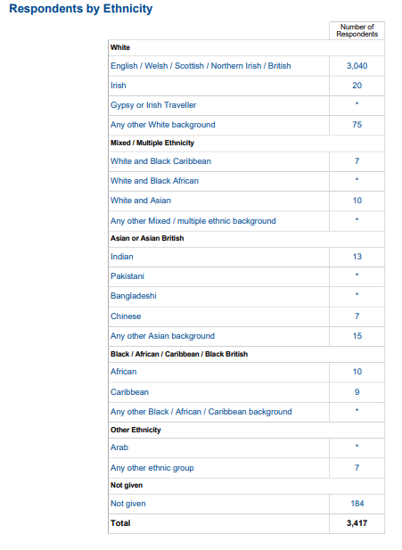
Responses by Patient characteristics:
Responses by Ethnicity:
 | National |  | SWAG
Ethnicity | No. of respondents | % of responses | No. of respondents | % of responses
White | 53,849 | 87.9% | 3,135 | 91.8%
Asian | 1,618 | 2.6% | 25 | 0.7%
Black | 1,009 | 1.6% | 26 | 0.8%
Mixed | 539 | 0.9% | 17 | 0.5%
Other | 338 | 0.6% | 7 | 0.2%
Not given | 3,915 | 6.4% | 184 | 6%
Total | 61,268 | 100% | 3,417 | 100%
Patient Characteristics:
By Gender
sexual orientation
Age
IMD quintile
long term conditions
different tumour groups
cancer types were reported.
By other characteristics
Further analysis

Slide 7
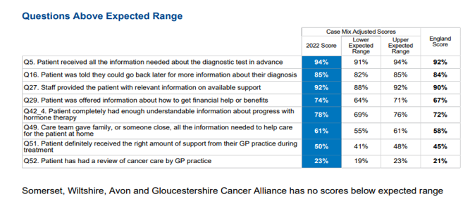
SWAG results:
Overall Experience within SWAG:
Captured by Q59 using scale 0-10 from very poor to very good.
SWAG Cancer Alliance scored at 8.9 (same as the England score) from 9.0 in 2021
Questions Above and Below Expected Range:
No question scored below Expected range
Q58 showed that SWAG is within the lower of the range.
This finding is consistent with last year

Slide 8
SWAG results (cont.):
Questions that scored less than previous year: Diagnostic, Care Planning, Hospital Care
Questions that scored higher than previous year: Q12 (finding out that you had cancer), Q22 (Deciding on the best treatment), Q52 (Patient has had a review of cancer care by GP practice)
The scores in the comparability tables, offered an indication of direction of changes, year on year, provide a signal in areas for continuous improvement and evidence for assurance in progress.

Slide 9
Urology Responses Prostate + other urological
Individual Trusts | responses
University Hospitals Bristol and Weston NHS FT | 21+23
Gloucestershire Hospitals NHS FT | 45+31
Somerset NHS FT | 67+23
Royal United Hospital Bath NHS FT | 53+20
Salisbury NHS FT | 35+34
North Bristol NHS FT | 142+47
Yeovil District NHS FT | 24+18
TOTAL: | 642
SWAG Urology overall rating of care = 8.8/10
SWAG overall rating of care = 8.9/10 (national average)

Slide 10
SWAG Urology Highest Scores > 90%
 | Question | Prostate SWAG | Urology SWAG | SWAG Average | National Average
5 | Patient received all the information needed about the diagnostic test in advance | 95 | 92 | 94 | 92
9 | Enough privacy was always given to the patient when receiving diagnostic test results | 96 | 93 | 95 | 95
19 | Patient found advice from main contact person was very or quite helpful | 95 | 96 | 96 | 95
25 | A member of their care team helped the patient create a plan of care to address any needs or concerns | 93 | 96 | 94 | 93
26 | Care team reviewed the patients care plan with them to ensure it was up to date | 97 | 97 | 98 | 99
27 | Staff provided the patient with relevant information on available support | 94 | 89 | 92 | 90
36 | Hospital staff always did everything they could to help the patient to control pain | 90 | 80 | 86 | 84
37 | Patient was always treated with dignity and respect in hospital | 92 | 87 | 88 | 88
41 | Beforehand patient had completely enough information about surgery | 87 | 91 | 90 | 89
 | Beforehand patient had completely enough information about radiotherapy | 92 | 78 | 90 | 88
56 | The whole team worked well together | 92 | 86 | 90 | 90

Slide 11
SWAG Urology Lowest Scores < 60%
 | Question | Prostae SWAG | Urology SWAG | SWAG Average | National average
23 | Patient could get further advice or a second opinion before making decisions about their treatment. | 51 | 50 | 52 | 50
29 | Patient was offered information about how to get financial help/benefits | 68 | 49 | 74 | 67
47 | Patient felt possible long-term side effects were definitely explained in a way they could understand in advance of their treatment | 66 | 55 | 60 | 59
48 | Patient was definitely able to discuss options for managing the impact of any long term side effects | 55 | 50 | 55 | 53
49 | Care team gave family or someone close, all the information needed to help care for the patient at home | 57 | 56 | 61 | 58
50 | During treatment, the patient definitely got enough care and support at home from community or voluntary services | 47 | 45 | 53 | 51
51 | Patient definitely received the right amount of support from their GP practice during treatment | 56 | 53 | 50 | 45

Slide 12
SWAG Urology Lowest Scores < 60%
 | Question | Prostae SWAG | Urology SWAG | SWAG Average | National average
52 | Patient has had a review of cancer care by GP practice | 24 | 24 | 23 | 21
53 | After treatment, the patient definitely could get enough emotional support at home from community or voluntary services | 35 | 39 | 35 | 31
58 | Cancer research opportunities were discussed with patient | 37 | 26 | 41 | 43
4 questions did not score due to lower than 10 responses (immunotherapy)

Slide 13
Suggested themes for Collaborative working
Celebrate what is going well
CNS teams and support/advice given (Q19, 41)
Team working well together(Q 56)
Recognise opportunities for improvement
Cancer research opportunities (Q58)
Information on side effects and management (Q47, 48)
Ability to influence cancer care reviews with EOTS (Q 52)

Slide 14
Next Steps:
Share and disseminate NCPES 2022 findings to Board, CAGs, Delivery groups and various forums
Continue to develop a SWAG CPES dashboard to enable further data analysis
Gain insights into patient experiences at more granular level
Highlight areas of challenges associated with health inequalities
Identify common themes of challenges and good practices across SWAG, trusts and primary care
Agree recommendation for improvement plans and opportunity for collaboration
Further embed and expand access to PCS
Triangulation with ongoing QoL survey results
Consider various strategies for increasing survey uptake for the next NCEPS in 2023

Slide 15
Thank you!

