Slide 1
Prostate Cancer Staging: A review of practice
Jonathan Aning
Consultant Urological Surgeon & Honorary Associate Professor

Slide 2
Staging of clinically localised prostate cancer
WHY DO WE STAGE CANCER?
To combine patients with a projected similar clinical outcome.
To inform discussion about treatment and prognosis with patients.
BONUS
To facilitate the design of clinical trials on homogeneous populations
To facilitate the comparison of global data
Enables development of recommendations for treatment for groups
EAU Guidelines 2023

Slide 3
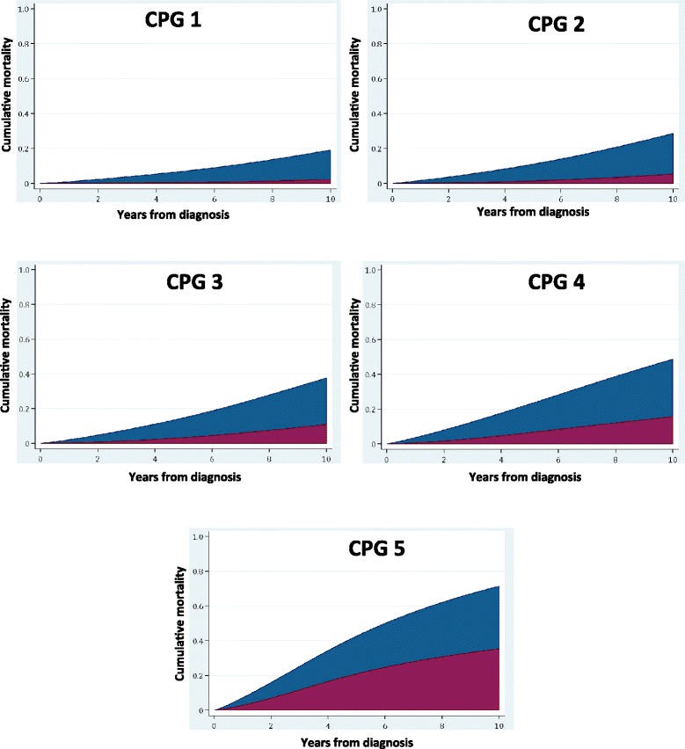
Prognosis of clinically localised prostate cancer ‘today’
BMC Medicine 16:31 2018
Notes:
Background: The purpose of this study is to validate a new five-tiered prognostic classification system to better discriminate cancer-specific mortality in men diagnosed with primary non-metastatic prostate cancer. Methods: We applied a recently described five-strata model, the Cambridge Prognostic Groups (CPGs 1-5), in two international cohorts and tested prognostic performance against the current standard three-strata classification of low-, intermediate- or high-risk disease. Diagnostic clinico-pathological data for men obtained from the Prostate Cancer data Base Sweden (PCBaSe) and the Singapore Health Study were used. The main outcome measure was prostate cancer mortality (PCM) stratified by age group and treatment modality. Results: The PCBaSe cohort included 72,337 men, of whom 7162 died of prostate cancer. The CPG model successfully classified men with different risks of PCM with competing risk regression confirming significant intergroup distinction (p < 0.0001). The CPGs were significantly better at stratified prediction of PCM compared to the current three-tiered system (concordance index (C-index) 0.81 vs. 0.77, p < 0.0001). This superiority was maintained for every age group division (p < 0.0001). Also in the ethnically different Singapore cohort of 2550 men with 142 prostate cancer deaths, the CPG model outperformed the three strata categories (C-index 0.79 vs. 0.76, p < 0.0001). The model also retained superior prognostic discrimination in the treatment sub-groups: radical prostatectomy (n = 20,586), C-index 0.77 vs. 074; radiotherapy (n = 11,872), C-index 0.73 vs. 0.69; and conservative management (n = 14,950), C-index 0.74 vs. 0.73. The CPG groups that sub-divided the old intermediate-risk (CPG2 vs. CPG3) and high-risk categories (CPG4 vs. CPG5) significantly discriminated PCM outcomes after radical therapy or conservative management (p < 0.0001). Conclusions: This validation study of nearly 75,000 men confirms that the CPG five-tiered prognostic model has superior discrimination compared to the three-tiered model in predicting prostate cancer death across different age and treatment groups. Crucially, it identifies distinct sub-groups of men within the old intermediate-risk and high-risk criteria who have very different prognostic outcomes. We therefore propose adoption of the CPG model as a simple-to-use but more accurate prognostic stratification tool to help guide management for men with newly diagnosed prostate cancer

Slide 4
Quality and impact of present staging
Bone scans for CPG 4 and 5
CT scans not necessary for CPG 4 unless PSA >50
CPG 5 CT and Bone scan
European Urology Open Science 2022 123-125

Slide 5
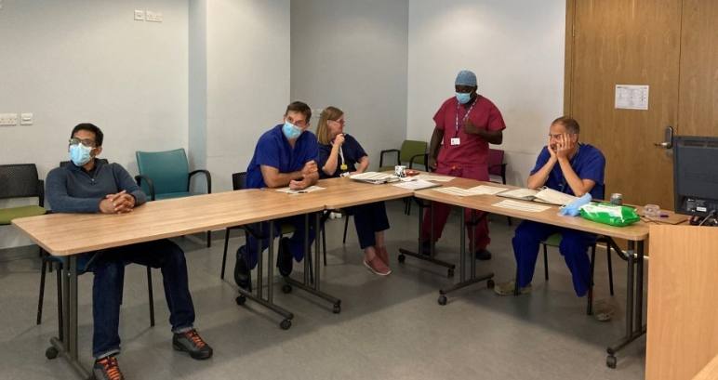
Surgical Reflections ( PERSONAL ) on PSMA staging
PRO | CON
Definitely see more lesions | Accessibility
Opportunity for real utility in high-risk disease | Definitely see more lesions BUT not all
 | No data that change in management will improve mortality outcomes
 | Unevidenced - Will Rogers Effect
Notes:
Staging is a snapshot process
Is what you see cancer / more importantly is there no more cancer
An image of cancer = a snapshot
Maybe a more systematic approach necessary.

Slide 6
WE NEED TO IMPROVE PRACTICE AND HAVE CONSENSUS
There actually is very little evidence in this space
Opportunity to save resource + minimise treatment variation

Slide 7
Proposal
Establish what each unit in the region is doing
Regional audit of practice and outcomes – 2015-2020
Identify all men dx (exclude men presenting with mets / PSA>100)
Categorise by PSA at dx 0-10,10-20,20-30,30-50,50+
MRI stage
GG
CPG
Validation PSMA PET Audit / registry
BASED ON DATA – Implement SWAG Guidelines

