Slide 1
Focal Therapy for Prostate Cancer
Miss Lucy Simmons
Royal United Hospitals Bath

Slide 2
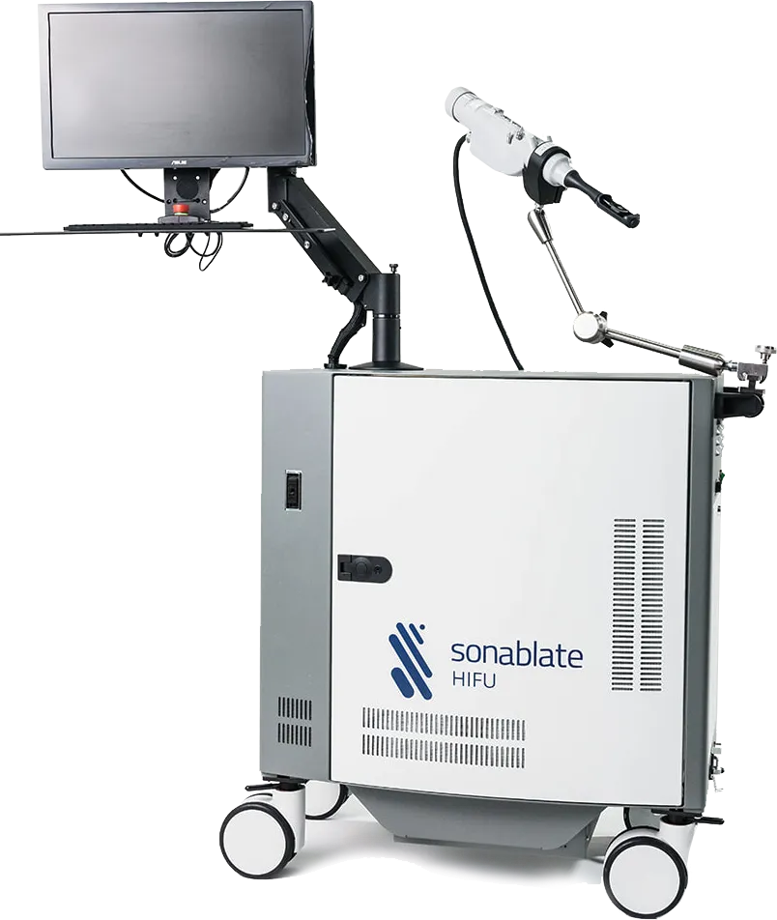
HIFU side effects
Current UK data from prospective trials and the NICE approved HEAT and ICE registry data of focal HIFU (n=1,367) and focal cryotherapy (n=215)
incontinence after focal therapy is 0-2% (radical therapy can lead to incontinence in 15-20%)
erectile dysfunction occurs in 5-15% of men (radical therapy rates vary between 30% and 60%).
Notes:
Reddy D, Peters M, Shah TT, van Son M, Tanaka MB, Huber PM, Lomas D, Rakauskas A, Miah S, Eldred-Evans D, Guillaumier S, Hosking-Jervis F, Engle R, Dudderidge T, Hindley RG, Emara A, Nigam R, McCartan N, Valerio M, Afzal N, Lewi H, Orczyk C, Ogden C, Shergill I, Persad R, Virdi J, Moore CM, Arya M, Winkler M, Emberton M, Ahmed HU. Cancer Control Outcomes Following Focal Therapy Using High-intensity Focused Ultrasound in 1379 Men with Nonmetastatic Prostate Cancer: A Multi-institute 15-year Experience. Eur Urol. 2022 Apr;81(4):407-413..
Shah TT, Peters M, Eldred-Evans D, Miah S, Yap T, Faure-Walker NA, Hosking-Jervis F, Thomas B, Dudderidge T, Hindley RG, McCracken S, Greene D, Nigam R, Valerio M, Minhas S, Winkler M, Arya M, Ahmed HU. Early-Medium-Term Outcomes of Primary Focal Cryotherapy to Treat Nonmetastatic Clinically Significant Prostate Cancer from a Prospective Multicentre Registry. Eur Urol. 2019 Jul;76(1):98-105.
At AUA 2022, Imperial presented the UK’s long-term cancer control outcomes of 1379 patients who underwent treatment with focal HIFU (Sonablate, Sonablate Corp.) across 13 UK sites since 2005.
Whilst many have criticised focal therapy for treating men with low-risk disease that are eminently suitable for active surveillance (often forgetting that they themselves have removed or irradiated thousands of prostate with low-risk cancer), it is worth noting that 93% of patients in this focal HIFU series had D’Amico intermediate or high-risk localised disease (79% had Grade Group >/=2).
Patients were given up to two focal HIFU sessions if required.
Reassuringly, we demonstrated a 7-year failurefree survival (a composite of transition to whole-gland, 3rd focal, metastases or cancer-specific death), of 69%, with only 0.5% serious adverse events.
No statistically significant differences in failure free survival (FFS) were observed between patients with intermediate versus high-risk disease, although lower FFS was observed in patients with Grade Group 3 disease compared to those with Grade Group 2. 7-year metastases and cancer specific survival was 100% (99-100%

Slide 3
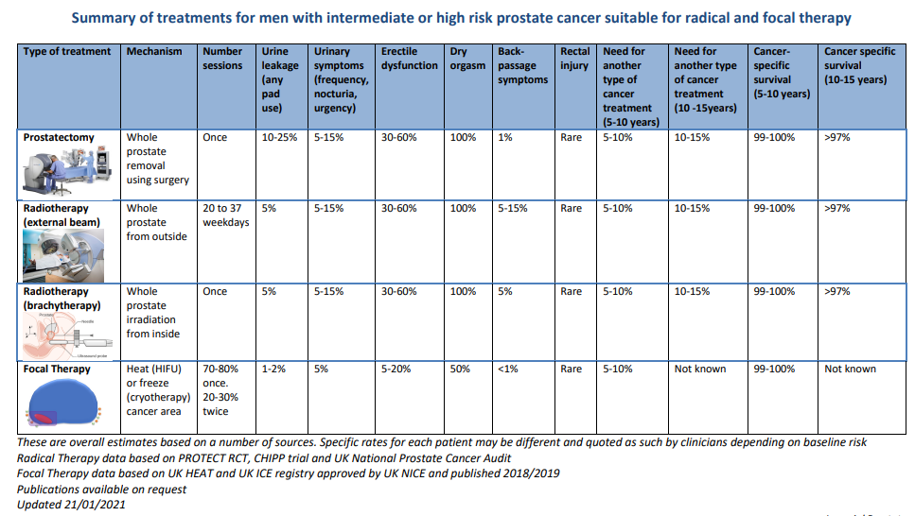

Slide 4
HIFU Inclusion Criteria
Clinical and Imaging
PSA </= 20ng/ml
Radiological T3aN0M0
Lesion no more than one quadrant on MRI –
NB –Best for posterior lesions (when cryo running will be able to focal anterior lesions also), we may also be able to consider anterior lesions in small glands (must be within 4cm of the rectal wall)
Fit for GA
Histology
Concordant with MRI
Gleason 7 (4+3 or 3+4)
Maximal 4+4 on targeted biopsy provided predominant Gleason 7 is permitted
No cancer length limit for Gleason 7
Large volume Gleason 6 if >/=6mm and MRI lesion 3,4 or 5
Allowed up to 5mm Gleason 6 in contralateral lobe (will be placed on Active surveillance for their Gl6)

Slide 6
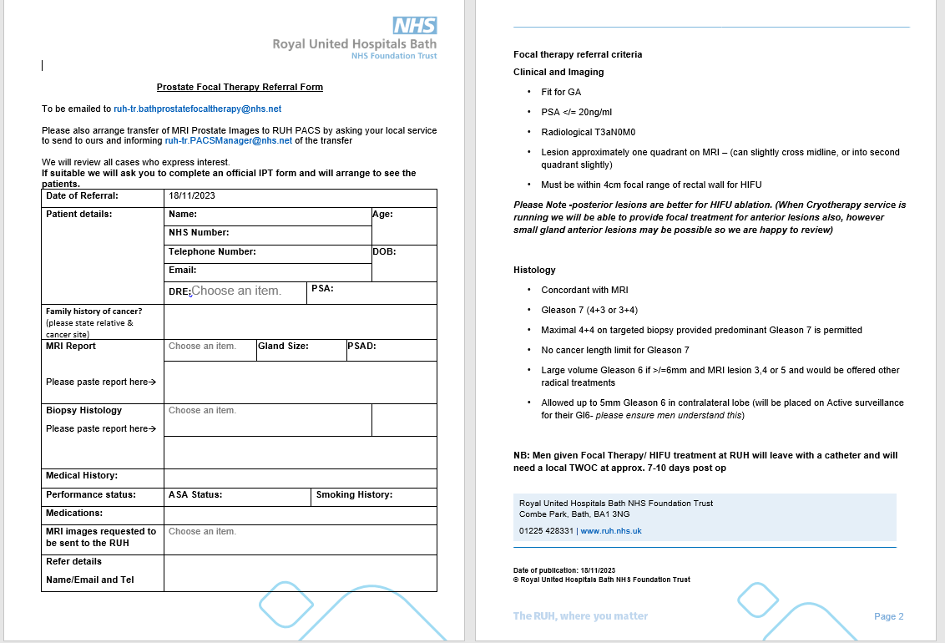
Referral Pathway
ruh-tr.bathprostatefocaltherapy@nhs.net

Slide 7
HIFU Referral Pathway
Initial email referral sent to prostate inbox
MDT co-ordinator for Referrer sends IPT form and referral to RUH
Sent back to referrer
Triaged by prostate consultants
Rejected
The IPT form needs to be the correct IPT with all of the details of the patients cancer and their treatment pathway and clock dates etc from Cancer registry on it.
Not just a secretarial IPT form please
Accepted
Sent back to referrer
First appointment with prostate consultant (Tel)
Rejected
F2F at RUH and Pre-op
Listed for “Endoscopic Oblation of Prostate”
and referred to MDT Registration
HIFU procedure
TWOC either RUH or local

Slide 8
RUH case reviews
All cases will be screened by myself or Jon McFarlane for eligibility
If felt to be eligible cases will be reviewed in our RUH MDT
Cases will then be seen Face to face for further discussion consent and pre-op
Are you going to repeat staging imaging / biopsies prior to doing focal therapy
In most cases No we will not be aiming to re-do any diagnostics, however if there is any concerns that imaging or biopsy do not confer enough info for focal we will offer patient re-staging.
Our RUH CNS team are on hand for these patients and any questions they may have. Once accepted for treatment.

Slide 9
Post op care
All men will need a TWOC 10-14 days post HIFU and may need to learn ISC if TWOC fails
We will do this locally for any man that would prefer, but we hope to save men travel that this can be accommodated back in referring centres where possible.
A PSA at 3 months will be needed
Then Telephone follow up with JPM/LAS at RUH
If PSA has fallen a PSA at 12/12 is needed – locally
MRI at 12/12 needed this will happen at the RUH

Slide 10
HIFU
Notes:
Reduction of anxiety provoking events
Clear guidance as to what to expect
Upfront education on recall etc
Studies on patient anxiety- summarise
Firstly, this review emphasizes 4706 Supportive Care in Cancer (2022) 30:4699–4709 1 3 the importance of transparent, understandable, relevant, and reliable information about PCa, treatments, AS risks, benefts, and protocols. In addition, information on lifestyle adjustments and CAM should be provided. Secondly, families and partners should receive adequate information and be involved in the decision-making process. Moreover, assessing the coping and self-management strategies used by men undergoing AS can identify those who fnd it difcult to handle. Men who are struggling with AS or have limited coping skills should be encouraged to adopt helpful coping strategies, such as a positive attitude and health-promoting behavior.

Slide 11
Long term Follow up schedule
12/12 PSA and MRI
Then 6/12 month PSA’s locally
Tel review by RUH at
24/12
36/12
48/12
60/12
MRI at any point if rising PSA trend (hopefully these can be co-ordinated locally to save travel)

Slide 12
Definition of failure
Residual disease in the intended treatment area (greater than small volume G3+3)
Each case will be assessed individually and a definition of failure is not possible on PSA alone. It will need assessment of repeat MRI’s and for cause biopsies
If it is a small area amenable to re-treatment with HIFU then this will be offered at patient choice

Slide 13
HIFU Governance
All cases are uploaded to a national registry for governance purposes
The service is also under regular RUH Governance review

Slide 14
Questions

