Slide 1
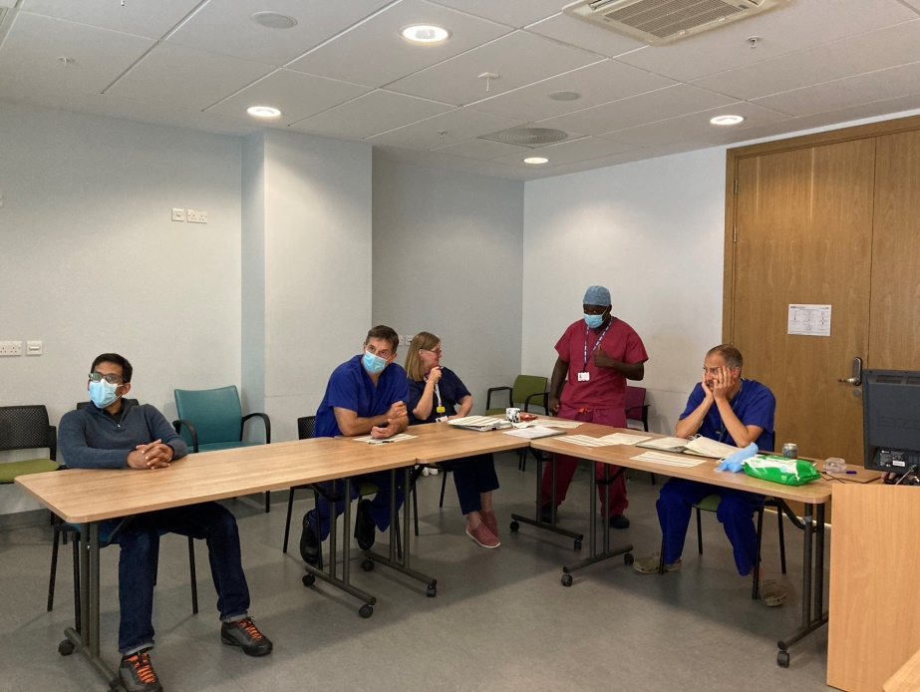
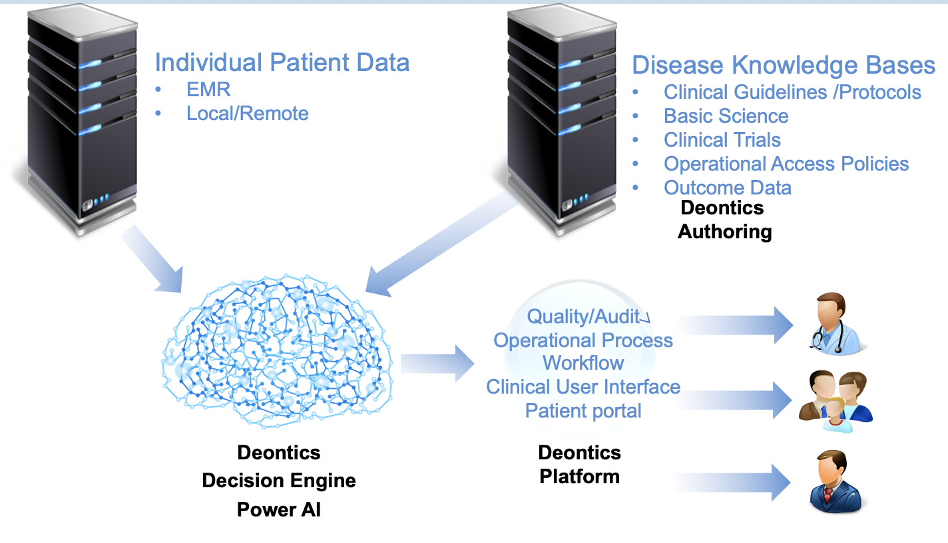
Artificial Intelligence in Prostate Multidisciplinary Team Meetings: a validation study
P8-1
J. ANING¹, S. KEARLEY¹, H. DUNDERDALE², A. KOUPPARIS¹, E. ROWE¹, R. PAL¹, R. PERSAD¹, G. BUTT³, I. CHRONAKIS³, V. PATKAR³
1 Bristol Urological Institute, North Bristol NHS Trust, Bristol, United Kingdom
2 Somerset, Wiltshire, Avon and Gloucestershire Cancer Alliance, United Kingdom
3 Deontics Clinical Ai Solutions, United Kingdom
Introduction
Multidisciplinary-team meetings(MDTMs) are challenged by the volume and complexity of cases referred. There is a need to better define which cases are discussed and which can be safely managed by protocol.
In this work we explore the use of a customised Artificial Intelligence application to manage real-life Prostate MDTM cases.
Results
1a
Over the study period 210 cases were discussed at the MDTM
Of these 152/210 (72%) could be entered into the application
Median age 69 years
Figure 2 illustrates the reasons for MDT discussion
Table 1 illustrates a summary of the pathology discussed
1b
AIM
To compare the MDT outcome recommendations made by the standard MDTM with the outcomes generated by the Deontics Clinical Decision Support Artificial Intelligence (AI) tool.
Figure 1 (a) Bristol Urological Institute MDTM (b) Deontics Artificial Intelligence Schematic
Figure 2) Illustration of types of prostate cases input into AI application
Method
An AI based algorithm was developed using EAU and NICE guidelines.
A customised web-based application was designed to facilitate data input and outputs.
Between December 2021 and January 2022, anonymised real-life prostate MDTM data at a single centre were prospectively entered into the application and outcomes recorded.
The data entry team were separate and blinded to official MDTM discussion, which occurred in parallel.
The application and MDTM outcomes were compared (Figure 1).
Total agreement between MDT + Deontics – 96/152 (63%)
Nuanced agreement between MDT + Deontics – 34/152 (22%)
Discordance between MDT + Deontics – 22/152 (15%)
Pathology | Number (%)
Benign | 26 (17)
Non-metastatic localised | 107 (70)
Metastatic | 20 (13)
Table 1) Pathology of cases discussed at MDTM
Conclusions
AI can be safely used in the prostate MDTM to determine the management options for newly diagnosed prostate cancer patients provided that the information quality used to inform the decision is robust.
The MDTMs perception of the AI application outcomes were that they were clearer and more consistent than the standard MDTM.
Acknowledgements
We are grateful to SWAG Cancer Alliance for providing funding to support this work and we would like to acknowledge all who have contributed to facilitating this work to date including : Tariq White, Rhona Galt, Tim Whittlestone, Helen Williamson, Tim Keen, Lorraine Woodward, Amar Challapalli, Amit Bahl, John Graham, Brendan Taggart, Rana Asir, Sara Moghabi
CONTACT INFORMATION
Email: jonathan.aning@nbt.nhs.uk
Twitter: @jonathananing

