Slide 1
Update on UKKCC Research & Skin Pathology SWAG Skin Cancer Meeting 6 Nov 2023
Dr Paul Craig
Cellular Pathology
Gloucestershire Hospitals NHS Foundation Trust

Slide 2
Conflicts of Interest
Grant from Sanofi for past SCC study expenses involved in retrieving pathology blocks and slides and laboratory costs of cutting tissue and postage
Grant from British Skin Foundation for UK Keratinocyte Cancer Collaborative (UKKCC)

Slide 3
UK Keratinocyte Cancer Collaborative (UKKCC) part of British Association of Dermatologists
Purpose
To create create a sustainable, internationally leading, collaborative research network building upon and supporting UK expertise and working together across the UK dermatology community to deliver major research initiatives on epidemiology, molecular pathogenesis, treatment and prevention of keratinocyte cancers (KC), starting with cutaneous SCC (CSCC).

Slide 4
UKKCC funding from the British Skin Foundation to build:
UKKCC-BIOBANK:
UK-wide tissue bioresource to support cSCC research in the UK
via a network of dermatopathologists
relevant governance structures and procedures for the collection, processing and retention of
a) biomaterial
b) associated clinical data sets.

Slide 5
UKKCC funding from the British Skin Foundation to build:
2. UKKCC-MOLECULAR:
molecular 'Atlas of cSCC' through coordinated molecular and bioinformatics analyses
focusing initially on transcriptomic and immunological characterisation of high-risk cSCC from immunosuppressed (IS) and immune competent (ICP) individuals
1. n=60 fresh frozen tumours; n=30 IS, n=30 ICP,
2. further validation in 240 additional cSCC (archival FFPE).

Slide 6
Identification of potential tumours (SCCs) for UKKCC project
The aim is to identify patients with cSCCs >2cm in diameter
with either
A) likely high-risk features no prior biopsy but large tumour with cSCC suspected clinically or
B) biopsy proven cSCC with high-risk features: pT3/4 (AJCC8) or pT2b/3 (BWH).
Responsibility of clinical, surgical and pathology staff to identify patients who may have suitable cutaneous SCC (cSCC) tumours for inclusion.
Skin as well as Head & Neck MDMs may provide an ideal opportunity to identify cases.

Slide 7
Next steps UKKCC & SWAG
IRAS approved study – easy to include sites but neds to go through local R&D
Prof Charlotte Proby (dermatology Dundee) leading
Meetings with clinical teams Bristol & Glos
Bath and Somerset to follow

Slide 8
Example of research possible from the UKKCC - aSanofi funded study using same format
Since only 1.5% of cSCC metastatise we need better predictors of those cases for management
To develop a robust and validated gene expression profile (GEP) signature for predicting primary cSCC metastatic risk
using an unbiased whole transcriptome discovery-driven approach.

Slide 10
Red = genes upregulated in metastatic cSCC Blue = genes downregulated in metastatic cSCC

Slide 11
Results & Conclusion
Results: A 20-gene prognostic model was developed and validated, with an accuracy of 86.0%, sensitivity of 85.7%, specificity of 86.1%, and positive predictive value of 78.3% in the testing set, providing more stable, accurate prediction than pathological staging systems.
A linear predictor was also developed, significantly correlating with metastatic risk.
Limitations: This was a retrospective 4-centre study and larger prospective multicentre studies are now required.
Conclusion: The 20-gene signature prediction is accurate, with the potential to be incorporated into clinical workflows for cSCC.

Slide 12
To be briefly discussed (if time)
WHO 5th edition Classification of Skin Tumours 2023
Digital Pathology in Dermatopathology & SWAG
Artificial Intelligence (AI) in Dermatopathology

Slide 14
Melanocytomas – intermediate lesions
some atypical features, but fall short of a malignant diagnosis by histopathology
harbour additional pathogenic mutations - evolved beyond initial stage of tumour development but have not reached the malignant state.
they carry different pathogenic mutations in addition to the initiating mutation that is the sole alteration in a histopathologically bland appearing lesion.
the secondary alterations found in these intermediate lesions alter specific signaling pathways that vary between the histopathological types, and therefore likely contribute to their characteristic clinicopathologic features.

Slide 15
Melanocytomas – intermediate lesions
Some of these ‘intermediate’ lesions have characteristic clinicopathologic features:
pigmented epithelioid melanocytoma (formerly animal type melanoma)
BAP1-inactivated melanocytoma (BAPoma)
WNT-activated deep penetrating/plexiform melanocytoma (deep penetrating naevus)
Spitz melanocytoma (atypical spitzoid tumour)

Slide 16
Spitzoid tumours
Benign:
Pigmented spindle cell naevus (Reed naevus)
Spitz naevus
Intermediate:
Spitz melanocytoma (Atypical Spitz tumour)
Malignant:
Spitz melanoma

Slide 18
Digital Pathology
using digital images – initially just digital cameras
now scan microscope slides with scanners – in Glos 3 machines up to 360 slides each
digital histopathology images contain far more pixels than other commonly used medical imaging techniques, such as magnetic resonance imaging (MRI) and computerized tomography (CT)
limited histological biomarkers large enough to be observed by the human eye.
deep learning offers a path to access this hidden wealth of information in digital histology images.

Slide 19
Current use of Digital Pathology in Dermatopathology
Used for teaching and training and EQA
Websites eg dermpathpro
Routine reporting – private and NHS
Early AI projects

Slide 20
Teaching and training and EQA uses of digital pathology:
websites with digitised images eg Leeds, RCPath Pathology portal

Slide 21
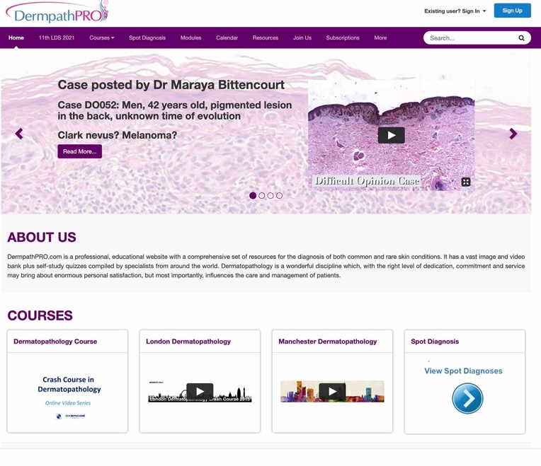
Websites for digital dermatopathology
Societies hosting or links to educational material
eg British Society for Dermatopathology, RCPath, BDIAP
Subscription sites eg dermpathpro

Slide 22
Routine reporting dermatopathology in UK
NHS – early adopters – Coventry, Leeds
NHS long term plan – and pathology plans now rolling out nationally
PathLAKE – 22 million people – Oxford, Cambridge, Nottingham, Coventry & Warwick, Southampton, Bath, Bristol, Glos, Devon and Cornwall
NPIC – Leeds, much of North of England
iCAIRD - Scotland
Private providers eg LDPath for last 10 yrs

Slide 23
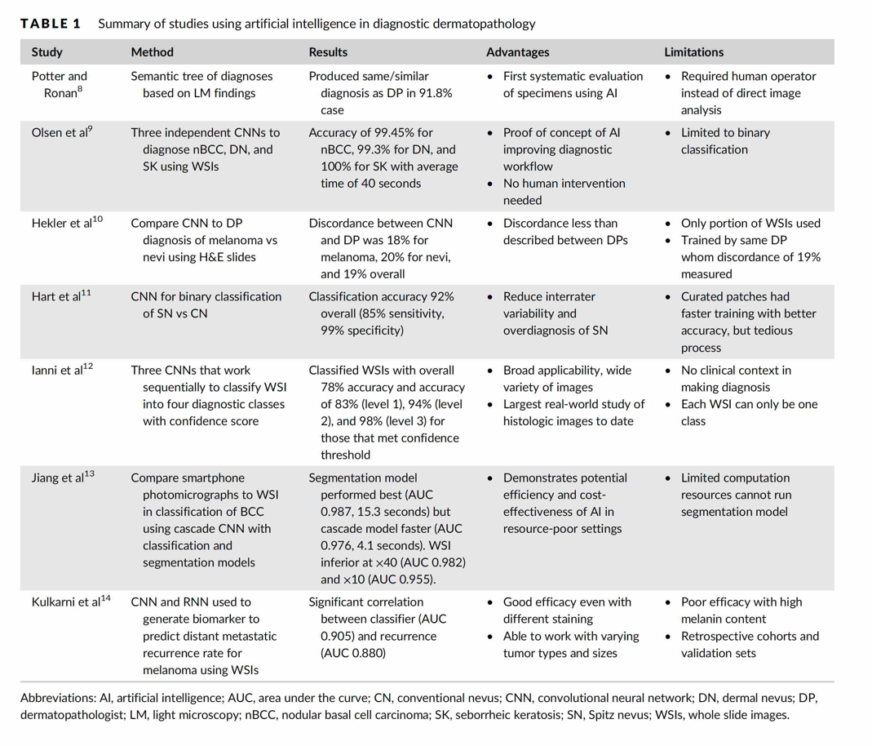
AI projects in Dermatopathology
Wells, A, Patel, S, Lee, JB, Motaparthi, K. Artificial intelligence in dermatopathology: Diagnosis, education, and research. J Cutan Pathol. 2021; 48( 8): 1061– 1068.

Slide 24
EXAMPLE OF HOW A DERMATOPATHOLOGY LABORATORY HAS GONE FROM
STARTING DIGITAL PATHOLOGY TO USING AI TO MAKE DIAGNOSIS AND REPORTS,
IN PARTNERSHIP WITH UNIVERSITY COMPUTER SCIENCE TEAM (BREMEN),
AND PUBLISHED THIS
Courtesy Joerg Schaller

Slide 25
Courtesy Joerg Schaller

Slide 26
Courtesy Joerg Schaller

Slide 27
Courtesy Joerg Schaller

Slide 28
Example of AI in Dermatopathology: one vendor kite marked AI algorithm
approx. 5000 whole slide images in training set, validated in real world setting re diagnosis using microscope slides:
AI algorithm shows: 92% specificity for suspicious melanocytic lesion diagnosis 92% specificity for benign melanocytic lesion diagnosis 97% specificity for SCC diagnosis 96% specificity for BCC diagnosis

Slide 29
AI position statement in Dermatopathology: Collaboration between British Asssocation of Dermatologists & Royal College of Pathologists
The BAD and RCPath are currently writing a position statement on the use of AI in this clinical setting and are working collaboratively to achieve the following aims:
To promote and take a strategic view of integrating AI interventions in dermatopathology
To support dermatology departments to ensure that safe and effective AI interventions are adopted to improve patient outcomes
To provide quality standards for adoption of AI interventions across dermatology care pathways from diagnosis to management of skin diseases.
To promote the involvement of Dematopathologists and Dermatologists in the development, evaluation and deployment of AI aimed to improve patient outcome

Slide 30
Acknowledgements
Helen Dunderdale & Ewan Wilson (SWAG)
Richard Carr, Dermatopathology, Warwick
Prof David Snead, PathLAKE (UH Coventry)
Andrew White, PathLAKE (UH Coventry)
Joerg Schaller, Dermatopathologie Duisberg Essen (Germany)
CONTACT ME AT PAUL.CRAIG2@NHS.NET

