Slide 1
Overview of Skin Cancer Service Developments
Lisa Brown
Regional Cancer Improvement Lead
Update for SWAG Skin Cancer CAG 06/12/23
Notes:
Standard title slide

Slide 2
Overview of Skin Cancer Service Developments
Teledermatology
Performance overview
Cancer Alliance & System Transformation Plans

Slide 3
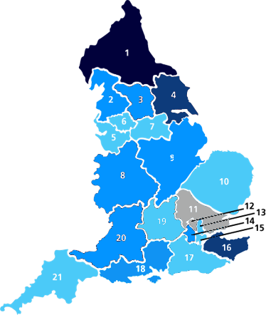
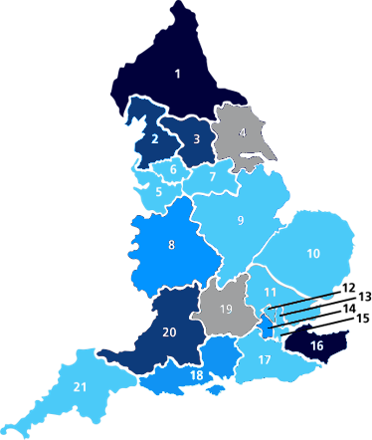
Teledermatology uptake increased by approximately 5% from Q1 to Q2 2023/24 (from 27-33%).
Cancer Alliance | Q1 % of USC referrals managed through telederm | Q2 % of USC referrals managed through telederm
Cheshire & Merseyside | 4% | 6%
East Midlands | 25% | 20%
East of England North | 13% | 16%
East of England South | No data | 18%
Greater Manchester | 6% | 8%
Humber and North Yorkshire | 58% | No data
Kent & Medway | 59% | 75%
Lancashire & South Cumbria | 40% | 50%
North Central London | 0% | pilots live, data Q3
North East London | 31% | 22%
Northern | 83% | 90%
Peninsula | 3% | 22%
South East London | 2% | 12%
South Yorkshire & Bassetlaw | 8% | 11%
Surrey & Sussex | 14% | 14%
SWAG | 47% | 50%
Thames Valley | Pilot live, data Q2 | No data
Wessex | 28% | 39%
West London (RMP) | 43% | 40%
West Midlands | 39% | 42%
West Yorkshire & Harrogate | 42% | 68%
Q1 23/24
Q2 23/24
 | 76-100%
 | 51-75%
 | 26-50%
 | 1-25%
 | Quarterly data not available
105 of 115 providers submitted data in Q2 23/24. Awaiting updates from TV, HNY, north Bristol, UH Bristol and Western, North Cumbria, & Queen Victoria .
12 new providers started piloting Teledermatology in Q2 2023/24.
79 providers now have telederm live. Uptake increased in 39 providers in Q2
Most CAs saw slight increases in Teledermatology uptake for USC referrals
Notes:
Latest info from Q3 Quarterly Assurance
Political interest in Telederm

Slide 4
Advantages and Challenges to Telederm
Advantages | Challenges
Reduce the number of times patients have to travel Manage demand Manage capacity in secondary care Cost effective Improved feedback to primary care (education) Approx >33% of patients can be discharged and informed quickly of diagnosis Approx >33% can be booked direct for surgical excision Can reduce waiting times for non-cancer dermatology | Primary care limited capacity to take images: particularly dermoscopic images for teledermatology skin lesion diagnosis Agreement and buy-in for best models IT infrastructure and capacity Poor quality images Project manager capacity Face to face interaction needed as well Must be job planned/funded appropriately

Slide 5
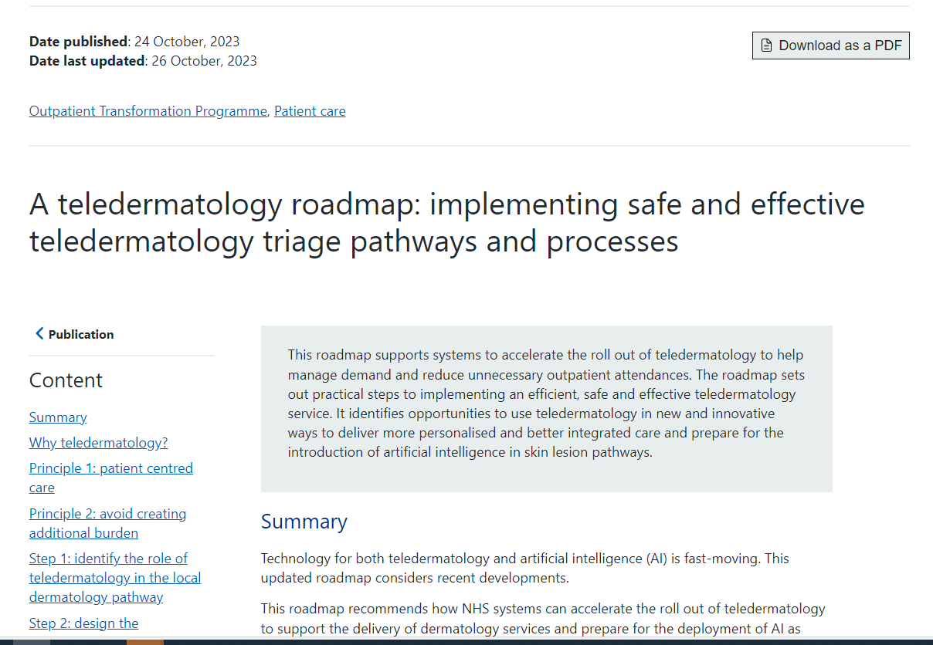
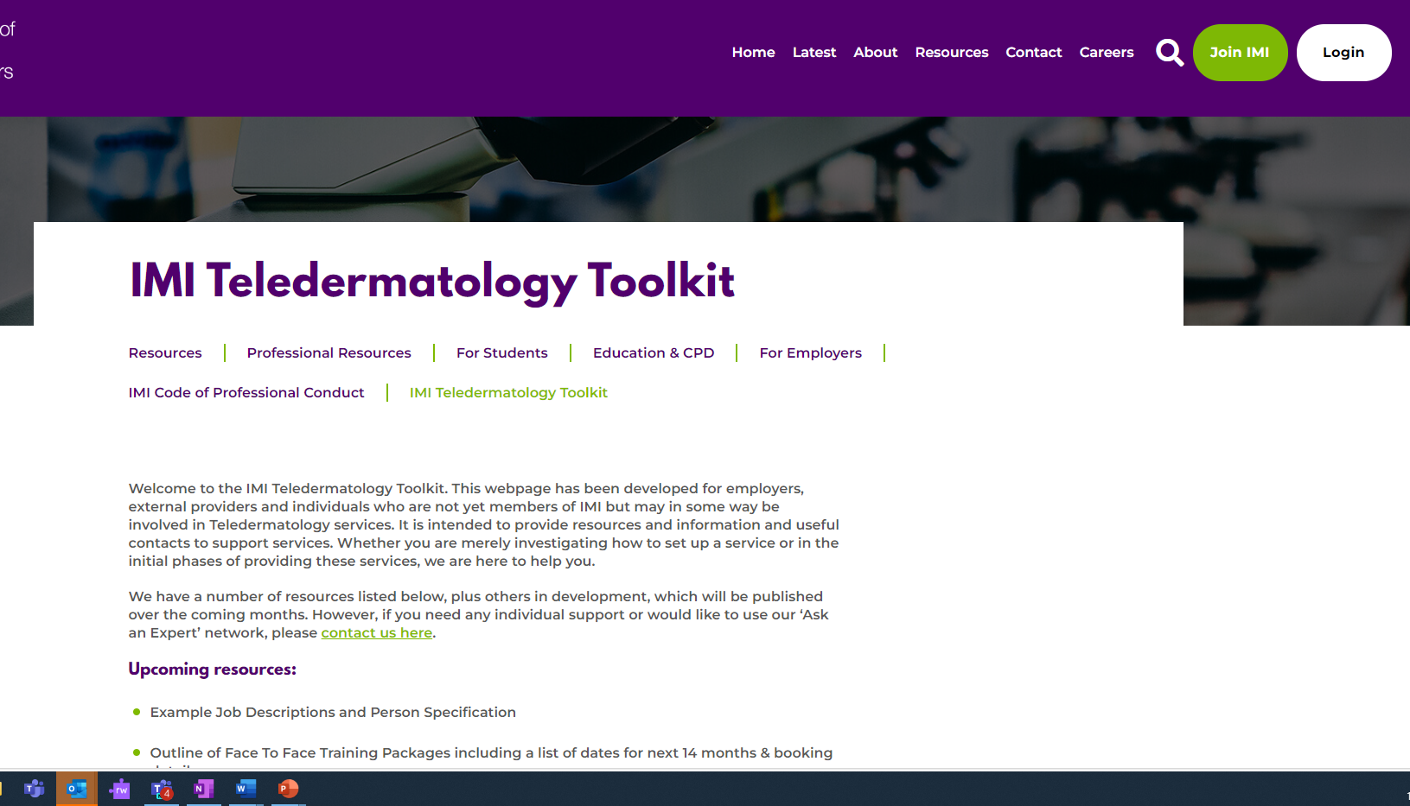
NHS England Resources

Slide 6
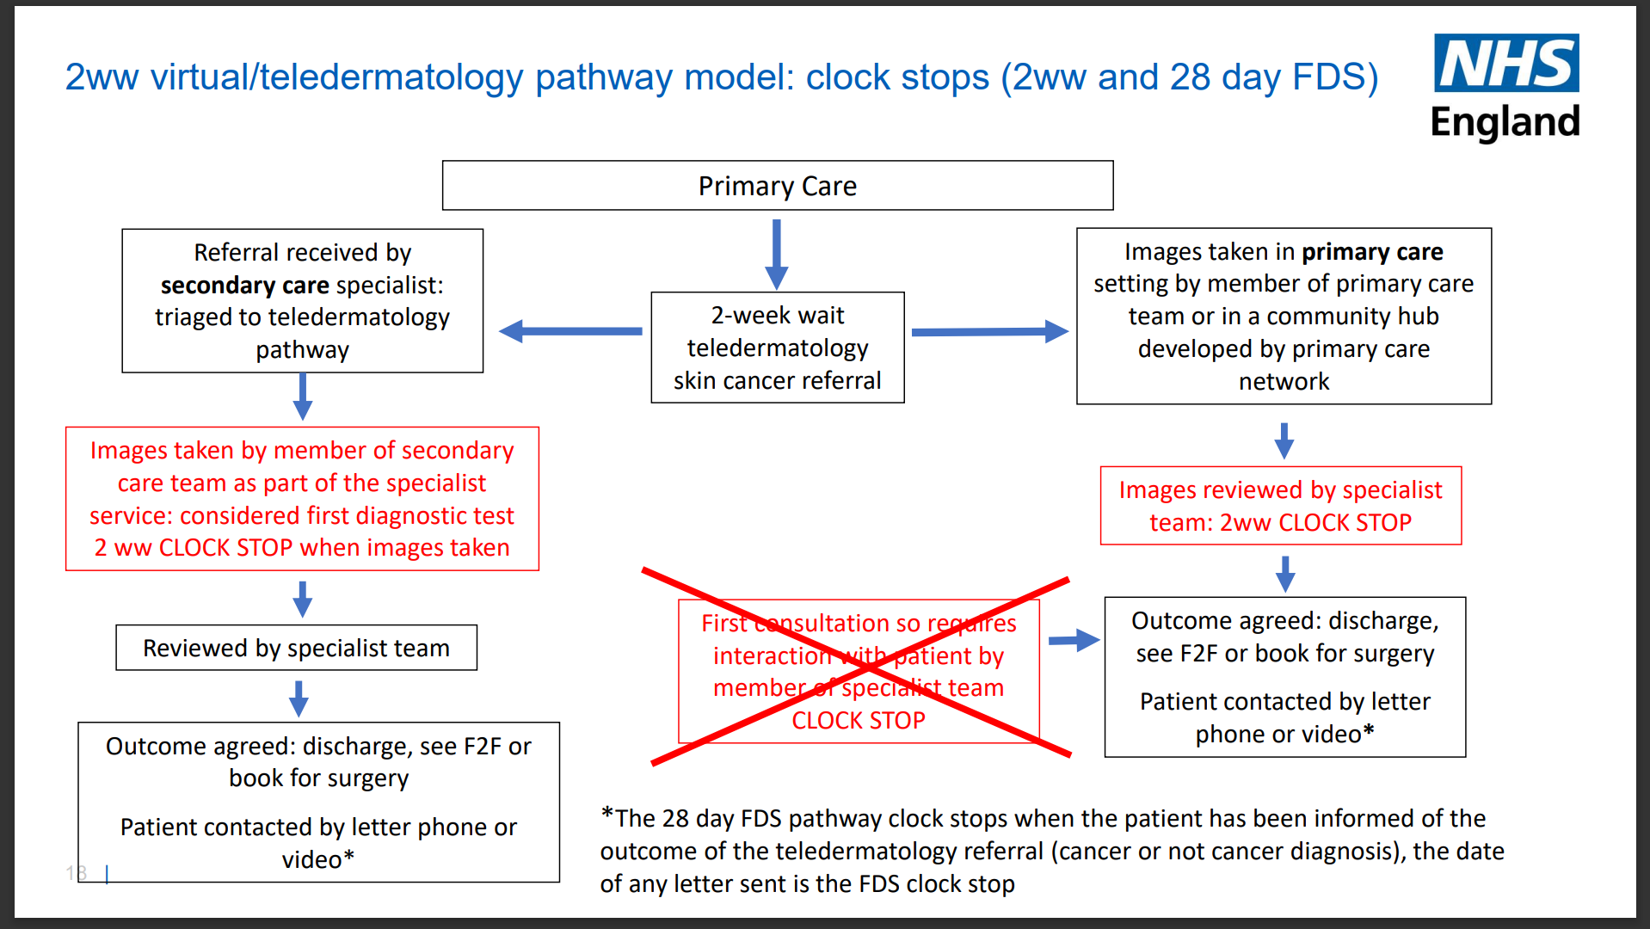
Telederm Clock Stops

Slide 7
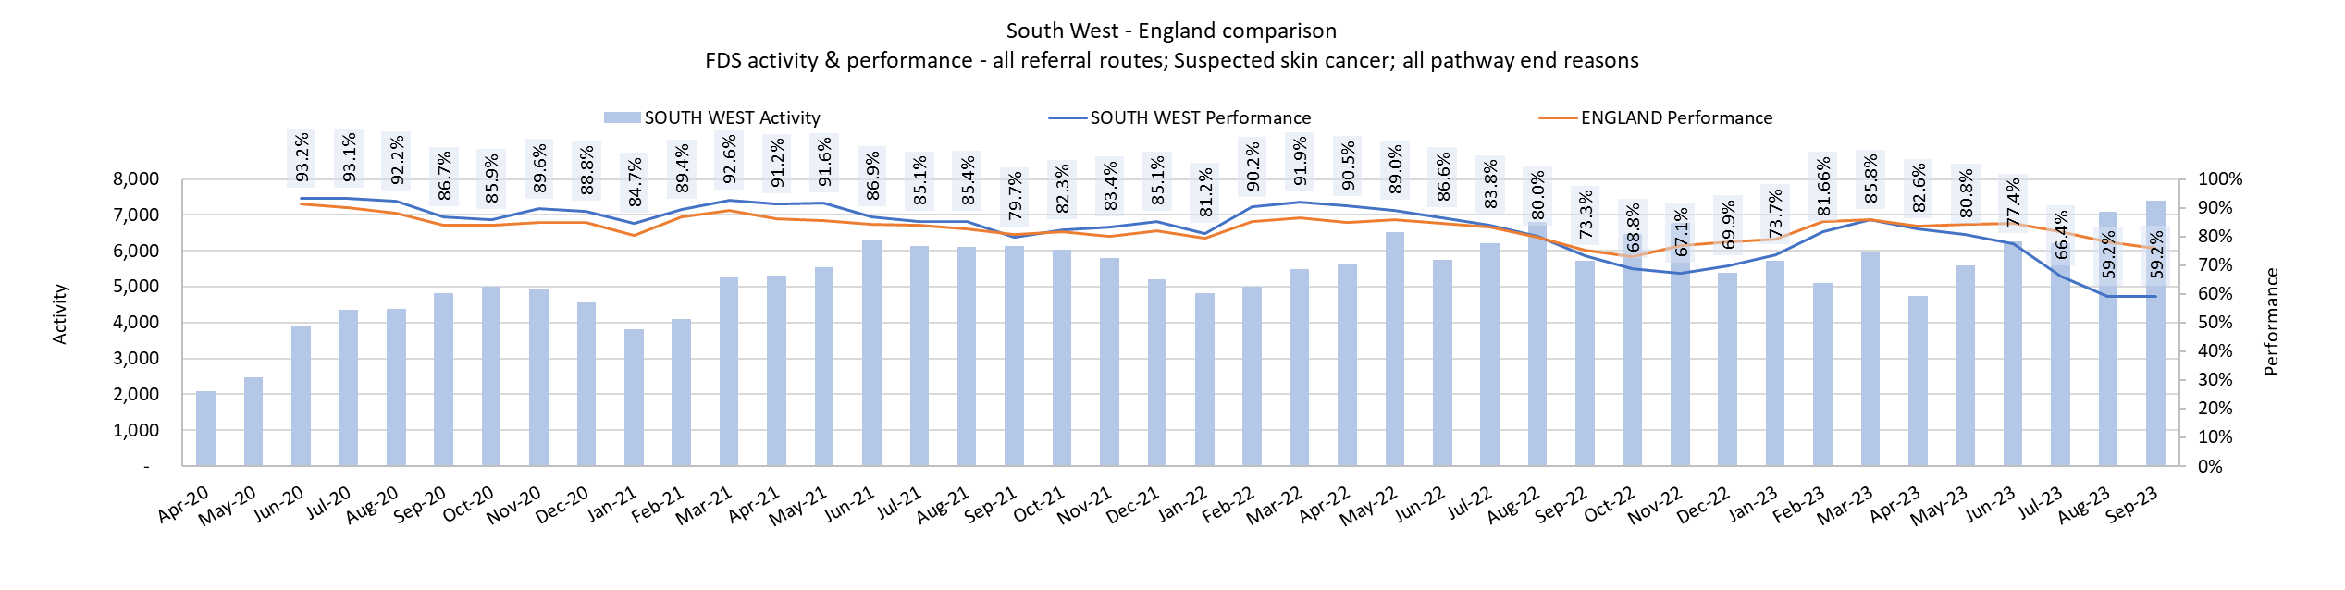
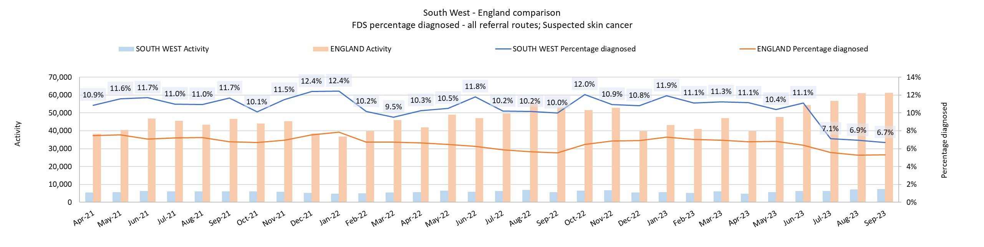
South West Skin Faster Diagnosis Standard (FDS) Overview

Slide 8
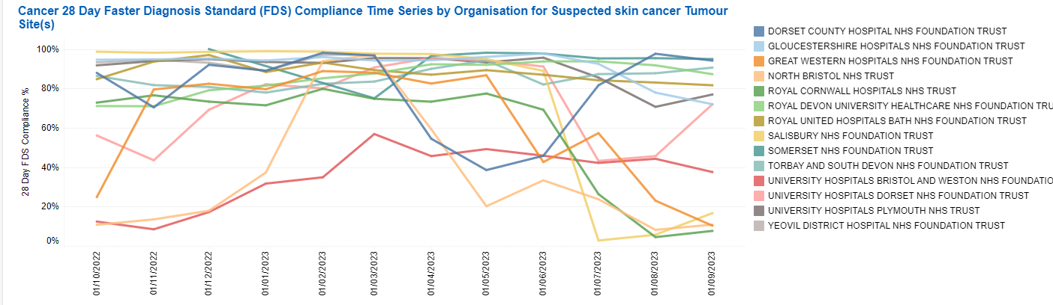
SW Skin FDS Performance by Provider

Slide 9
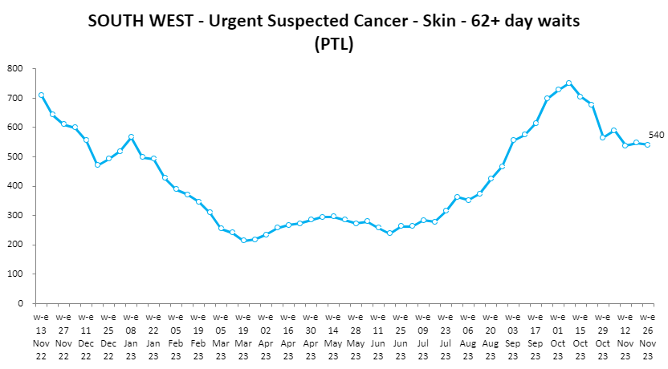
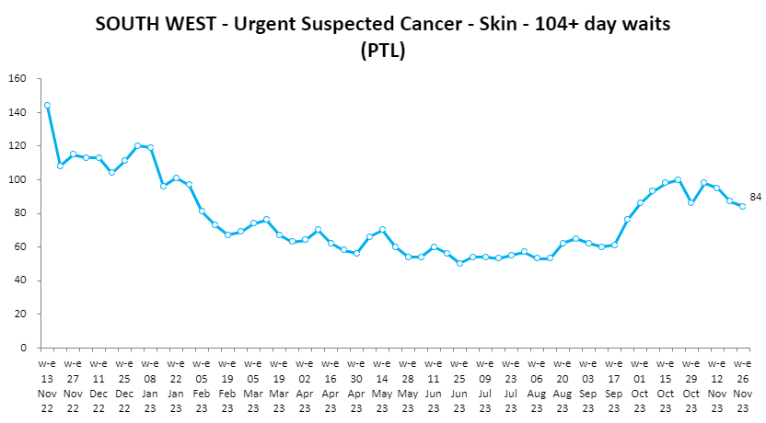
Skin Cancer Backlog Position

Slide 10
SWAG Skin Highlight Report
G | On track, no intervention required
A | Project remains on track. However, there are a number of risks/issues that should be noted and monitored carefully
R | Off track, Diagnostic Implementation Working Group and/or Diagnostic Programme Board intervention required
Reporting Month
November 2023
Updated by:
Lisa Brown
RAG
Summary
PWC were commissioned January 2022 to conduct a full review of the service provision across SWAG, this highlighted high level actions for each system to consider and develop to improve service delivery and referral to treatment targets. System updates are to be fed through via the quarterly assurance process with support provided for BNSSG and Somerset to ensure plans are progressed.
Key achievements
Planned activities
Increased focus on skin services and collaboration with Regional Outpatient Dermatology Transformation Programme to support system wide outputs.
Funded and arranged university places for 7 CNSs ^{(+ 1 CNS funded elsewhere)}. Outline plans with systems on how they will utilise and measure training to support FDS pathway.
Supported collaboration in BNSSG to outline and define scope of practice and training competencies.
Glos – hybrid, medical photography led telederm hub ensuring all referrals are accompanied by a good quality image for triage. Benign skin lesion surgery activity resumption in primary care
Somerset- building up new skin service, including workforce, procured telederm, establishing premises, running spot clinics
NBT established Poly Clinics, piloting in new location
UHBW – expanding medical photography services
BSW – A&G telederm service review and expansion of community-based secondary care skin surgery services. ​Benign skin lesions revision and BCC demand management policy development.
Collation of measurement of CNS training output metrics from systems and Systems to present their achievements from upskilled CNS/AHP workforce at Skin CAG
Continue discussions around estate - provide support to remove blockers
Support Systems and remove blockers relating to key priorities
To continue to develop and foster a culture of shared learning
BNSSG: business case to develop PCN hubs
Glos - Evaluate and where appropriate role out medical photography pilot

Slide 11
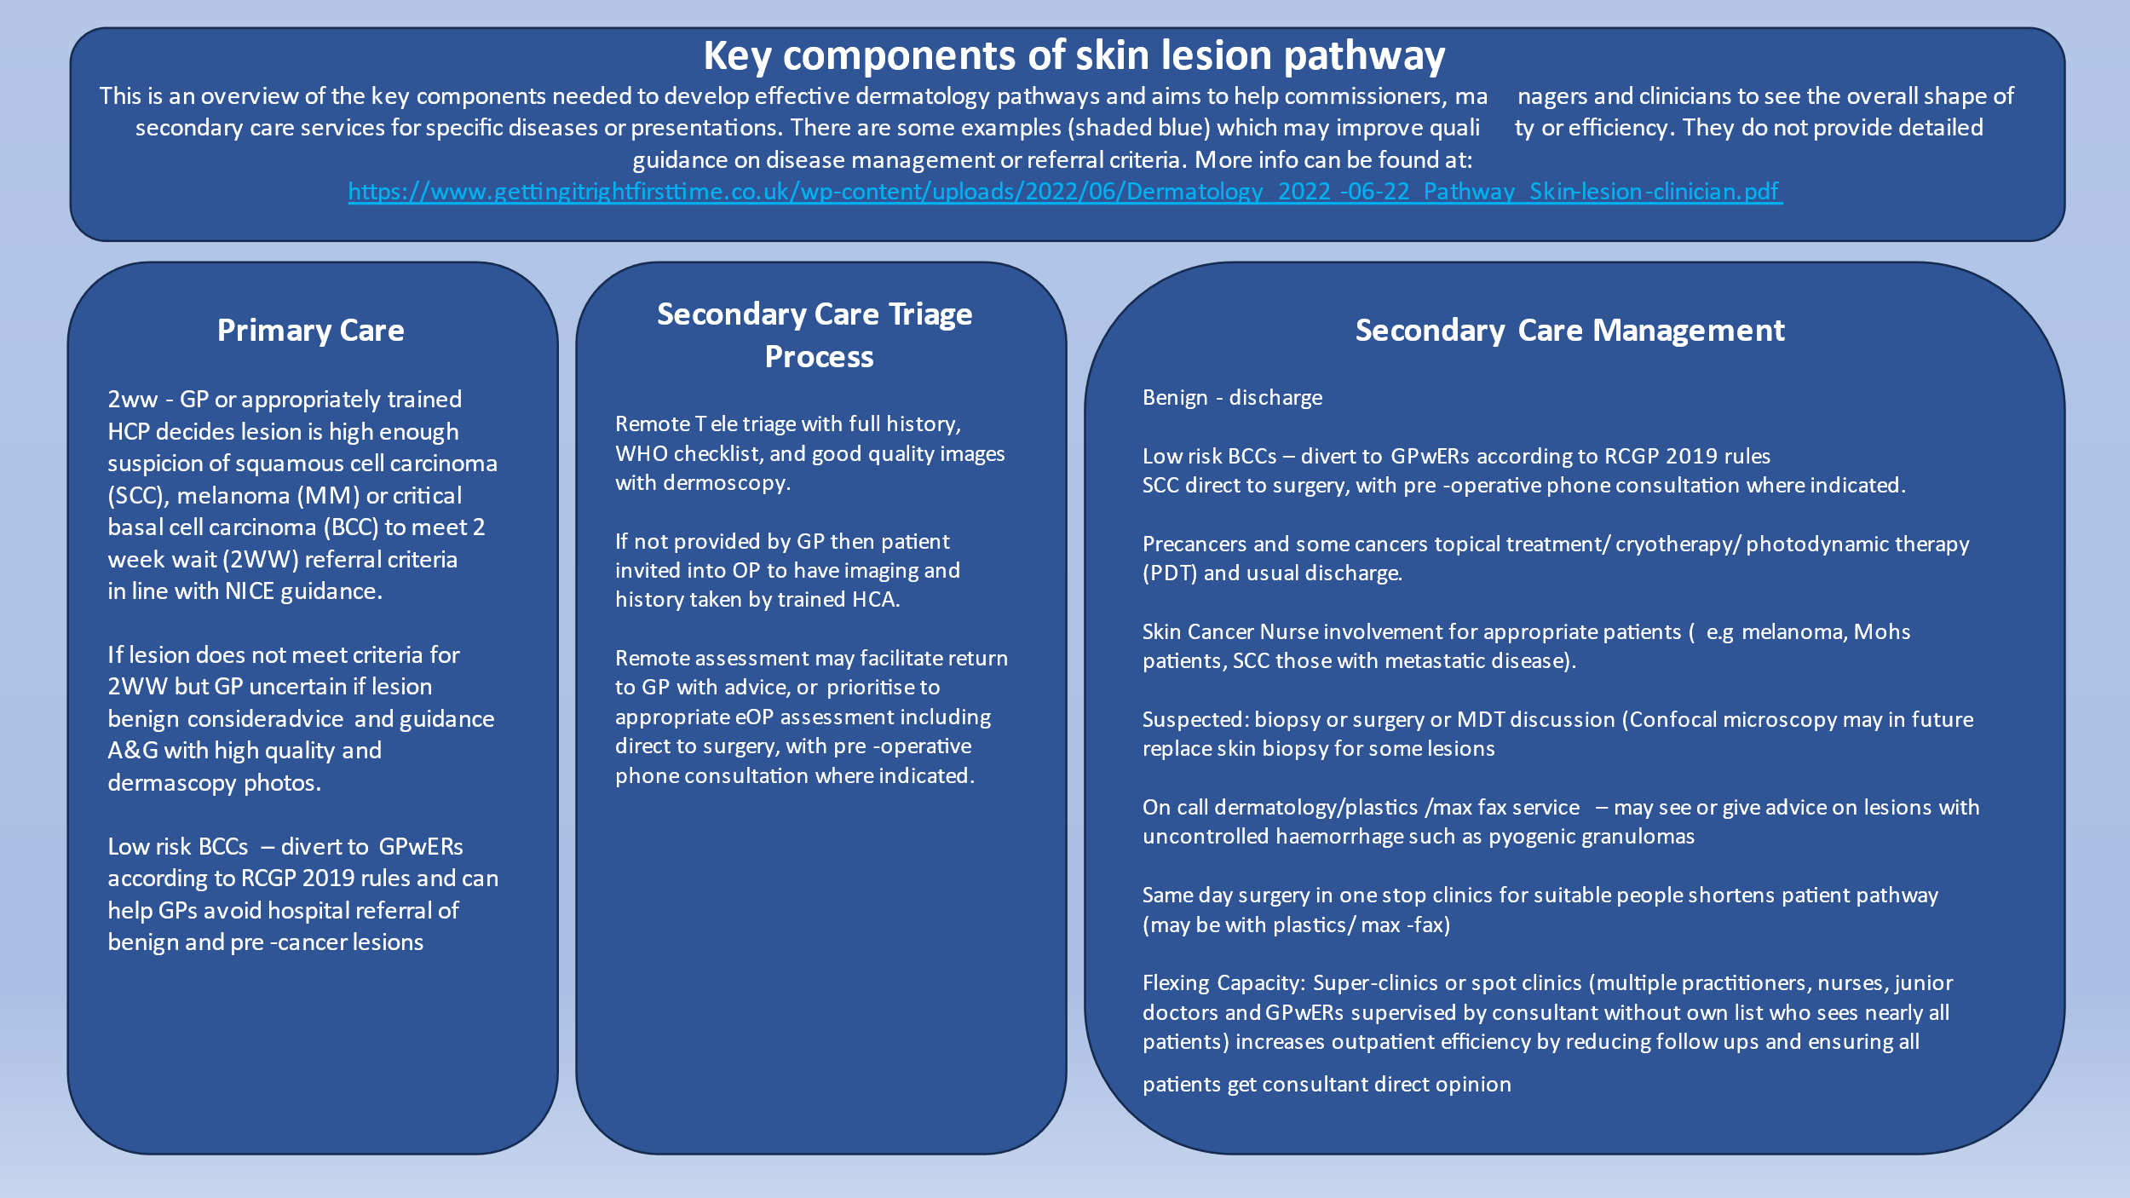
Peninsula Alliance Approach
Pilots ran and evaluated
Summit in March 2023
A prioritised action plan has been developed
An overview of a pathway design reflecting the direction of travel and aspirations of
A skin cancer project lead has been assigned to support trusts with ongoing development of their pathways.
Investment in skin services

Slide 12
Dorset
Telederm
AI
CDC Image Hub
Secondary Care Triage
Skin Analytics AI Post Referral Pilot across Dorset with imaging hubs (with trained HCAs) in acute and CDC setting: go-live January 2024
Pre-Referral Pilots in targeted PCNs using imaging hubs (with trained HCAs) and GPwER
Finalise Patient Primary Care Questionnaire
Kit requirements
Training GP Admin Teams
Agree PCNs for pre-referral
SOPs
IT Infrastructure

Slide 13
End slide

