Slide 1
SWAG Network Skin Cancer
Clinical Advisory Group
Research Update
Claire Matthews
02/11/2022

Slide 2
National Recruitment to Skin Cancer Studies
Apr 2022 - Mar 2023
Apr 2023 - Nov 2023
Data cut 29/11/2023
Source: ODP All Portfolio

Slide 3
National vs Regional Recruitment to Skin Cancer Studies Apr 2019 - Oct 22
National Recruitment
SWAG Region Recruitment
Data cut 29/11/2023
Source: ODP All Portfolio

Slide 4
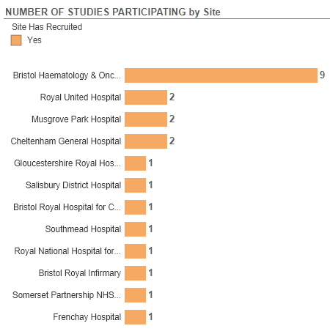
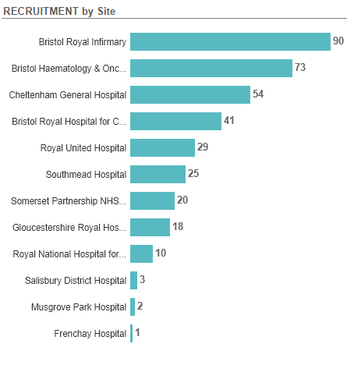
Studies and Recruitment by site 2019 - present

Slide 5
SWAG region Open Skin Cancer Studies
CPMS | Short Name | Sites | Open | Closure | Target Eng | Eng Recruits
56560 | The RESCUE Study | Musgrove, Yeovil | 08/09/2023 | 01/04/2024 | 350 | 0
54772 | IMPACT | BHOC | 28/09/2023 | 30/04/2027 | 35 | 1
53055 | MK-7684A-010 | Salisbury | 14/08/2023 | 14/05/2025 | 12 | 0
52188 | Phase 3: Fianlimab (Regn3767, Anti-Lag-3) + Cemiplimab Vs Pembrolizumab In Patients With Melanoma | Somerset | 14/02/2023 | 13/04/2030 | 26 | 7
50777 | HBI-8000 with Nivolumab v Placebo with Nivolumab | BHOC | 15/07/2022 | 30/09/2023 | 7 | 3
50660 | TebeMRD: Tebentafusp in MRD Melanoma | Salisbury | 01/08/2022 | 01/12/2024 | 450 | 22
50634 | MyMelanoma: An Accessible Resource Melanoma Cohort Study | Yeovil, salisbury | 01/09/2022 | 31/08/2027 | 17150 | 790
50169 | REFINE | BHOC, RUH, Musgrove | 25/05/2022 | 31/12/2025 | 882 | 11
47497 | EPIC Trial | BHOC | 23/08/2021 | 31/07/2024 | 37 | 30
46627 | The STARBOARD Study | Salisbury | 14/03/2023 | 01/02/2024 | 9 | 1
46063 | PROPHETIC | Chelt, Salisbury | 04/06/2021 | 01/10/2024 | 167 | 146
44146 | Melanoma Wide Excision Trial - MelMarT-II | NBT | 18/08/2020 | 31/12/2025 | 750 | 343
43756 | MITRE | RUH, Somerset, BHOC, Salis | 08/07/2020 | 31/01/2025 | 1296 | 271
41173 | Cancer-0456/0232-Regeneron | BHOC, Salisbury | 24/12/2019 | 30/05/2024 | 21 | 9
40068 | The SCOPE Study | Musgrove, BHOC | 19/08/2019 | 31/10/2024 | 87 | 20
38748 | Observational Study of Melanoma Patients Treated with IMLYGIC® | Glos, Musgrove | 22/01/2019 | 31/08/2032 | 33 | 30
36774 | Long and Short-Term effects of Standard-of-Care treatments for Cancer | NBT | 13/05/2020 | 31/10/2026 | 350 | 98
54905 | V940-001 | Glos, BHOC | 25/10/2023 | 10/08/2025 | 36 | 0
Data cut 02/02/2022
Source: ODP All Portfolio
Notes:
Is this open at any other sites - Claire Barlow (abandoned at BHOC)

Slide 6
SWAG region In Setup Skin Cancer Studies
CPMS No. | Title | Sites | Sponsor | Planned Opening | Planned Closure | Sample Size England | Sample Size UK
54958 | A First-in-Human, Open-label, Multicenter, Phase 1 Clinical Study to Evaluate the Safety, Tolerability, Pharmacokinetics, and Pharmacodynamics of PYX‑ 106 in Subjects with Advanced Solid Tumors | BHOC | Pyxis Oncology Inc. | 01/10/2024 | 19/08/2025 | - | 19
54905 | A Phase 3 Registrational Study in Adjuvant Melanoma Testing mRNA-4157/V940 + Pembrolizumab Versus Pembrolizumab in Patients with High-Risk resected Melanoma. | BHOC, Chelt | MERCK SHARP & DOHME CORP. | 14/11/2023 | 10/08/2025 | 36 | 42
National In Setup Skin Cancer Studies, open to new sites
CPMS No. | Short Name | Lead LCRN | CI | Planned Opening | Planned Closure | Sample Size England | Sample Size UK
58011 | Secondary intention wound healing following excision of keratinocyte cancers on the lower leg (HEALS2) | West Midlands | David Veitch | 15/01/2024 | 31/12/2025 | 252 | 396
Data cut 29/11/2023
Source: ODP All Portfolio

Slide 7
Cancer Vaccine Studies
Working in partnership with BioNTech, Moderna and MSD (Individual Neoantigen Therapies)
Skin cancer studies:
BioNTech - A Phase 2 study of BNT113 in HPV16+ HNSCC patients expressing PD-L1 (CPMS 47443)
BNT111-01: Open-label, randomized Phase 2 trial with BNT111 and cemiplimab in combination or as single agents in patients with anti-PD1-refractory/relapsed, unresectable Stage III or IV melanoma (CPMS 46300)
MSD V940-001 (CPMS 54905) A Phase 3 Registrational Study in Adjuvant Melanoma Testing mRNA-4157/V940 + Pembrolizumab Versus Pembrolizumab in Patients with High-Risk resected Melanoma
MSD V940-007: A Phase 2/3, adaptive, randomized, open-label, clinical study to evaluate neoadjuvant and adjuvant V940 (mRNA-4157) in combination with pembrolizumab (MK-3475) versus standard of care and pembrolizumab monotherapy in participants with resectable locally advanced cutaneous squamous cell carcinoma (LA cSCC)

Slide 8
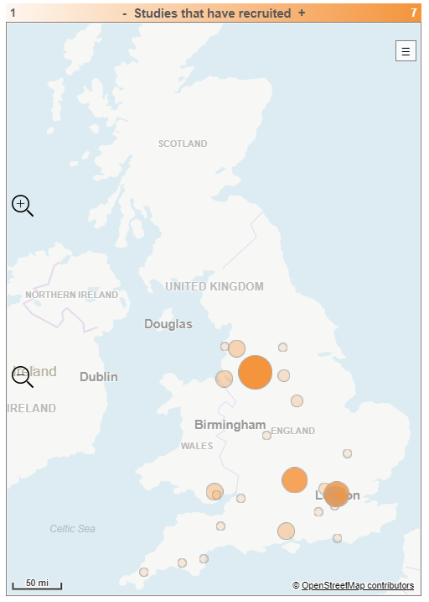
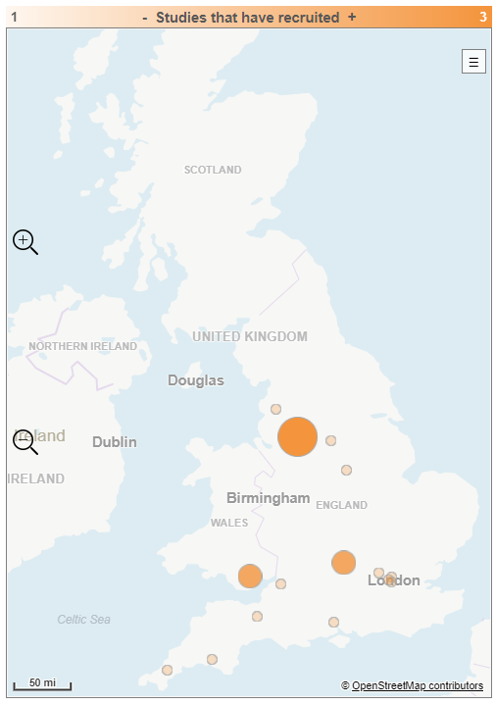
All Cancer Vaccine Pathway Studies
Skin Cancer Vaccine Pathway Studies

Slide 9
Associate PI Scheme
https://www.nihr.ac.uk/health-and-care-professionals/career-development/associate-principal-investigator-scheme.htm
A six month in-work training opportunity, providing practical experience for healthcare professionals starting their research career. People who would not normally have the opportunity to take part in clinical research in their day to day role have the chance to experience what it means to work on and deliver a NIHR portfolio trial under the mentorship of an enthusiastic Local PI.
Skin Cancer Studies now on the scheme:
RESCUE
TebeMRD
REFINE
MelMarT-II
MITRE

Slide 10
Cancer PES survey results 2022 - Q58 research
National Results

Slide 11
Cancer PES survey results 2022 - Q58 research
SWAG regional results
SWAG region results PDF

Slide 12
Talking about research
https://learn.nihr.ac.uk/

Slide 13
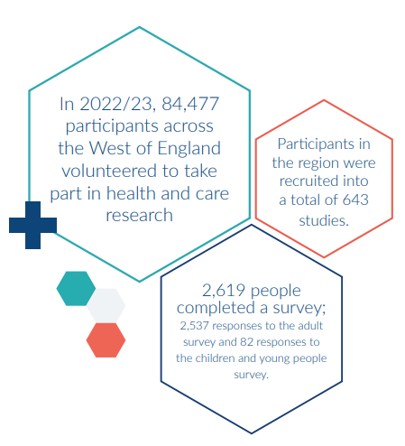
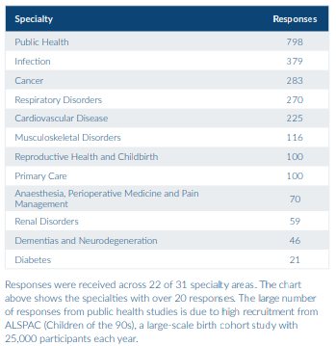
Link to full PRES report

Slide 14
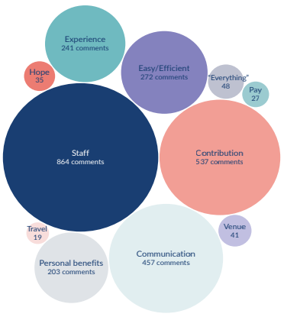

Slide 15
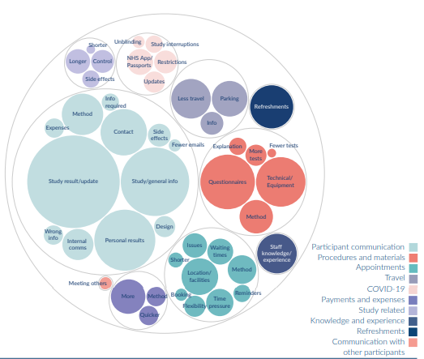
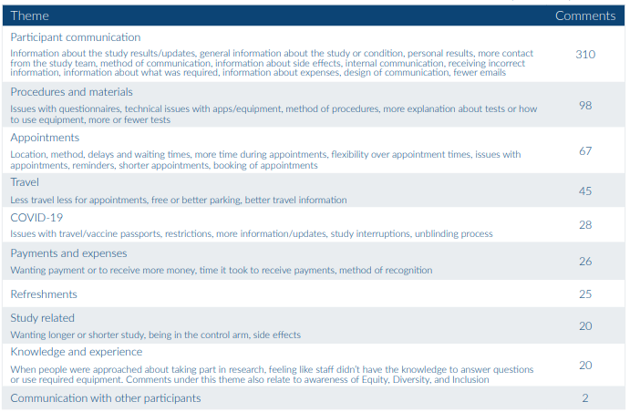

Slide 16
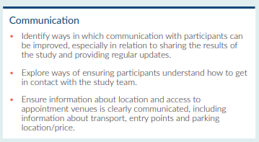
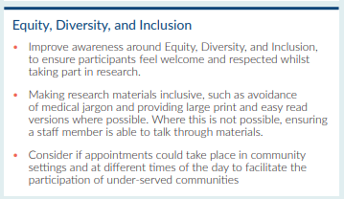
Implicit Bias Workshop
Public Newsletter
Training
Community engagement
Research Champions
Research Scholars
For further info: we.ppie@nihr.ac.uk
Strategic Funding

Slide 17
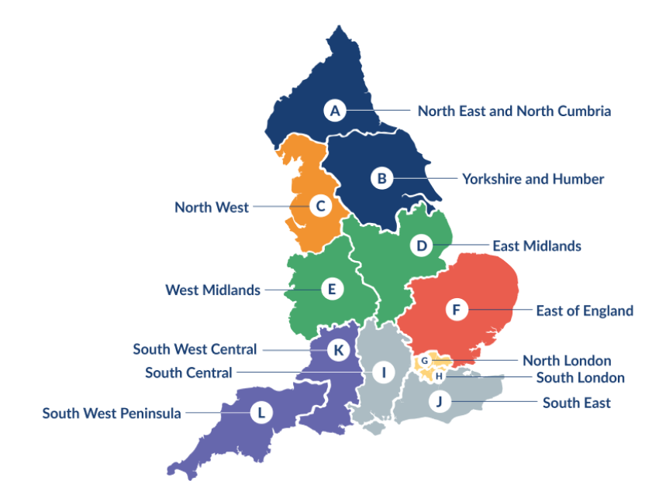
Clinical Research Network Transition to Research Delivery Network
Launching Oct 2024
The NIHR RDN has 2 primary purposes:
To support the successful delivery of high quality research, as an active partner in the research system
To increase capacity and capability of the research infrastructure for the future
Will operate as 1 organisation across England, through a network of 12 Regional Research Delivery Networks (RRDNs) and a central Coordinating Centre (RDNCC)

Slide 18
NIHR ODP https://odp.nihr.ac.uk/
Open data platform. Data on performance and restart across whole CRN, including all specialty areas
NIHR Be Part of Research https://www.ukctg.nihr.ac.uk/
See which studies are open across the country
National Cancer Research Institute Portfolio Maps http://csg.ncri.org.uk/portfolio/portfolio-maps/
View current national portfolio of open, closed and ‘in set up’ cancer studies
Find a Clinical Research Study (ODP) http://csg.ncri.org.uk/portfolio/portfolio-maps/
Search for a study to fit criteria. Good for horizon scanning, eligibility criteria

Slide 19
LCRN Contacts
Research Delivery Manager
claire.matthews@nihr.ac.uk
Research Portfolio Facilitator
rebecca.pienaar@nihr.ac.uk
Sub-specialty Lead
Chris Herbert

