Slide 1
An overview of the support offered by Brain Tumour Support

Slide 2
Our support
Our vision is that no one should feel alone when facing the impact of a brain tumour diagnosis
Patients and families can access our support at any stage, from diagnosis to bereavement
We recognise the unique support needs at each touchpoint and our Support Professionals are skilled at assessing needs
We offer individualised, patient and family-led support. We respond to frequently changing needs

Slide 3
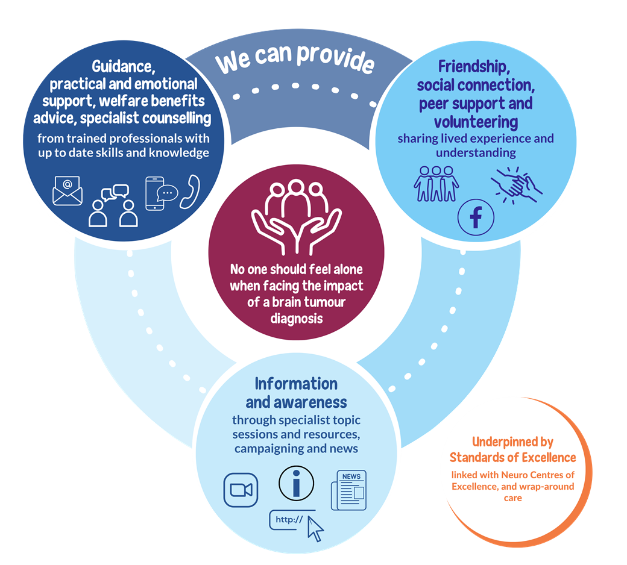
Our support
Our support model

Slide 4
Innovative early intervention
Brain Tumour Support and Southmead Hospital early intervention study
Early intervention in oncology is key to better outcomes and indications are that early access to support leads to improved QOL
This Early Intervention Pilot ran from 1st April to 30th September 2023, in partnership with Southmead Hospital
Patients were automatically referred to Brain Tumour Support (BTS) by the Southmead clinical team. Opt out was possible
Patients were contacted by a BTS Support Professional within 7 days (or sooner if urgent)
Individual needs of patients and families were assessed and triaged and one-to-one support offered
Also enabled early access to specialist counselling and welfare benefits support

Slide 5
Innovative early intervention
Uptake of support
Uptake
101 patients referred; 119 people took up BTS support (includes families and friends)
Only 1 person declined support
Type of support accessed from BTS
Emotional support and support groups
Family support and guidance
Counselling
Finance and benefits support

Slide 6
Innovative early intervention
Outcomes
Overall impact
93% of those referred reported that they found it useful to be referred so soon after diagnosis
93% reported that they didn’t know about BTS before their referral
87% reported that they feel less alone owing to our support
“Your support is invaluable and I tell you things I would never tell anyone else.”
Our Southmead Partners
The CNS team saw a 50% reduction in the number of emotional support calls during the pilot
Garry shared “We feel like the pressure is off knowing that Brain Tumour Support is there looking after our patients.”

Slide 7
Innovative early intervention
Future directions
Southmead
Reports from clinical stakeholders indicate that the pilot had a positive impact on patients and the clinical team
BTS now has connections with the skull based team, the pre-hab team and other members of the MDT, which has increased referrals and ensures more patients receive support
The pilot evaluation is in progress and outcomes and learnings will be shared in due course
BTS and the clinical team are continuing to offer the early intervention referral scheme at the hospital
The wider impact and potential
Speak with funders and partners such as the TJBCM across our regions to consider where else this could be rolled out, in a sustainable way to increase our reach

