Slide 1
Peri-operative Systemic therapy in early stage NSCLC
Ashley Cox
Consultant Clinical Oncologist RUH
Lung CAG November 2023

Slide 2
Discussion
Trial data
Molecular testing
Pathways
Accommodate oncology appointment earlier
Joint surgical/oncology clinics – is this realistic?
Has the definition of resectable lung cancer changed (surgery vs radiotherapy)?

Slide 3
Clinical trials
Post operative
Chemotherapy
IMPOWER 010: adjuvant atezolizumab (PD-L1 >= 50%)
ADAURA: adjuvant osimertinib (common EGFR mutation)
Pre/Peri operative
Checkmate 816
Neo-adjuvant nivolumab+chemo, 3 cycles (all PD-L1; EGFR and ALK negative)
KEYNOTE 671 (not yet funded)
Neo-adjuvant pemboliozumab+chemo, 4 cycles. Adjuvant pembrolizumab 1 year

Slide 4
Peri-operative drug therapy
Surgery
Adjuvant chemotherapy

Slide 5
LACE meta analysis
Notes:
Individual patient data 4584
9% planned for chemo did not receive any
14% received only 1 cycle, 10% only 2

Slide 6
EGFR common mutations
Osimertinib
Surgery
Adjuvant chemotherapy
Notes:
What is the role of chemotherapy in resected EGFRm NSCLC?

Slide 7
ADAURA
Osimertinib
(80mg PO QD)
n=339
Primary endpoint
DFS based on investigator assessment in II/IIIA patients
Key secondary endpoints
DFS in the ITT population
DFS at 2, 3, 4 and 5 years
OS
Safety
HRQoL
Patient population
Confirmed Stage IB‒IIIA* primary non-squamous NSCLC
≥18 years of age (patients from Taiwan or Japan: ≥20 years)
WHO PS 0‒1
Exon 19 deletion or L858R†
Complete resection with negative margins‡
With or without adjuvant chemotherapy
Maximal interval between surgery and randomisation:
10 weeks without adjuvant chemotherapy
26 weeks with adjuvant chemotherapy
R
1:1
Placebo
(PO QD)
n=343
Stratification factors:
Stage (IB / II / IIIA)
Mutation status (exon 19 deletion / L858R)
Race (Asian / non-Asian)
Planned treatment duration: 3 years or until recurrence or discontinuation
Treatment continued until: Disease recurrence Treatment completed Discontinuation criterion met | Follow-up occurred: Until recurrence: weeks 12 and 24, and then every 24 weeks to 5 years, then yearly After recurrence: every 24 weeks for 5 years, then yearly

Slide 8
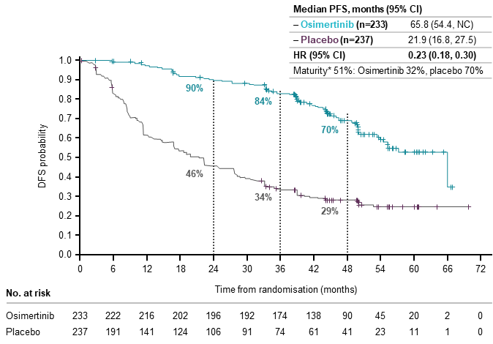
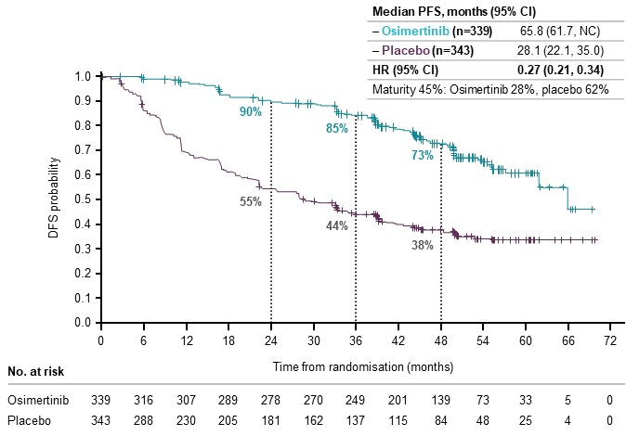
ADAURA: Disease-free survival in Stage II/IIIA (4-years)
Primary endpoint: DFS in Stage II/IIIA disease
DFS in the overall population (Stage IB/II/IIIA disease)
(16.6,
Median follow-up: Osimertinib 44.2 months (range 0 to 67), placebo 19.6 months (range 0 to 70); DFS by investigator assessment.
Data cut-off: April 11, 2022
Median follow-up: Osimertinib 44.2 months (range 0 to 69), placebo 27.7 months (range 0 to 70); DFS by investigator assessment.
Data cut-off: April 11, 2022

Slide 9
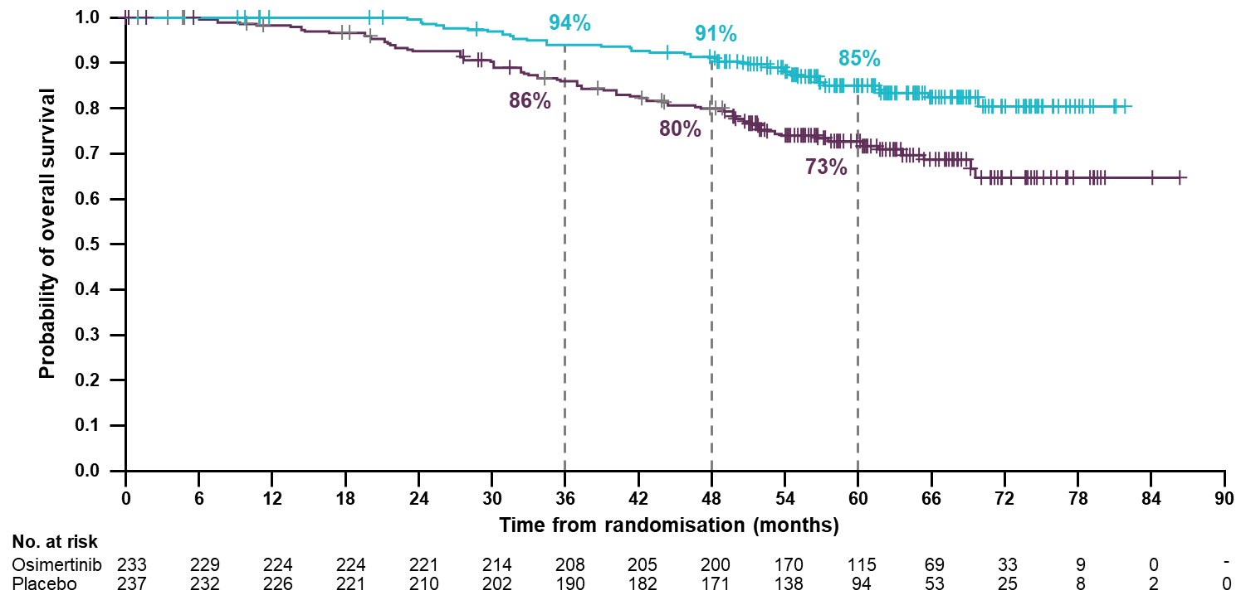
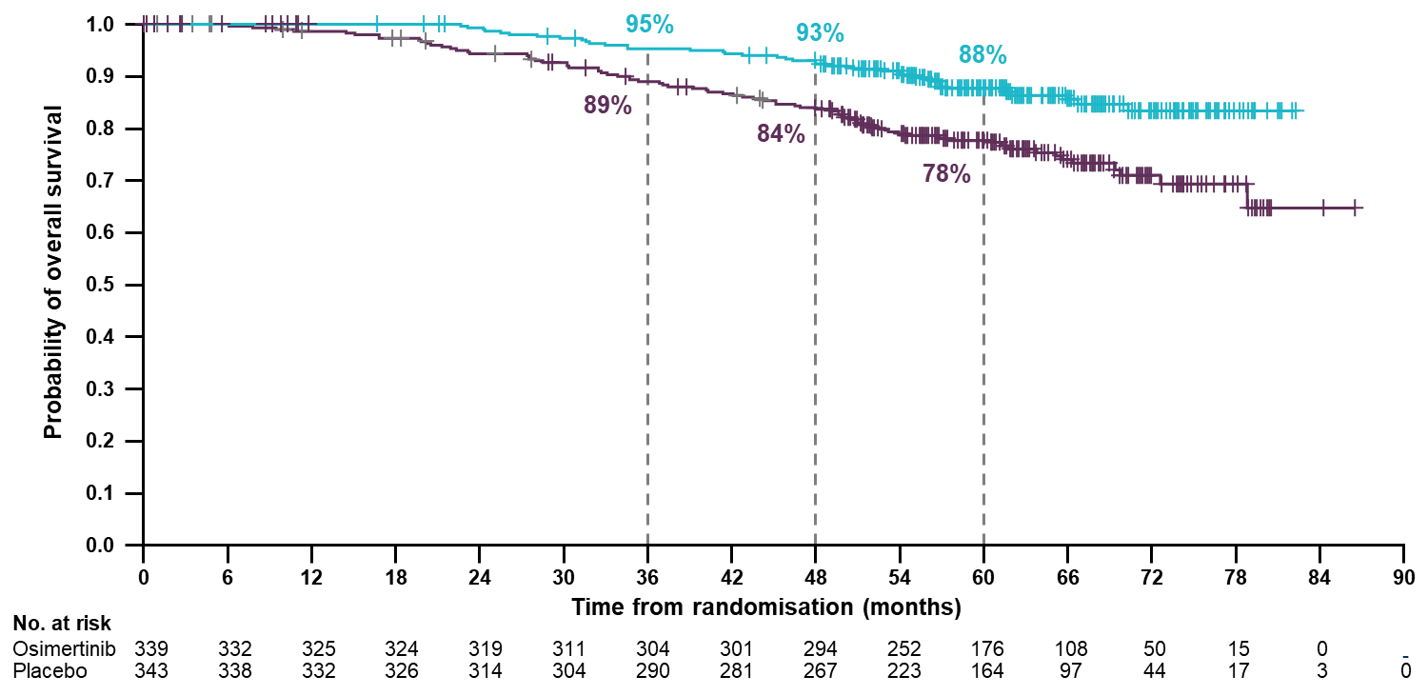
ADAURA: OS data – ASCO 2023
OS in Patients with Stage II/IIIA Disease
OS in Patients with Stage IB–IIIA Disease
Data maturity 21% (osimertinib 15%, placebo 27%)
Data maturity 18% (osimertinib 12%, placebo 24%)
 | OSIMERTINIB | PLACEBO
5-year OS, % (95% CI) | 85 (79–89) | 73 (66–78)
HR (95.03% CI) | 0.49 (0.33–0.73) p=0.0004
 | OSIMERTINIB | PLACEBO
5-year OS, % (95% CI) | 88 (83–91) | 78 (73–82)
HR (95.03% CI) | 0.49 (0.34–0.70) p<0.0001
This corresponds to a 51% reduction in the risk of death
ARR=12% at 60 months
This corresponds to a 51% reduction in the risk of death
ARR=10% at 60 months
Overall survival was a secondary endpoint (5 year data)

Slide 10
Peri-operative drug therapy
Osimertinib
Surgery
Adjuvant chemotherapy
Other targeted drugs
Immunotherapy
Notes:
What is the role of chemotherapy in resected EGFRm NSCLC?

Slide 11
Peri-operative drug therapy
Osimertinib
Neo-adjuvant
Immunotherapy
Surgery
Adjuvant chemotherapy
Other targeted drugs
Immunotherapy
Notes:
What is the role of chemotherapy in resected EGFRm NSCLC?

Slide 12
Neoadjuvant resectable Stage III: CheckMate-816
Primary endpoint
pCR (0% viable tumour cells in lung and lymph nodes)
EFS (BICR)
Secondary endpoints
MPR
OS
Time to death or distance metastasis
Safety
Key exploratory endpoints
EFS by surgical outcomes
EFS by pCR
pCR and EFS by 4-gene inflammatory signature score
Key patient inclusion criteria
Stage IB (≥4 cm)–IIIA NSCLC (per AJCC 7th edition)
No known sensitising EGFR or ALK alterations
ECOG PS 0–1
(N=358)
Nivolumab 360 mg Q3W + chemotherapy Q3W for 3 cycles (n=179)
SURGERY
Stratification
Stage (IB vs. II vs. IIIA)
PD-L1 status
Sex
Optional adjuvant chemotherapy ± radiotherapy
R
1:1
Chemotherapy Q3W for 3 cycles (n=179)
No sensitising EGFR or ALK mutations
Re-staging with PET-CT 1 week prior to surgery

Slide 13
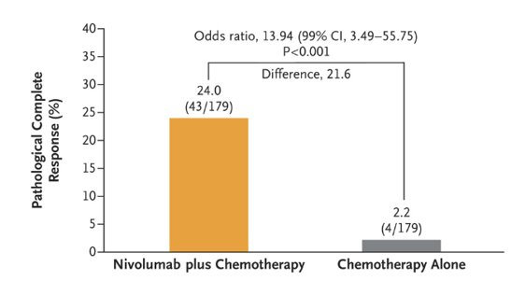
Pathological complete response pCR
Event-free survival in patients treated with nivolumab + chemotherapy²

Slide 14
CheckMate-816: EFS 3-year update
Event-free survival (exploratory analysis)
*

Slide 15
CheckMate-816: OS 3 year update
Overall survival (secondary endpoint)

Slide 16
Neoadjuvant: CheckMate-816 surgery?
 | Chemotherapy alone (%) | Nivolumab + chemotherapy (%)
Surgery | 75.4 | 83.2
Reason for not having surgery
Disease progression | 9.5 | 6.7
Adverse events | 0.6 | 1.1
Other | 10.6 | 7.8

Slide 17
Peri-operative drug therapy
Osimertinib
Neo-adjuvant
Immunotherapy
Surgery
Adjuvant chemotherapy
Other TKIs
Peri-operative immunotherapy
Immunotherapy
Notes:
What is the role of chemotherapy in resected EGFRm NSCLC?

Slide 18
NOT YET FUNDED

Slide 21
Summary please – resectable NSCLC!
EGFR mutation (exon 19del or L858R)
Surgery, adjuvant chemotherapy (optional), 3 years adjuvant Osimertinib
>=3cm and/or node positive
EGFR/ALK/(ROS-1/RET) negative
Chemo-nivolumab 3 cycles then surgery*
>=4cm and/or node positive
PD-L1 >=50% with no pre-operative SACT
Surgery, adjuvant chemo. atezolizumab

Slide 22
Implications
Early results of molecular testing essential
EGFR or ALK positive (ROS-1/RET) → straight to surgery
Turn around times:
Reflex PD-L1/ALK (IHC)
NGS may take too long
‘Urgent’ pathways for EGFR (PCR)
Consider waiting for full NGS panel in light/never smokers

Slide 23
Discussion
Local experience of neo-adjuvant pathways
Surgical experience
Molecular testing
Joint surgical/oncology clinics

Slide 24
“I see this as a priority now we are in the era of peri-operative immunotherapies , adjuvant TKI’s and also great for borderline patients.
If the surgeons really cannot deliver peripheral joint clinics, how would colleagues feel about the oncologists from the region having a rota to attend Bristol. I personally would be happy to offer chemo-io after a consultant colleagues assessment and likewise adjuvant osi for appropriate patients.
Without this approach I fear us achieving optimal pathway timings will be impossible.”

