Slide 1


National Cancer Patient Experience Survey Results 2022 – Peninsula Gynae Responses
SWAGGER Nov 2023
Prepared by Beth Kingshott

Slide 2
National Cancer Patient Experience Survey 2022
The NCPES Survey has been running since 2010
It has been designed to monitor national progress on cancer care; to provide information to drive local quality improvements; to assist commissioners and providers of cancer care; to inform the work of varies charities and stakeholder groups support cancer patients.
The survey Is run by Picker on behalf of NHS England.
The 2022 survey involved 133 NHS Trusts. Out of 115,662 people, 61,268 people responded to the survey, yielding a response rate of 53%.
The sample for the survey included all adult ( aged 16 and over) NHS Patients, with a confirmed primary diagnosis of cancer, discharged from an NHS Trust after an inpatient episode or day case attendance for cancer related treatment in the months of April, May and June 2022.
An interactive dashboard and other local/national reports can be accessed at www.ncpes.co.uk.

Slide 3
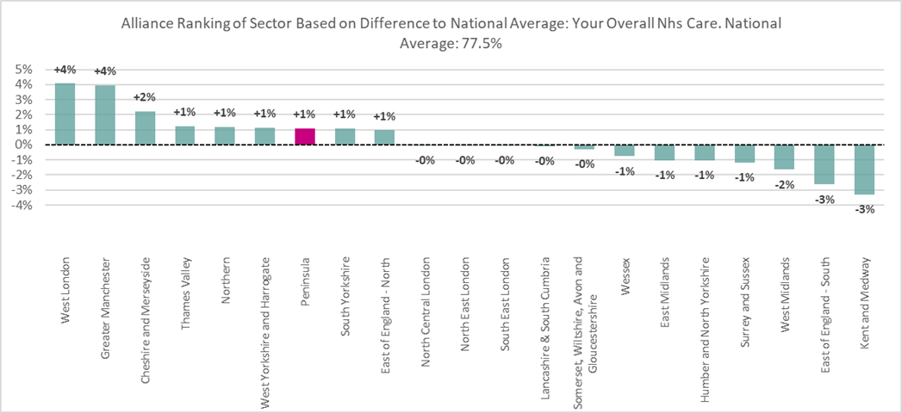
Patient's average rating of care scored from very poor to very good – Alliance Ranking (0-10)

Slide 4
Response Rates Gynae
 | 2022
RCHT | 35
UHP | 35
TSDFT | 23
RDUH | 63
PCA | 156
Overall Gynae Results Vs National – Peninsula

Slide 5
HIGHLIGHTS
91.7% said they received all the information needed about the diagnostic test in advance
91.5 % said enough privacy was always given to the patient when receiving diagnostic test results
96% said they had a main point of contact within the care team, and 91.1% said they were very or quite easy to get hold of. 94% found the advice helpful
88.1% said they had enough understandable information about surgery and 90% said this about radiotherapy.
90.7 % said their care team helped them address any needs or concerns

Slide 6


SUPPORT FROM YOUR GP
Section | Question | Question Text | Responses | Score (Unadjusted) | Vs National Score for that Question
Support From Your GP Practice | Q02 | Patient only spoke to primary care professional once or twice before cancer diagnosis | 90 | 75.6% | -0.1%
 | Q03 | Referral for diagnosis was explained in a way the patient could completely understand | 118 | 62.7% | -1.4%
DIAGNOSTIC TESTS
Section | Question | Question Text | Responses | Score (Unadjusted) | Vs National Score for that Question
Diagnostic Tests | Q06 | Diagnostic test staff appeared to completely have all the information they needed about the patient | 141 | 73.0% | -6.7%
 | Q08 | Diagnostic test results were explained in a way the patient could completely understand | 140 | 75.7% | -0.5%
 | Q09 | Enough privacy was always given to the patient when receiving diagnostic test results | 142 | 91.5% | -1.5%

Slide 7
FINDING OUT THAT YOU HAD CANCER
Section | Question | Question Text | Responses | Score (Unadjusted) | Vs National Score for that Question
Finding Out That You Had Cancer | Q12 | Patient was told they could have a family member, carer or friend with them when told diagnosis | 148 | 70.3% | -1.3%
 | Q13 | Patient was definitely told sensitively that they had cancer | 153 | 69.3% | -2.5%
 | Q14 | Cancer diagnosis explained in a way the patient could completely understand | 153 | 74.5% | -0.6%
 | Q15 | Patient was definitely told about their diagnosis in an appropriate place | 152 | 77.6% | -2.6%
DECIDING ON THE BEST TREATMENT
Section | Question | Question Text | Responses | Score (Unadjusted) | Vs National Score for that Question
Deciding On The Best Treatment | Q20 | Treatment options were explained in a way the patient could completely understand | 136 | 79.4% | -4.7%
 | Q21 | Patient was definitely involved as much as they wanted to be in decisions about their treatment | 148 | 76.4% | -2.0%
 | Q22 | Family and/or carers were definitely involved as much as the patient wanted them to be in decisions about treatment options | 117 | 76.9% | -2.9%
 | Q23 | Patient could get further advice or a second opinion before making decisions about their treatment options | 69 | 47.8% | -1.0%

Slide 8
CARE PLANNING
Section | Question | Question Text | Responses | Score (Unadjusted) | Vs National Score for that Question
Care Planning | Q24 | Patient was definitely able to have a discussion about their needs or concerns prior to treatment | 137 | 62.8% | -7.7%
 | Q25 | A member of their care team helped the patient create a care plan to address any needs or concerns | 75 | 90.7% | -1.2%
 | Q26 | Care team reviewed the patient's care plan with them to ensure it was up to date | 59 | 96.6% | -2.1%
 | Q29 | Patient was offered information about how to get financial help or benefits | 80 | 67.5% | -1.2%
 | Q35 | Patient was always able to discuss worries and fears with hospital staff | 84 | 59.5% | -2.4%
 | Q36 | Hospital staff always did everything they could to help the patient control pain | 80 | 80.0% | -4.3%
 | Q37 | Patient was always treated with respect and dignity while in hospital | 91 | 86.8% | -0.2%
 | Q38 | Patient received easily understandable information about what they should or should not do after leaving hospital | 87 | 85.1% | -2.2%
 | Q39 | Patient was always able to discuss worries and fears with hospital staff while being treated as an outpatient or day case | 119 | 74.8% | -2.1%

Slide 9
YOUR TREATMENT
Section | Question | Question Text | Responses | Score (Unadjusted) | Vs National Score for that Question
Your Treatment | Q41_1 | Beforehand patient completely had enough understandable information about surgery | 109 | 88.1% | -1.6%
 | Q41_2 | Beforehand patient completely had enough understandable information about chemotherapy | 86 | 87.2% | -0.9%
 | Q41_3 | Beforehand patient completely had enough understandable information about radiotherapy | 42 | 90.5% | -0.5%
 | Q41_5 | Beforehand patient completely had enough understandable information about immunotherapy | 15 | 53.3% | -30.8%
 | Q42_1 | Patient completely had enough understandable information about progress with surgery | 108 | 81.5% | -3.3%
 | Q42_2 | Patient completely had enough understandable information about progress with chemotherapy | 85 | 78.8% | -1.0%
 | Q42_5 | Patient completely had enough understandable information about progress with immunotherapy | 13 | 38.5% | -35.4%
NB -Q.41.5 &42.5 not enough responses

Slide 10
IMMEDIATE AND LONG TERM SIDE EFFECTS
Section | Question | Question Text | Responses | Score (Unadjusted) | Vs National Score for that Question
Immediate And Long Term Side Effects | Q44 | Possible side effects from treatment were definitely explained in a way the patient could understand | 137 | 65.7% | -9.7%
 | Q45 | Patient was always offered practical advice on dealing with any immediate side effects from treatment | 138 | 68.1% | -1.9%
 | Q46 | Patient was given information that they could access about support in dealing with immediate side effects from treatment | 113 | 84.1% | -2.9%
 | Q47 | Patient felt possible long-term side effects were definitely explained in a way they could understand in advance of their treatment | 127 | 55.9% | -1.4%
 | Q48 | Patient was definitely able to discuss options for managing the impact of any long-term side effects | 110 | 43.6% | -8.8%

Slide 11
SUPPORT WHILE AT HOME AND LWBC
Section | Question | Question Text | Responses | Score (Unadjusted) | Vs National Score for that Question
Support While At Home | Q49 | Care team gave family, or someone close, all the information needed to help care for the patient at home | 96 | 49.0% | -6.1%
 | Q52 | Patient has had a review of cancer care by GP practice | 140 | 17.9% | -5.6%
Living With And Beyond Cancer | Q53 | After treatment, the patient definitely could get enough emotional support at home from community or voluntary services | 37 | 27.0% | -5.9%
 | Q55 | Patient was given enough information about the possibility and signs of cancer coming back or spreading | 128 | 55.5% | -3.5%
YOUR OVERALL NHS CARE PCA Vs NATIONAL
Section | Question | Question Text | Responses | Score (Unadjusted) | Vs National Score for that Question
Your Overall Nhs Care | Q56 | The whole care team worked well together | 141 | 87.2% | -1.5%
 | Q57 | Administration of care was very good or good | 150 | 82.0% | -2.8%
 | Q58 | Cancer research opportunities were discussed with patient | 93 | 34.4% | -9.3%
 | Q59 | Patient's average rating of care scored from very poor to very good | 148 | 8.7 | -10.8%

