Slide 1

PIFU in management of out-patient care in Cancer Unit
Dr Sundararajan
Dr newton

Slide 2
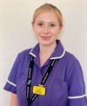
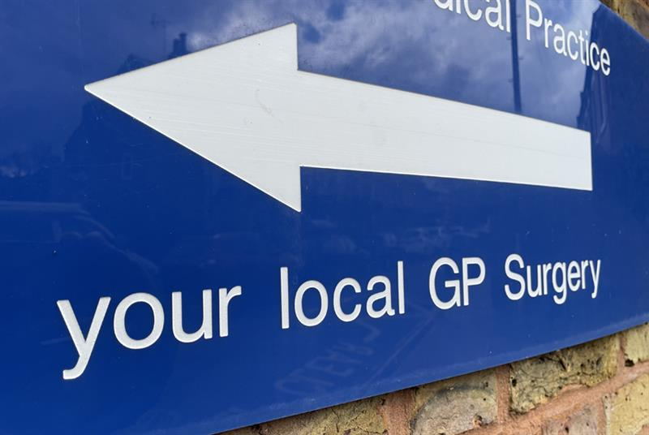

Patient contact after PIFU

Slide 3
PIFU Study- Aim
Reasons for contact
Recurrence data
Management of recurrence

Slide 4
methodology
Retrospective observational study
Cervix, Endometrial , ovarian (incl of borderline tumours) , vulval and vaginal cancer
Excluded- palliative PIFU, lost to F-U, Benign
Somerset cancer registry
Electronic patient records
1/1/2017 to 30/10/2022

Slide 5
RESULTS
573 patients on PIFU
160(27.92%) contacted our service
DEMOGRAPHICS
Age
Range - 23-97 years
Mean+_ SD- 57.5(+_10.606)
Median -68

Slide 6
ETHNICITY
Ethnic group | Number of patients | Percentage of patients (%)
White British | 492/573 | 85.8%
Unknown | 37/573 | 6.45%
Asian- British, Indian, Pakistani, other Asian background | 15/573 | 2.61%
Any other White background | 12/573 | 2.09%
Black- British, African, Caribbean | 8/573 | 1.39%
White Irish | 4/573 | 0.69%
Any other ethnic group | 2/573 | 0.34%
Asian Chinese | 1/573 | 0.17%
Any other mixed background | 1/573 | 0.17%
Eastern European | 1/573 | 0.17%

Slide 7
DISEASE DISTRIBUTION
Primary site of cancer | Number of patients | Percentage of patients (%)
Uterus | 347/573 | 60.5%
Cervix | 108/573 | 18.8%
Ovary/Fallopian tube/ Peritoneum | 56/573 | 9.77%
Borderline ovarian tumours | 31/573 | 5.41%
Vulval and vaginal | 18/573 | 3.14%
Mixed pathological site | 13/573 | 2.26%

Slide 8

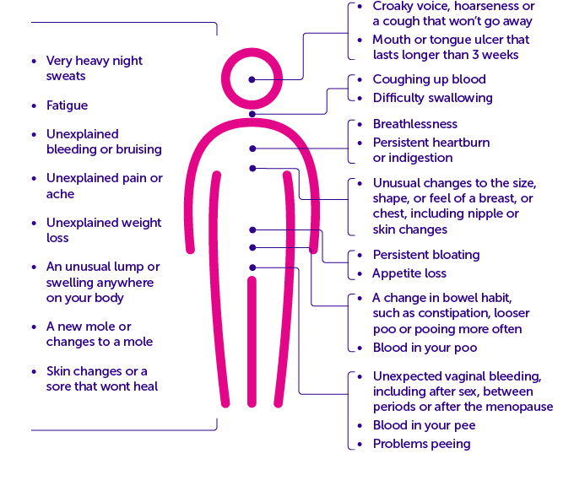

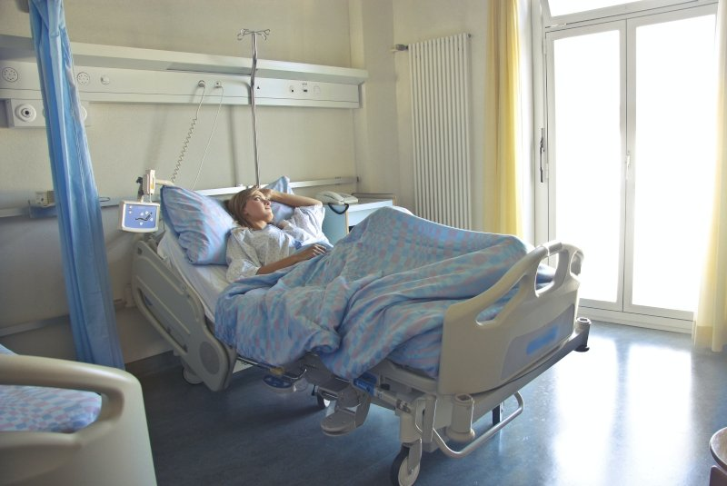
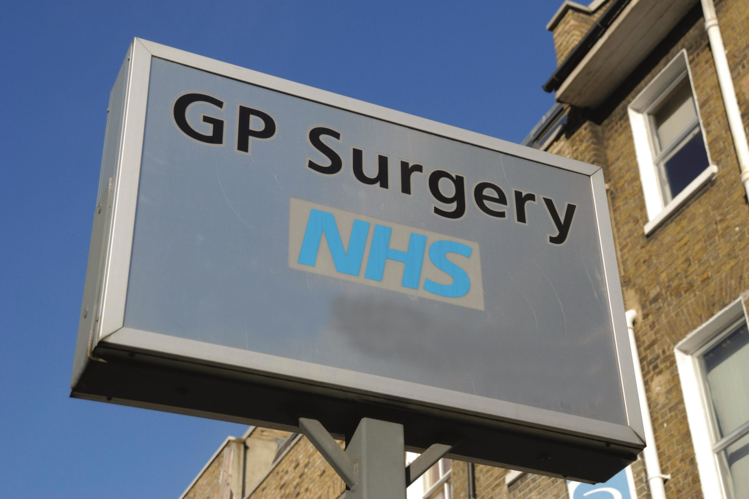
REASON OF CONTACT
Do I need a smear?

Slide 9
ETHNIC VARIATION IN CONTACT
ethnicity | Number of patients contacted our service | percentage
WB | 137 out of 492 | 27.84%
UNKNOWN | 7 out of 37 patients | 18.9%
Asian- British, Indian, Pakistani, other Asian background | 5 out of 15 patients | 33.3%
Afro-Caribbean | 4 out of 8 | 50%
other White background | 3 out of 12 | 25%
other Ethnic group | 1 out of 2 patients | 50%
Eastern European | 1 out of 1 patient | 100%
other Mixed ethnic background | 1 out of 1 patient | 100%
Asian Chinese | 1 out of 1 patient | 100%

Slide 10
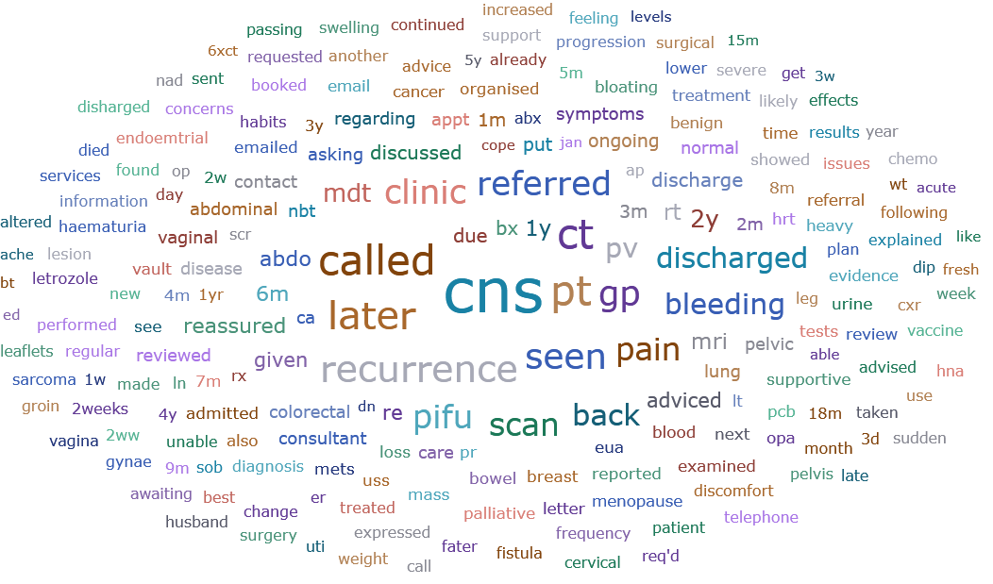

Slide 11
BREAKDOWN OF CONTACT INFORMATION
21 patients
74 PATIENTS
6
1
46 patients
18

Slide 12
RECURRENCE
23 (4.01%) patients

Slide 13
Symptoms of recurrence
Site of cancer | symptoms
ENDOMETRIAL CANCER | PV bleeding
 | b/l leg swelling
 | Supraclavicular lymph nodes
 | Pelvic pain, PR Bleeding, abdo distension
 | Rt. Scapula pain, weight loss, SOB after knee replacement , cough
CERVICAL CANCER | Axillary LN, Abdo pain- para-aortic LN
OVARIAN CANCER | Abdo pain and haematuria
 | RIF pain, LIF pain
 | SOB, Cough,

Slide 14
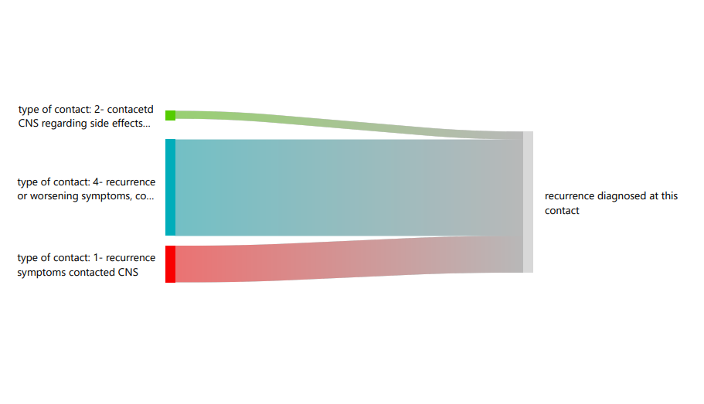

Slide 15
CONCLUSION
413 out of 573 patients (72%) not contacted our services- confident with management
Women of all ethnic group have contacted our service
The role of CNS is pivotal in implementing PIFU

Slide 16
DISCUSSION
Evidence re: patients with different needs and from lower socio economic background
Recurrence analysis – diagnostic and management challenges in unusual sites of recurrence
future research

