Slide 1
Gynaecological Oncology Research Update for SWAGGER
West of England & South West Peninsula CRNs
- Claire Matthews & Joanne Taylor
03/11/2023

Slide 2
Gynae Oncology National Research Recruitment
22/23
23/24 (first six months)
Data cut: 25/10/2023
Source: ODP All Portfolio

Slide 3
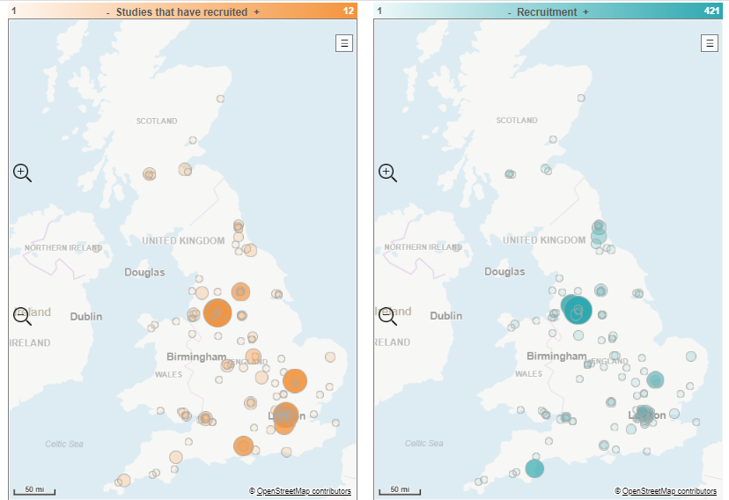
Primary and Secondary Care sites recruiting to Gynae Onc studies 23/24
BHOC, St Michael’s BRI, RBHC
RDE; 4 Studies
Royal Cornwall Hospital: 4 studies
Torbay: 1 Study, 233 recruited

Slide 4
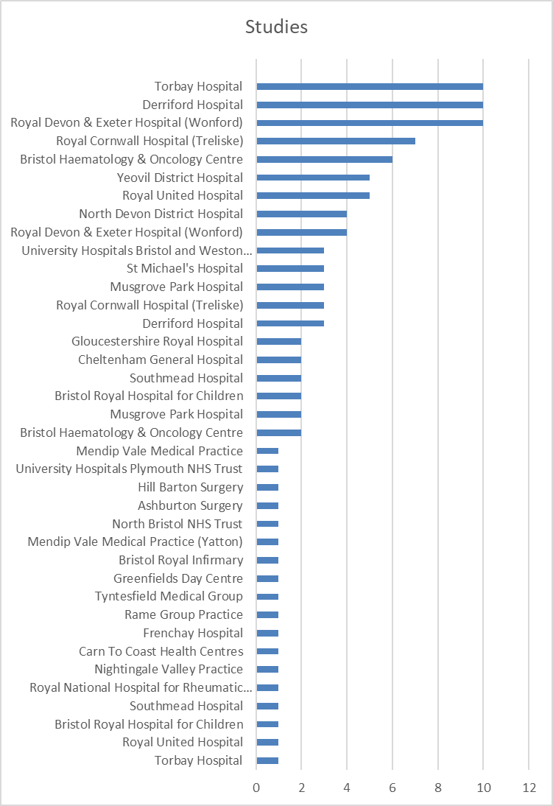

Slide 5
Gynae Onc Studies - opened in SW Pen/WE since Jan 22
CPMS ID | Short Name | Opening | Closure | Sample Size Eng | Eng Recruits
54802 | ROSELLA | 28/09/2023 | 30/06/2024 | - | 0
54099 | Dose Escalation Study of NMS-03305293 in Patients with Selected Advanced/Metastatic Solid Tumours | 11/07/2023 | 05/01/2024 | 5 | 1
55489 | Attitudes to Postnatal Instead of Normally-Timed Cervical Screening | 15/04/2023 | 15/04/2024 | 500 | 0
52784 | ACTOv | 10/03/2023 | 01/09/2025 | 70 | 4
53270 | Phase 1b Study of SL-172154 Administered with Combination Agent(s) in Subjects with Ovarian Cancers | 17/02/2023 | 09/04/2024 | 9 | 4
51921 | MK3475-C93 | 13/12/2022 | 16/11/2023 | 12 | 4
50700 | An open-label continuation study for avelumab study participants | 06/09/2022 | 28/02/2025 | 8 | 5
51118 | PAIRS | 02/06/2022 | 01/05/2026 | 130 | 15
49720 | Anlotinib in Ovarian Cancer | 29/04/2022 | 31/12/2023 | 20 | 59
50364 | Evaluation of MCM5 in postmenopausal bleeding patients | 07/03/2022 | 31/10/2023 | 390 | 2448
49696 | Reproductive function in TYA cancer survivors. (The PROTECT study) | 28/01/2022 | 28/01/2024 | 800 | 310
Data cut: 25/10/2023
Source: ODP All Portfolio

Slide 6
Gynae Onc Studies - closing in SW Pen/WE in 23/24
CPMS ID | Short Name | Opening | Closure | Sample Size Eng | Eng Recruits
47399 | Validation of HPV test system using self-collected vaginal samples | 01/07/2021 | 30/09/2023 | 6750 | 5747
50364 | Evaluation of MCM5 in postmenopausal bleeding patients | 07/03/2022 | 31/10/2023 | 390 | 2448
51921 | MK3475-C93 | 13/12/2022 | 16/11/2023 | 12 | 4
49720 | Anlotinib in Ovarian Cancer | 29/04/2022 | 31/12/2023 | 20 | 59
48062 | First-in-human Study of OVM-200 as a Therapeutic Cancer Vaccine | 21/09/2021 | 31/12/2023 | 14 | 6
46521 | ROSY-O | 31/08/2021 | 31/12/2023 | 8 | 10
45863 | PARPi 2X-121 in Ovarian Cancer | 16/07/2021 | 31/12/2023 | 10 | 5
45981 | 2X-1000 Drug Response Predictor (DRP®) Pre-screening | 01/07/2021 | 31/12/2023 | 20 | 0
35791 | LN-145 in Advanced Cervical Carcinoma | 26/02/2018 | 31/12/2023 | 8 | 8
30876 | FORECEE: Case control study of inherited women's cancer | 01/12/2015 | 31/12/2023 | 4000 | 2974
54099 | Dose Escalation Study of NMS-03305293 in Patients with Selected Advanced/Metastatic Solid Tumours | 11/07/2023 | 05/01/2024 | 5 | 1
49696 | Reproductive function in TYA cancer survivors. (The PROTECT study) | 28/01/2022 | 28/01/2024 | 800 | 310

Slide 7
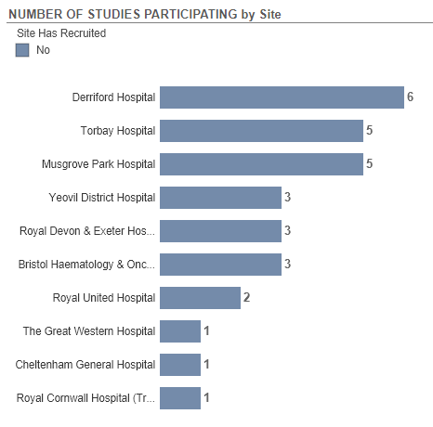
Studies in Set-up

Slide 8
Gynae Onc Studies - in set up in SW Peninsula & West of England
CPMS ID | Short Name | Opening | Closure | Sample Size UK
58229 | eVOLVE Cervical | 29/02/2024 | 25/08/2026 | 54
57783 | DETECT-2 | 30/09/2023 | 30/11/2026 | 832
57242 | KRC-01 | 01/11/2023 | 31/03/2025 | 3
56232 | EQ132 | 30/11/2023 | 30/06/2025 | 18
56138 | Could supported weight loss reduce womb cancer surgery complications? | 01/11/2023 | 29/02/2028 | 72
55713 | PICCOS | 31/10/2023 | 30/04/2026 | 216
54856 | BNT142-01- BioNTech SE - solid tumors - 4781/0029 | 19/11/2023 | 01/01/2027 | 15
54752 | SURPASS-3 | 30/11/2023 | 14/08/2024 | 8
54165 | PRESCORES | 01/01/2023 | 31/12/2024 | 750
54098 | Randomized, multicenter, open-label, phase 3 study of mirvetuximab soravtansine | 31/10/2023 | 01/02/2026 | 18
53613 | BLU-222 | 16/10/2023 | 03/03/2025 | 23
53410 | IMGN853-0420/Mirvetuximab soravtansine (IMGN853) | 15/11/2023 | 15/11/2024 | 10
52288 | ADP-0077-001 Adaptimmune Solid Tumors (4636/0018) | 31/12/2023 | 31/08/2024 | 12
Data cut: 25/10/2023
Source: ODP All Portfolio

Slide 9
Associate PI Scheme
https://www.nihr.ac.uk/health-and-care-professionals/career-development/associate-principal-investigator-scheme.htm
A six month in-work training opportunity, providing practical experience for healthcare professionals starting their research career.
People who would not normally have the opportunity to take part in clinical research in their day to day role have the chance to experience what it means to work on and deliver a NIHR portfolio trial under the mentorship of an enthusiastic Local PI.

Slide 10
NIHR Associate Principal Investigator (PI) Scheme Educational Event
associatepischeme@nihr.ac.uk

Slide 11
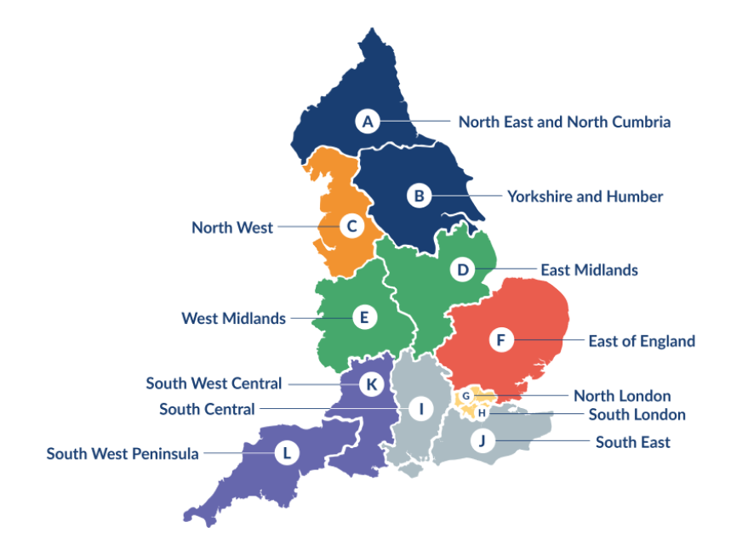
Clinical Research Network Transition to Research Delivery Network
Launching Oct 2024
The NIHR RDN has 2 primary purposes:
To support the successful delivery of high quality research, as an active partner in the research system
To increase capacity and capability of the research infrastructure for the future
Will operate as 1 organisation across England, through a network of 12 Regional Research Delivery Networks (RRDNs) and a central Coordinating Centre (RDNCC)

Slide 12
NIHR ODP
Open data platform. Data on performance and restart across whole CRN, including all specialty areas
NIHR Be Part of Research
See which studies are open across the country
National Cancer Research Institute Portfolio Maps
View current national portfolio of open, closed and ‘in set up’ cancer studies
Find a Clinical Research Study (ODP)
Search for a study to fit criteria. Good for horizon scanning, eligibility criteria

Slide 13
Research Delivery Manager
claire.matthews@nihr.ac.uk (WE)
Joannetaylor1@nhs.net (SWP)
Research Portfolio Facilitator
rebecca.pienaar@nihr.ac.uk (WE)
Sub-specialty Lead
Rebecca.bowen (WE)
Clare Barlow (SWP)

