Slide 1
SWAGGER Meeting Update
Frank McDermott
Siobhan John

Slide 2
National Update
Funding transformation project
BCSP / registration
Mainstreaming
Mysunrise app
MSI plus
Strategy for managing Lynch patients in trust/ Ca Alliance/ Region

Slide 3
Mainstreaming
About
Mainstreaming event
Identifying members of the team

Slide 4
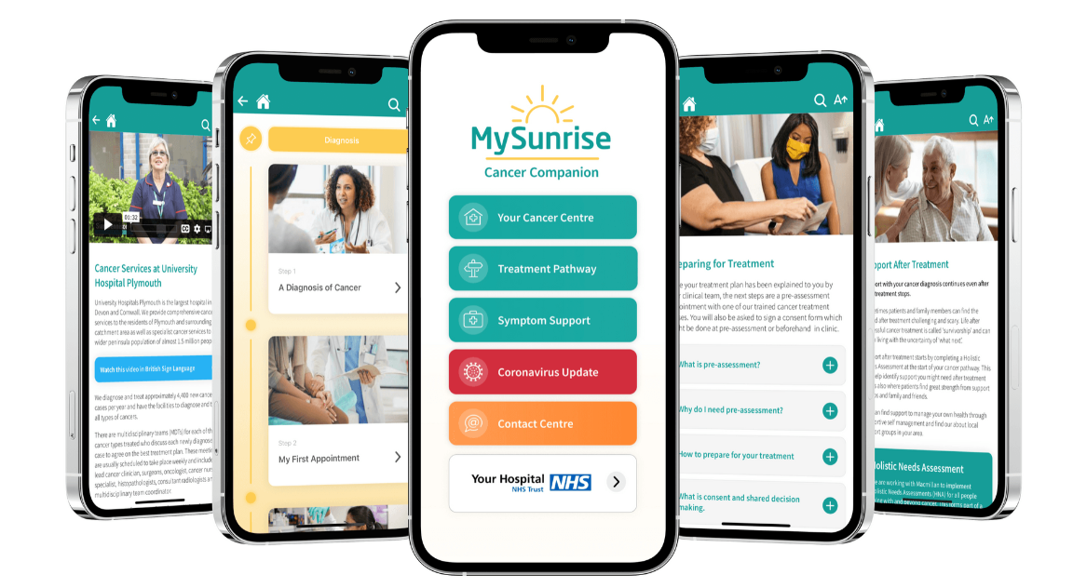
Mysunrise app

Slide 6
Regional Expert Network
Monthly, first Monday at 1230 - 1330
Lynch and Polyposis
Educational part
MDT proforma
Email: rduh.lynch-polyposis@nhs.net
Next 6/11/2023

Slide 7
Patients discussed so far…
Mosaic lynch syndrome
dMMR in a rectal cancer needed CRT
FAP ? Surgical timing
Devon polyposis
Education on unexplained dMMR (Lynch-like)

Slide 8
https://www.genomicseducation.hee.nhs.uk/genotes/

Slide 9
Meeting in December
Sustainability meetings
Workforce
Job planning

Slide 10
Contacts:
Frank McDermott
f.mcdermott@nhs.net
Adam Chambers
adam.chambers@bristol.ac.uk
Siobhan John
siobhan.john@nhs.net
Tracie Miles
tracie.miles@nhs.net
Megan Wilkie
megan.wilkie@nhs.net

