Slide 1
Developing novel intra-operative speech tests for awake brain surgery
Hajira Mumtaz, Anna Piasecki, Neil Barua, Minna Kirjavainen-Morgen

Slide 2
“My Beautiful Broken Brain”
My Beautiful Broken Brain (2014) available at: https://www.netflix.com

Slide 3
Awake brain surgery
Surgical practice consisting in awakening the patient during surgery to administer motor/language/cognitive tests
Applied to people with brain tumours and medically untreatable epilepsy
Primary goals: maximize tumour removal and minimize language impairments
Open window to explore language in the brain!

Slide 4
Intra-operative language testing – an example

Slide 5
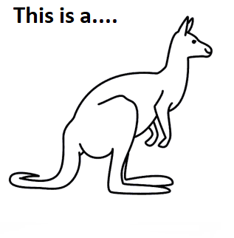
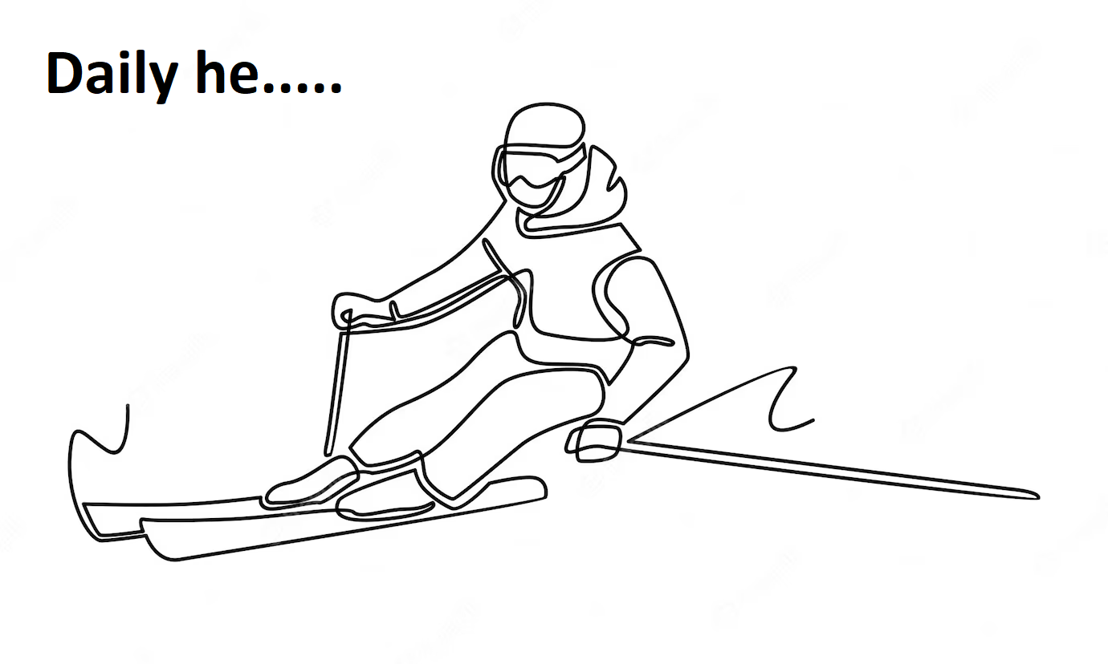
Current intra-operative language tests
Traditional testing: counting 1-10
Object naming (the most common task)
Action naming

Slide 6
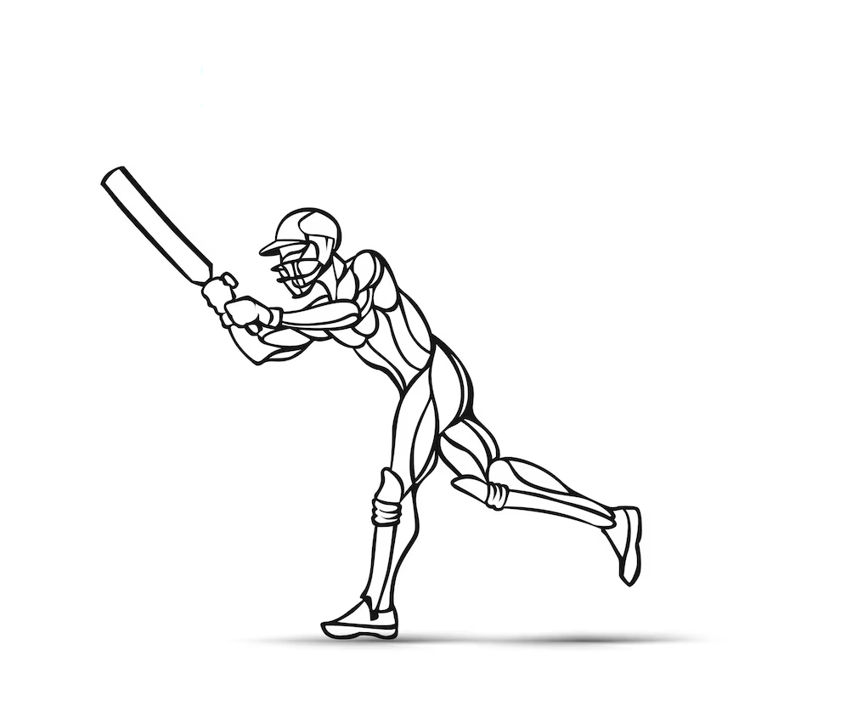
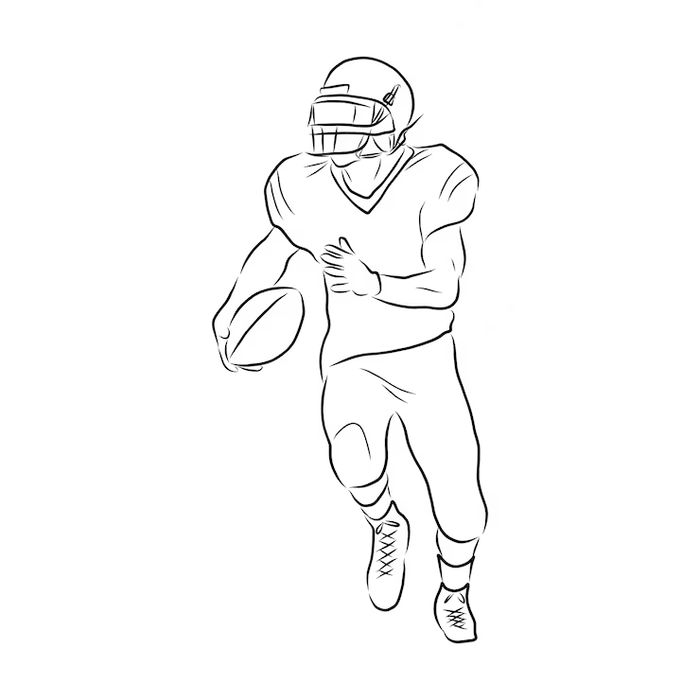
Are the currently used intra-operative language tests effective?
Despite of the intra-operative testing, deficits in spontaneous speech are common (Santini et al., 2012)
Language tests should be:
Relevant
Sensitive
Complex

Slide 7
Our work
Designing tests specific to the British population
Including task items that refer to concepts that are most familiar and most frequently used by the British speakers
Use of the British National Corpus to compile test items

Slide 8
How can we make the tests more complex?

Slide 9
My old school friend Emma came on a flying visit this weekend. We had a girls’ night out on Saturday with a couple of other friends. Even though it was raining cats and dogs, but we still went out for a meal to a local restaurant. Emma kept ordering all the junk food that the restaurant had, while continuously having a whinge about her weight and not being able to stick to her diet.
(taken from O’Dell & McCarthy, 2009)
Did you notice anything peculiar about this text?

Slide 10
Testing beyond single words
My old school friend Emma came on a flying visit this weekend. We had a girls’ night out on Saturday with a couple of other friends. Even though it was raining cats and dogs, but we still went out for a meal to a local restaurant. Emma kept ordering all the junk food that the restaurant had, while continuously having a whinge about her weight and not being able to stick to her diet.
(taken from O’Dell & McCarthy, 2009)
Language does not exist in the form of individual words that are put together to convey meanings
50-60% of our daily language use comprises ‘multi-word expressions’
Eye-tracking evidence shows that ‘multi-word expressions’ are processed faster than grammatical language

Slide 11
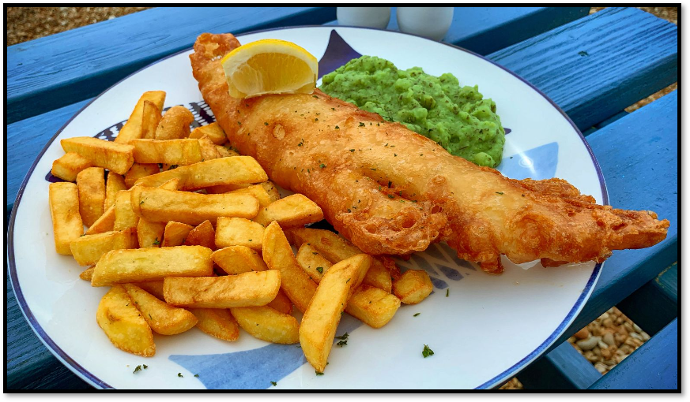
Notes:
With that in mind, our intention is to develop tests containing ‘multi-word chunks .. But those that are familiar and most frequently used by British speakers .. So something like fish and chips and tea and biscuits

Slide 12
Project work to-date
STEP 1 STEP 2 STEP 3 STEP 4
Clinical validation
Design
Item selection
Standardization
Design
Item selection
Standardization
Clinical validation
Selection of the task items from the BNC
≥80 accuracy in normal population
Collecting norms in normal population
Data collection in patients

Slide 13
Thank you for your attention!

Slide 14
References
BNC Consortium, The British National Corpus, XML Edition, 2007, Oxford Text Archive,
Erman, B., & Warren, B. (2000). The idiom principle and the open choice principle. Text & Talk, 20(1), 29–62.
O’Dell, F., & McCarthy, M. (2009). English collocations in use: Advanced. The Electronic Journal for English as a Second Language, 13(2).
https://www.youtube.com/
https://images.google.com/
https://www.netflix.com
Rofes, A. (2015). Verbs and nouns in awake neurosurgery: Needs and answers [Phd, University of Trento]. Retrieved from http://eprints-phd.biblio.unitn.it/1572/
Santini, B., Talacchi, A., Squintani, G., Casagrande, F., Capasso, R., & Miceli, G. (2012). Cognitive outcome after awake surgery for tumors in language areas. Journal of Neuro-Oncology, 108(2), 319–326.
Wray, A., & Perkins, M. R. (2000). The functions of formulaic language: An integrated model. Language & Communication, 20(1), 1-28.

Slide 15
Further considerations
Designing and validating tests for:
Less transparent collocations (e.g., explode a myth)
Free word combinations (e.g., read a newspaper)
Idioms (e.g., kick the bucket)
Metaphors (e.g., heart of gold)
Compound words may be?
Effect/interaction of word-related properties/psycholinguistic variables on task performance.

