Slide 1
SWAG Cancer Alliance
Targeted Lung Health Check Programme (TLHC)
Dr Anna Bibby
Respiratory Consultant & Lung Cancer Lead, North Bristol NHS Trust
Clinical Director, SWAG TLHC
NIHR Advanced Fellow, University of Bristol

Slide 2
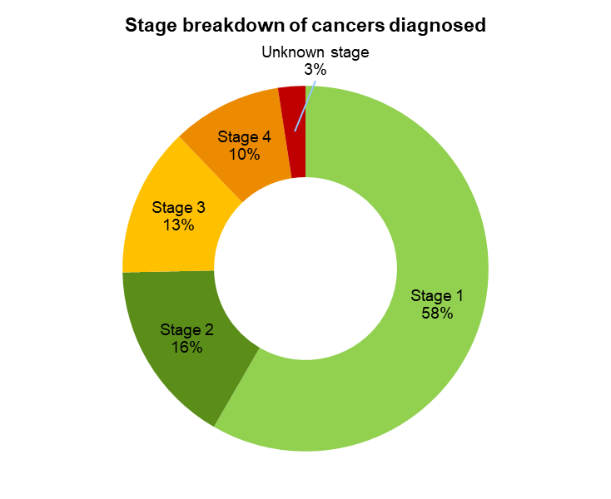
National TLHC activity
2,396
Total

Slide 3
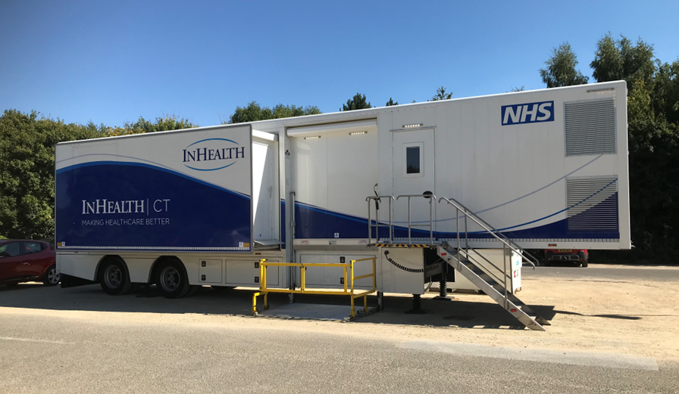
SWAG pilot
Community-based, roving model
Accessible, non-clinical locations
Areas of highest need
Targeting underserved communities
Equal distribution of workload & learning
Upskilling & capacity building
Complex…

Slide 4
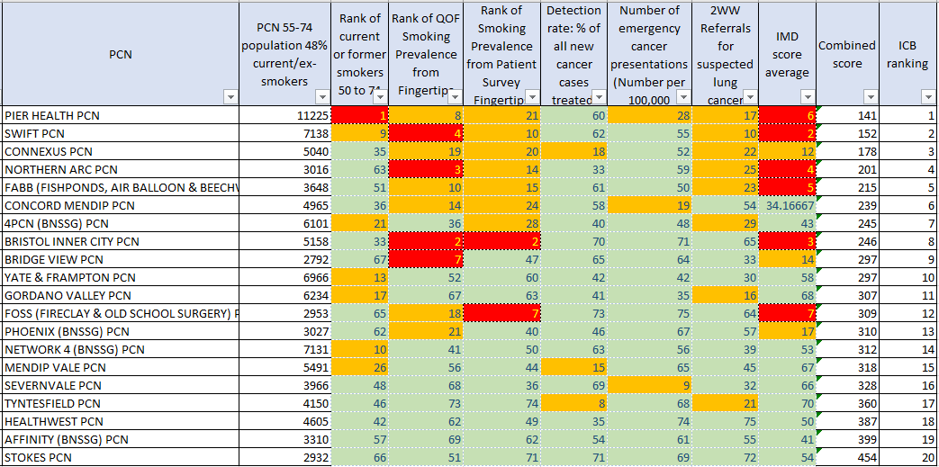
BNSSG PCN rankings

Slide 5
Pilot PCNs

Slide 6
Bath experience, July 2022-Nov 2022
Number of telephone lung health checks - 2851
Number of patients referred for LDCT - 1002
200 smoking cessation referrals
Successful quits - 24
Baseline CTs – 980
Follow up CTs – 190
183 nodules under surveillance
Remain in TLHC
31 suspected lung cancer referrals to RUH 2WW
18 lung cancers diagnosed
Treated radically - 15
1 alternative malignancy
Multiple myeloma

Slide 7
Bridgwater experience, Dec 2022 – May 2023
Number of telephone lung health checks - 6,000
Number of patients referred for LDCT - 3500
354 smoking cessation referrals
Successful quits - 103
Baseline CTs – 2810
Follow up CTs – 400
50 suspected lung cancer referrals to MPH 2WW
41 from baseline scans
9 from 3/12 FU scans

Slide 8
Bath experience
Aortic valve calcification | 14 | Referred to cardiology, ECHOs requested by TLHC team
Thoracic aortic aneurysm | 12
Liver or spleen lesions | 4 | Alternative scan requested and reviewed in TLHC SRM
Renal lesions | 3 | GP advised to request alternative scan
Adrenal lesions | 1
Bone abnormalities | 2
Mediastinal mass | 2 | Referred to lung 2WW
Interstitial lung abnormalities | 2 | Referred to respiratory clinic
Pleural effusion/ thickening | 1 | Referred to respiratory clinic
Respiratory bronchiolitis/ consolidation | 3

Slide 9
Important incidentals
Coronary artery calcification ~58%
Radiological emphysema ~40%
Spirometry not currently offered within programme
National taskforce to standardise management/ advice – output awaited
Letters written to participants with advice based on severity, symptoms & smoking status
Including signposting to parallel resources e.g. over 40s health check
Notes:
representatives from NHSE CV prevention groups and both outgoing and incoming president of Primary Care CV Society

Slide 10
The future

Slide 11
Expansion
347,994 eligible people across SWAG
BSW: 104,064
BNSSG: 95,260
Glos: 73,233
Somerset: 75,207
EOFY 2028/2029
Translates to 20,000-30,000 TLHC per year
~3500 cancers in total

Slide 12
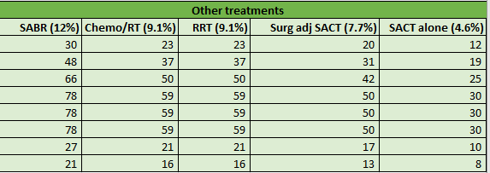
Expansion modelling
Notes:
Cancers diagnosed includes baseline scans and FU scans
Accounting for Salisbury and some of glos going to other surgical sites.
Monthly meetings with UHBW managers re capacity

Slide 13
Expansion modelling
Notes:
Mention already 6m delay

Slide 14
Expansion modelling
Notes:
About 64 per month, so ~10-15 per centre per
Almost all will need PET & PFTs. Most will need biopsy.
We can map out to match when trucks in each locality once timelines established
Funding for Spec comm services established. Still ongoing discussions re downstream work.
In reality sites will need more radiology staffing, more CT capacity, more resp physiology, more resp cons, as well as more surgeons, oncs and RT space.

Slide 15
Future challenges
NHS capacity – diagnostics, incidentals and treatment (surg + onc)
TLHC staffing – clinical delivery team – resp rads & clinicians
Delivery model – is external provider correct approach?
Business as usual (April 2029) – what does this look like?
Multiple autonomous SRMs
?brining services back in house
Link up with CDCs

Slide 16
Positives
SWAG TLHC is a positive exemplar
SRM management
SRM as accelerator
Participant communication & documentation
CAC signposting/ management – reducing burden on primary care
Deliberate (and successful) attempts to engage populations at highest risk
Dissemination at conferences – BTS, BTOG

Slide 17
Research
Notes:
Research supportin uptake and repeat attendance
Also optimal approaches for smoking cessation

Slide 18
Discussion

