Slide 1
SWAG Treatment Variation workstream update
Please note: These slides contain sensitive data which is for management purposes only. Please do not share these slides.

Slide 2
Content
Treatment Variation Group recommendations
Roche Pathway Analyser tool
Nurse led surgical f/u proposal
Discussion

Slide 3
Recommendation |  | Royal United Hospitals Bath | Gloucestershire | University Hospital Bristol and Weston | Salisbury | North Bristol Trust
9 | All trusts should have an overall radical treatment rate of 85% or more in those patients with NSCLC stages I-II and of performance status 0-2. This includes all treatment modalities (surgery, radiotherapy including SABR, multimodality treatment and thermoablative techniques). | yes |  |  |  | yes
10 | All trusts should have an overall surgical resection rate for NSCLC of over 20%. |  |  |  |  | yes
11 | All trusts that treat lung cancer with radiotherapy should be able to deliver SABR in line with the clinical commissioning policy.
12 | All trusts should deliver radiotherapy in line with the Royal College of Radiologists consensus statements.
13 | Where a patient has early stage disease but is declined for radical treatment, or does not have access to the full range of radical treatment options, more effective mechanisms should exist for a second opinion.
14 | Trusts should monitor rates of post-surgical adjuvant and neoadjuvant treatments and this data should be available for national benchmarking.
15 | Trusts should record and monitor multimodality treatment in stage IIIA disease and offer radical intent treatment as standard in fit patients. | yes | yes | Agree | Agree | yes
16 | Radical intent treatment should commence by day 49 of the overall NOLCP pathway. Furthermore, for surgery, thermoablation or radiotherapy, treatment should commence by day 16 after the decision to treat in line with NOLCP. | Agree | Agree | Agree | Agree | Agree
17 | All trusts should improve their treatment rates with SACT to achieve greater than 70% treatment for fit patients with advanced NSCLC, and greater than 70% chemotherapy rates in small cell lung cancer.
18 | Ensure that all patients lung cancer have access to enhanced supportive care and/or specialist palliative care. Inpatient specialist palliative care provision should be available seven days per week. |  |  |  | Agree
19 | Produce and implement protocols for follow-up pathways following radical therapies. |  |  | yes | Agree
20 | Clinical trial recruitment should be considered a focus for prioritisation, with MDTs collaborating to offer a wider regional portfolio.

Slide 5
Deliverable Alliances to continue to oversee the implementation of 3 selected treatment recommendations from the national lung Getting It Right First Time (GIRFT) report.
Radical intent treatment should commence by day 49 of the overall NOLCP pathway. Furthermore, for surgery, thermoablation or radiotherapy, treatment should commence by day 16 after the decision to treat in line with NOLCP.
All trusts should have an overall radical treatment rate of 85% or more in those patients with NSCLC stages I-II and of performance status 0-2. This includes all treatment modalities (surgery, radiotherapy including SABR, multimodality treatment and thermoablative techniques).
Trusts should record and monitor multimodality treatment in stage IIIA disease and offer radical intent treatment as standard in fit patients.
Notes:
3rd recommendation agreed IIIA disease PS 0-1

Slide 6
Somerset, Wiltshire, Avon and Gloucestershire Cancer Alliance
Diagnosis and staging
Survival outcome
1,548
patients were diagnosed with lung cancer in 2021
79%
of patients with stage I/II disease, performance status (PS) 0-1 had pathological confirmation of their diagnosis
45%
of patients with a one year survival after diagnosis
51%
of patients presented with stage IV disease
Surgery for non-small cell lung cancer (NSCLC)
Chemotherapy for small cell lung cancer (SCLC)
34%
of patients were diagnosed via emergency presentation
of patients with NSCLC had surgical treatment for their cancer
of patients with SCLC received treatment with chemotherapy
15%
66%
Treatment with curative intent
Systemic anticancer treatment
of patients with NSCLC (stage I/II, PS 0-2) received treatment with curative intent*
of patients with NSCLC (stage IIIA, PS 0-2) received treatment with curative intent*
of patients with NSCLC (stage IIIB-IV, PS 0-) received systemic anticancer treatment
74%
48%
62%
88%
91%
63%
90%
60%
40%
Sources: NLCA-State-of-the-Nation-Report-2023_final-12.04.23.pdf (lungcanceraudit.org.uk) and NLCA-data-tables_SotN-report-2023_12.04.23.xlsx (live.com)
*surgery or radical radiotherapy, **surgery, radical radiotherapy or multimodal combination with chemotherapy
For NHS internal use only to inform service improvement discussions

Slide 7
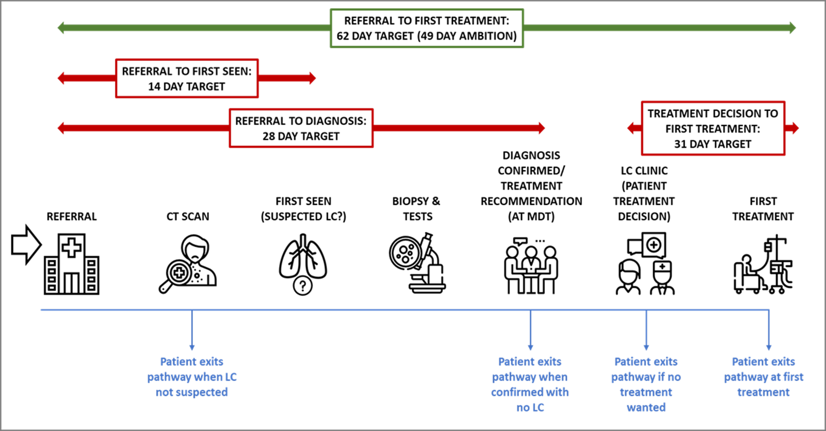
ROCHE pathway analyser tool
It utilises data from hospital clinical systems to map the patient journey through the lung cancer pathway from referral to diagnosis and first treatment - see infographic

Slide 8
What does the ROCHE tool show?
Goes beyond the 28 day and 62 day targets
Tells you where the “Pinch Points” are, i.e. WHY performance the target is being missed and WHERE it can be improved
Where are the problems in the pathway?

Slide 9
Data imported from hospital clinical systems is presented in a series of dashboards – some examples

Slide 10
23/24 Q1 position
4/6 providers have Roche tool v2.1 installed – GHFT and RUH pending

Slide 11
23/24 Q1 position

Slide 12
SWAG problem statement
The NOLCP Timed Treatment Pathway 1- Thoracic surgery requires 3 days between IPT and Surgical OP, 11 days between OP and POAC and 15 days between POAC and surgery
When reviewing the 15 patients (who met the criteria – none required CT PET) treated at UHBW in August the median time from IPT to surgery was 50 days. The median time from IPT to surgical OP was 18 days (1-27), Surgical OP to POAC anaesthetic review was 21 days (0-44) and POAC to surgery 8 days (2-26 days)
Additional capacity required for Surgical activity
Limited potential for additional lists within existing estate
Future demand increase from TLHC
Risk increase delays downstream at POAC identified

Slide 13
SWAG proposal
SWAG Lung Cancer Lead engagement with lung, surgical and physician workforce
Identified an opportunity for NBT model of local nurse led 1 year post surgery follow up roll out and standardisation across SWAG
UHBW have confirmed that the reduction in fu work will be reflected in additional new patient activity commitment in surgeon’s job plans and will reflect the full capacity released once established
Proposal supported by SWAG and funding agreed in principle
0.5 WTE Band 8a clinical project manager for 6 months (£25k)
2.0 WTE Band 7 lung CNS for 2 years (£120) / (£125k) split between trusts as required
Training and backfill (£15k)
POAC demand risk recognised and potential to support additional resource to mitigate
SABR pathway analysis to be undertaken

