Slide 1
SWAG Network Brain & CNS Cancer
Clinical Advisory Group
Research Update - Claire Matthews
17/05/2023

Slide 2
National Brain Cancer Research Recruitment
Apr 23 - May 23
Apr 22 - Mar 23
Source: ODP All Portfolio
Data cut:

Slide 3
National vs Regional Recruitment
National
SWAG Region
Source: ODP All Portfolio
Data cut:

Slide 4
Brain Cancer Studies - open in SWAG region
CPMS ID | Short Name | Sites | Opening | Closure | Sample Size Eng | Eng Recruits
53094 | PRIMALung (EORTC 1901-LCG) | BHOC, Chelt | 19/12/2022 | 30/04/2026 | 68 | 1
52902 | ARISTOCRAT | BHOC | 03/02/2023 | 01/08/2024 | 174 | 2
52518 | Elacestrant and Abemaciclib in brain metastases from breast cancer | Musgrove | 24/03/2023 | 18/11/2024 | 8 | 0
45956 | FUTURE GB | NBT (13) | 18/12/2020 | 31/10/2023 | 332 | 169
45917 | Identifying and validating molecular targets in nervous system tissue | NBT - single site | 20/07/2020 | 20/07/2024 | 938 | 74
44006 | Tessa Jowell BRAIN MATRIX - Platform Study | BHOC | 24/11/2020 | 01/01/2025 | 800 | 183
42202 | SIOP-HRMB | BRHC | 19/01/2021 | 15/10/2027 | 202 | 9
41890 | BTB | NBT (140) | 31/01/2020 | 31/01/2025 | 500 | 244
40175 | Improving treatment of glioblastoma, 1.0 | NBT | 04/10/2019 | 26/05/2024 | 500 | 394
33914 | SPECTA (EORTC 1553) | BRHC | 07/06/2018 | 30/09/2027 | 288 | 129
33552 | PARADIGM 2 | UHBW (24), NBT (SC) | 08/11/2016 | 30/09/2023 | 52 | 40
18503 | SIOP Ependymoma II | BRHC (7), NBT (SC) | 12/02/2016 | 12/02/2026 | 230 | 188
18137 | PARADIGM (Cancer) | BHOC (29), Chelt (5), RUH | 03/03/2015 | 30/09/2023 | 143 | 117
15941 | NIHR BioResource - Rare Diseases | UHBW, Salis, RUH, NBT, | 13/09/2012 | 30/11/2024 | 22000 | 17194
8630 | Molecular Genetics of Adverse Drug Reactions (MOLGEN) | RUH, NBT, UHBW, Somerset | 01/06/2009 | 30/04/2026 | 3000 | 3138
4663 | AIP | Yeov, UHBW, Somerset, Salis, NBT | 01/03/2007 | 31/12/2037 | 8500 | 4667

Slide 5
Cancer Patient Experience Survey 2021 Results - Research Question
Somerset, Wiltshire, Avon and Gloucestershire: Published July 2022.
The score shows the percentage of respondents who gave the most favourable response to a question
The expected range charts in this report show a bar with the lowest and highest score received for each question nationally. Within this bar, an expected range is given (in grey) and a black diamond represents the actual score for this Alliance.

Slide 6
Cancer Patient Experience Survey 2021 Results - Research Question
SWAG region had a below average score compared to the national result for discussions about research during their appointments
Patient representatives have voiced a desire to have research mentioned at their appointments even if there is none available to them at that time.
Brain/CNS had an above average score. Can you share best practice?

Slide 7
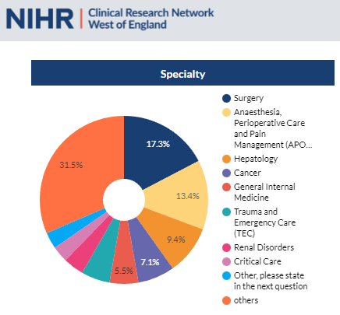
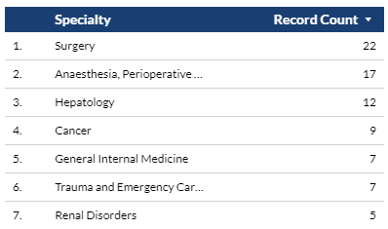
Associate PI Scheme
https://www.nihr.ac.uk/health-and-care-professionals/career-development/associate-principal-investigator-scheme.htm
A six month in-work training opportunity, providing practical experience for healthcare professionals starting their research career.
People who would not normally have the opportunity to take part in clinical research in their day to day role have the chance to experience what it means to work on and deliver a NIHR portfolio trial under the mentorship of an enthusiastic Local PI.
Cancer Studies with APIs
MITRE
HoT
HER2-RADICAL
PLATFORM
VICTOR
VALTIVE-1
TRACC
ARIEL
FaR-RMS
121 Eligible Cancer Studies in West of England

Slide 8
Associate PI Scheme
Tessa Jowell BRAIN MATRIX - Platform Study
A British feasibility study of molecular stratification and targeted therapy to optimize the clinical management of patients with glioma by enhancing clinical outcomes, Reducing avoidable toxicity, improving management of post-operative residual & recurrent disease and improving survivorship - Platform Study
Open 24/11/2020-01/01/2025 BHOC, Chris Herbert
ARISTOCRAT
A randomised phase II trial of temozolomide with or without cannabinoids in patients with recurrent glioblastoma. Open 03/02/2023-01/08/2024 BHOC, Chris Herbert
FUTURE GB
Functional and Ultrasound Resection of Glioblastoma. Open 18/12/2020-31/10/2023 NBT, Neil Barua
PARADIGM 2
OlaPArib plus RADIotherapy alone or radiotherapy plus temozolomide in newly-diagnosed glioblastoma stratified by MGMT status. Open 08/11/2016-30/09/2023 BHOC, Chris Herbert
SIOP Ependymoma II
An international Clinical Programme for the diagnosis and treatment of Children, adolescents and young adults in Ependymoma. Open 12/02/2016-12/02/2026 UHBW, Rachel Cox
MOLGEN
Molecular Genetics of Adverse Drug Reactions. Open 01/06/2009-30/04/2026 RUH, NBT, UHBW, Somerset

Slide 9
NIHR ODP
Open data platform. Data on performance across whole CRN,
including all specialty areas
NIHR Be Part of Research
See which studies are open across the country
National Cancer Research Institute Portfolio Maps
View current national portfolio of open, closed and ‘in set up’ cancer studies
Find a Clinical Research Study (ODP)
Search for a study to fit criteria. Good for horizon scanning, eligibility criteria

Slide 10
Research Delivery Manager
claire.matthews@nihr.ac.uk
Research Portfolio Facilitator
rebecca.pienaar@nihr.ac.uk
Brain Cancer Sub-specialty Lead
christopher.herbert@uhbw.nhs.uk
Notes:
Section separator template using the motifs.

