Slide 1
Navigational Bronchoscopy
Andrew Low
Respiratory Consultant
Bristol Royal Infirmary
SWAG November 2023

Slide 2
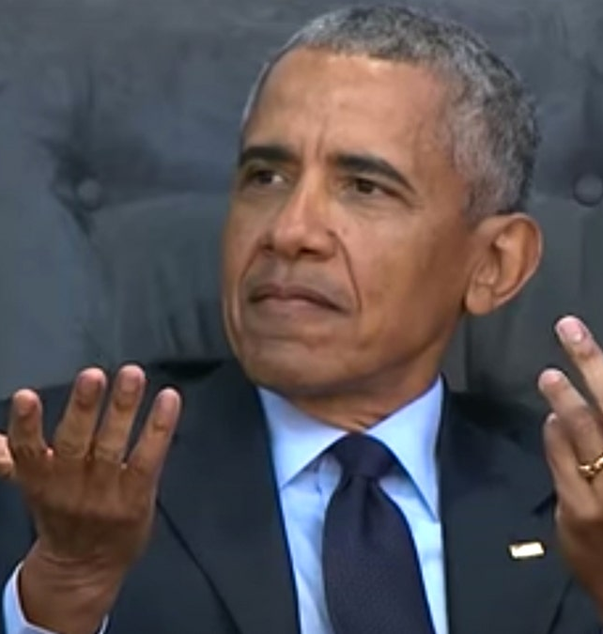
Aims
How?
HOW?
Notes:
Why we need it
What it is
How it works and how we do it
How we’re getting on
Who we’re doing it on and so who to refer

Slide 3
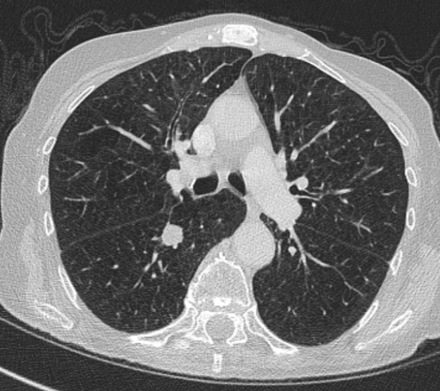
Case 1
Notes:
58M Smoker
Incidental pick up on a CTPA – presented with CP
27mm RLL mass
PET avid SUV 23.3
Radiological staging and diagnosis of a lung cancer T1cN0M0

Slide 4
Case 1
Notes:
PS2
CT shows higher up emphysema
FEV1 0.81 (38.9%), DLCO 2.52 (35.5%)
Too deep for a biopsy
Not accessible by bronch
No other lesions to target
Treatment:
SABR without biopsy

Slide 5
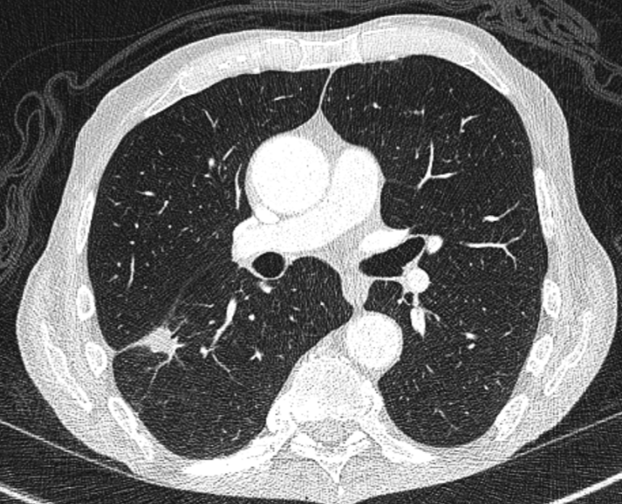
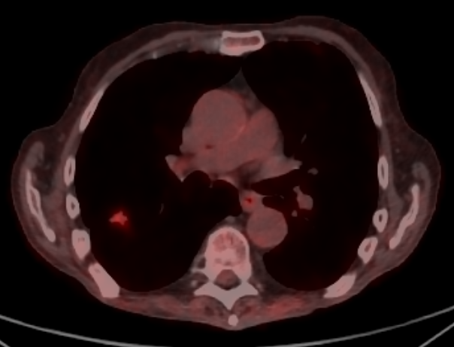
Case 2
Notes:
72 yo Man
Smoker
Presented with Wt loss
CT showed a spiculated 21mm RLL nodule
T1c 21mm, SUV 6.2

Slide 6
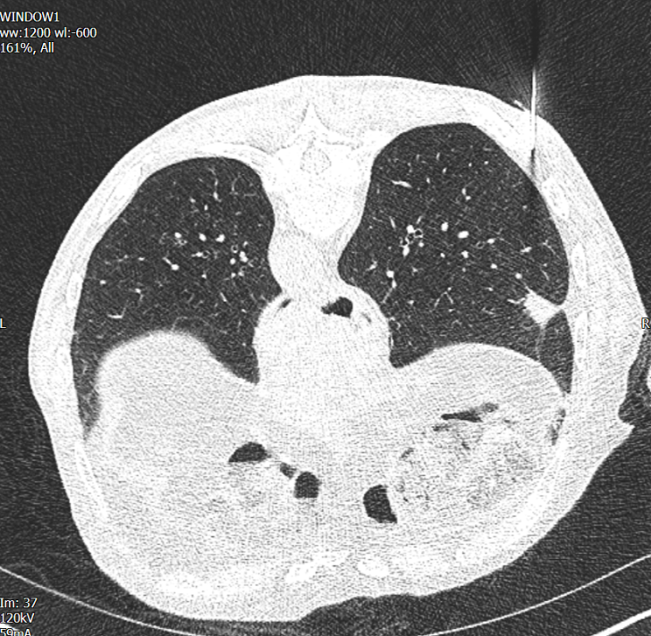
Case 2
Notes:
Attempted a biopsy

Slide 7
Case 2
Notes:
Sustained a PTX
Otherwise fit with good lung function
Went for surgery wedge resection
– granulomatous necrotising inflammation (not sent for TBC…)
6 months empirical TB treatment
10-15% benign resection rate – presumable must be similar in SABR

Slide 8
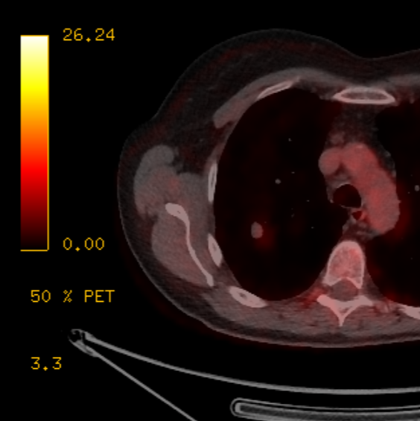
Case 3
Notes:
61yo lady
Smoker – persistent cough despite Abx… settled by the time of 2WW appointment
CT scan showed a 14mm RUL nodule
SUV low 1.9, but Herder risk 20% - radiologically T1bN0M0
PS1 - still working in the hospital as a cleaner 3 days a week
But SOB on stairs and hills
Further assessment
Lung function FEV1 1.4 (55% predicted), TLCO 3.72 (46%)
RUL lesion – Post RULectomy FEV1 46%, TLCO 38%
8 High risk for surgery
>20 low risk
15-20 intermediate risk
<15 high risk
Single figures… surgery is off the cards
S/B oncology – low avidity herder risk 20%
No biopsy – surrounding emphysema – too deep for bronch
ongoing FU… maybe SABR if there’s progression
Patient left with uncertainty… no definitive treatment

Slide 9
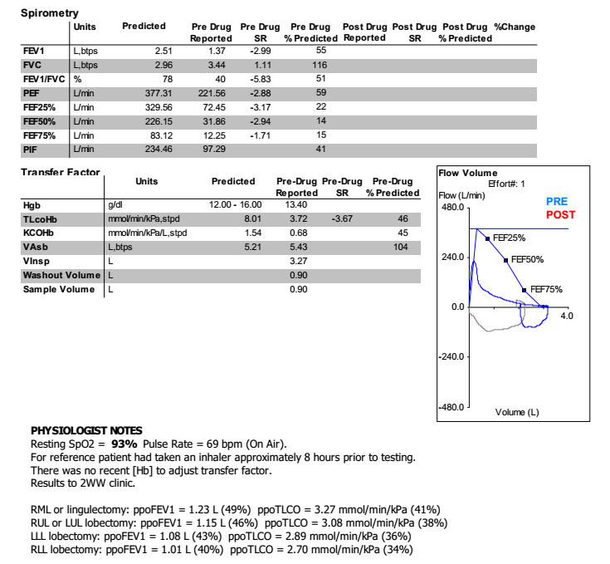
Case 3
Notes:
Further assessment
Lung function FEV1 1.4 (55% predicted), TLCO 3.72 (46%)
RUL lesion – Post RULectomy FEV1 46%, TLCO 38%

Slide 10
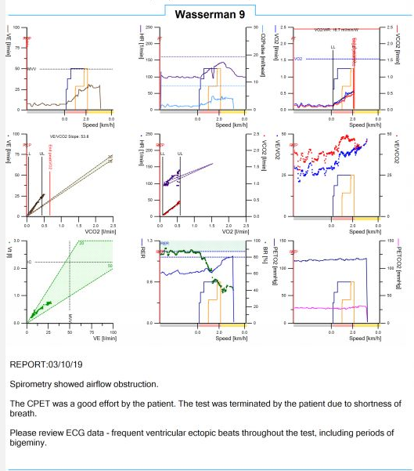
Case 3
Notes:
Further assessment – CPET
Wasserman 9 plot

Slide 11
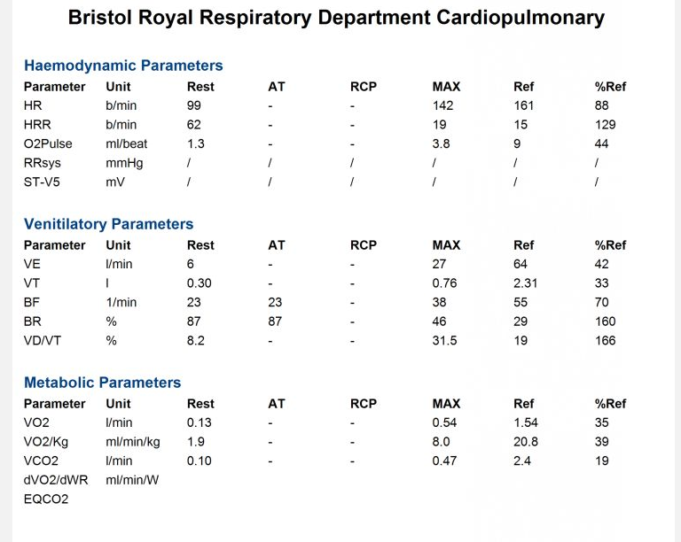
Case 3
Notes:
Numbers
VO2max

Slide 12
Case 3
VO₂ max
=
8.0
Notes:
8 High risk for surgery
>20 low risk
15-20 intermediate risk
<15 high risk

Slide 13
Case 3
VO₂ max
=
8.0
Notes:
Single figures… surgery is off the cards

Slide 14
Case 3
Notes:
S/B oncology – low avidity herder risk 20%
No biopsy – surrounding emphysema – too deep for bronch
ongoing FU… maybe SABR if there’s progression
Patient left with uncertainty… no definitive treatment

Slide 15
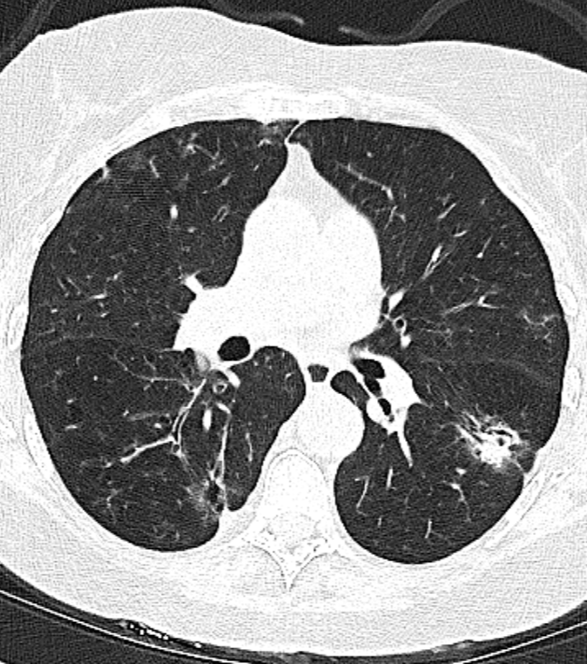
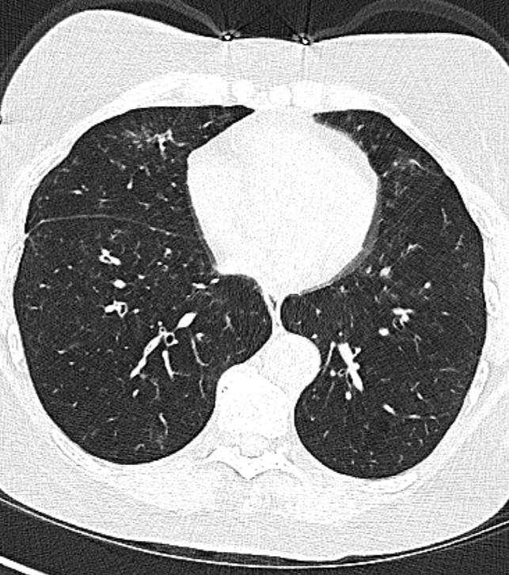
Case 4
Notes:
74F
COPD exacerbation – slot to resolve – went on to have a CXR, which was abnormal
Settled by the time of clinic
PS1 – unlimited on the flat, can manage a flight of stairs
A little SOB on hills
Still working – in Sainsbury’s, walks the dog
Ex smoker 5 years ago – 25 pack years
CT – multifocal disease
Also shows emphysema
FEV1 0.77
But largest lesion in RUL abutting the pleura
(FEV1 0.77 (44%)
FVC 2.24 (101%)
FEV1/FVC 44%
TLCO 3.66 67%)

Slide 16
Case 4
Notes:
Couldn’t breath hold
Possibly in the lesion… possibly not

Slide 17
Case 4
Notes:
Sustained a PTX – Abandoned
Left with multifocal disease… probably adeno, but no tissue for diagnosis
What do we do – blind wash and brush?
Try again
Watch and wait

Slide 18
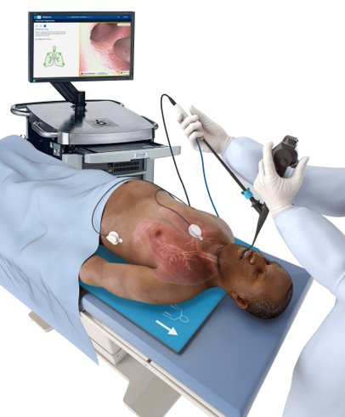
Navigational Bronchoscopy
Navigation bronchoscopy
Nav bronch
ENB
Electromagnetic navigational bronchoscopy
Notes:
?Where Navigational bronchoscopy comes in
- a way of biopsying these lesions
- more accurate diagnosis
- earlier diagnosis in the pathway
- allow better treatment decisions – sometimes treat without ever knowing
- or as with surgery the treatment leads to the diagnosis – which may not have been lung cancer
What is it?
Names…
Most useful is electromagnetic navigational bronchoscopy
- Bronchoscopic technique
- uses electromagnetic technology
- to help navigate to lung lesions
- using electromagnetic technology because lesions are too deep for fibreoptic guidance – scope too big

Slide 19
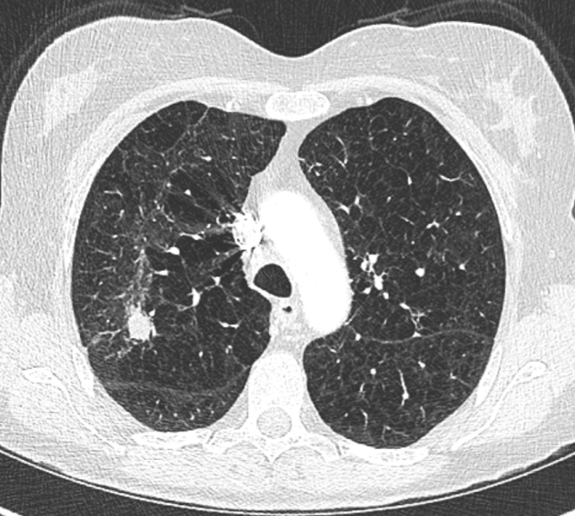
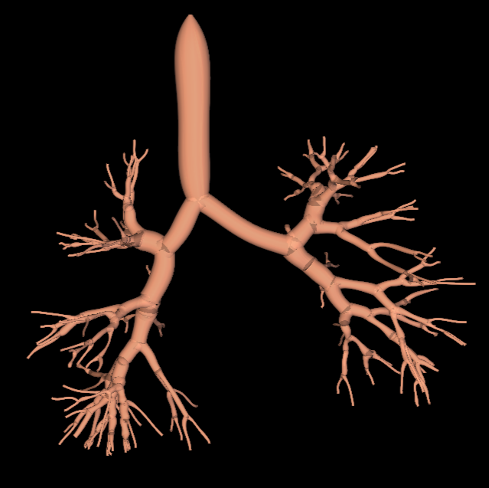
Navigational bronchoscopy
Notes:
How does it work
Combining 3 main technologies
- bronchoscopy
- electromagnetic navigation
- CT imaging
Uses CT imaging to create a 3D reconstruction

Slide 20
Navigational bronchoscopy
Notes:
Using the 3D reconstruction to create a map through the airways to the lesion

Slide 21
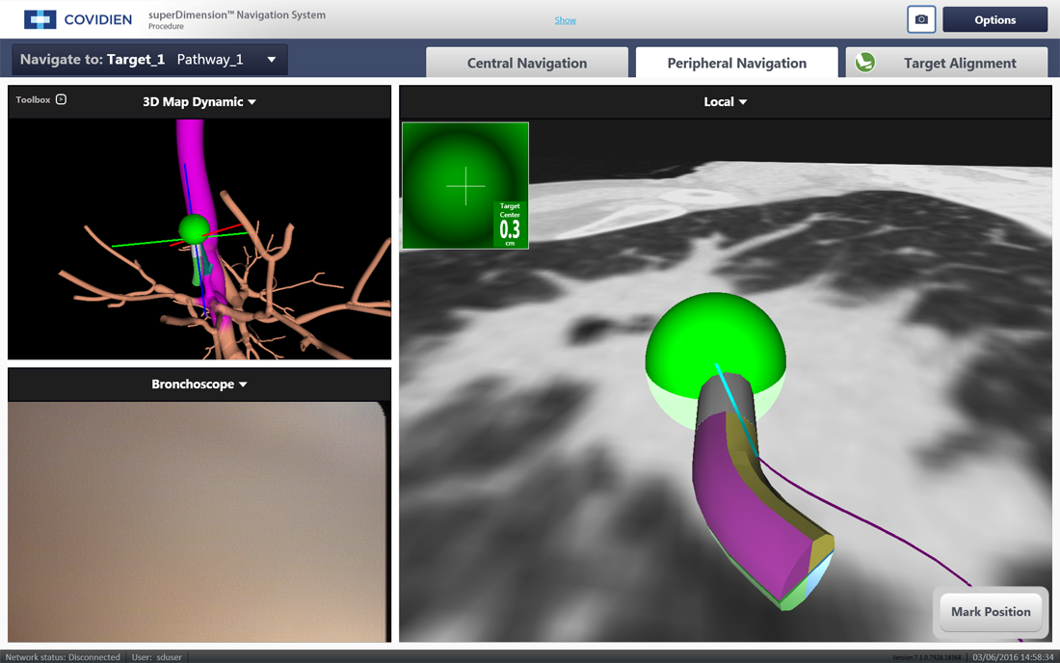
Navigational bronchoscopy
Notes:
Use that map to then guide you to the lesion, which you otherwise wouldn’t see with the scope
During the procedure using the 3D map to navigate in real time to the lung lesion
Allows sampling of the lesion
Otherwise wouldn’t be able to get there with standard bronchoscopy

Slide 22
Planning
Notes:
How do we do it?
Planning
Pre procedure
Import the CT images
Indicate where the lesion is
Manipulate the green shape to the shape of the lesion

Slide 23
Planning
Notes:
Then need to create your map
Rotate the image until airway to the lesion is located
Draw a line to the lesion

Slide 24
Planning
Notes:
Software then creates the rest of the map to the larger more proximal airways

Slide 25
Planning
Notes:
The sorts of images you then see during the procedure as your working your way through the airways

Slide 26
Registration
Notes:
Procedure itself
Need to superimpose the CT images – the 3D recon of the airways and the map to the lesion, onto the body
Patient placed on a board
3 probes place on the chest
Creates an EM field

Slide 27
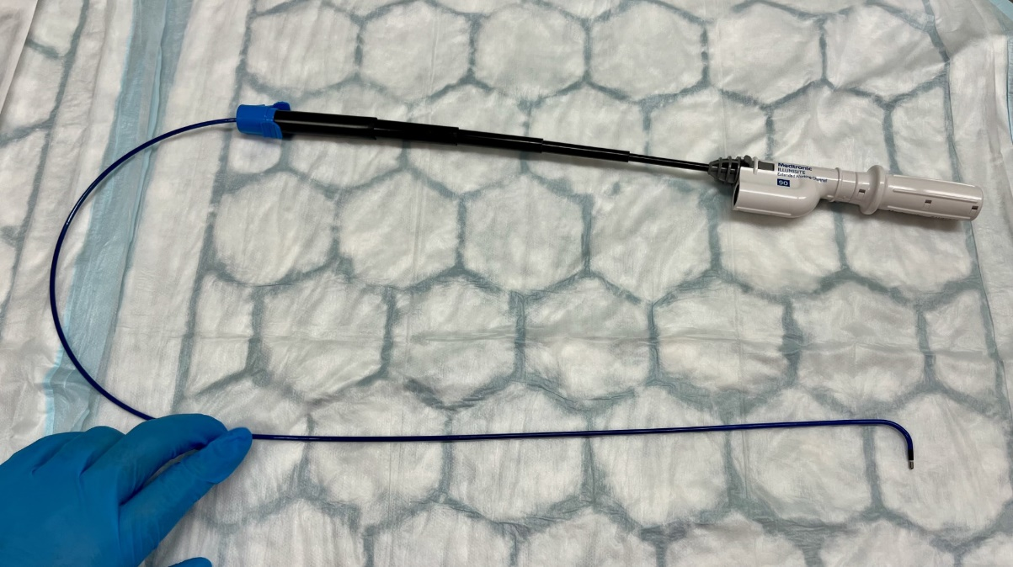
Registration
Notes:
Pass a probe down the working channel of the bronchoscope
- so that it’s just out of the bronchoscope

Slide 28
Registration
Notes:
Probe is then tracked within the EM field

Slide 29
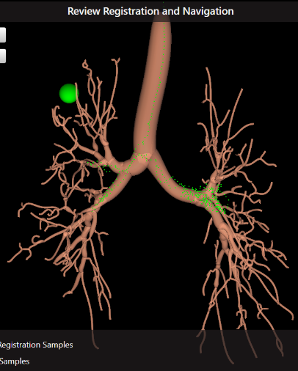
Registration
Notes:
Probe is collecting data within the EM field as moving it around the airways to create a real time map of the airways
Once enough data collected, it allows the 3D CT reconstruction to be snapped to the real time map of the airways
So that CT images are superimposed onto the body

Slide 30
Navigating
Notes:
EM field tracks the probe and then allows navigation through the airways using the 3D reconstruction to the lesion
Use the scope to nav to the upper lobe, insert probe into the posterior upper lobe bronchus right upper lobe
Can then use the map to navigate the locatable probe in the EM field and therefore through the airways to the lesion using the 3D reconstructed map
3 yellow probe keeps the 3D reconstruction in line with the chest as the chest wall moves

Slide 31
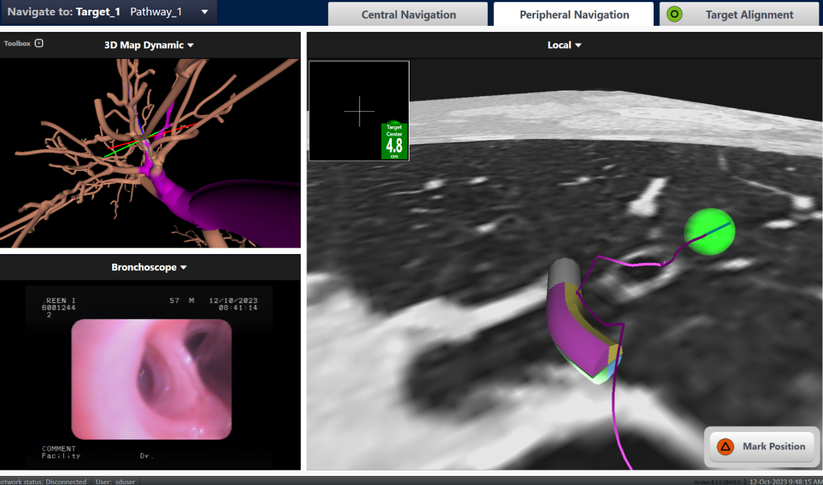
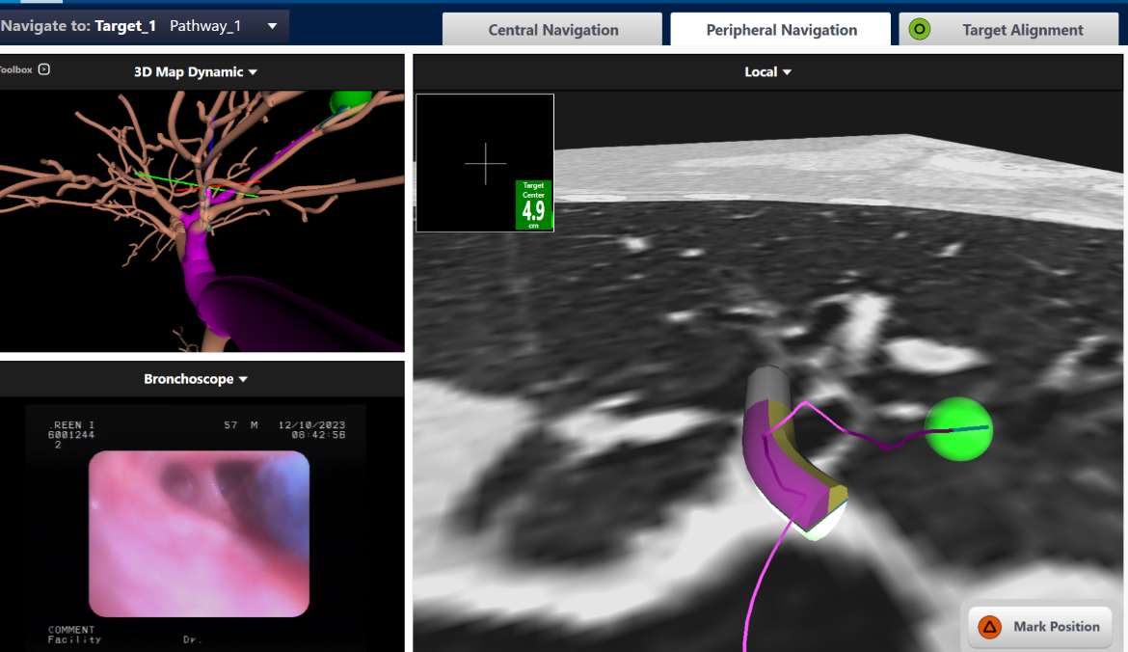
Navigating
Notes:
Tried to take photos in real time, but you guide the end of the probe down the airways to the lesion
The locatable probe has a curve on it, so you can turn it until you’re pointing at the right airway before advancing
Navigate to the lesion - Green ball indicates the centre of the lesion

Slide 32
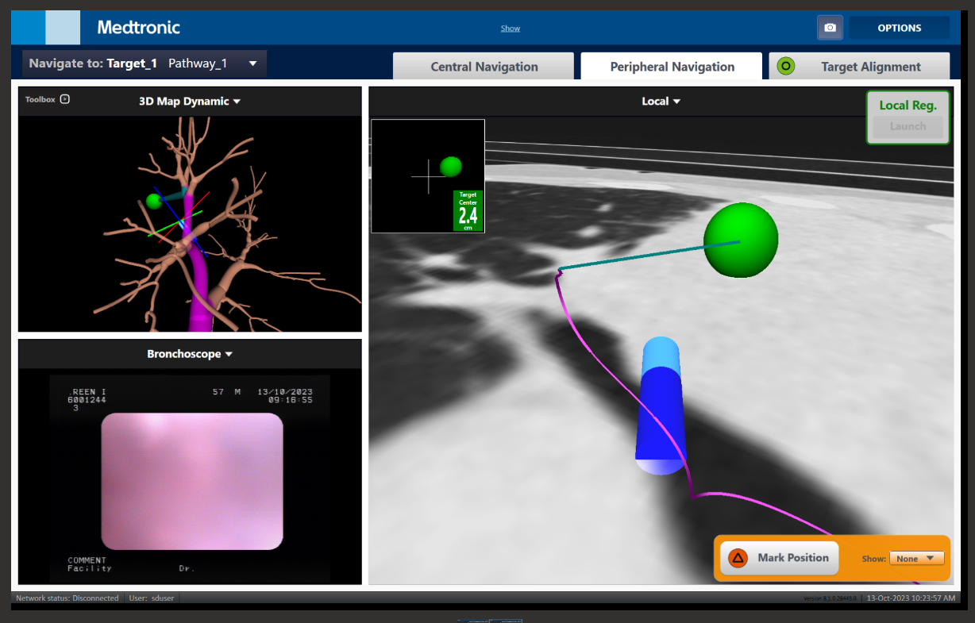
Sampling
Notes:
Remove the inner probe (locatable guide) leaving the outer working channel – has some nav tech in it to help maintain position – slightly fewer degrees of navigation

Slide 33
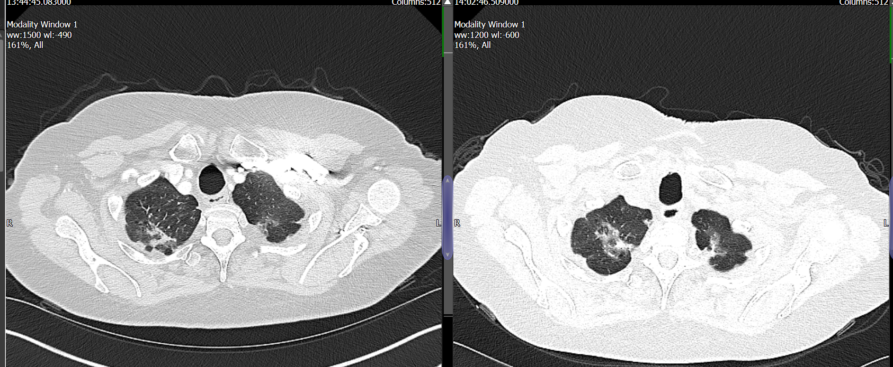
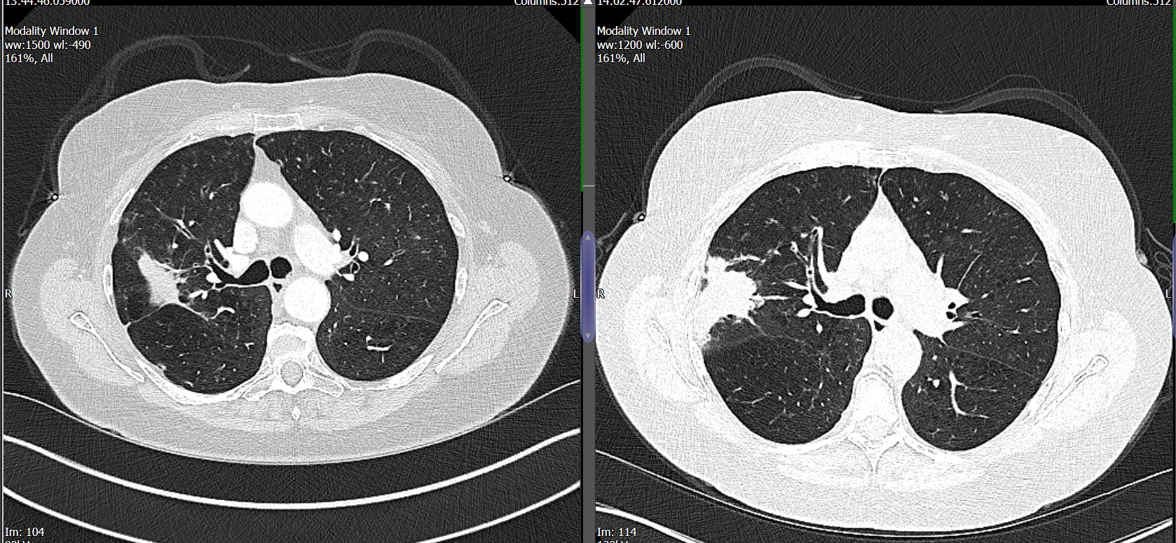
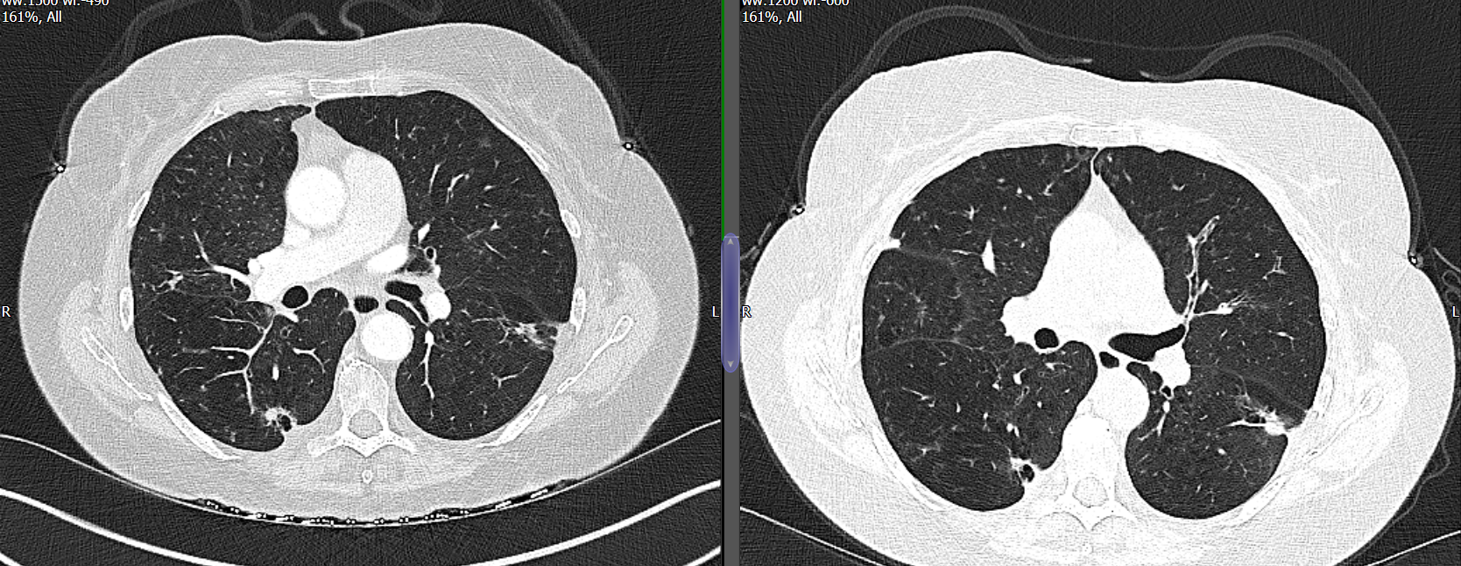
Case 4
Notes:
Carboplatin, pemetrexed and pembrolizumab
Now on maintenance immune
Stable if not improved after 12 months
New images on the left of the screen – old on the right

Slide 34
Results
Total | 32
Procedure type - diagnostics - localisation | 29 3
Patients - age (range) - sex | 68.3 years (49-83) 66% female
Lesions - size (range) - solid - semi-solid - GGO | 27mm (9-59) 22 1 2

Slide 35
Results
Total | 32
Cancer | 13
Infection / Inflammation | 5
Non-diagnostic | 11
(Localisation | 3)
Sensitivity 60.7%
Notes:
Meta-analysis of 19 studies >1000 patients – sensitivity of 82%, specificity of 100%

Slide 36
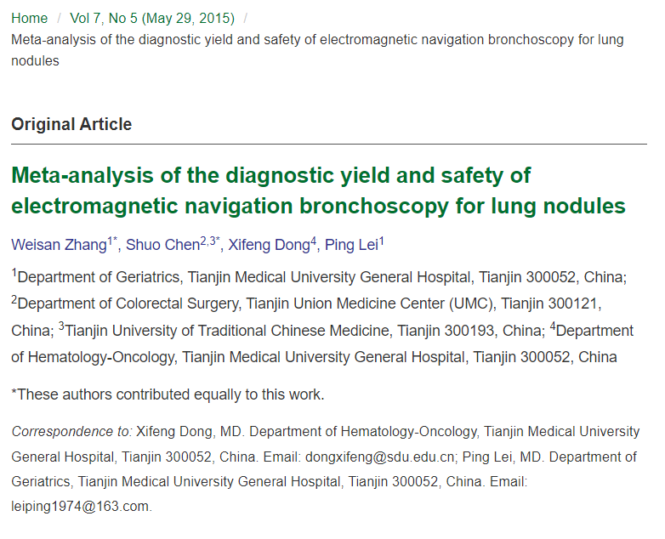
Sensitivity
1106 pts
19 studies
Sensitivity 0.82
(0.79-0.85)
Specificity 1.00 (0.98-1.00)
Notes:
Meta-analysis of 19 studies >1000 patients – sensitivity of 82%, specificity of 100%

Slide 37
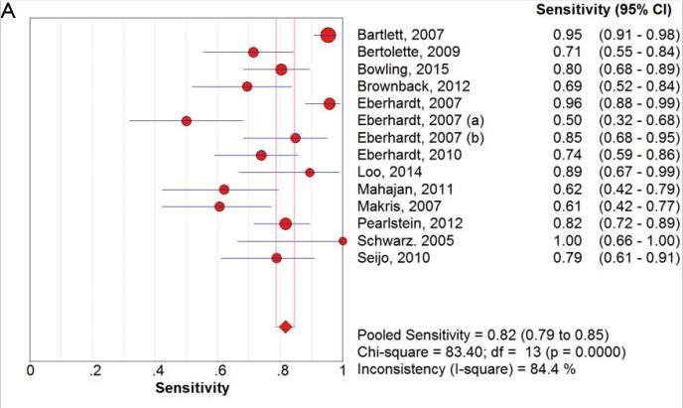
Sensitivity
1106 pts
19 studies
Sensitivity 0.82
(0.79-0.85)
Specificity 1.00 (0.98-1.00)
Notes:
Meta-analysis of 19 studies >1000 patients – sensitivity of 82%, specificity of 100%

Slide 38
Sensitivity

Slide 39
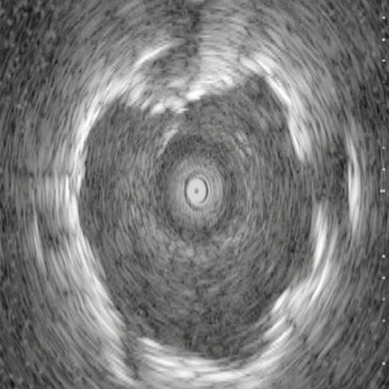
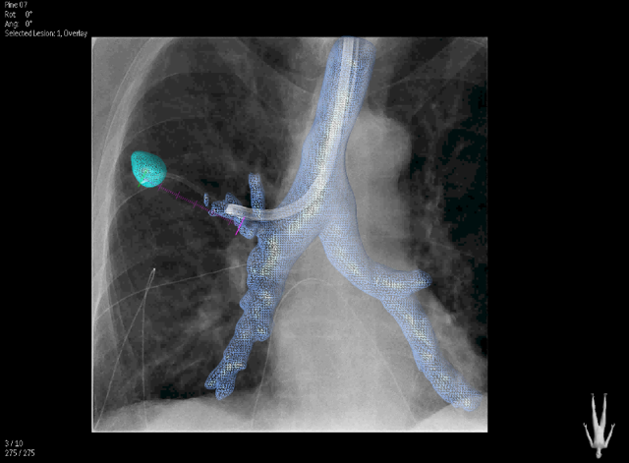
Complimentary imaging
Fluoroscopy
Radial EBUS
Rapid On-Site Evaluation
Cone Beam CT
Notes:
Majority of the higher sensitivity studies
Using combination fluoroscopy, radial EBUS or rapid onsite evaluation by a pathologist

Slide 40
Other uses
Localisation
Therapeutic?
Microwave ablation

Slide 41
Complications
Zhang et al 2015 - PTX rate of 5.9%
Deng et al 2018 – PTX rate of 5.2%
Towe et al 2017 – 341 patients
8.3% complication rate
PTX 27 (7.5%) – 11 needed ICD, 16 observed
2 bleeds
3 with resp failure
64 – severe COPD, 114 – moderate COPD
Notes:
Systematic Review Deng et al 2018 comparing CTGB vs ENB
1648 patients PTX rate of 5.2% in ENB vs 23% in CTGB
Towe et al – single centre US

Slide 42
Complications
2x pneumothoraces
2/32 = 6.3%
Notes:
Systematic Review Deng et al 2018 comparing CTGB vs ENB
1648 patients PTX rate of 5.2% in ENB vs 23% in CTGB
Towe et al – single centre US
5-7.5%

Slide 43
Who?

Slide 44
Who?
Will it change management?
Can’t be accessed by
Standard bronchoscopy
EBUS
CT guided biopsy
Able to tolerate a GA
Biopsy from another site

Slide 45
Bronchus sign

Slide 46
Greater than 2cm…
ideally!

Slide 47
Referral Centre
UHBW | 34.4%
NBT | 15.6%
RUH | 25.0%
Cheltenham/Gloucester | 12.5%
MPH | 12.5%

Slide 48
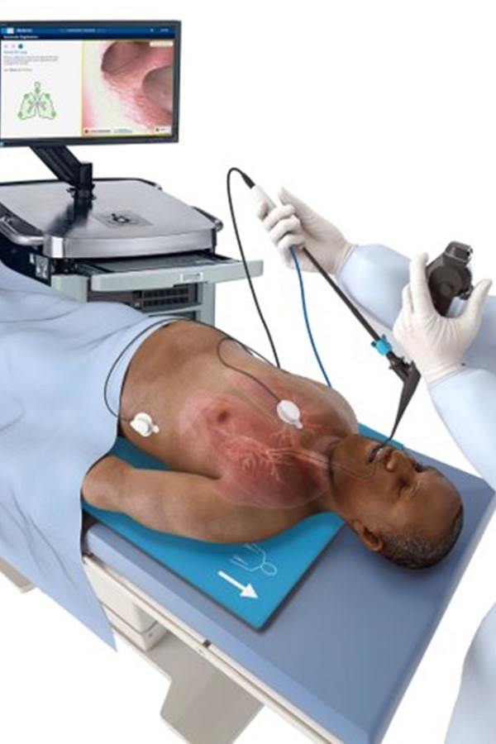
Summary
Overview of Nav Bronch
Role in diagnostics
Acceptable sensitivity and safety?
Notes:
Overview of Nav bronch
- why we need it
- how it works and how we do it
Role in diagnostics
- role in patients – too far in to get to with CT guided biopsy, too far out for bronch or EBUS – no other sites
- or inaccessible due to other structures – scapula, position in relation to vessels, fissures, too high in the upper lobes
- adjacent emphysema… but as the our recent experience shows – can’t guarantee they won’t get a PTX
Allow to make accurate diagnoses to help make better treatment decisions, and in some patients, earlier treatment decisions
- role in reducing benign resections, and presumably in reducing benign irradiation
Hopefully shown an ok sensitivity so far – room for improvement, but I think we are getting better, and may have potential to improve things further with other modalities
Safety – recent PTX, but so far so good

Slide 49
Questions?

