Slide 1
SWAG Network Sarcoma Cancer
Clinical Advisory Group
Research Update - Claire Matthews
17/10/2023

Slide 2
National Sarcoma Cancer Research Recruitment
Apr 22 - Mar 23
Apr 23 - Oct 23
Data source: ODP All Portfolio
Data cut 12/10/2023

Slide 3
National vs Regional Recruitment
National
SWAG region
Data source: ODP All Portfolio
Data cut 12/10/2023

Slide 4
Sarcoma Cancer Studies - open and in set up in SWAG region
CPMS ID | Short Name | Sites | Opening | Closure | Sample Size Eng | England Recruits
42490 | FaR-RMS | MUS, BHOC, RUH, BRHC | 17/09/2020 | 28/02/2029 | 310 | 163
42003 | RAGNAR - 42756493CAN2002 | BRHC, BHOC | 05/01/2020 | 15/11/2026 | 21 | 24
41346 | ICONIC | BRHC, BHOC | 25/10/2019 | 31/01/2025 | 350 | 274
33914 | SPECTA (EORTC 1553) | BRHC | 07/06/2018 | 30/09/2027 | 288 | 172
17239 | rEECur | BRHC, BHOC | 18/12/2014 | 30/09/2025 | 151 | 160
15941 | NIHR BioResource - Rare Diseases | SAL, BHOC, NBT, RUH, BRHC, | 13/09/2012 | 30/11/2022 | 22000 | 15,386
51601 | Paediatric (2-21 Years) EWS | BHOC | 29/07/2023 | 03/12/2023 | 5 | 0
55970 | PM1183-C-010-22 | SAL | 02/03/2024 | 15/01/2026 | 17 UK | In set up
46263 | Nanabis™ For Management Of Chronic Pain From Metastatic Bone Cancer | SAL | 01/03/2024 | 01/09/2025 | 60 UK | In set up
Data source: ODP All Portfolio
Data cut 12/10/2023

Slide 5
PM1183-C-010-22: Randomized, Controlled, Open-label, Phase IIb/III Study of Lurbinectedin in Combination with Doxorubicin vs Doxorubicin Alone as First-line Treatment in Patients with Metastatic Leiomyosarcoma
Study to test the effectiveness and safety of lurbinectedin in combination with doxorubicin, compared to doxorubicin alone, in patients with metastatic LMS.
Aims of the study:
Determine the ideal dosing regimen of the study medications
Test the study medications in a larger number of LMS patients to verify the findings from previous studies.
40 months, approx 240 participants
First-line treatment for LMS patients, so only patients that have not received previous systemic therapy for their cancer are eligible to participate.

Slide 6
Nanabis™ For Management Of Chronic Pain From Metastatic Bone Cancer
The purpose of this study is to determine whether a nanoparticle cannabis-based medicine (NanaBis™) is effective in reducing metastatic bone pain in patients with cancer.
Multi-centre, long term, double blind, clinical protocol for NanaBis™ as a monotherapy treatment in participants 18-75 years of age with cancer related pain.
Commercial Study: Medlab Clinical Ltd

Slide 7
Associate PI Scheme
https://www.nihr.ac.uk/health-and-care-professionals/career-development/associate-principal-investigator-scheme.htm
A six month in-work training opportunity, providing practical experience for healthcare professionals starting their research career.
People who would not normally have the opportunity to take part in clinical research in their day to day role have the chance to experience what it means to work on and deliver a NIHR portfolio trial under the mentorship of an enthusiastic Local PI.
FaR-RMS: An overarching study for children and adults with Frontline and Relapsed RhabdoMyoSarcoma
Open 17/09/2020 - 28/02/2029
ICONIC: Improving outcomes through collaboration in osteosarcoma
Open 25/10/2019 - 31/01/2025

Slide 8
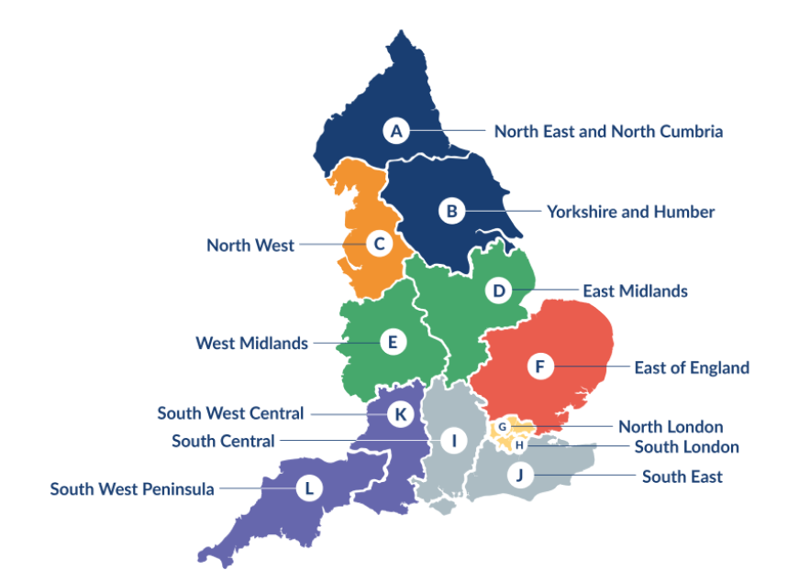
Clinical Research Network Transition to Research Delivery Network
Launching Oct 2024
The NIHR RDN has 2 primary purposes:
To support the successful delivery of high quality research, as an active partner in the research system
To increase capacity and capability of the research infrastructure for the future
Will operate as 1 organisation across England, through a network of 12 Regional Research Delivery Networks (RRDNs) and a central Coordinating Centre (RDNCC)

Slide 9
NIHR ODP
Open data platform. Data on performance across whole CRN, including all specialty areas
NIHR Be Part of Research
See which studies are open across the country
National Cancer Research Institute Portfolio Maps
View current national portfolio of open, closed and ‘in set up’ cancer studies
Find a Clinical Research Study (ODP)
Search for a study to fit criteria. Good for horizon scanning, eligibility criteria

Slide 10
Research Delivery Manager
claire.matthews@nihr.ac.uk
Research Portfolio Facilitator
rebecca.pienaar@nihr.ac.uk
Sub-specialty Lead
adam.dangoor@uhbw.nhs.uk

