Slide 1
Meeting of the Sarcoma Clinical Advisory Group
Chris Wragg, Head of Cancer Genomics, Bristol Genetics Laboratory
17th October 2023

Slide 2
Meeting of the Sarcoma Clinical Advisory Group
Genomics update
Changes to FISH/RNA fusion panel analysis
TYA Cancer audit

Slide 3
Testing Changes and Benefits
Change of NGS chemistry
Expanded panel to include 114 target genes (from 55)
Compliant with National Cancer Genomics test directory v7.3
Inclusion of gene rearrangements we have been testing by FISH or exporting to laboratories outside our GLH
Benefits:
Technology alignment in the laboratory allowing improved efficiency in testing
Improved turn around compared to previous gene panel
Shorter technical workflows (move from 5 day to 3 day laboratory set up)
No requirement to forward samples to other laboratories, so testing can be initiated as soon as it reaches us
Fusion testing by this method allows ascertainment of fusion partner
One-size fits all- assay for solid tumours, sarcomas and neurological tumours
All 114 genes will be tested on every case
Potential to replace some targeted FISH testing

Slide 4
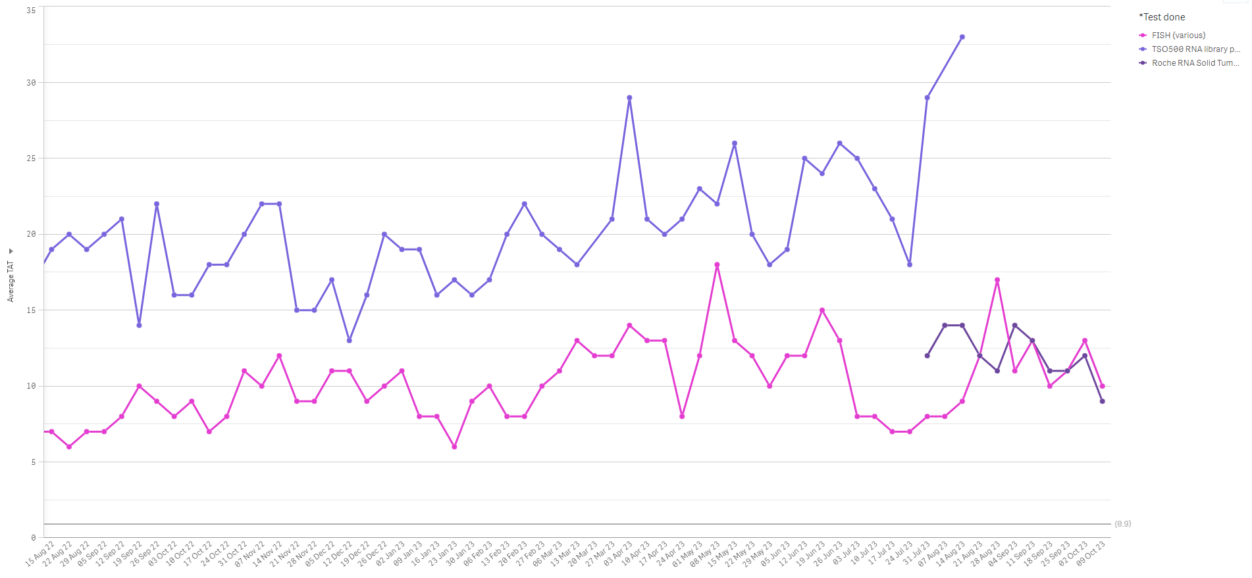
Turn Around Time

Slide 5
Full list of target genes
AGK | BRCA2 | DDIT3 | ETV4 | FLT1 | IDH2 | MN1 | NPM1 | PAX3 | PVT1 | TCL1B | WWTR1
AKAP9 | BRD2 | DNAJB1 | ETV5 | FMR1 | JAZF1 | MSH2 | NR4A3 | PAX7 | RAF1 | TFE3 | YAP1
AKT3 | BRD3 | EGFR | ETV6 | FN1 | KDR | MYB | NRG1 | PDGFB | RELA | TFEB | YWHAE
ALK | BRD4 | EML4 | EWSR1 | FOSB | KIAA1549 | MYC | NTRK1 | PDGFRA | RET | TGFBR3 | ZFTA
AR | CAMTA1 | EPC1 | FAM118B | FOXO1 | KIT | NCOA2 | NTRK2 | PDGFRB | ROS1 | TMPRSS2
ASPSCR1 | CCDC6 | ERBB2 | FGFR1 | FUS | MACF1 | NFIA | NTRK3 | PHF1 | RPS6KB1 | TPM3
AXL | CCNB3 | ERG | FGFR2 | FXR1 | MALAT1 | NFIB | NUTM1 | PIK3CA | SERPINE1 | TPM4
BCOR | CDK4 | ESR1 | FGFR3 | GNA11 | MAML2 | NOTCH1 | NUTM2B | PPARG | SRGAP3 | TTYH1
BRAF | CIC | ETS1 | FGFR4 | HEY1 | MET | NOTCH2 | NUTM2E | PRCC | SS18 | USP6
BRCA1 | COL1A1 | ETV1 | FLI1 | IDH1 | MITF | NOTCH3 | OGA | PRKACA | SUZ12 | WT1
Tumour agnostic
Sarcoma FISH

Slide 6
Case Study 1
16 year old female with unexplained mediastinal mass with lymph node enlargement
? Round cell sarcoma of soft tissue / Ewings
For urgent EWSR1 FISH, round cell sarcoma structural rearrangement testing and neuroblastoma testing
EWSR1 FISH testing negative
RNA panel reported with 8 day turnaround

Slide 7
Case study 2
67 yr old male with renal mass.
Poorly differentiated malignant tumour with some rhabdoid/plasmacytoid features and a non-specific (largely negative) immunoprofile
For Round Cell Sarcoma of Soft Tissue Differential panel testing

Slide 8
Case study 3
52 yr old female with fibroblastic proliferation from right thumb
Histological appearances are most in keeping with benign fibroblastic proliferation
For Desmoid-Type Fibromatosis DNA NGS testing and COL1A1-PDGFB rearrangement FISH to exclude DFSP
DNA and RNA extraction carried out on a single curl

Slide 9
Changes to requests
Sample requirements:
FISH testing is still available where required
What isn’t covered:
MDM2 amplification testing still requires FISH analysis
Update to referral form underway
In the meantime please comment in clinical summary if panel not covered on referral form
Any queries please contact the laboratory on swglhcancer@nbt.nhs.uk

Slide 10
TYA South West Genomic audit
TYA (16-25 years of age) cancer genomic referrals (samples) Sep 2022-Aug 2023 by site
NBT activity reflects location of UHBW Pathology
Haematological cancer include more than one sample per patient, particularly where sequentially monitoring (ALL, MPN, AML)
Incidence data pending from CTYA Cancer ODN - TYA Service Engagement Group
Further analysis of data ongoing (but primarily single target rather than NTRK/panel tests)
Trust | Haem | Tumour
University Hospitals Bristol NHS Foundation Trust | 54 | 4
North Bristol NHS Trust | 11 | 22
University Hospitals Plymouth NHS Trust | 23 | 6
Royal Devon University Hospitals | 19 | 5
Other SW Trusts | 25 | 6
Total | 132 | 43

Slide 11
Any questions?
Chris Wragg │Head of Cancer Genomics
South West Genomic Laboratory Hub
E-mail: christopher.wragg@nbt.nhs.uk
Tel: 01174146141 Mobile: 07880056843

