Slide 1
Somerset, Wiltshire, Avon and Gloucestershire (SWAG) Cancer Services
National Cancer Patient Experience Survey Results (2022)
Sarcoma Clinical Advisory Group
Tuesday 17th November 2023

Slide 2
NCPES Introduction
Annual survey, commissioned & managed by NHS England (since 2010)
new design for 2021, therefore break in series data, limited to 2021 / 2022 year on year comparison
Picker - responsible for designing, running & analysing the survey
Designed to:
Monitor progress in cancer care
Provide information to drive local quality improvements
Assist commissioners and providers of cancer care
Inform the work various charities and stakeholder groups, supporting cancer patients

Slide 3
NCPES Methodology
Provider survey samples
Adults (16 and over), with a confirmed diagnosis of cancer
Discharged from NHS Trust (after an inpatient or day-case attendance for cancer related treatment) in April, May and June 2023.
Survey fieldwork Oct. 2022 – Feb. 2023
Reports published July 2023 (National, Alliance, ICS, Trust)

Slide 4
Cancer Alliance report
Report reflects experience of people referred from within CA footprint (not all those treated by that CA’s Providers)
‘referring’ CA report - based on patient home postcodes
According to ONS postcode mapping
Based on ICB / ICS mapping (introduced from July 2022)

Slide 5
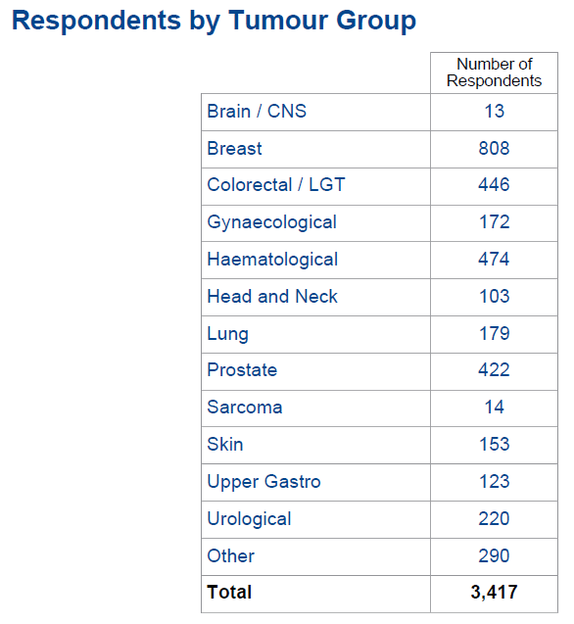
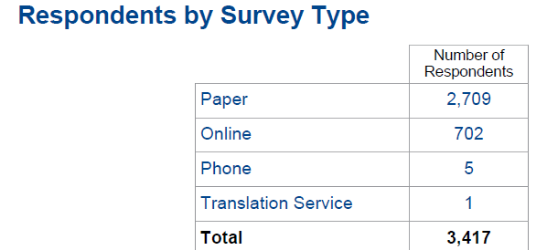
NCPES SWAG responses

Slide 6
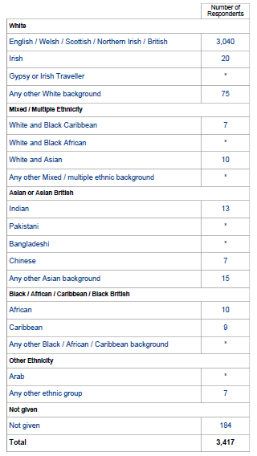
All SWAG respondents by Ethnicity
89%
92 % (3135)
2% (78)
6%

Slide 7
Sarcoma
Total SWAG Sarcoma responses: 14
(people with a SWAG post-code, who responded to the survey)
32 - answers supressed, as responses were <10
29 - a % score given as >10 respondents for that question

Slide 8
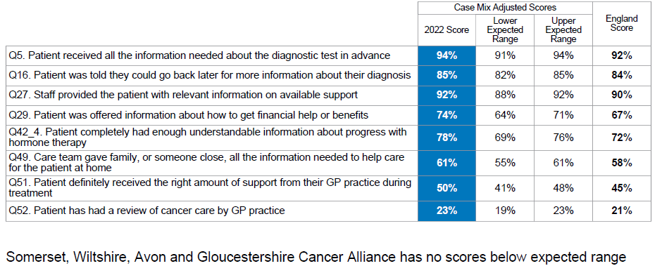
SWAG Summary
Overall rating of care 8.9 (national average 8.9)
8 questions were above the expected range (all others were in line with the national average)

Slide 9
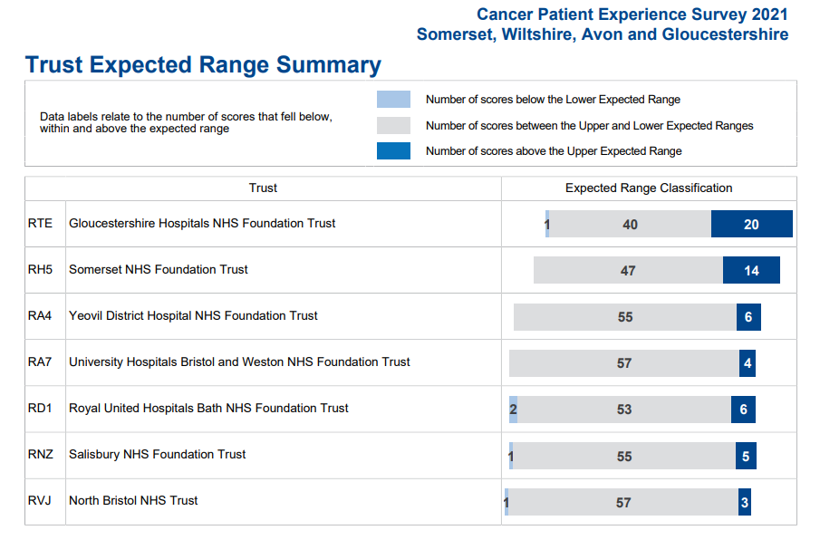
Trust Summary

Slide 10
Variations by tumour site
Comparison between tumour sites
Some significant variation in scores (e.g. >30%)
Significant variation in numbers of responses
Caution in making these comparisons and interpreting results
NCPES discussion at SWAG Clinical Advisory Groups (CAGs) and local clinical teams / MDTs
Alliance, ICS and Trust level scrutiny and pathway planning

Slide 11
SWAG Sarcoma highest scores ≥ 90%
 | Question | SWAG | National average
9 | Enough privacy was always given to the patient when receiving diagnostic test results | 91 | 95
17 | Patient had a main point of contact within the care team | 91 | 92
20 | Treatment options were explained in a way the patient could completely understand | *100 | 82
55 | Patient was given enough information about the possibility and signs of cancer coming back or spreading | *92 | 62
* sarcoma results significantly higher than other SWAG tumour groups and National average
(caution as only 14 respondents, but very high scores nonetheless)

Slide 12
SWAG Sarcoma lowest scores ≤ 60%
 | Question | SWAG | National average
7 | Patient felt the length of time waiting for diagnostic test results was about right | * 55 | 78
47 | Patient felt possible long-term side-effects were definitely explained in a way they could understand in advance of their treatment | 55 | 59
48 | Patient was definitely able to discuss options for managing the impact of any long-term side-effects | 45 | 53
49 | Care team gave family, or someone close, all the information needed to help care for the patient at home | 60 | 58
52 | Patient had had a review of cancer care by GP practice | ** 46 | 21
* sarcoma results significantly lower than other SWAG tumour groups and National average
** sarcoma results significantly higher than other SWAG tumour groups and National average
(caution as only 14 respondents, but very high scores nonetheless)

Slide 13
Cancer context – 3417 responses
How long ago were you told you had cancer?
Less than 6 months 10% 340
6 – 12 months 47% 1589 77% (2615)
1 – 2 years 20% 686
2 – 5 years 14% 441
At least 5 years ago 9% 304
Respondents were reflecting on quite recent cancer experiences, 77% had been diagnosed within the last 2 years.

Slide 14
Cancer context cont.
Who told you that you had cancer?
Specialist doctor / consultant 79% (2626)
Specialist cancer nurse 12% (388)
Someone at your GP practice 5% (167)
Another member of the hospital team 3% (101)
Someone else / can’t remember 1% (40)

Slide 15
Cancer context cont.
During the last 12 months, have you had
Surgery 59% (1981)
Chemotherapy 50% (1585)
Radiotherapy 37% (1240)
Hormone therapy 20% (678)
Immunotherapy 13% (447)
None of these 6 % (187)
Most people had more than one type of cancer treatment in the last year, with only 6% (187) having no treatment.

Slide 16
Patient comments
Patients were asked
How would you describe your care and treatment?
Was there anything that could have been improved?
Any other comments
‘Patient comment’ feedback and analysis presented by topic, themes and sentiment, available in Trust level reports only. Very few sarcoma specific comments.

Slide 17
Initial SWAG observations
‘Personalised Care and Support’ (PCS) is making a tangible difference – need to continue to expand access
Overall, themes of low scores relating to
communication and shared care, between care providers, Trusts, departments
Information giving (including side effects, immunotherapy)
access to support from community & primary care services
Younger patients, females, all BAME groups and patients from the least deprived areas tend to report a less positive patient experience
Positive reflection of many services, given the context of the pandemic

Slide 18
Clinical Advisory Group - Next Steps
Discuss and agree SWAG Sarcoma patient experience improvement priorities, including areas of lowest scores (Slide 12) to be collated and fed back
Next steps / timeline
Nominated lead
Recognition of areas of good practice
Consider / plan additional in-year Sarcoma-specific patient experience activity to gain further insight

