Slide 1
SWAG Network Urological Cancer
Clinical Advisory Group
Research Update - Claire Matthews
06/07/2023

Slide 2
National Recruitment to Urological Cancer Studies
Apr 2023 - Jun 2023
Apr 2022 - Mar 2023
Data cut 03/07/2023
Source: ODP All Portfolio

Slide 3
National vs Regional Recruitment to Urological Cancer Studies Apr 2019 - Jun 23
National Recruitment
SWAG Region Recruitment
Data cut 03/07/2023
Source: ODP All Portfolio

Slide 4
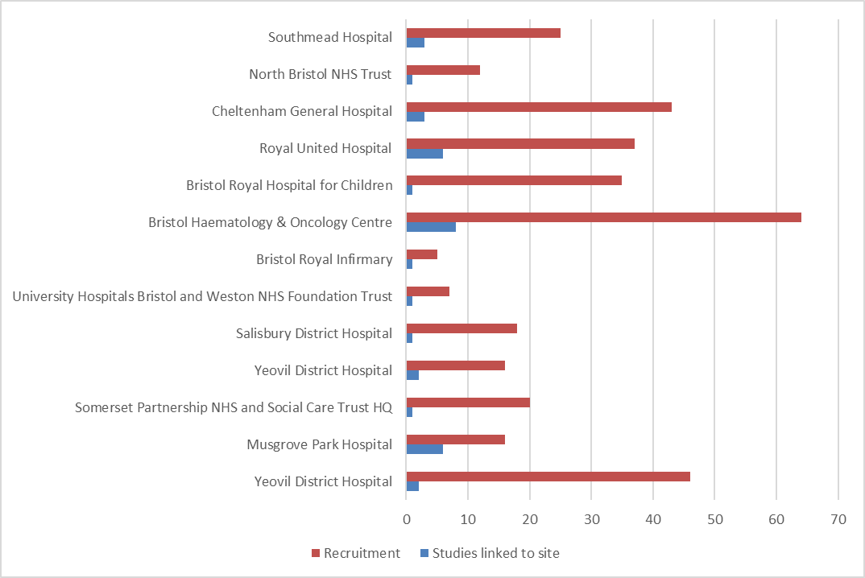
Recruitment by Site to Urological Cancer Studies Apr 2022 - June 2023
Data cut 03/07/2023
Source: ODP All Portfolio

Slide 5
Recently opened studies (last 12 months)
CPMS | Short Name | Sites | Open | Closure | Sample Size Eng | Eng Recruits
53394 | EvIDHence - Longitudinal retrospective CCA chart review study | BHOC, Salisbury | 25/05/2023 | 15/08/2023 | 32 | 2
52452 | JAVELIN Bladder Medley | BHOC | 23/03/2023 | 28/06/2024 | 15 | 0
51346 | Proton beam trials (PBT) recruitment study | BHOC, RUH | 04/10/2022 | 31/12/2023 | 95 | 13
52871 | IP7-PACIFIC | Yeovil, NBT | 03/10/2022 | 30/09/2023 | 700 | 94
52562 | PACE-NODES | BHOC, Musgrove, Chelt | 05/09/2022 | 31/12/2024 | 446 | 122
51823 | CAPItello-280 | BHOC, RUH | 31/08/2022 | 12/02/2024 | 90 | 3
51629 | E-bikes and prostate cancer: CRANK-P | NBT | 07/07/2022 | 30/06/2023 | 30 | 14
49286 | Volga | BHOC | 05/07/2022 | 31/10/2023 | 18 | 0
47737 | MK3475+MK1308, MK3475+MK6482, MK3475 | Yeovil | 01/07/2022 | 15/01/2024 | 25 | 23
51326 | ANG-010 (INFORM Study) | NBT, Salisbury | 30/06/2022 | 31/01/2024 | 155 | 211
53225 | AURORA | Musgrove | 27/06/2022 | 30/05/2024 | 33 | 4

Slide 6
Studies off-target
CPMS ID | Short Name | Open | Planned Closure | Study Rating | Recruitment | Target
46046 | CONTACT-02 | 20/10/2021 | 07/08/2023 | Red | 8 | 13
40049 | Rad-IO | 09/10/2020 | 31/05/2024 | Red | 24 | 159
37624 | PERSEUS1: A Phase II trial of Pembrolizumab in patients with mCRPC | 27/11/2018 | 01/06/2023 | Red | 17 | 90
41201 | PROTEUS | 11/07/2019 | 06/10/2023 | Amber | 61 | 72
40854 | IP2 - ATLANTA | 10/04/2019 | 31/08/2024 | Amber | 277 | 377
38918 | European Active Surveillance of Renal Cell Carcinoma study | 06/12/2018 | 30/06/2026 | Amber | 17 | 40
32594 | InPACT | 12/05/2017 | 31/05/2024 | Amber | 30 | 49

Slide 7
Highest recruiting studies nationally
CPMS ID | Short Name | Open | Closure | Sample Size Eng | Eng Recruits | SWAG recruitment
869 | UK Genetic Prostate Cancer Study | 15/06/1992 | 31/12/2027 | 24450 | 21633 | 829
15941 | NIHR BioResource - Rare Diseases | 13/09/2012 | 30/11/2024 | 22000 | 17592 | 537
18067 | Add-Aspirin | 05/10/2015 | 31/10/2023 | 7351 | 7379 | 402
34511 | PIVOTALBoost | 02/01/2018 | 30/06/2024 | 1652 | 1655 | 108
39433 | ICI Genetics | 12/04/2019 | 31/03/2024 | 3000 | 1296 | 67
47442 | Urine Biomarkers for detecting prostate cancer | 01/12/2020 | 31/10/2023 | 1275 | 1152 | 18
45624 | STAMINA - WP 4 & 5 | 20/01/2022 | 31/08/2023 | 697 | 655 | 48
34496 | RAMPART | 19/07/2018 | 30/04/2024 | 940 | 421 | 14
39870 | IMreal | 11/03/2019 | 30/06/2023 | 286 | 365 | 9
46367 | IP5-MATTER | 01/02/2021 | 28/02/2023 | 295 | 327 | 25

Slide 8
SWAG In Setup Urological Cancer Studies 2023
CPMS | Short Name | Sites | Planned Opening | Planned Closure | Sample Size England
55351 | WISER-P Version 1.0 (pre-set up) | Musgrove, Yeovil | 01/05/2023 | 31/10/2024 | 126
54260 | LION | Yeovil | 24/04/2023 | 01/04/2025 | 89
54256 | GUSTO | Yeovil, BHOC, Musgrove, NBT | 01/06/2023 | 28/02/2026 | 260
53087 | Trophy U-01 | BHOC, Musgrove | 05/06/2023 | 30/09/2024 | 32
52252 | BO43936 | Musgrove | 31/07/2023 | 31/12/2023 | 31
50746 | 21197 OBR | Yeovil, Salisbury | 31/08/2023 | 18/09/2024 | 26
Data cut 04/07/2023
Source: ODP All Portfolio

Slide 9
Cancer Patient Experience Survey 2021 Results - Research Question
Somerset, Wiltshire, Avon and Gloucestershire: Published July 2022.
The score shows the percentage of respondents who gave the most favourable response to a question
The expected range charts in this report show a bar with the lowest and highest score received for each question nationally. Within this bar, an expected range is given (in grey) and a black diamond represents the actual score for this Alliance.

Slide 10
Cancer Patient Experience Survey 2021 Results - Research Question
SWAG region had a below average score compared to the national result for discussions about research during their appointments
Patient representatives have voiced a desire to have research mentioned at their appointments even if there is none available to them at that time.
How can you increase conversations about research in your tumour site?

Slide 11
Associate PI Scheme
https://www.nihr.ac.uk/health-and-care-professionals/career-development/associate-principal-investigator-scheme.htm
A six month in-work training opportunity, providing practical experience for healthcare professionals starting their research career. People who would not normally have the opportunity to take part in clinical research in their day to day role have the chance to experience what it means to work on and deliver a NIHR portfolio trial under the mentorship of an enthusiastic Local PI.
CIs working with a CTU can register their study on the scheme
https://www.nihr.ac.uk/health-and-care-professionals/career-development/register-your-study-for-the-associate-principal-investigator-scheme.htm

Slide 12
Principal Investigator Pipeline Programme (PIPP)
https://www.nihr.ac.uk/documents/principal-investigator-pipeline-programme-pipp/33803
A new scheme support research delivery nurses and midwives by supporting them to become Principal Investigators (PIs)
Free of charge for eligible participants
Delivered through a variety of live virtual and on-line classroom environments, combined with real world hands-on experience.
COHORT 1 key dates:
30th September 2023: Close to applications
End October 2023: Applicants notified of outcome of application
January 2024: COHORT 1 begins

Slide 13
Save the Date!
CRN West of England Cancer Research Event
17th November 2023
Chairs: Helen Winter/Claire Newton
Face to face event to be held in Bristol (venue tbc)
Focus on equity of access to research and innovative cancer research
More info to follow soon

Slide 14
NIHR ODP https://odp.nihr.ac.uk/
Open data platform. Data on performance and restart across whole CRN, including all specialty areas
NIHR Be Part of Research https://www.ukctg.nihr.ac.uk/
See which studies are open across the country
National Cancer Research Institute Portfolio Maps http://csg.ncri.org.uk/portfolio/portfolio-maps/
View current national portfolio of open, closed and ‘in set up’ cancer studies
Find a Clinical Research Study (ODP) http://csg.ncri.org.uk/portfolio/portfolio-maps/
Search for a study to fit criteria. Good for horizon scanning, eligibility criteria

Slide 15
Research Delivery Manager
claire.matthews@nihr.ac.uk
Research Portfolio Facilitator
rebecca.pienaar@nihr.ac.uk
Sub-specialty Lead
Amit.bahl@uhbw.nhs.uk

