Slide 1
Somerset Wiltshire Avon Gloucestershire Cancer Alliance Urology CAG 6 July 2023 Treatment Variation: Prostate Cancer Winnie Lo Transformation Project Manager Patient and Public Voice Lead

Slide 2
Treatment Variation for Prostate Cancer:
2023/24 Audit Recommendation: Prostate Cancer
Investigate why men with high-risk/ locally advanced disease are not considered for radical treatment
Rationale:
Annual National Clinical Audit reports have highlighted significant variation in access to cancer treatment.
The NHS Cancer Programme Clinical Advisory Group
Supported analysis on the extend and impact of variation across audit recommendations
Selected one priority recommendation from each cancer audit report to prioritise to reduce variation in cancer treatment.

Slide 3
NHSE Cancer Programme: Treatment Variation
Urology: Prostate Cancer
Recommendation | Investigate why men with high-risk/ locally advanced disease are not considered for radical treatment
Recommendation source | National Prostate Cancer Audit (NPCA) 71% of men diagnosed with locally advanced prostate cancer underwent radical treatment within 12 months of diagnosis in England and Wales equating to 29% of men being “potentially under-treated”. NPCA-Annual-Report-2020_Final_140121.pdf
Metrics | Numerator: No. of patients having radical prostatectomy, radiotherapy or brachytherapy within 12 months of diagnosis Denominator: No. of men with high-risk/ locally *advanced*prostate cancer *High risk is defined as: Cambridge Prognostic Group 4-5 as recommended by NICE https://www.nice.org.uk/guidance/ng131/chapter/Recommendations , OR 8-10 Gleason Score, OR PSA>20, OR Stage 3

Slide 4
Prostate cancer (cont.)
Metrics Data Source | No specific national target for this recommendation. NPCA guidance on how to pull the data
Target/ Ambition | 75% of men diagnosed with locally advanced prostate cancer undergoing radical treatment within 12 months of diagnosis When working towards the 75% target, clinicians will need to consider age and co-morbidity. Intensifying treatment in older men with co-morbid conditions could add to harm rather than better
Timeframe for reporting Q1,Q2,Q3,Q4 | Q4 (Jan-Mar), Q1 (Apr-Jun), Q2 (July-Sep), Q3 (Oct-Dec)
Implementation support | A minimum of two workshops will be held during the year for Alliances and prostate cancer clinical teams to attend to understand the context behind the recommendations and ideas for improvement. These will be led by NHSE Prostate Cancer Clinical Lead: John Kelly

Slide 5
NPCA – Prostate Metric Calculation
NPCA Performance indicator Calculation
Number of men with high-risk/locally advanced disease who received radical treatment.
Assessing the number of men with high-risk/locally advanced disease:
Men were assigned to a prostate cancer risk according to a modified D’Amico classification
(Table 1), which is a three-tiered disease status category, assigned according to their TNM stage,
Gleason score and PSA, using an algorithm previously developed by the NPCA using the variables indicated in Table 2
Assessing the treatment received by men with high-risk/locally advanced disease
Calculation
Source: NPCA Annual Report 2016, https://www.npca.org.uk/content/uploads/2017/11/NPCA-2016-Annual-Report-Final_131216.pdf

Slide 6
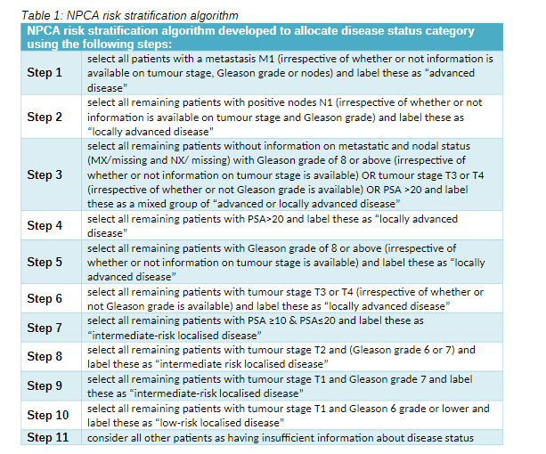
Assessing the number of men with high-risk/locally advanced disease:
Table 1: NPCA risk stratification algorithm

Slide 7
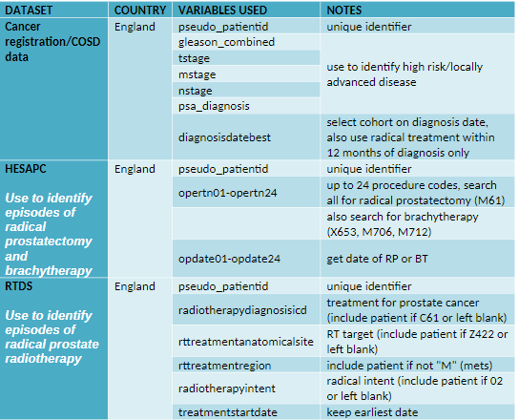
Assessing the treatment received by men with high-risk/locally advanced disease
Table 2: Variables from CRD/COSD, HES and RTDS

Slide 8
Calculation
Numerator:
the number of men having radical prostatectomy, radiotherapy or brachytherapy within 12 months of diagnosis
(derived from Table 2).
Denominator:
the number of men with high-risk/ locally advanced disease
(derived from algorithm in Table 1).

Slide 9
The Role of the Cancer Alliance:
Oversee the implementation of one priority recommendation from 4 (now3) existing clinical audits
Work with Trusts and local clinical groups to develop action plans to implement clinical audit recommendation in Prostate Cancer
Ensure sufficient project management and analytical support at an Alliance/ Trust level for this work *funding*
Addressing Health Inequalities
Embedding CORE20plus5 as a cross cutting theme in Work Programme
Deliverables: Target inequalities in access to the best treatment
Implementation: Work with providers to ensure the recommendations are implemented equitably across different groups/ areas across the alliance
*Ethnicity Recording*
Differential in incidence and access
Uptake on radical therapies
Community Engagement
& events (FOCT)
PPV with lived experience

Slide 10
Cancer Alliance - Next steps:
Once deliverables have been met for a full quarter, Cancer Alliances to confirm sustainable commissioning arrangement with ICBs.
Data collection will continue for two quarters beyond the completion of delivery to ensure changes are fully embedded.
Priority audit recommendations will be reviewed annually.

Slide 11
NHSE Cancer Programme:
The National Team is inviting the Cancer Alliance Treatment Variation Leads and two clinical experts (per session) to the following workshops to support the implementation of the audit recommendations in Breast, Bowel and Prostate cancer.
Workshop: Friday, 7 July, 2023 at 14:00-15:30
The workshops aim to:
Bring together clinical specialists from each Cancer Alliance (two per Alliance) and the Treatment Variation Lead.
Explore the feasibility of implementing this recommendation
Identify the associated challenges
Discuss how to avoid unintended consequences
Come to consensus as to how best to reduce variation in this area

Slide 12
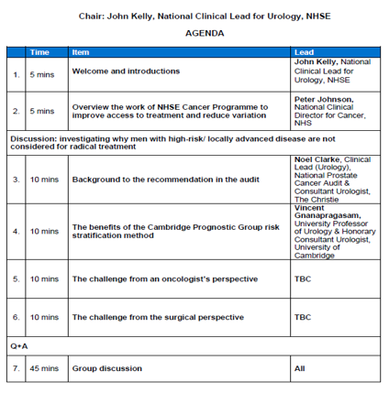
NHSE National Workshop

Slide 13
Where we are?
NPCA 2020
71% of men diagnosed with locally advanced prostate cancer underwent radical treatment
Note:
No data on metrics after 2020
Audit moved to RRDS during Covid
 | 2019 data
National | 71%
Gloucestershire | 70%
Bristol (NBT) | 69%
Bath | 69%
Salisbury | 70%
Taunton | 76%

Slide 14
Resources:
National Prostate Cancer Audit (NPCA)
Reports: Reports - National Prostate Cancer Audit (npca.org.uk)
Feb 2023
Determinants of variation in the diagnosis and treatment of patient with metastatic disease
https://www.npca.org.uk/resources/npca-quality-improvement-workshop-2023/
National Prostate Cancer Audit (npca.org.uk)
NPCA Quality Improvement Workshop Dec 2021
Reducing variation in the treatment
Reducing variation in the treatment of men with high risk/locally advanced prostate cancer - National Prostate Cancer Audit (npca.org.uk)
CORE25PLUS5 Health Inequalities:
NHS England » Core20PLUS5 (adults) – an approach to reducing healthcare inequalities

Slide 15
Thank you I

