Slide 1
SWAG Clinical Guidelines
Urology Cancer Clinical Advisory Group (CAG)
6th July 2023

Slide 2
2015 Version to comply with Cancer Peer Review Measures
Individual sections on renal, bladder, prostate and penile updated by multiple CAG members. Testicular cancer team developed separate guidelines
52 page document
Ratified by MDT Leads
Signed off by Cancer Network/Alliance Managing Director on behalf of the South West Head for Cancer
Uploaded to the public facing website: Urological Cancer Clinical Advisory Group – Information for CAG Members - SWAG Cancer Alliance
Biennial update in 2017, 2019, (separate Covid Guidelines in 2020) and 2021 with version control table and disclaimer:
These are living documents that will be continually reviewed and updated

Slide 3
Peer Review replaced with Quality Surveillance (2017)
There should be agreed Clinical Guidelines
Clinical Guidelines should reflect National Guidelines
Many Regional Guidelines now reduced to tables of links to National Guidelines

Slide 4
2023 Version
Removal of sign off by Cancer Alliance Managing Director as instructed by South West Regional Head of Cancer, Michelle Dixon
Removal of sign off by MDT Leads (for discussion)
Reduced from 52 pages to 28.

Slide 5
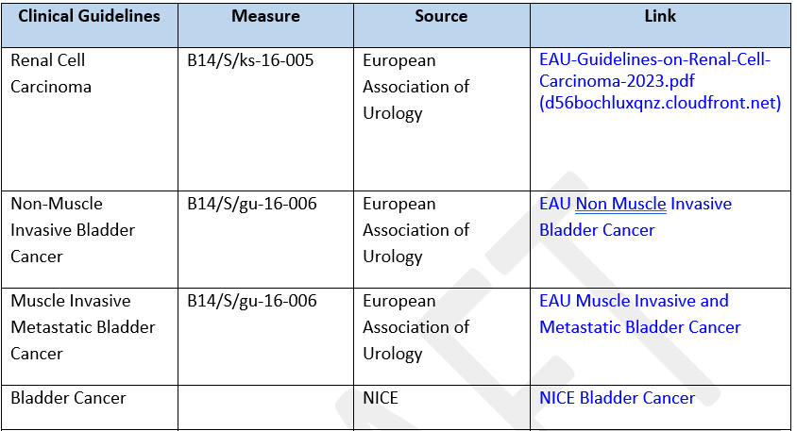
Links to National/SWAG Guidelines

Slide 6
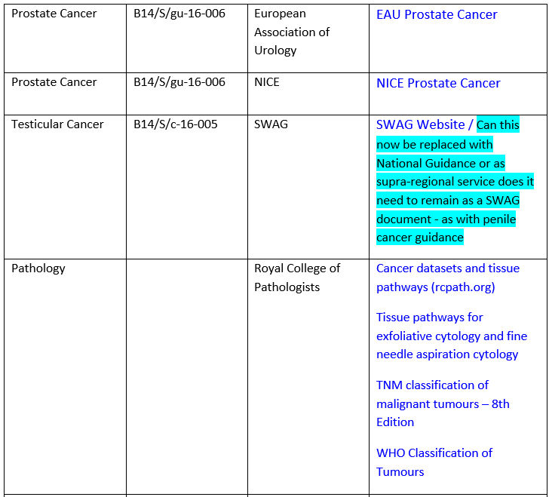
Links to Guidelines Continued

Slide 7
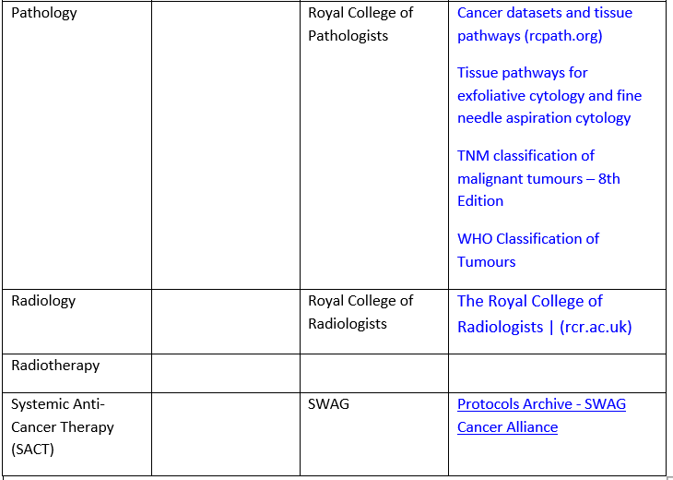
Links to guidelines continued

Slide 8
Regional Additions
CT Kidneys, Ureter and Bladder (KUB) will replace CT Urogram for visible haematuria in patients ≥50 to reduce the risks associated with radiation exposure: Agreed by CAG once the paper has been Peer Reviewed / Published 24th June 2021 – For confirmation
Prostate Specific Membrane Antigen (PSMA) PET Guidelines: Ratified by CAG 24th June 2021 following update from Amar Challapalli
Penile Cancer Guidelines: Ratified by CAG 18th November 2021 following update from Aditya Manjunath
No comments following circulation of reports
Any other regional additions to National Guidelines (should we revisit bone scan audit)?

