Slide 1

Genomic Prostate Cancer Testing for Olaparib
Laura Yarram-Smith
Solid Tumour Lead SWGLH
July 2023

Slide 2

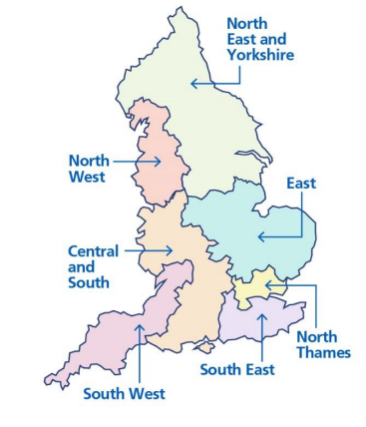
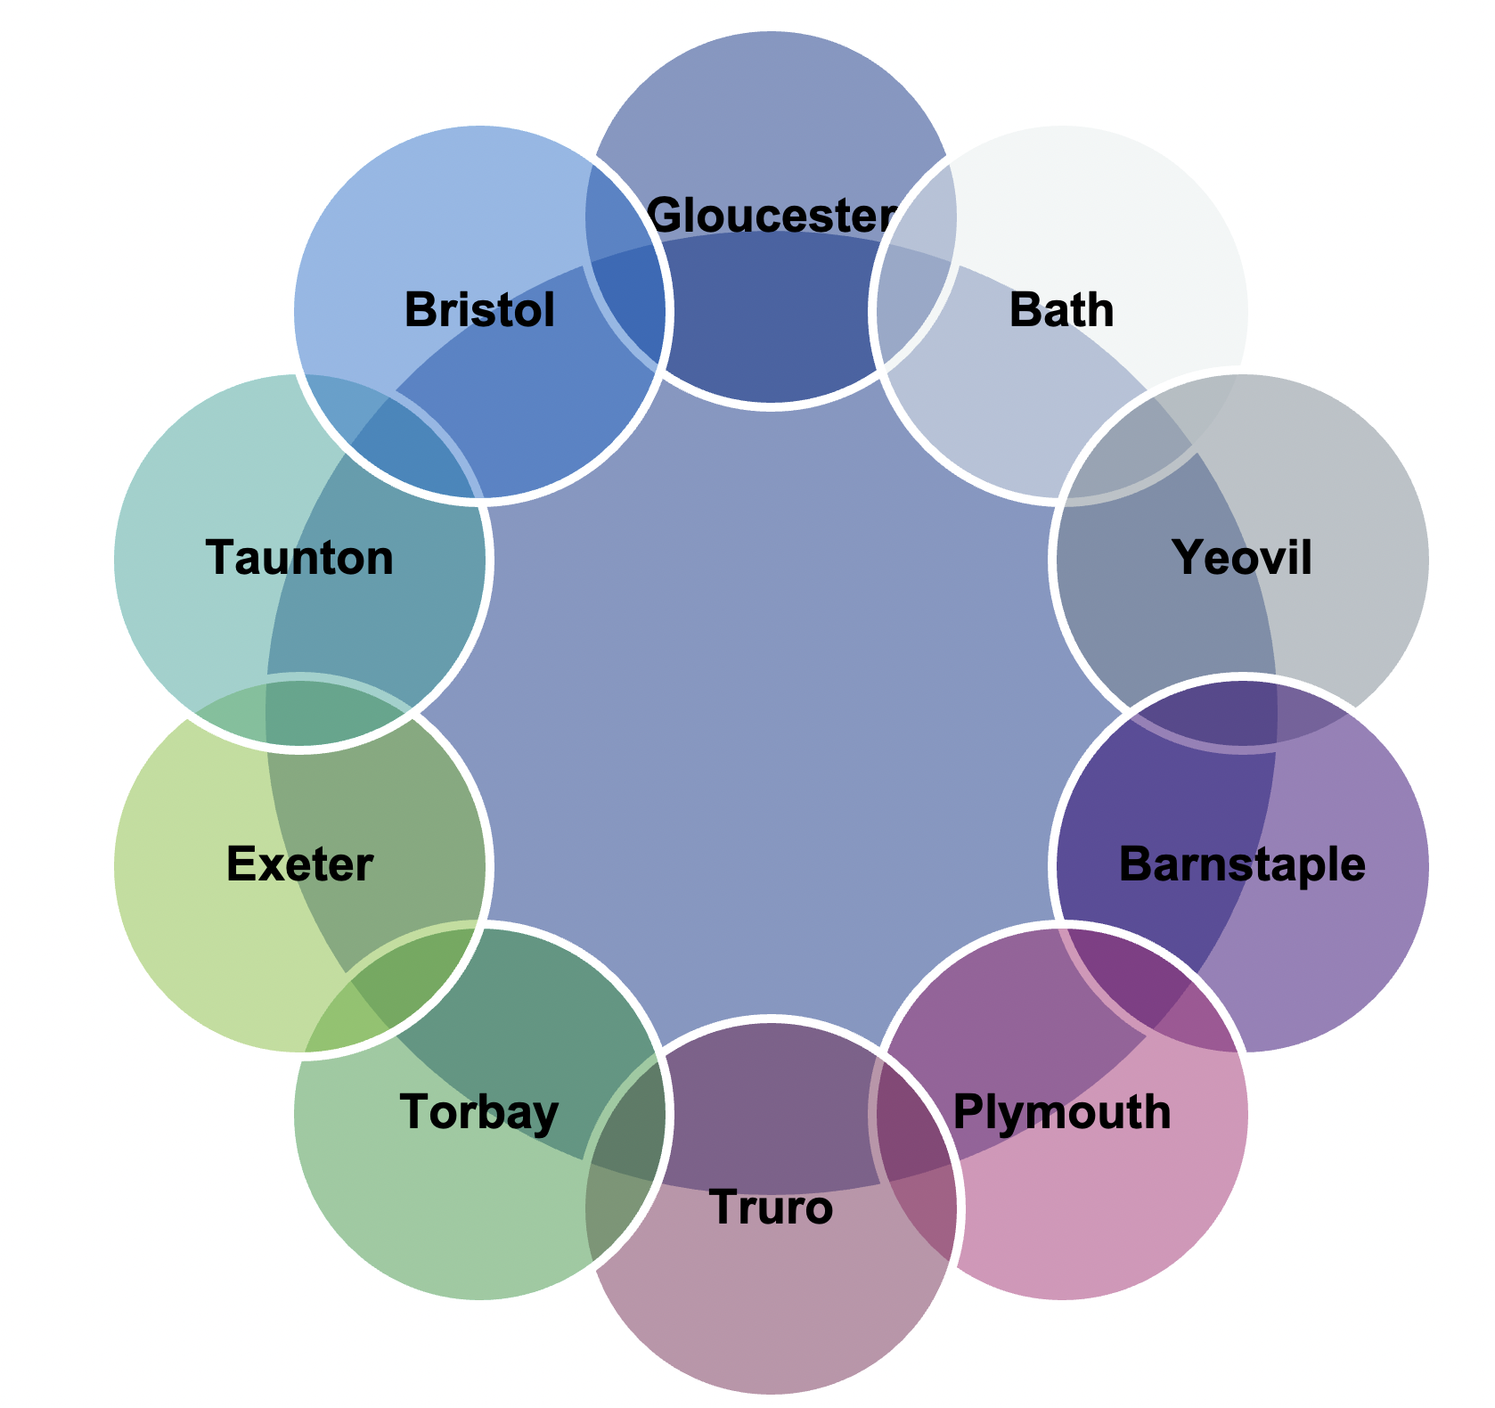
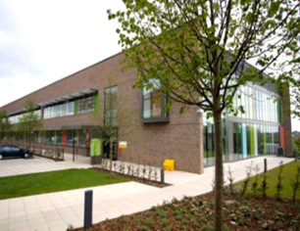

Part of a Genomic Medicine Service
Bristol Clinical Genetics
Peninsula Clinical Genetics
SW Genomic Laboratory Hub
Bristol Laboratory
Exeter Laboratory
SWGLH
SWGMSA
https://www.nbt.nhs.uk/south-west-genomic-laboratory-hub

Slide 3
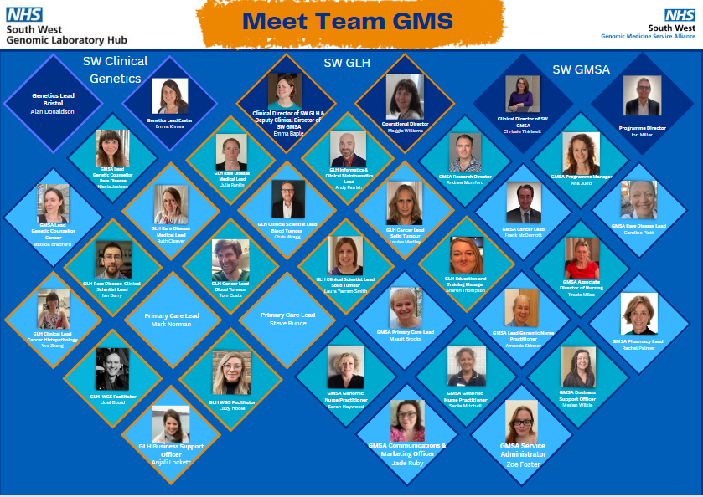

Slide 4


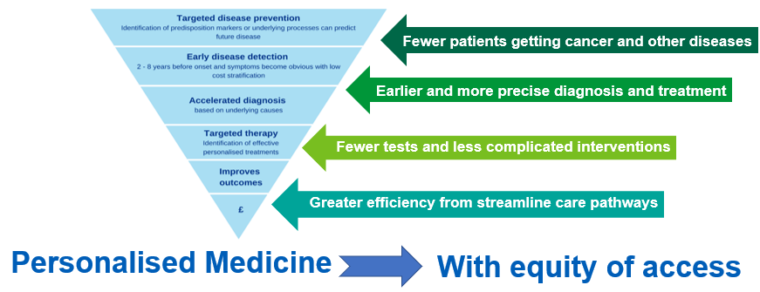
What do we at the SWGMSA do?
Work with the SW GLH and the two genetics services to
Support mainstreaming in Genomic Medicine
Providing practical support with new genomic pathways and
To facilitate access to education and training
Notes:
Supporting diagnosis at the earliest point in the pathway
Proactively direct resources where they can impact on patient care most
Adapt the way we work to make the best use of new technologies
Provide an infrastructure which supports decision making
Increasing access to safe and appropriate genomic testing
Does not replace the expertise of Clinical Genetics. It’s a partnership

Slide 5
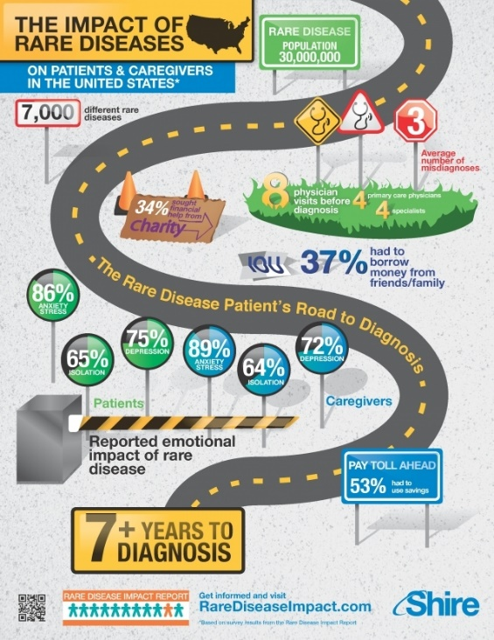
Mainstreaming in Genomic Medicine
What it is…
Supporting diagnosis at the earliest point in the pathway
Proactively direct resources where they can impact on patient care most
Adapt the way we work to make the best use of new technologies
Provide an infrastructure which supports decision making
Increasing access to safe and appropriate genomic testing
What it’s not…
A replacement for the expertise in the genetics service

Slide 6







Improving Health Through Genomics
Driving uptake of Genomic Testing
Right Test
Right Time
Competence
Confidence
Simplicity
Patient
Patient
Information
Clinician
Pathology & Phlebotomy
Logistics
Training
Process
GMS Support
National Resources
NGTD, GEP
IT

Slide 7
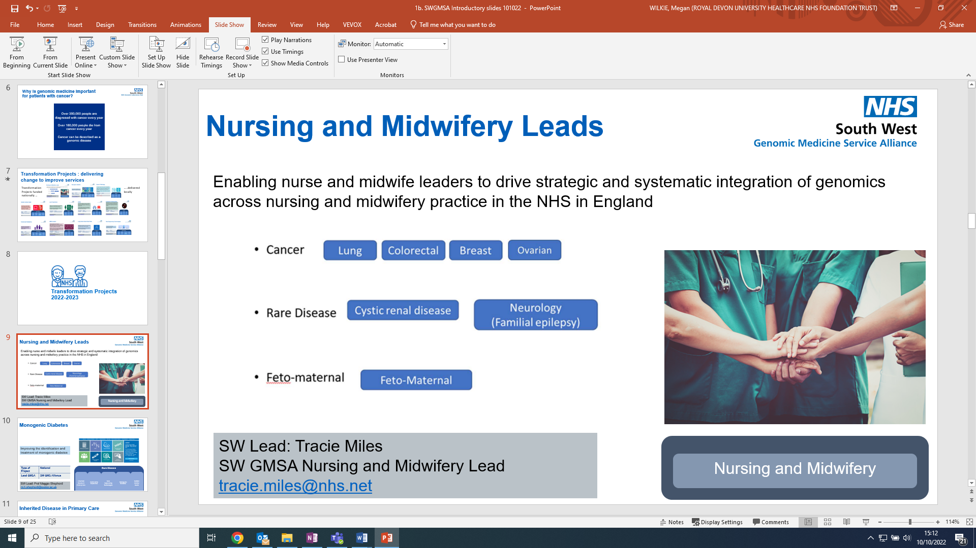
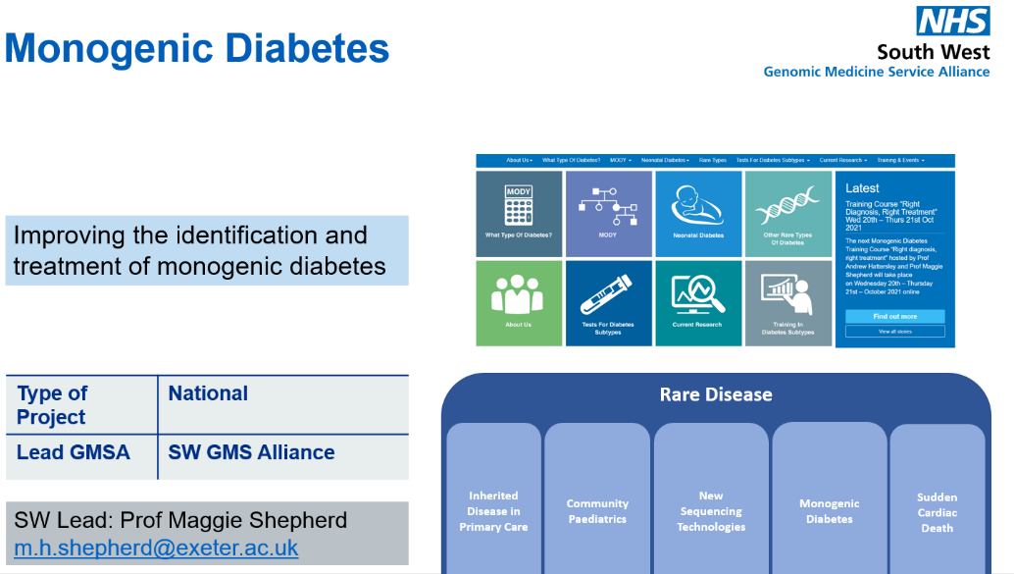
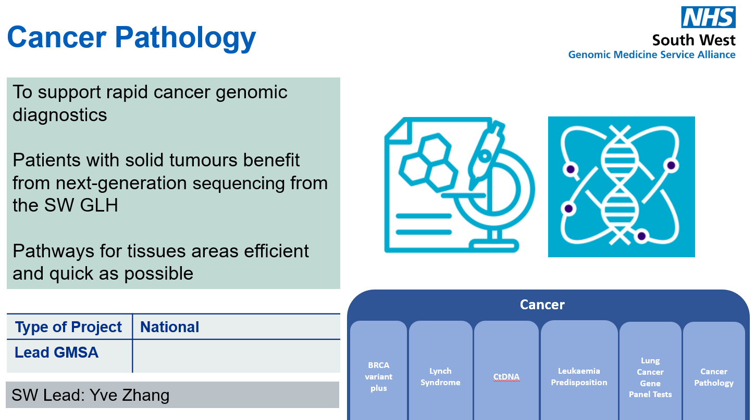
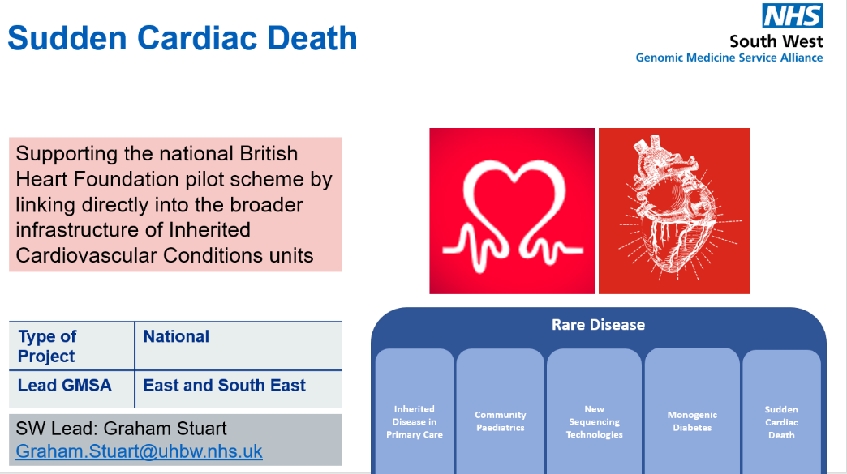
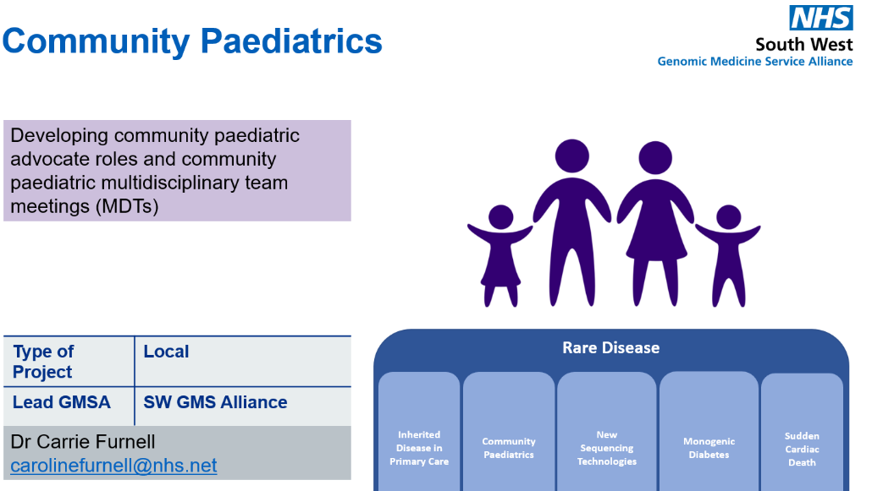
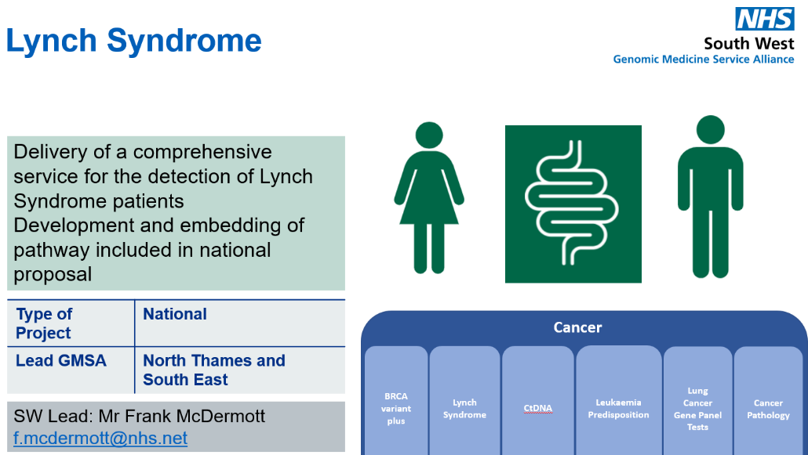
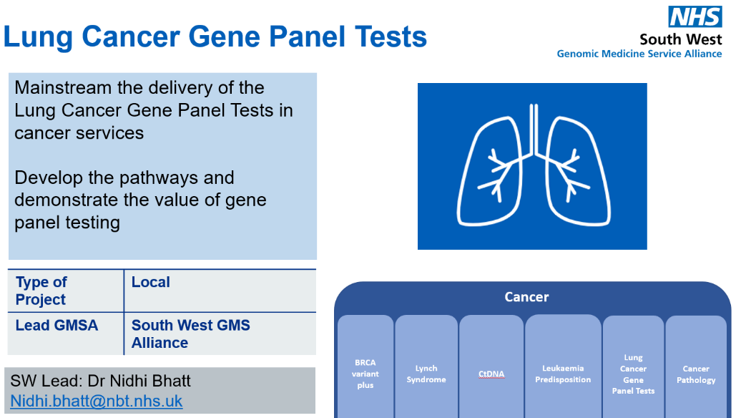
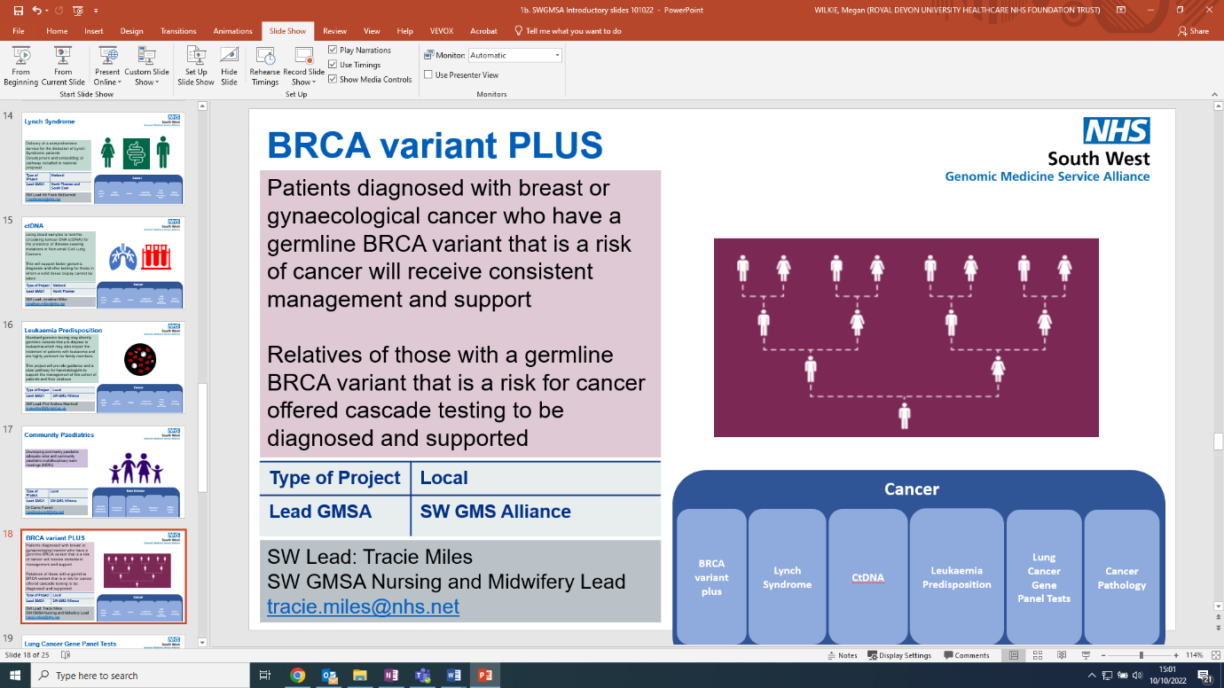
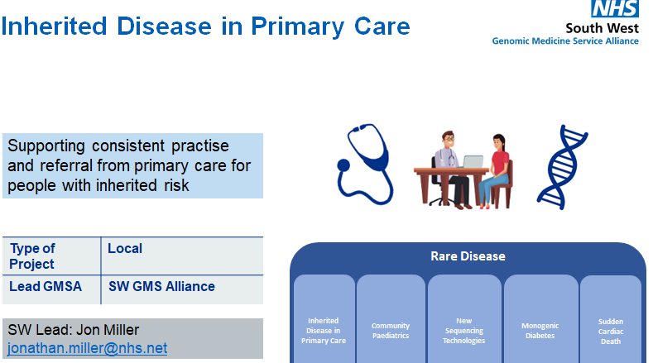
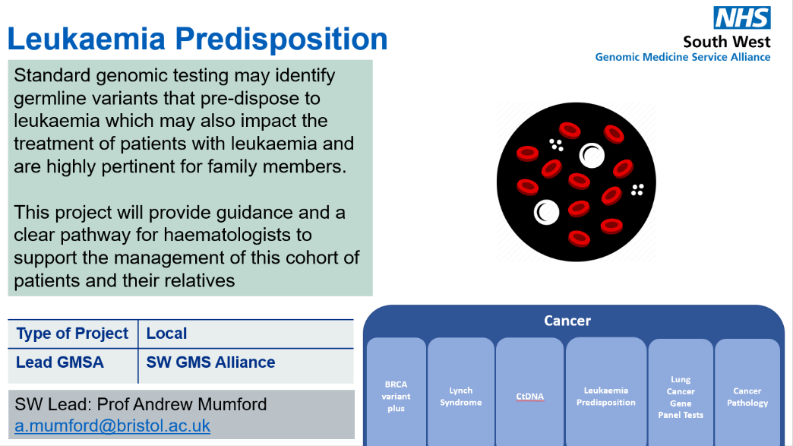
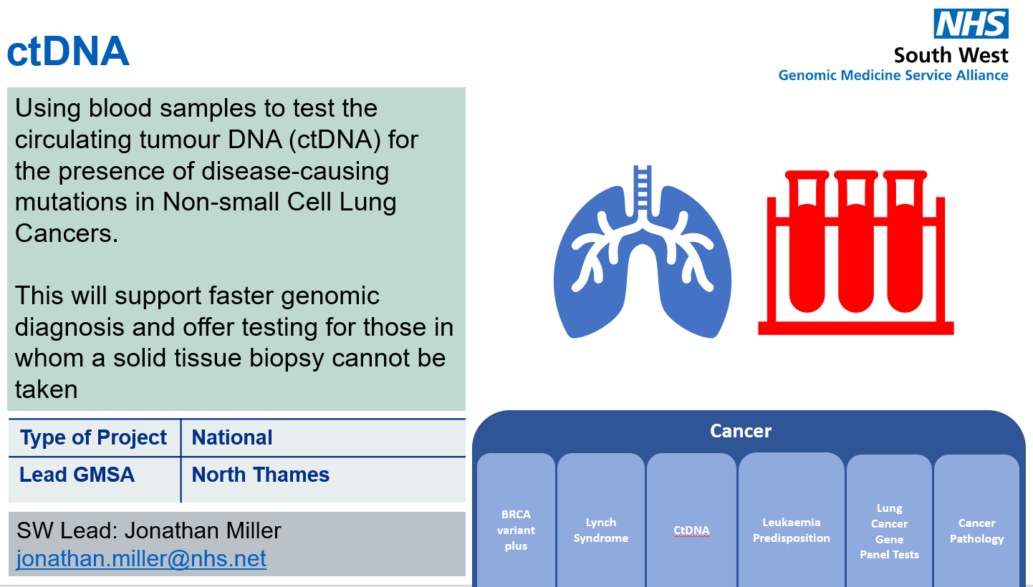
Transformation Projects : delivering change to improve services
Transformation Projects funded nationally …
…..delivered locally

Slide 8
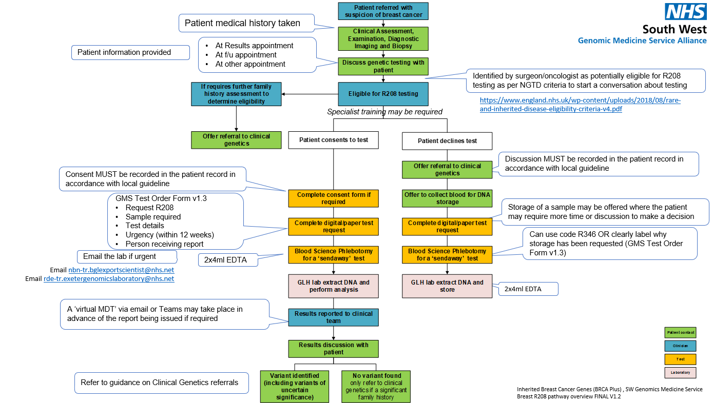
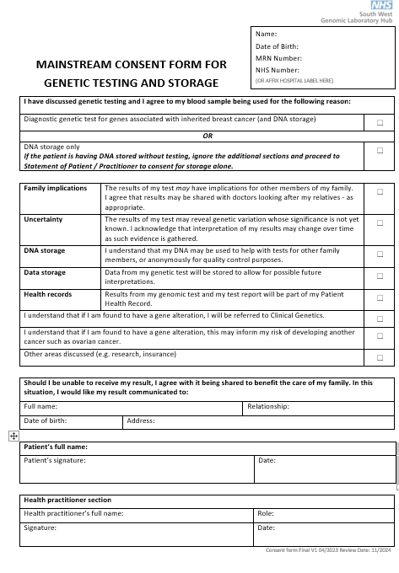
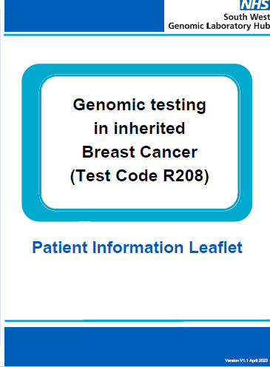
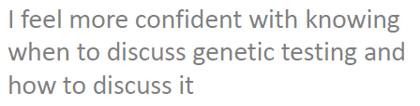

Slide 9


Slide 10
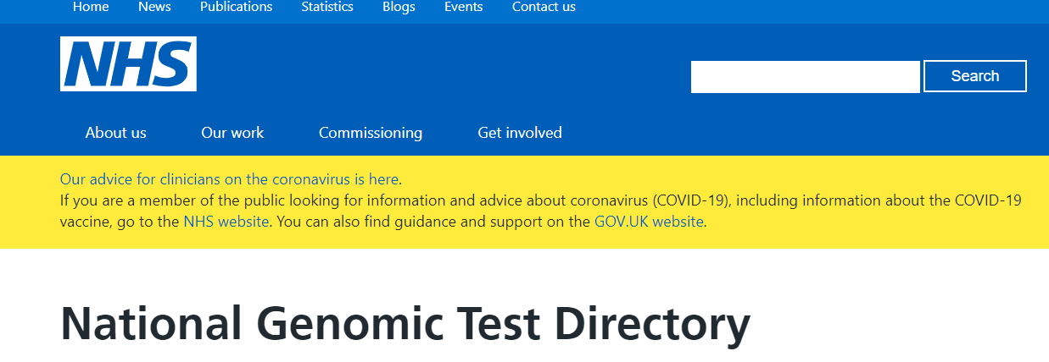
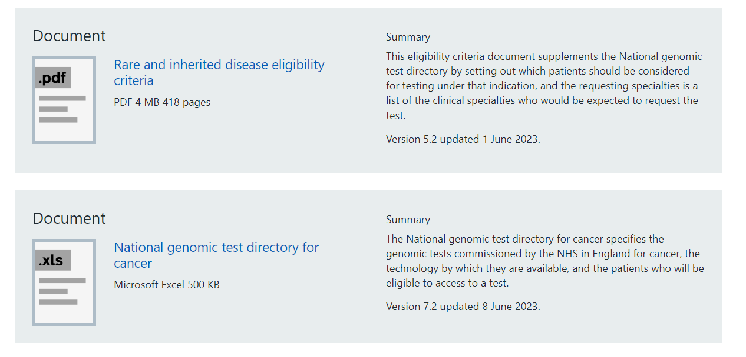
Testing to Treat
https://www.england.nhs.uk/publication/national-genomic-test-directories/

Slide 11
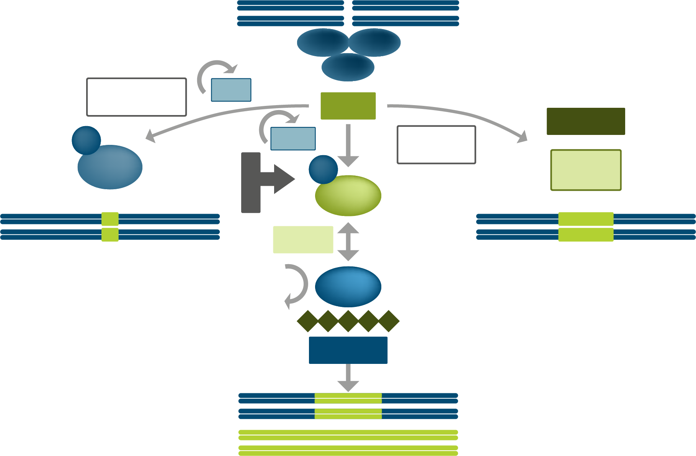
Mechanism of homologous recombination repair defects
Mechanisms of DNA double-strand break repair¹
HRD ‘cause and effect’ tests
NBS1
MRE11
DSBs
RAD50
End
preparation
G1
ATM
RAD52
P
G2/S
End
resection
53BP1
P
DNA
ligase1
Cause of HRD:
Test for BRCA1/2, plus many other HR genes
C
D
K
BRCA1
PALB2
Classical-NHEJ
Inaccurate
Single-strand
annealing
Inaccurate
BRCA2
RPA
RAD51
Effect of HRD:
Functional test for HR deficiency
Homologous
recombination repair
Accurate
BRCA1/2=breast cancer 1 or 2 gene; CDK= Cyclin-dependent kinases; DSBs=double-strand DNA breaks; HR=homologous recombination; HRD=homologous recombination deficiency; NHEJ=non-homologous end joining.
1. Adapted from O’Kane G et al. Trends Mol Med. 2017;23(12):1121–1137.

Slide 12
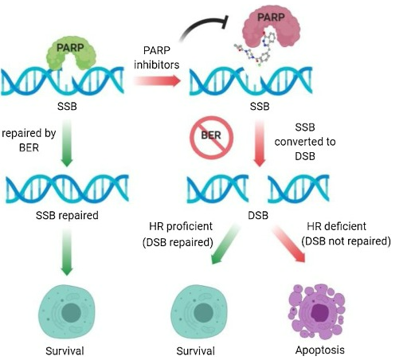
PARPi

Slide 13
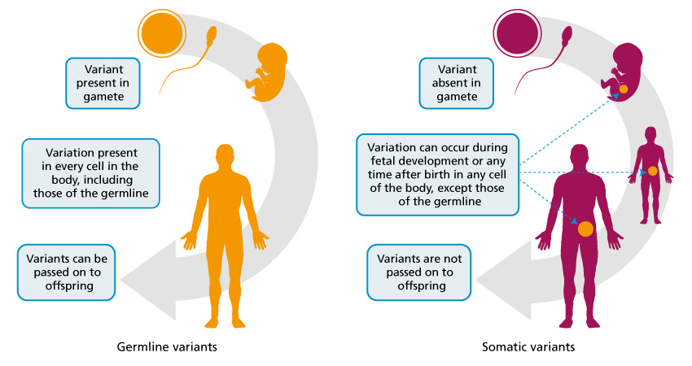
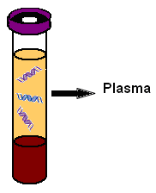

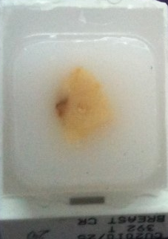
Sample types
ctDNA
Tissue
Blood
Prof Clare Turnbull, Genomics Education Programme

Slide 14
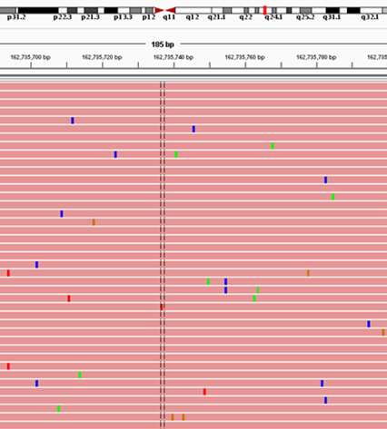
Tumour BRCA analysis
Testing DNA extracted from paraffin-fixed tissue
  Degraded, short fragments, artefacts
  Pre-analytical handling standards essential
  Old archival tissue
NGS analysis of the full genes, with modifications (high depth, molecular bar-codes…)
Copy number analysis is not currently possible
Detects germline and somatic variants
  Requires germline analysis to confirm inheritance
Classification of variants

Slide 15
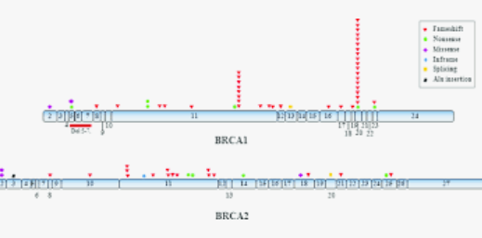
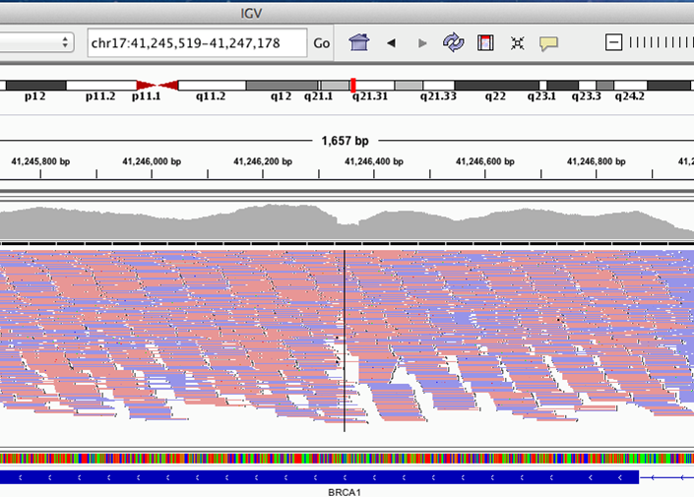
Germline BRCA analysis
Variants found throughout the BRCA1/2 genes
  SNVs, small ins/dels and CNVs
Variants are “private”
Analysis best achieved by NGS analysis of the full genes, including copy number analysis
Good quality DNA from blood will detect >99% mutation types
BUT Germline only
Classification of variants

Slide 16
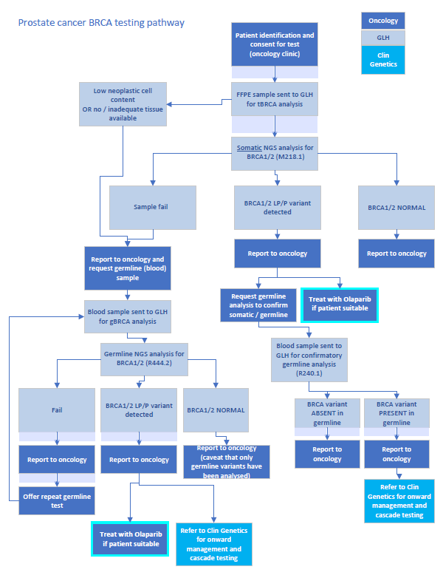
Prostate Cancer BRCA1/2 Testing
Somatic testing FIRST
Test code = M218

Slide 17
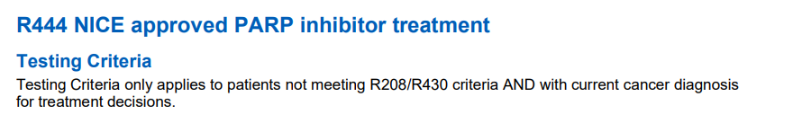
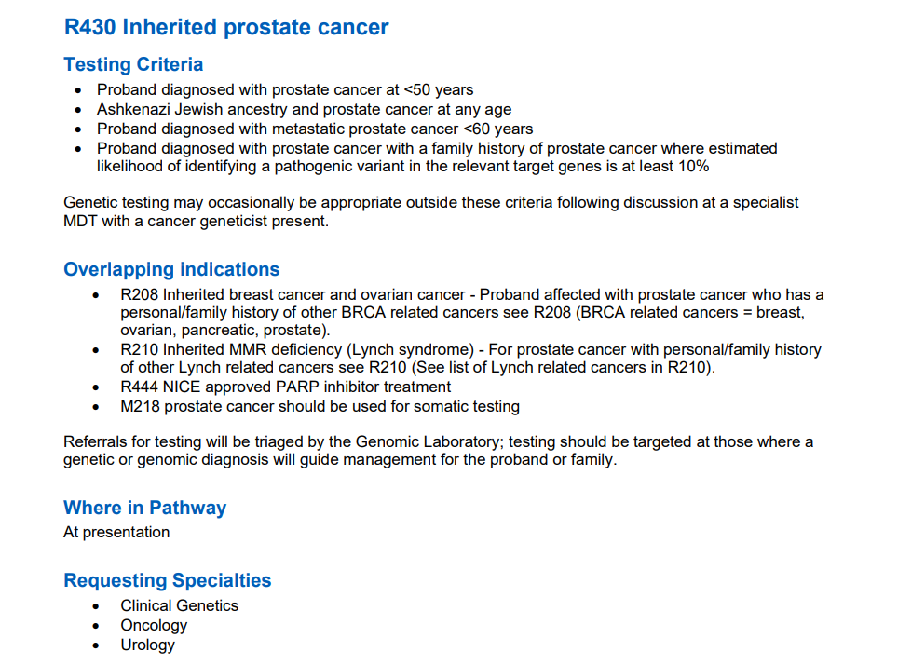
Eligibility for germline testing
ALL patients with a germline BRCA1/2 variant should be referred to the Clinical Genetics Service

Slide 18
Testing Strategy Summary
For patients with a diagnosis of metastatic castration-resistant prostate cancer that are potentially eligible for Olaparib we can offer:
When to request? | Test Code | Referral Form | Sample Type | Somatic/Germline | Genes Tested
First | M218.1 | Adult Solid Tumour | FFPE | Somatic | BRCA1/2 Will not currently identify CNV’s
Second. Only required if M218.1 fails | R444.2 | GMS Test order form | EDTA blood | Germline | BRCA1/2 Will not identify variants that have arisen somatically
If eligibility criteria met For patients diagnosed with prostate cancer <50yrs, metastatic prostate cancer <60yrs, strong family history (refer to eligibility Rare Disease criteria Document). | R430 | GMS Test order form | EDTA blood | Germline | BRCA1, BRCA2, MLH1, MSH2, MSH6, ATM, PALB2, CHEK2.
ALL patients with a positive germline finding should be referred to their local clinical genetics service (Bristol/Exeter) for ongoing discussion and cascade testing of family members.

Slide 19
Other Available Tests
Prostate Cancer
M218.2 – TMPRSS2-ERG, NTRK1, NTRK2, NTRK3
Bladder Cancer
M217 – FGFR2, FGFR3, NTRK1, NTRK2, NTRK3
Renal Cell Carcinoma
M18 - Various diagnostic tests + NTRK1, NTRK2, NTRK3

Slide 20
Contact
nbn-tr.swglhcancer@nhs.net
  Team of Solid Tumour Scientists, checked daily by Duty Scientist

Slide 21
Why is genomic medicine important for patients with cancer?
Over 350,000 people are diagnosed with cancer every year
Over 160,000 people die from cancer every year
Cancer can be described as a genomic disease
1600 children under 14yrs of age (1:500 children) per year in uk, get Cancer
Average survival rate at 5years is 80%
250 Children per year die of Cancer in the uk
Nearly 25% of those getting cancer get leukaemia and 18% get CNS tumours.
Notes:
Remembering that there is a large component of our work in the SWGMA which is looking at rare conditions.
This audience is Cancer so we are focusing on the cancer objectives of genomic medicine.

Slide 22
NHS publishes first Genomic Strategy
“The investment made by the UK Government and the NHS in genomics over the last decade, including through the ground breaking 100,000 Genomes Project delivered by the NHS and Genomics England alongside the existing genomics expertise within the NHS, laid the foundations for the use of genomics in routine clinical care”
Launched 12th October 2022

Slide 23

Code on Genetic Testing and Insurance
If you are applying for insurance from a company who has signed up to the Code, they agree to act according to its rules. This means that the company has committed to the following:
To never require or pressure you to have a predictive or diagnostic genetic test, under any circumstances
To not ask for, or take into account the result of a predictive genetic test if you are applying for insurance with the only exception being if you are applying for life insurance over £500,000 and you have had a predictive genetic test for Huntington’s Disease. Only in this circumstance do you need to tell the insurance company the result of the test, if they ask
Notes:
replace

Slide 24
Code on Genetic Testing and Insurance
The Code on Genetic Testing and Insurance was published in October in collaboration between the Department of Health & Social Care and the Association of British Insurers (ABI), replacing the previous ‘Concordat and Moratorium on Genetic Testing and Insurance’.
It is an agreement between Government and the insurance industry prohibiting insurer’s access to the results of predictive genetic test results, with exceptions for a very small minority of cases.
The Code offers the same levels of protection as the Concordat but with additional benefits to provide greater reassurance to those considering undertaking a predictive genetic test (for example the new agreement no longer has an expiry date).
NHS GMCs are encouraged to be aware of the impact of the new code, and to promote awareness of it amongst patients and clinicians.
https://www.gov.uk/government/publications/code-on-genetic-testing-and-insurance
https://www.gov.uk/government/publications/code-on-genetic-testing-and-insurance-consumer-guide
https://www.abi.org.uk/data-and-resources/tools-and-resources/genetics/genetics-faqs/
Notes:
replace

