Slide 1
South West Radiotherapy Late Effects Service
Lisa Durrant PhD
Macmillan Consultant Radiographer
Beacon Radiotherapy Centre
Musgrove Park Hospital
Taunton

Slide 2
Why do we need late effects services?
Survivorship is increasing
LWBC (Personalised care) initiative
Improved documentation (treatment summaries)
Reduced costs (remote follow up and self management strategies)
Supported patients with general information and signposting
(H&W events, Cancer Support Workers, level 2 psychological training)
It has not provided a mechanism to manage long term, life changing symptoms
Notes:
Survivorship has increased dramatically in the last 10 years. This is due to investment in diagnosis and treatment, but there is currently only minimal investment in survivorship or late effects.

Slide 3
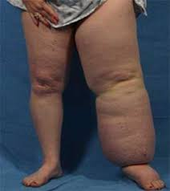
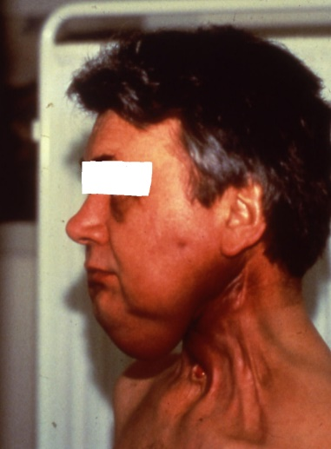
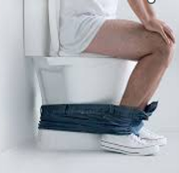
Consequences of treatment

Slide 4
What does Beacon Late Effects service offer?
Clinical expertise:
Management and support for patients with long term radiotherapy related symptoms. Single point of contact for patients to access the correct resources. Source of expertise for other HCPs
Service development & research:
Building links with non-cancer services, developing pathways, working with CCG and community services, developing novel & sustainable solutions
Education, training and development:
Support for new services, providing training and sharing best practice, teaching, webinars etc.
Professional leadership & consultancy:
SoR special interest group for late effects, contributing to national guidelines

Slide 5
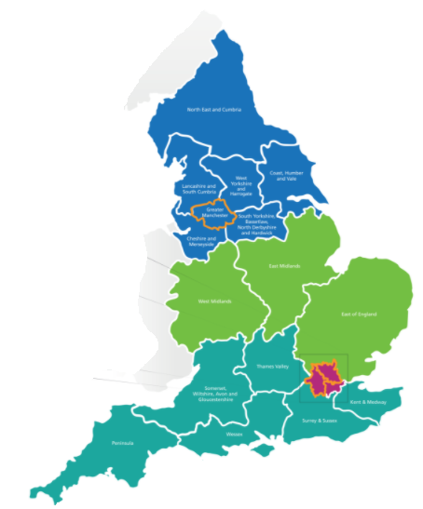
What can a local service achieve?
Improve outcomes for patients (reduce symptoms, improve function, QoL)
Provide excellent patient care
Promote and support self management
Prevent inappropriate referrals
Prevent referrals in circles
Reduce appointment costs
Provide quality data

Slide 6
…but a local service cannot achieve?
Care and support for everyone!
Out of area patients
Referral to patients local services
Responsibility for out of area patients
Data to underpin other services
Broad research base
access to large patient numbers
Universal expertise
one person can not be an expert in everything. Late effects cover all anatomical sites, all diagnoses, multiple treatment types etc.

Slide 7
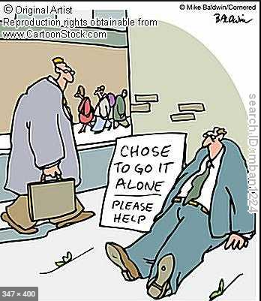
Leaving it too late
Radiotherapy services have been set up with no shared planning or strategy
Patients develop complex symptoms
Where do responsibility lie?
Cancer patients without cancer
Lack of (meaningful) data
Lack of consensus on terminology
Lack of evidence, guidance and trials
Problems with commissioning and funding
Reliance on short term charity funding
Inequity in service provision
Retrospective services for legacy patients

Slide 8
Managing radiation late effects – models of care
Personalised treatment
Most centres offer no late effects support
A few offer retrospective late effects support
Personalised aftercare
We can work together to offer prospective late effects management
Personalised care
Notes:
There is no NICE guidance on management of late effects and currently only 2 full time late effects radiographers in the UK. Most services have an inactive model of care.

Slide 9
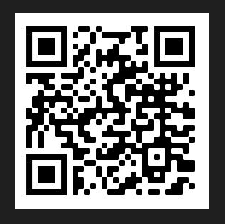
Collecting data
Currently lack of consensus
Lack of terminology
Lack of diagnosis
Lack of reporting
Lack of outcome measures
Lack of standardisation
PRDA Best Practice Pathway: Incidence and Prevalence
Gastro 2- 20%, 11%, 59%, 45%
Urinary 3.7- 52%
Pain 1/3, many moderate to severe and unmanageable
Sexual difficulties females 24%, 80%
Sexual difficulties males at least 50%, 67-85%, 5-51%
Lymphoedema, not understood
Bone 4- 20%
How many people have late effects?
What are their symptoms?
What was treated?
How are they managed?

Slide 10
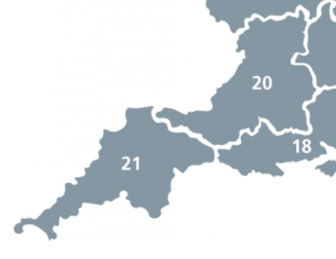
Scale of the problem?
2030 –1 million with side effects
(main increase in older patients)
Cost of the problem?
170,000 in South-West living with and beyond cancer, of these 42,000 could have treatment related consequences
Data shows repeated appointments in secondary care over many years
Primary care?
Societal costs – unable to work due to unmanaged symptoms
Personal costs – ‘financial toxicity’ and quality of life
(2 million/67 million) x 100 = 3%
3% of 5.6 million = 170,000
9333-TSO-2900664-NCSI_Report_FINAL.pdf (publishing.service.gov.uk)
170,000 legacy patients
does not include
new patients

Slide 11
What could a regional service achieve?
Build on the LWBC initiative
Work with GP’s to build late effects into EMIS and/or develop
a register
Provide equity of service to cancer patients after treatment across the region
Role extension and
support across the region.
Therapeutic rads area key to
driving improvements in
reducing/preventing/predicting
late effects
Produce an information &
resource hub for patients,
GP’s and HCP’s
Produce data to develop
tariff to manage patients
with late effects and provide
simple equipment
Gather meaningful
data to inform guidance
and best management
of patients – UK first
Intersectoral working
in alignment with NHS & CCG
Save costs, outpatient appointments,
GP appointments, inappropriate meds

Slide 12
Regional model
Local referral pathways dealing with simple cases and regional pathways to help manage more complex cases
Single point of access to correct services
Virtual MDT
Standardised documentation to improve data collection and outcomes
Co-ordinated training
Core outcome data collection
(RT Service Spec 2019)
Local centres are required to link with local specialities to develop referral pathways
(GP’s, lymphoedema, colorectal, gastroenterology, dermatology, orthogeraitrics, continence, counselling, neurology, breast screening, dieticians, sexual health)
Regional centres for complex symptoms, specialist surgery, specialist diagnostics

Slide 13
SW RT ODN (RT Service Spec 2019)
Macmillan funding
Alliance funding
Local funding
SW CSU (data, costings, evaluation)
Clinical team
8 Radiographers
1 Navigator
Project Team
Steering Group (inc patients)
Data analyst
Project managers
Commissioners
Macmillan funded
Part Macmillan funded
Alliance or locally funded 0.4 WTE
No funding

Slide 14
SWRLES: South West Regional Late Effects Service
Education & Training
What is a LE radiographer?
Clinical service
Rad led service in each centre
Data
Commissioning and sustainability
Outreach & development
Information resources
Links to local services for referrals
Point of access for patients
Patient level data
Service level data
Who, what, when
Governance & safety
Job descriptions
Scope of practice
Guidance
Training others
Innovation and trials
MDT decisions
What does it cost / save
Referral Criteria

Slide 15
Data
Developed with
commissioners
Key Performance Indicators
Basic service numbers
Quality of Life
Pathways and providers of care
Outcome measures
Use of primary care
Reporting and recording (SNOMED)
eHNA
Collecting data and sharing data
(sustainable services are not funded on anecdotal evidence)

Slide 16
SWRLES: Core Data
Standardised introduction letter (IG ratified)
Referral form
Consultation form
Activity data (appts, phone calls, referral etc.)
Core Outcome Measures
Standardised set of outcomes that should be measured and reported, as a minimum
Patient Reported Outcome Measures (PROMS)
Quality of Life
Anonymised data
Sites use a patient code
Postcode

Slide 17
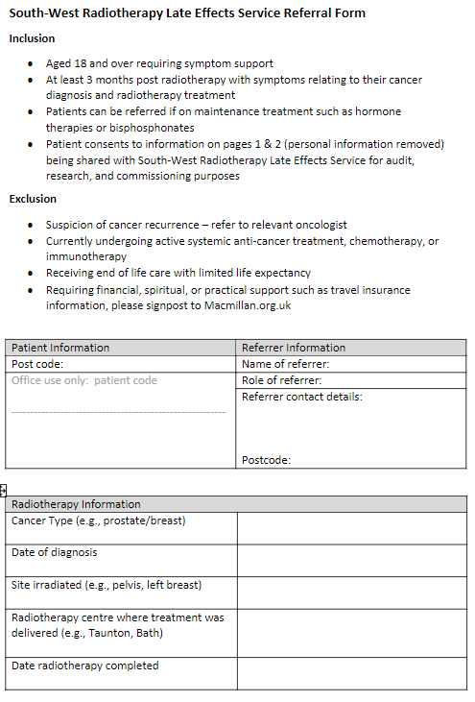
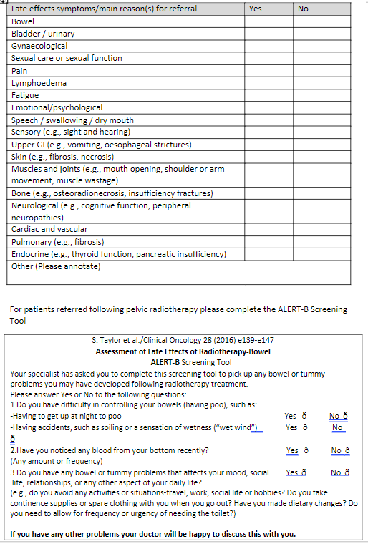
(RT Service Spec 2019)

Slide 18
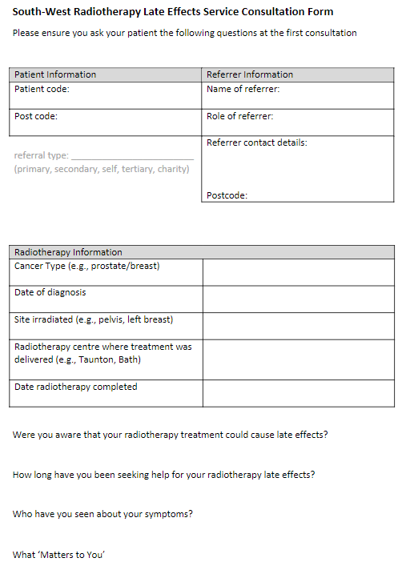
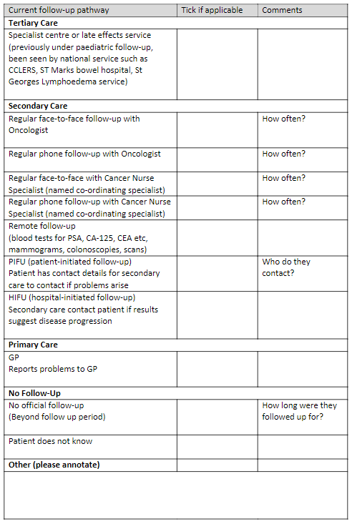

Slide 19
Data management
Individual sites
Input information
Data is assessed,
scored, presented
by Navi
Access their
own site data
All anonymised
Data available to
analyst
Large dataset of useful, core information

Slide 20
Core Outcome Set
Descriptive stats & qualitative data (referral and consultation forms)
Quality of Life
EORTC QLQ-C30 and EQ 5D 5L
Cancer-quality-of-life-survey-summary-report-first-data-release.pdf (england.nhs.uk)
Site specific
EORTC questionnaires - PROMS
Questionnaires - EORTC - Quality of Life : EORTC – Quality of Life
Macmillan
HNA
Long term condition management
Patient Activation Measure

Slide 21
EORTC Questionnaires (European Organisation for Research and Treatment of Cancer)
Produced by evidence review with patient and HCP input
Validated, scorable, population data
Different languages
Data on action levels, minimally important differences
Licensed but free
Many cancer types
Relevant to radiotherapy late effects
Questionnaires - EORTC - Quality of Life : EORTC – Quality of Life
PR20 radiation proctitis
H&N43 head and neck
2054 Immune Checkpoint inhibitors
Metastatic malignant melanoma (irAEs – immune related adverse events)

Slide 22
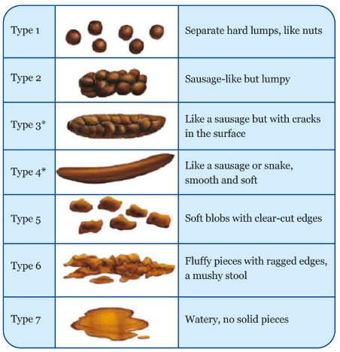
Further information?
Add whatever will improve your service
Bladder diary
Blood tests
Pain measures
Food diaries
Bristol Stool Chart
Range of movement measurements
Fatigue scores
This information is not required to be submitted
- it does not add to the core data set

Slide 23
Sharing data - Coding and Primary Care
Beyond follow-up…
Primary care
Treatment not recorded properly
Could be used to flag potential late effects
SNOMED CT (systemised nomenclature of medicine clinical terms)
Radiation injury
Chronic radiation proctitis
Code diagnosis or symptom

Slide 24
Building pathways – costing a service
Proposed model
Universal, targeted, and specialist
Patients seen, referred to national services
CCLERS
National Fatigue service
DDRC
National Radiation Cystitis Service
4:
National
specialist
services
Level 2:
Local specialist services
Level 1:
Late effects radiographer service
Level 3:
Regional specialist services
Patients seen, referred to regional services
Ano-rectal physiology service , SNS services
Patients seen, referred to local services
Colonoscopy
Bladder instillations
Lymphoedema team
Cost effective
Service?
Patients seen and managed by rad-led service
Resources to help patients self-manage
Resources for GPs to provide basic management
Need to show that radiographer-led service is not just a referral/triage service and we can manage a cohort of patients ourselves

Slide 25
Progress to date
As one region…
Supported each other
Discovered new services
Services are now seeking collaboration and information
(RT ODNs, oncology menopause, SW IO service)
Developing SOPs, protocols, information leaflets
Commissioners are actively seeking data
All have referrals
As many regions?...
Big data
ePROMS
Emphasis on living rather than surviving

Slide 26
Cheltenham & Gloucester
Samantha Bostock
Samantha.Bostock@nhs.net
Bristol
Zoe Walker
lateeffects@uhbw.nhs.uk
Bath
Hazel Clarke
Ruh-tr.RTlateEffects@nhs.net
Exeter
Alexandra Board
A.Board@nhs.net
Taunton
Lisa Durrant, Vicki Hands
RTLateEffects@SomersetFT.nhs.uk
Michele Chirossel (regional navigator)
Michele.Chirossel@somersetft.nhs.uk
Truro
Emma Crozier
Emma.crozier1@nhs.net
Torquay
Suzanne Hill
Suzanne.hill@nhs.net

Slide 27
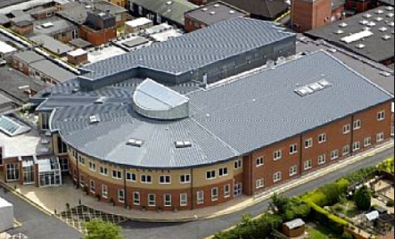
Beacon Late Effects Service lisa.durrant@somersetFT.nhs.uk 01823 342933 @DrLisaDurrant

