Slide 1
Mainstreaming
Sarah John
Lynch Nurse Facilitator SWGMSA

Slide 2
‘Mainstreaming’ refers to the shift of genomic testing away from the Clinical Genetics to other clinics and specialities.
Within the Lynch Syndrome testing pathway, this means healthcare professionals in cancer MDTs become directly involved in consenting patients for germline genetic testing and communicating the results.
Notes:
So what do we mean by mainstreaming. We are referring to the process of consenting patients who have been found to have a error in their MMR/BRAF/MLH1 promotor methalation, to germ line testing. Once results known patients will then be referred to genetics accordingly

Slide 3
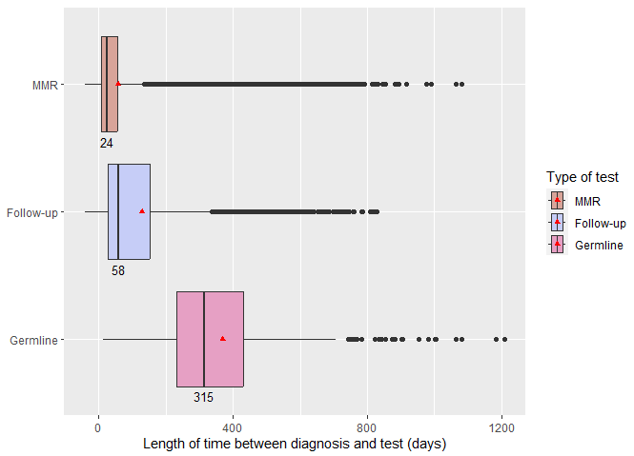
NDRS data for length of time to diagnosis
Notes:
We have an updated graph with the number of dates that it takes from the diagnosis of cancer to the diagnosis of Lynch syndrome from the NDRS (National Disease Registration Service)

Slide 4
Why Mainstream

Slide 5
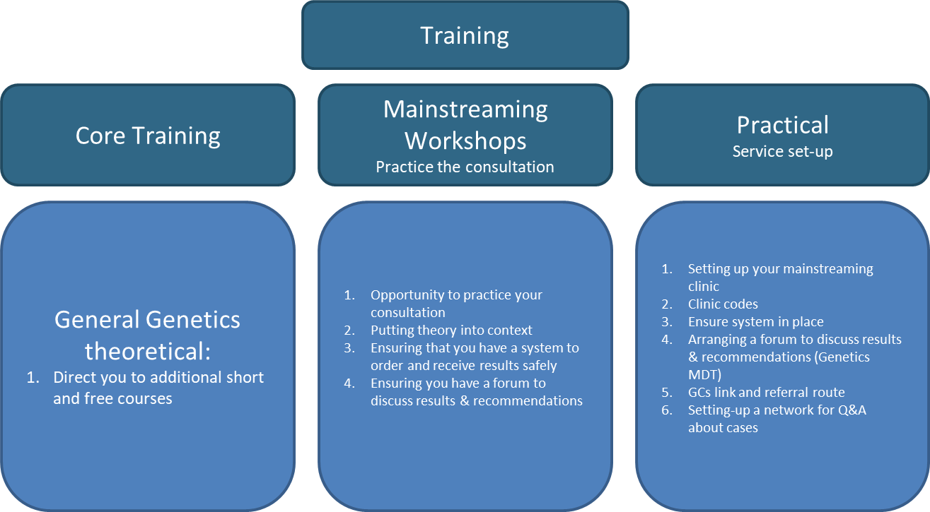
Mainstream Training

Slide 6
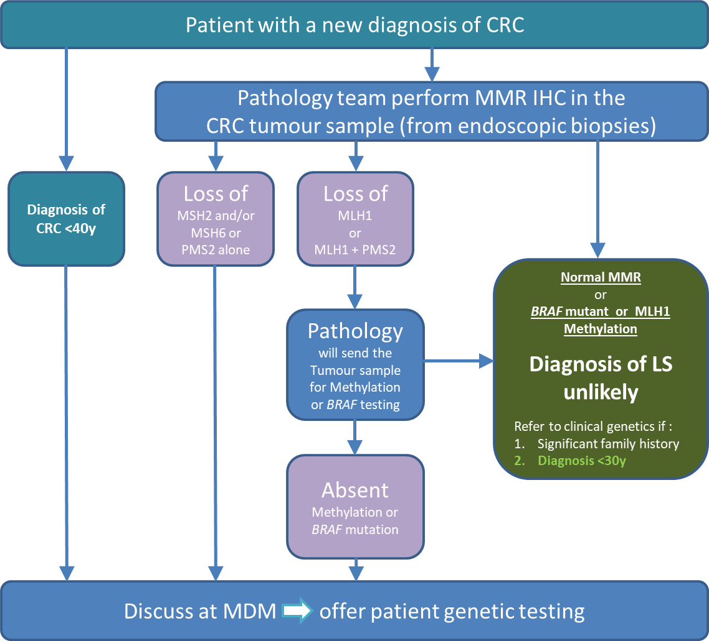
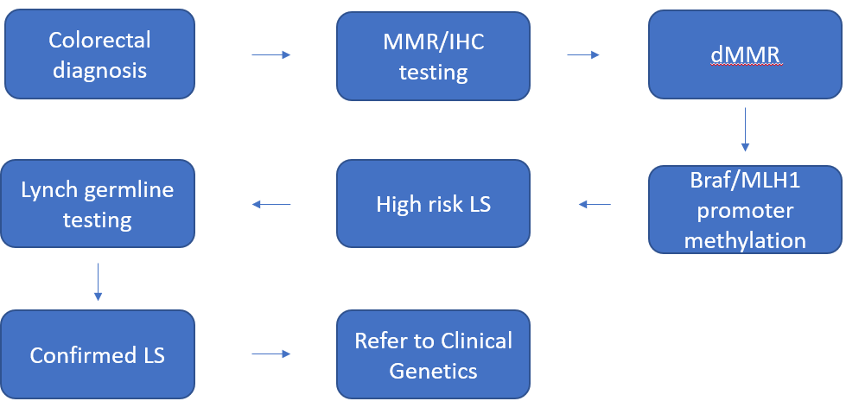
Image

Slide 7
Contacts:
Sarah John
Sarah.brook2@nbt.nhs
Siobhan John
siobhan.john@nhs.net

