Slide 1
Somerset Wiltshire Avon Gloucestershire Cancer Alliance (SWAG CA) 11 May 2023 Treatment Variation: Rectal Cancer Winnie Lo Transformation Project Manager, PPV lead

Slide 2
Treatment Variation for Colorectal Cancer:
Deliverable:
National Cancer Audit Implementation:
Alliances to oversee the implementation of one priority recommendation from each of the 4 (now 3) existing clinical audits for cancer other than lung cancer.
Bowel:
Reduce variation in neoadjuvant radiotherapy treatment in rectal cancer patients undergoing resection.
Ensure evidence-based local radiotherapy policies are in place.

Slide 3
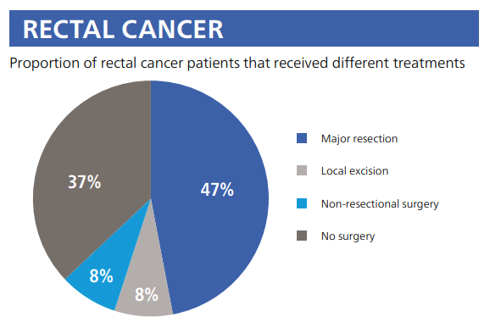
National Bowel Cancer Audit – Annual Report 2021
The majority of the results in this report are from patients diagnosed 1 April 2019 to 31 March 2020
47% of rectal cancer patients received Major resection as treatment

Slide 4
Rectal Cancer Key finding: (Report 2021)
Overall, 36% of patients undergoing major resection for rectal cancer received neo-adjuvant therapy with the vast majority receiving long-course radiotherapy.
There was considerable variation between English cancer alliances (14% to 62%)
NBOCA only has access to RTDS data for England

Slide 5
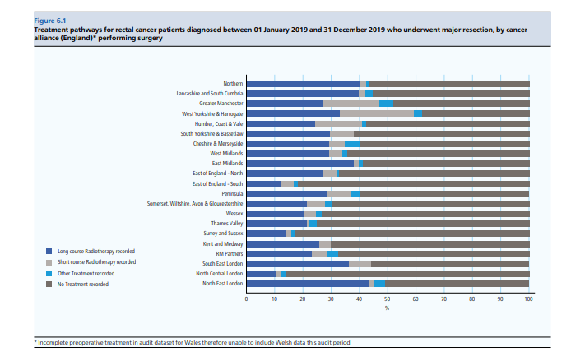
Rectal Cancer Key finding: (Report 2021)
During this audit period, 8,830 patients were diagnosed with rectal cancer (Table 6.1)
The Geographical Variation in the use of neo-adjuvant radiotherapy
Consistent with previous audit periods
A significant variation in both the use of neo-adjuvant radiotherapy and the type of radiotherapy used across English cancer alliances (Fig 6.1)

Slide 6
Rectal Cancer Key finding: (Report 2021)
Use of Radiotherapy in Rectal Cancer patients undergoing major resection:
3,826 rectal cancer patients diagnosed between 01 Jan 2019 and 31 Dec 2019 who underwent a major resection
1,387 (36%) received neo-adjuvant treatment
Of those 1,387 patients, 18% short-course radiotherapy, 76% long-course radiotherapy

Slide 7
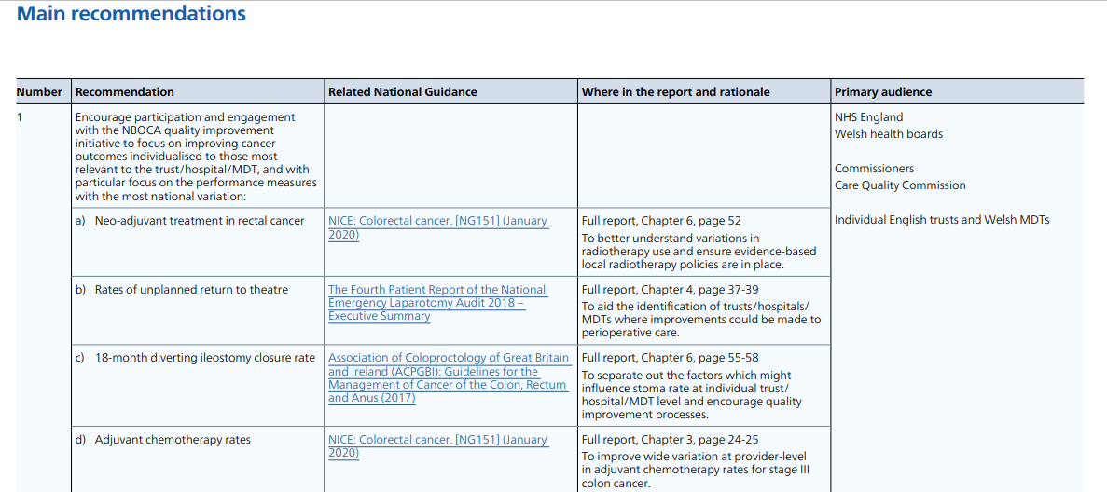
Main Recommendations: (Report 2021)

Slide 8
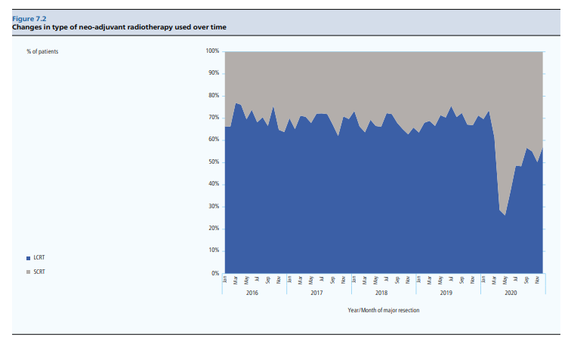
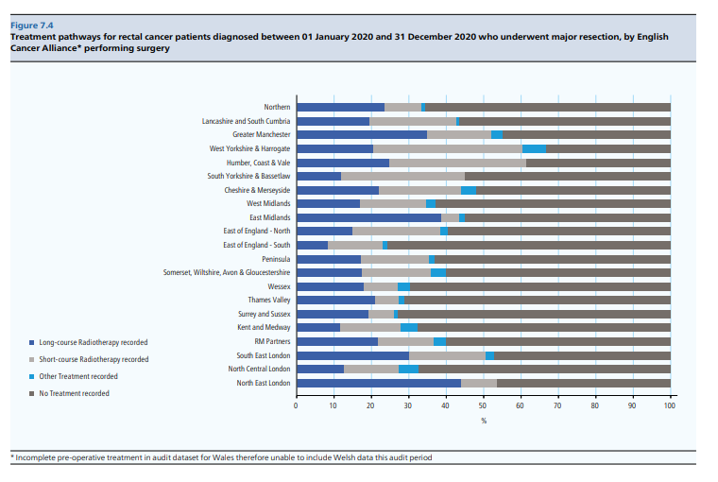
NBOCA – 2022 Report
Treatment pathways for rectal cancer patients diagnosed between 01 Jan 2020 and 31 Dec 2020 underwent Major resection, by English Cancer Alliance
Changes in Type of Neo-adjuvant radiotherapy used over time
Characteristics of patients having short-course radiotherapy

Slide 9
NICE Guideline: NG151 – 29 Jan 2020
Preoperative treatment for people with rectal cancer
1.3.2 Do not offer preoperative radiotherapy to people with early rectal cancer (cT1-T2 cN0, M0), unless as part of a clinical trial.
1.3.3 Offer preoperative radiotherapy or chemoradiotherapy to people with rectal cancer that is cT1-T2, cN1-N2, M0, or cT3-T4, any cN, M0.
Overview | Colorectal cancer | Guidance | NICE

Slide 10
NICE Guideline: NG151 – 29 Jan 2020
How the recommendations might affect practice:
Some variation in current practice among different Multidisciplinary teams as to who is offered pre-operative therapy
The aim of the recommendation is to standardise treatment across the country
May have a resource impact in areas where pre-operative therapy is not currently offered and where more clinical oncologists and radiotherapy equipment and staff will be needed
Therapeutic radiographers are taking on roles at advanced and consultant level to support specialist oncologists
There may be savings downstream through reduced recurrence and increase disease-free survival, avoiding or delaying expensive further treatment.
May increase the number of people offered pre-operative radiotherapy for lower-risk tumours
People with cancer in the upper and mid rectum might not have preoperative therapy because there is a lower risk of recurrent in cancers in these locations compared to cancer in the lower rectum.

Slide 11
Evidence review C2: Pre-operative radiotherapy and chemoradiotherapy for rectal cancer
NICE Guideline Evidence review C2

Slide 12
Treatment Variation Working Group meeting – 23 Feb 2023
Discussion: Agenda item 6 – Cancer Alliance Planning 2023-24
National Team are working with audit leads and NHSE Clinical Leads:
To understand what the metrics will be for the recommendations
How the data will be collected once the metrics have been defined
What the overall target will be
Action 8: National Team to schedule meetings with InfoFlex and Somerset to explore solutions for data reporting
Action 9: National Team to develop and circulate a data definitions document before the start of the 2023/24 financial year
The recommended funding for the Treatment Variation work is increasing by a significant amount this year and asked that Alliances to outline how they will manage this increase in work and funds in 2023/24.
Next Meeting: 25 May 2023

Slide 13
NHS Cancer Programme:
BOWEL: Rectal Cancer
Recommendation | Reduce variation in neoadjuvant radiotherapy treatment in rectal cancer patients undergoing resection. Ensure evidence-based local radiotherapy policies are in place.
Recommendation source | National Audit Bowel Cancer Report (http://www.nboca.org.uk/content/uploads/2022/02/NBOCA-2021-!R-Final.pdf) The use of neoadjuvant radiotherapy varied from 14% - 62%
Metric | Numerator: Number of patients who received neoadjuvant radiotherapy Denominator: Number of patients with rectal cancer undergoing major resection
Metric data source | There is no timely national data available specific recommendation. The National Team are working to confirm whether this metric can be made available in Model Hospital. This means there will be no requirement for Alliances to collect this data from trusts. More information will be available from the National Team in April on support for data collection for this recommendation.

Slide 14
BOWEL (cont.)
Target/ Ambition | Cancer Alliance should work with rectal cancer teams to reduce variation in neoadjuvant radiotherapy treatment in rectal cancer patients undergoing resection.
Target/ Ambition Rationale | There is no specific national target for this recommendation. We have been given a clear steer by our Clinical Leads that setting a target may lead to unintended consequences. High levels of neo-adjuvant radiotherapy are not necessarily a reflection of best practice – the worst outcomes for patients would be high positive resection margins and high neoadjuvant treatment, the best outcome would be low positive resection margins with low rates of neo-adjuvant treatment.
Timeframe Q1,Q2,Q3,Q4 | Q4 (Jan-Mar), Q1 (Apr-Jun), Q2 (July-Sep), Q3 (Oct-Dec)
Implementation support | A minimum of two workshops will be held during the year for Alliances and bowel cancer clinical teams to attend to understand the context behind the recommendations and ideas for improvement. These will be led by NHSE Bowel Cancer Clinical Lead: Omar Faiz
Consulted: Omar Faiz NHSE Bowel Cancer Clinical Lead & NBOCA Clinical Leads

Slide 15
NHS Cancer Programme:
The National Team is inviting the Cancer Alliance Treatment Variation Leads and two clinical experts (per session) to the following workshops to support the implementation of the audit recommendations in Breast, Bowel and Prostate cancer.
Wed 5 July, 2023 at 12:00-13:30
NHS England Workshop on Neoadjuvant Radiotherapy in Rectal Cancer | NHS England Events
The Workshop will be led by the National Clinical Leads and supported with presentations from clinical experts in the field.
The workshops aim to explore:
The feasibility of implementing these recommendations
The challenges associated with the implementation
Discuss how to avoid unintended consequences
Try to come to a consensus as to how best to reduce variation in this area
Provide opportunity for discussion and to ask questions

Slide 16
Data Definitions Document – in working progress (Draft v0.1 0 – 2023)

Slide 17
Data Definitions Document – in working progress (Draft v0.1 0 – 2023_

Slide 18
Model Hospital Data:
Denominator: Number of adult patients receiving elective resection for colorectal cancer
Numerator: Number of adult patients receiving pre-operative radiotherapy within 12 week prior to elective resection for colorectal cancer
Pre-operative radiotherapy within 12 week prior to elective resection for colorectal cancer (12 months to qtr end)
Pre-operative radiotherapy within 12 week for adult (17+ years) patients prior to elective resection for colorectal cancer
General surgery: GIRFT All Clinical Metrics – Colorectal Cancer

Slide 19
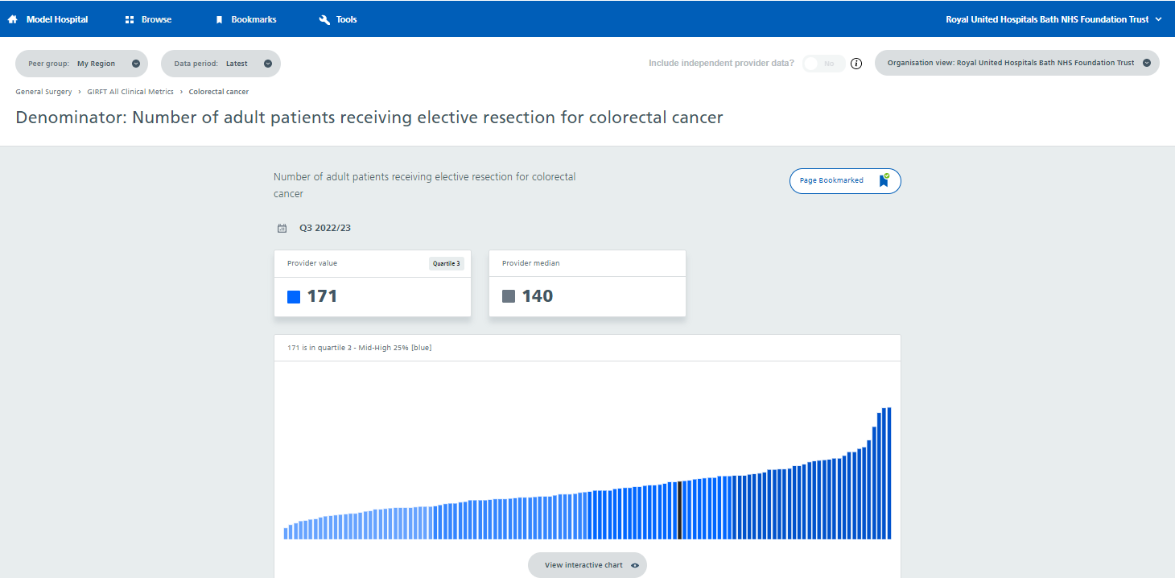
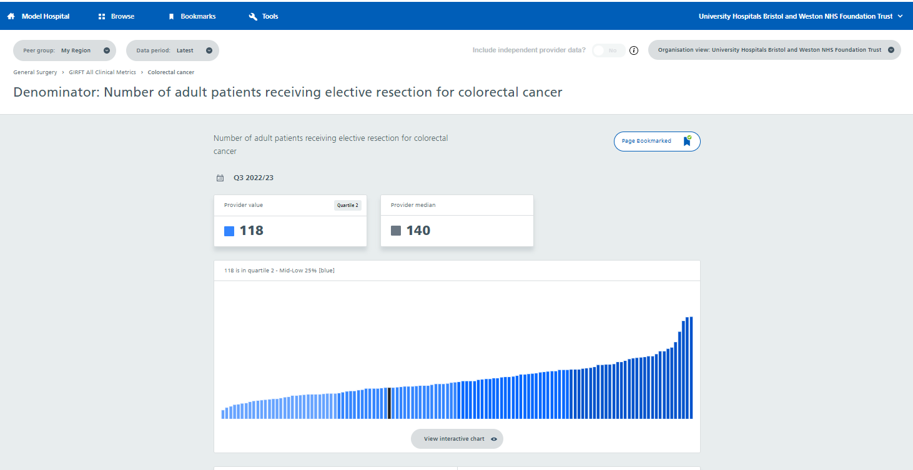
Model Hospital Data: By Denominator

Slide 20
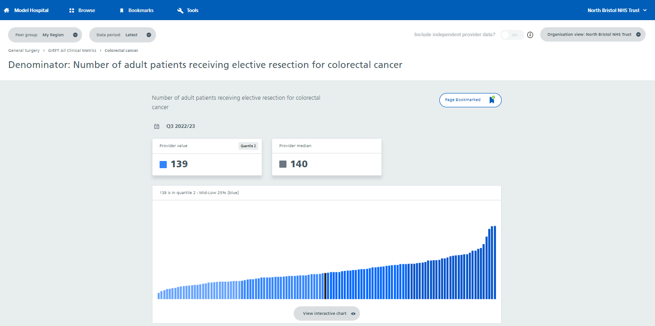
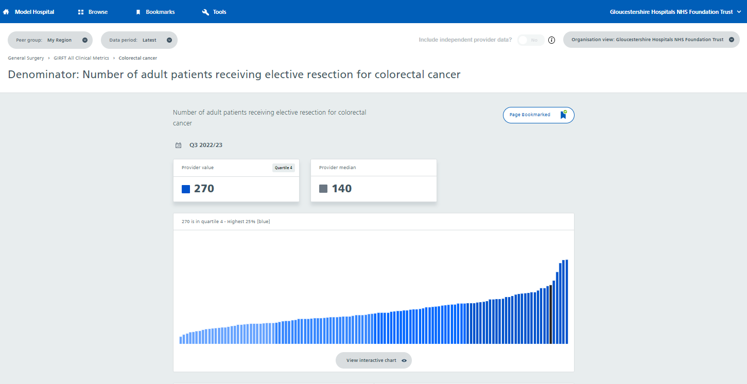
Model Hospital Data: By Denominator

Slide 21
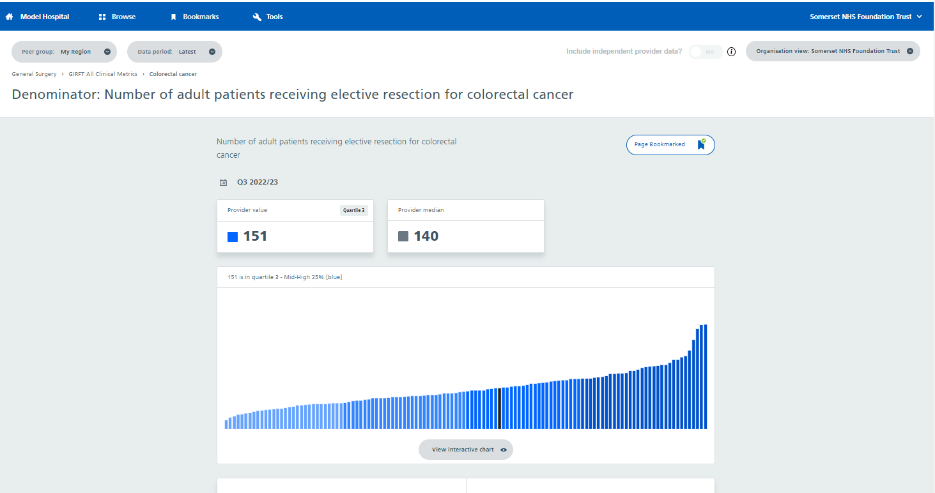
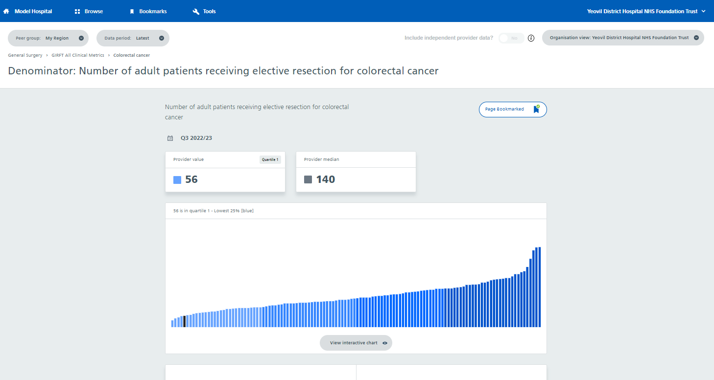
Model Hospital Data: By Denominator

Slide 22
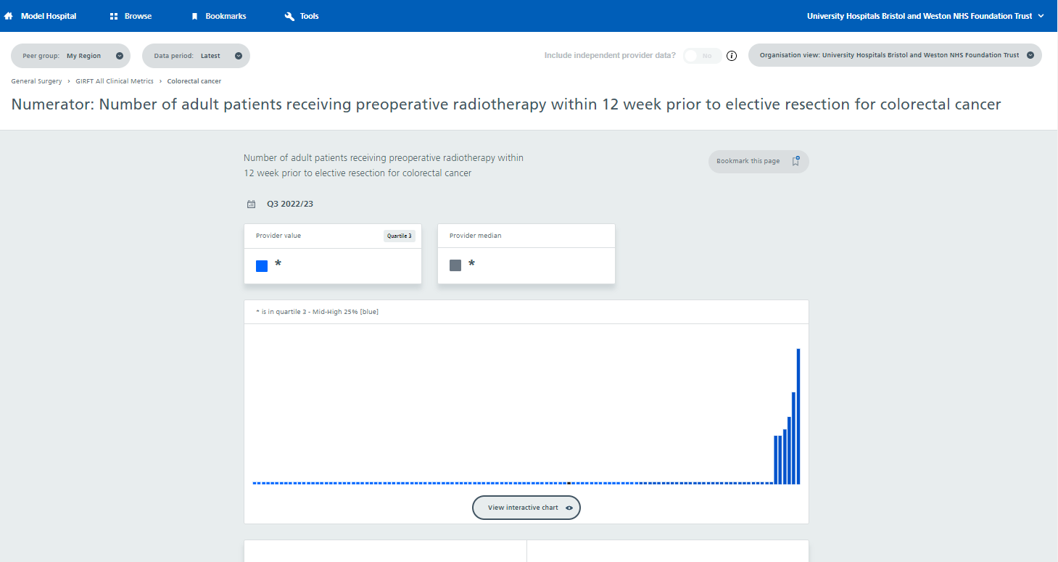
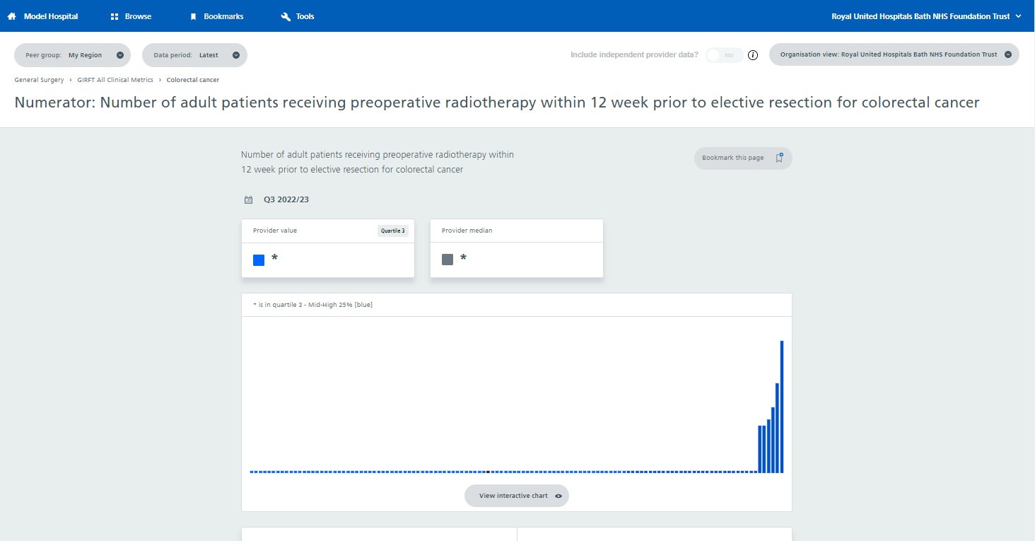
Model Hospital Data: By Numerator
Work in progress
No data available
Data ready by June 2023

Slide 23
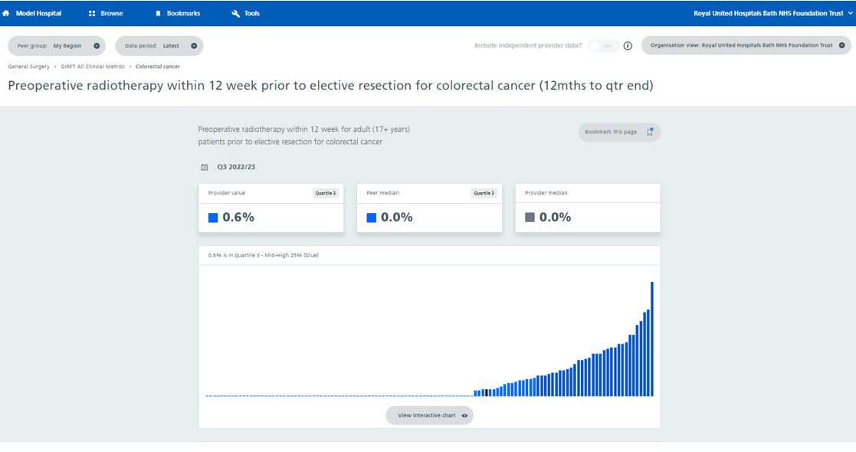
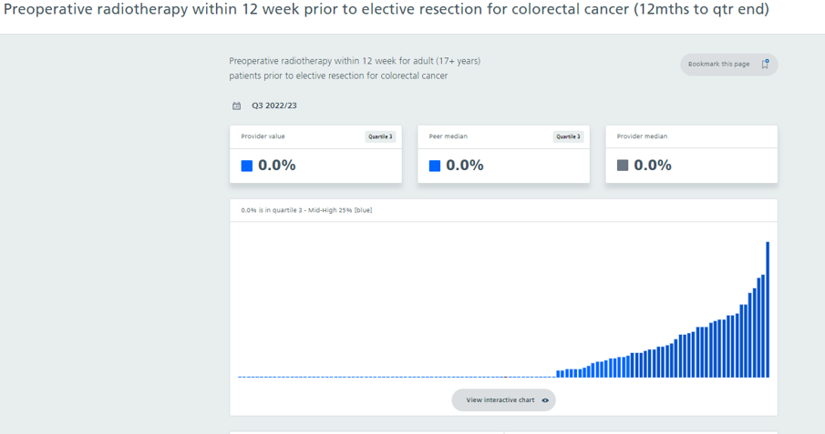
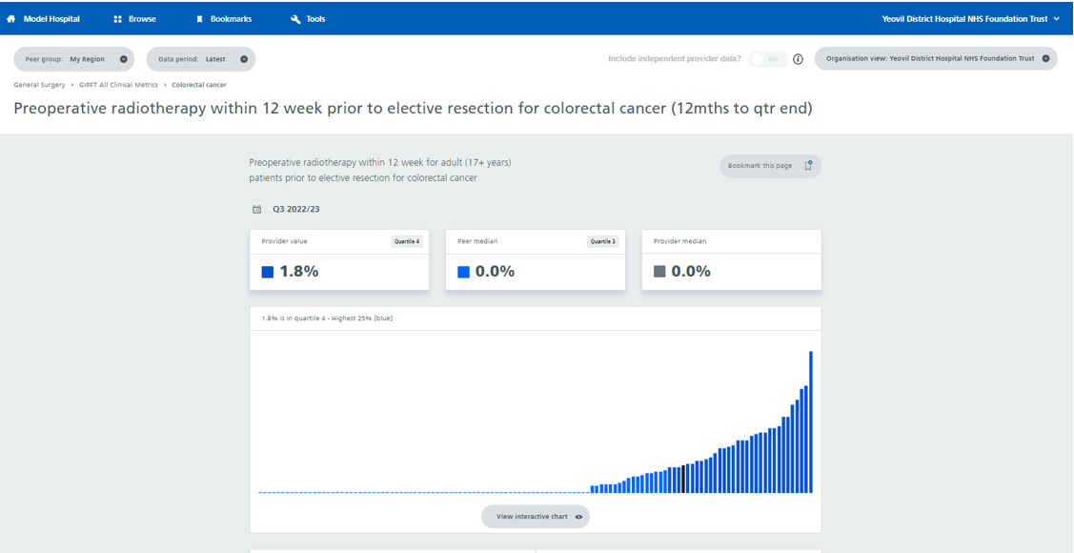
Model Hospital Data: By Pre-operative radiotherapy within 12 weeks prior to elective resection for colorectal cancer
Work in progress
Data only available in 2 Trusts
Data ready by June 2023

Slide 24
NHS Cancer Programme Workshop
Cancer Alliance Treatment Variation Leads and two clinical experts
Wed 5 July, 2023 at 12:00-13:30
NHS England Workshop on Neoadjuvant Radiotherapy in Rectal Cancer | NHS England Events

Slide 25
Thank you I

