Slide 1
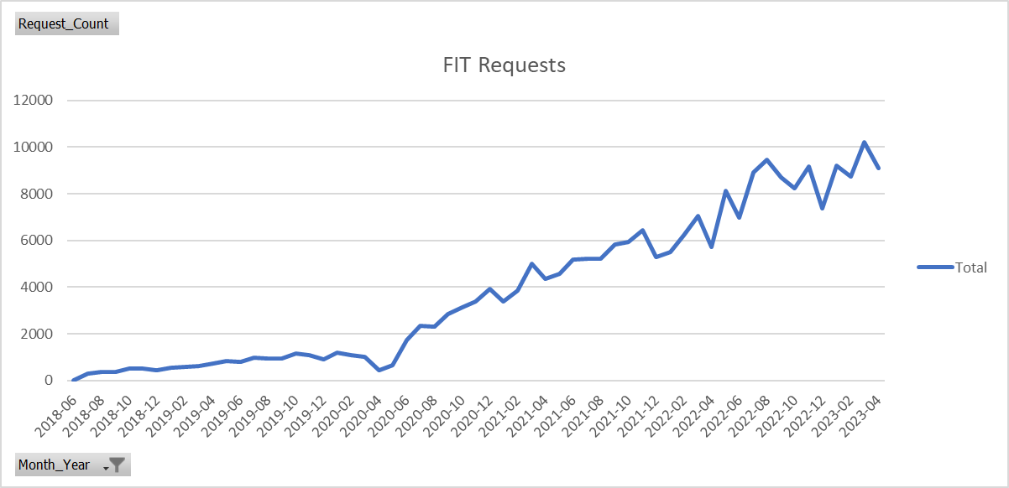
All qFIT Requests
Notes:
Total qFIT requests have now started breaking the 10,000 tests per month.
April 2023 was 9089 tests

Slide 2
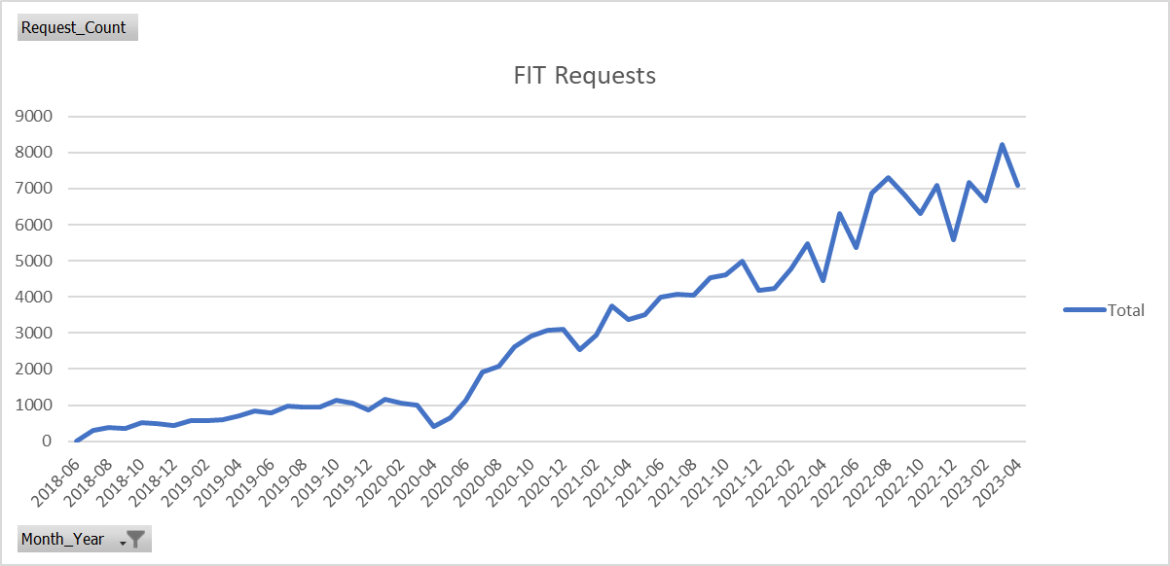
GP qFIT Requests (not including GHFT NPEx)
Notes:
Note this does not include NPEx requests received from other laboratories and therefore this is an underestimate of the total number of GP requests
April 2023 = 7094 tests

Slide 3
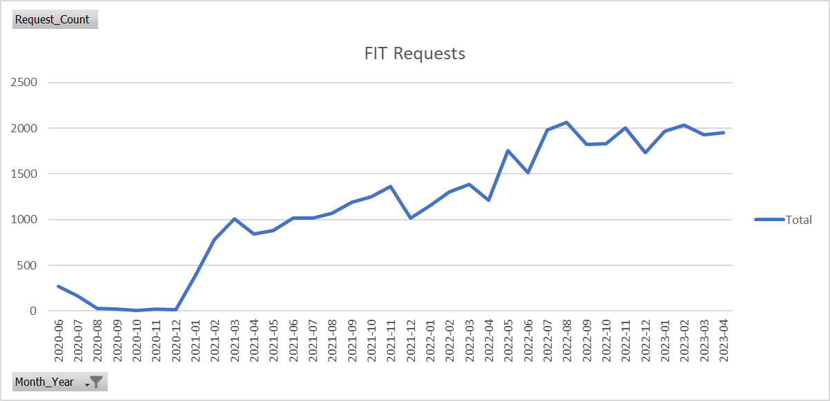
NPEx qFIT Requests (mostly GHFT, includes both primary and secondary care requests)
Notes:
~20% of requests are received via NPEx links from other Trusts pathology laboratories (primarily Gloucester), these will be a mixture of both GP and inpatients requests and therefore skews the rest of the data.
NPEx requests for April 2023 = 1954

Slide 4
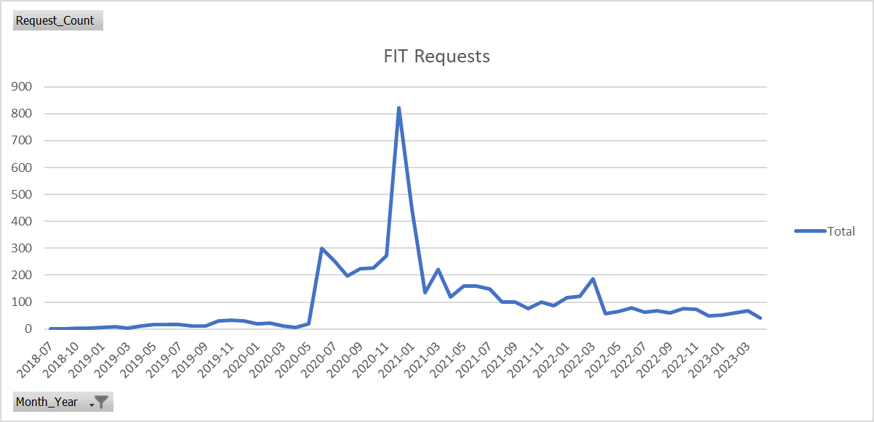
“other” qFIT Requests
Notes:
Other requests include day case, emergency, external, inpatient, outpatient and private requests. Currently <100 requests per month.
Other requests April 2023 = 41

Slide 5
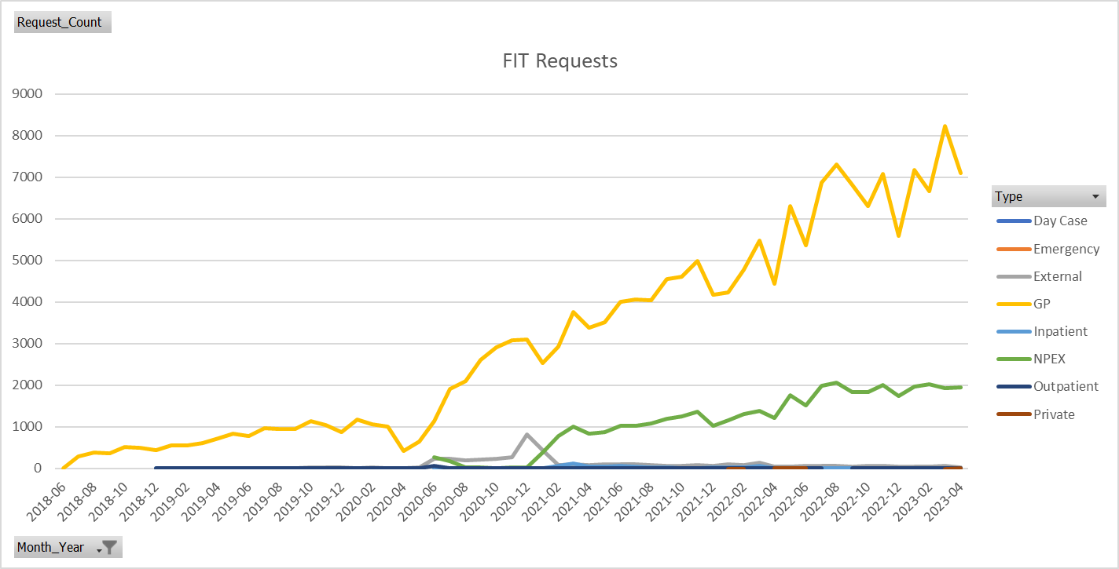
qFIT Request summary

Slide 6
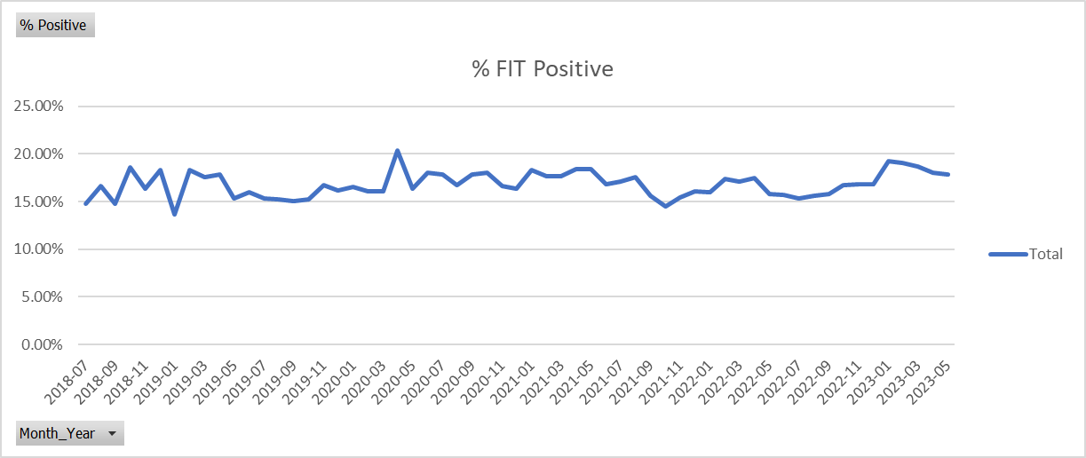
qFIT % Positive (All)
Notes:
% positive for all requests
April 2023 – 17.9% +

Slide 7
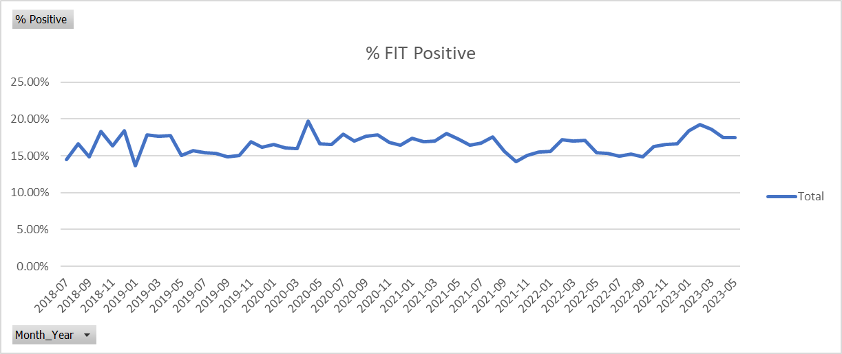
qFIT % Positive GP (not including NPEx)
Notes:
% positive for GP requests not including NPEx requests
April 2023 – 17.5% +

Slide 8
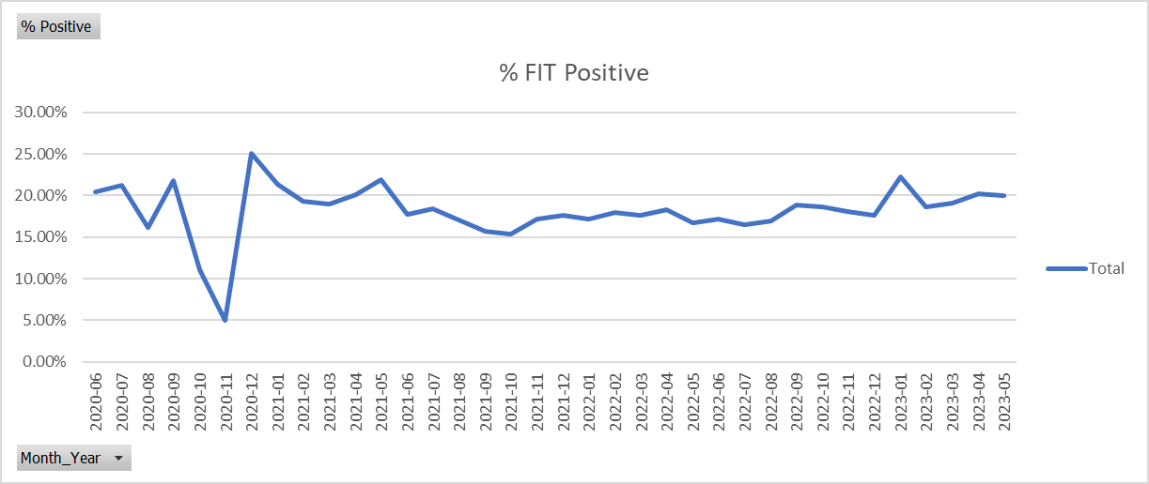
qFIT % Positive NPEx
Notes:
% positive for NPEx requests
April 2023 – 20.0% +

Slide 9
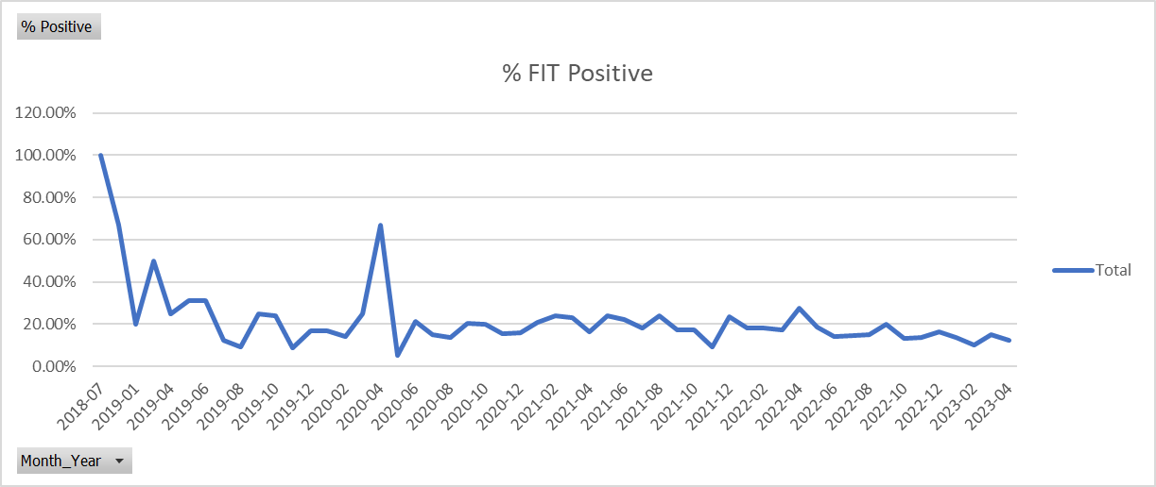
qFIT % Positive “other” (minus GP and NPEx)
Notes:
% positive for other requests
April 2023 – 12.2% +

Slide 10
GP qFIT % positive by age: 2021, 2022, 2023
2021 |  |  |  |  | 2022 |  |  |  |  | 2023
Age | Total | +ve | % +ve |  | Age | Total | +ve | % +ve |  | Age | Total | +ve | % +ve
10-19 | 48 | 3 | 6% |  | 10-19 | 115 | 6 | 5% |  | 10-19 | 50 | 4 | 8%
20-29 | 598 | 62 | 10% |  | 20-29 | 1613 | 222 | 14% |  | 20-29 | 882 | 131 | 15%
30-39 | 1933 | 241 | 12% |  | 30-39 | 4352 | 457 | 11% |  | 30-39 | 2174 | 270 | 12%
40-49 | 4500 | 471 | 10% |  | 40-49 | 7991 | 817 | 10% |  | 40-49 | 3759 | 503 | 13%
50-59 | 9561 | 1062 | 11% |  | 50-59 | 13625 | 1646 | 12% |  | 50-59 | 5799 | 806 | 14%
60-69 | 9183 | 1349 | 15% |  | 60-69 | 13334 | 1890 | 14% |  | 60-69 | 6099 | 1016 | 17%
70-79 | 11950 | 2226 | 19% |  | 70-79 | 16705 | 3064 | 18% |  | 70-79 | 7233 | 1549 | 21%
80-89 | 7547 | 1809 | 24% |  | 80-89 | 11011 | 2595 | 24% |  | 80-89 | 4820 | 1233 | 26%
90-99 | 1204 | 367 | 30% |  | 90-99 | 1807 | 542 | 30% |  | 90-99 | 812 | 288 | 35%
100-109 | 12 | 2 | 17% |  | 100-109 | 26 | 9 | 35% |  | 100-109 | 10 | 3 | 30%
Grand Total | 46540 | 7592 | 16% |  | Grand Total | 70584 | 11248 | 16% |  | Grand Total | 31646 | 5804 | 18%
% Tests performed under 50 years |  |  |  |  | % Tests performed under 50 years |  |  |  |  | % Tests performed under 50 years
15% |  |  |  |  | 20% |  |  |  |  | 22%

Slide 11
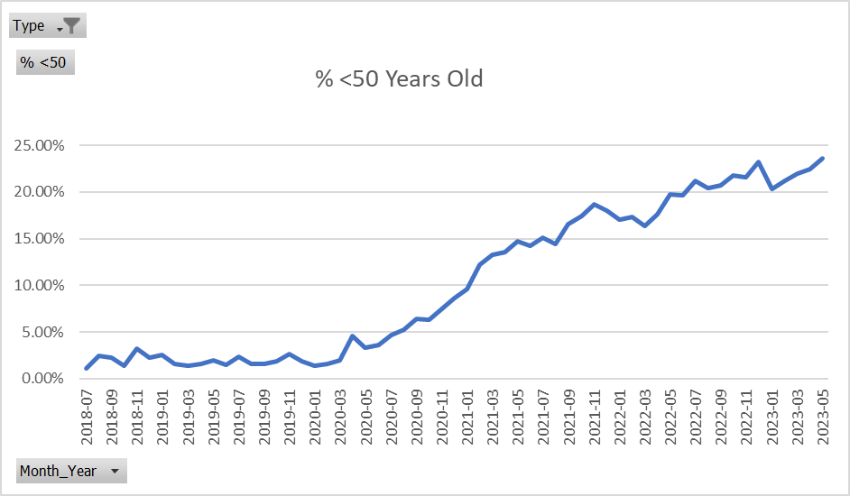
GP % of patients tested <50 years since 2018

Slide 12
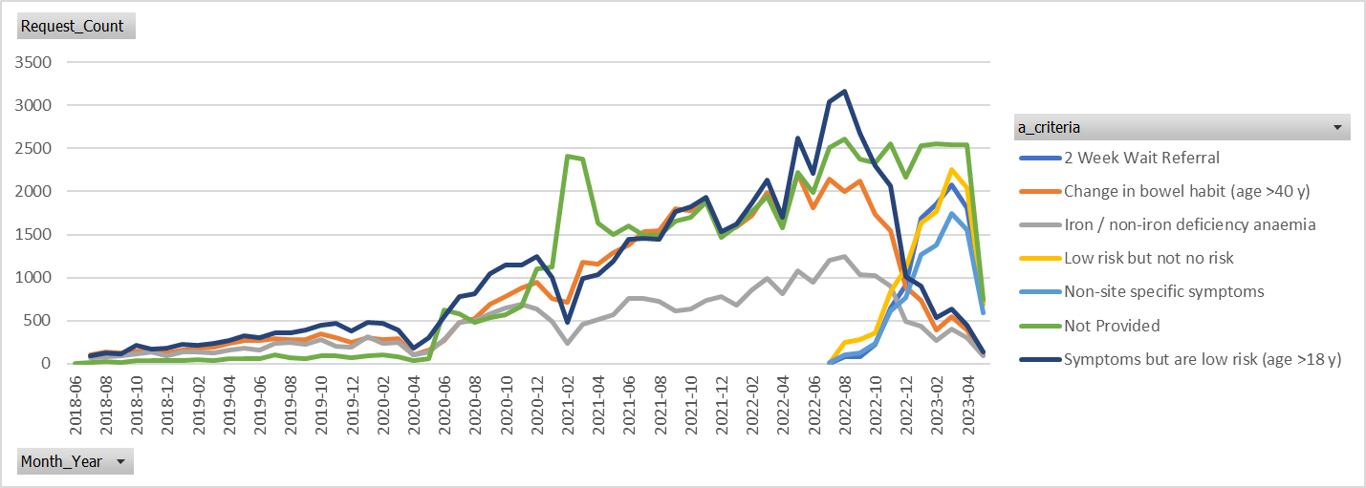
Requests by criteria: note change in Q2 2022
Notes:
July 2022, criteria for requests were adjusted in line with new BSG guidelines. Residual requesting using older criteria is from paper request forms that are being phased out. Therefore, requests for:
1) Change in bowel habit (age >40 y) 2) iron / non-iron deficiency anaemia 3) symptoms but are low risk (age >18 y) should all eventually disappear.

