Slide 1
SWAG Network Oesophago-gastric (OG) Cancer
Clinical Advisory Group
Research Update
Claire Matthews & Sharath Gangadhara
24/03/2023

Slide 2
National Recruitment to Upper GI Cancer Studies
SYPMLIFY recruited 5972
NIHR BioRescource recruited 1933
Apr 21 - Mar 22
NIHR BioRescource recruited 2341
Apr 22 - Mar 23
Data cut 22/09/2022
Source: ODP All Portfolio

Slide 3
National vs Regional Recruitment to Upper GI Cancer Studies Apr 2019 - Mar 23
National Recruitment
SWAG region Recruitment
Data cut 20/03/2023
Source: ODP All Portfolio

Slide 4
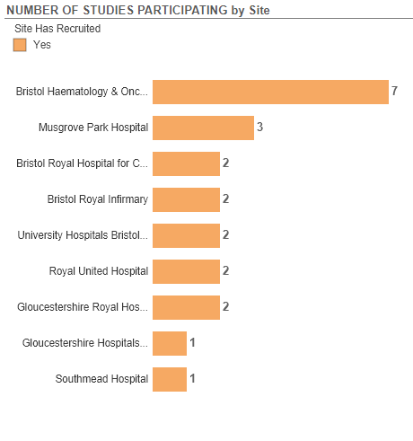
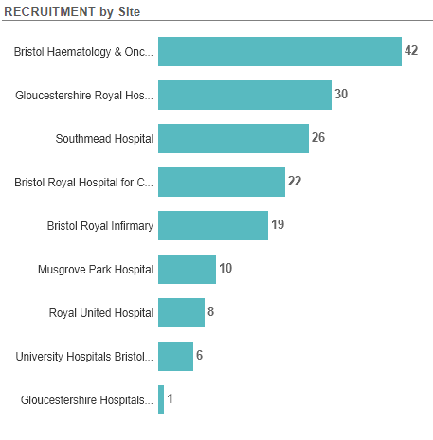
Recruitment to Upper GI Cancer Studies SWAG Region Apr 2022 - Mar 23
Data cut 20/03/2023
Source: ODP All Portfolio

Slide 5
SWAG region Open OG Cancer Studies
CPMS | Short Name | Sites | Site Recruits | Opening | Closure | Sample Size Eng | Eng Recruits
20358 | SCOPE 2 | BHOC | 36 | 15/12/15 | 30/11/25 | 306 | 282
 |  | Musgrove Park | 4
 |  | Glos | 3
 |  | Cheltenham | 1
18432 | PLATFORM | UHBW | 60 | 23/02/15 | 31/03/25 | 694 | 1048
 |  | Glos | 26
 |  | Musgrove Park | 17
 |  | Salisbury | 2
 |  | Yeovil | 0
 |  | RUH | 0
15941 | NIHR BioResource - Rare Diseases | BRI | 328 | 13/09/12 | 30/11/24 | 22000 | 16781
 |  | Salisbury | 65
 |  | BHOC | 37
 |  | RUH | 31
 |  | BRHC | 20
 |  | NBT | 25
Data cut 21/03/2023
Source: ODP All Portfolio

Slide 6
SWAG region Open OG Cancer Studies
CPMS | Short Name | Sites | Site Recruits | Opening | Closure | Sample Size Eng | Eng Recruits
50774 | Augmented biomarker response in oesophagogastric cancer | Yeovil, Salisbury | 0, 0 | 28/02/22 | 01/07/23 | 558 | 131
50090 | Ph1b/3 Bemarituzumab in Advanced Gastric Gastroesophageal Cancer | BRI, BHOC | 0, 0 | 30/06/22 | 14/12/24 | 26 | 3
49425 | HERIZON-GEA-01 | BHOC | 1 | 11/04/22 | 31/12/23 | 11 | 2
45150 | YO42137 Atezolizumab with or without Tiragolumab (Anti-Tigit Antibody) | Salisbury | 0 | 18/12/20 | 31/05/23 | 12 | 8
42784 | Early diagnosis of upper digestive tract disease | Yeovil | 0 | 01/10/19 | 01/08/24 | 300 | 61
42781 | Questions to Predict Disease Risk (RISQ) | Yeovil | 0 | 06/02/20 | 31/05/29 | 4000 | 501
42715 | WAKING: Wnt and checKpoint INhibition in Gastric cancer | BHOC | 0 | 11/02/20 | 31/12/24 | 52 | 24
42573 | Pembrolizumab & Chemoradiation in Oesophageal Carcinoma Participants | Salisbury | 0 | 06/08/20 | 24/01/23 | 32 | 19
42082 | Non-Invasive Testing for Early Oesophageal Cancer and Dysplasia | Salisbury | 0 | 19/08/19 | 01/10/24 | 900 | 635
33908 | SALIVA TO PREDICT DISEASE RISK (version 1) | Salisbury | 0 | 06/04/17 | 01/03/23 | 5000 | 2764
8880 | OCCAMS: Multicentre Study Determining Predictive Biomarkers & Targets for Oesophageal Adenocarcinoma | Glos | 50 | 19/07/10 | 31/03/26 | 5000 | 3930
1203 | RECaD | Glos | 477 | 01/01/01 | 31/12/23 | 500 | 477
Data cut 21/03/2023
Source: ODP All Portfolio

Slide 7
Early stage
Short Name | Sites | Opening date | Closure date | Sample Size England | England Recruits
SCOPE 2-A Randomised Phase II/III Trial to Study Radiotherapy Dose Escalation in Patients With Oesophageal Cancer Treated With Definitive Chemo-radiation With an Embedded Phase II Trial for Patients With a Poor Early Response Using Positron Emission Tomography (PET) | BHOC, Chelt, MUS | 15/12/2015 | 01/12/2022 | 146 | 165

Slide 8
Advanced/Metastatic
Short Name | Sites | Opening date | Closure date | Sample Size England | England Recruits
Ph1b/3 Bemarituzumab in Advanced Gastric Gastroesophageal Cancer |  | 30/06/22 | 14/12/24 | 26 | 0
HERIZON-GEA-01 | BHOC | 11/04/22 | 31/01/25 | 33 | 0
YO42137 Atezolizumab with or without Tiragolumab (Anti-Tigit Antibody) |  | 18/12/20 | 01/12/22 | 20 | 6
WAKING: Wnt and checKpoint INhibition in Gastric cancer | BHOC | 06/07/2020 | 11/02/2022 | 52 | 7
PLATFORM-Planning Treatment for Oesophago-gastric Cancer: a Maintenance Therapy Trial | MUS, GWH, WES, YEO, RUH, UHBW | 23/02/2015 | 16/02/2020 | 694 | 939

Slide 9
KEYNOTE-811
Pembrolizumab Plus Trastuzumab and Chemotherapy in Previously Untreated Advanced HER2-Positive Gastric Adenocarcinoma
Double-blind trial, 434 patients from sites in 20 countries
Pembrolizumab at 200 mg (n = 217) or placebo (n = 217) every 3 weeks plus trastuzumab and investigator’s choice of fluorouracil/cisplatin (n = 189 vs 187) or capecitabine/oxaliplatin (n = 28 vs 30).
The addition of pembrolizumab to trastuzumab and chemotherapy significantly improved objective response rate in HER2-positive gastric cancer.
Objective response was observed in 74.4% vs 51.9% of patients, with complete response in 11.3% vs 3.1%

Slide 10
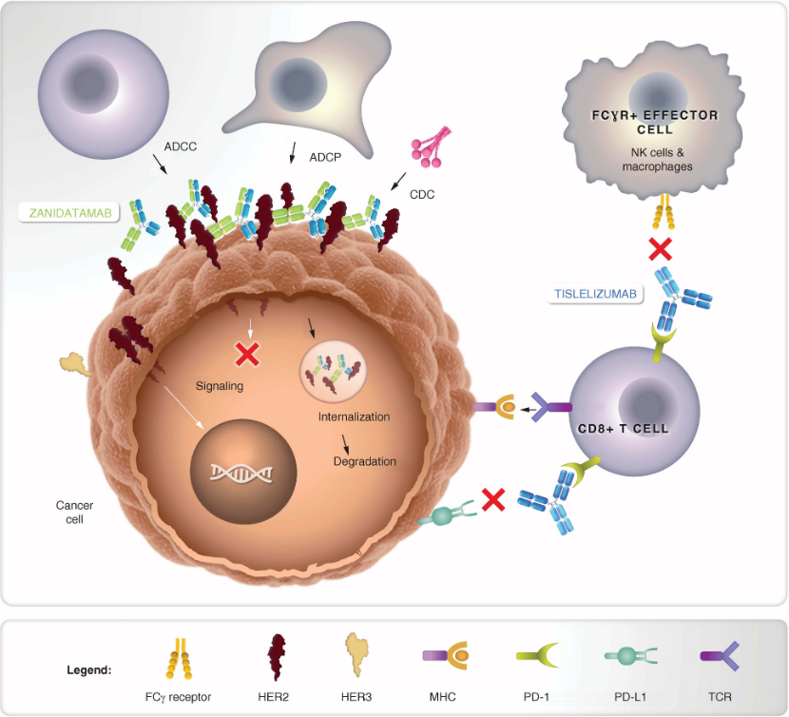
HERIZON- Zanidatamab and Tislelizumab

Slide 11
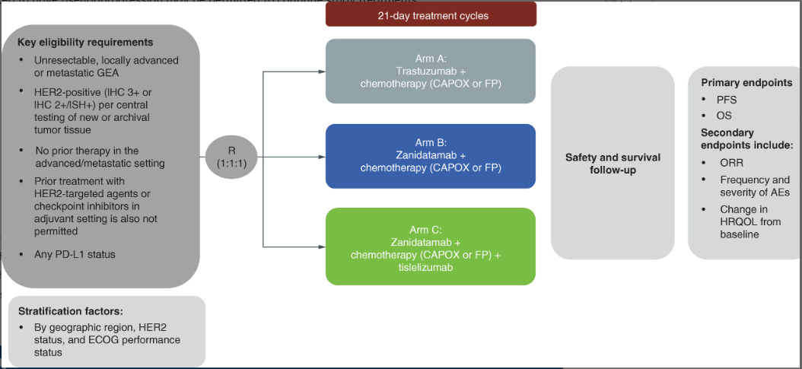
HERIZON-GEA-01: Zanidatamab + chemo ± tislelizumab for 1L treatment of HER2-positive gastroesophageal adenocarcinoma

Slide 12
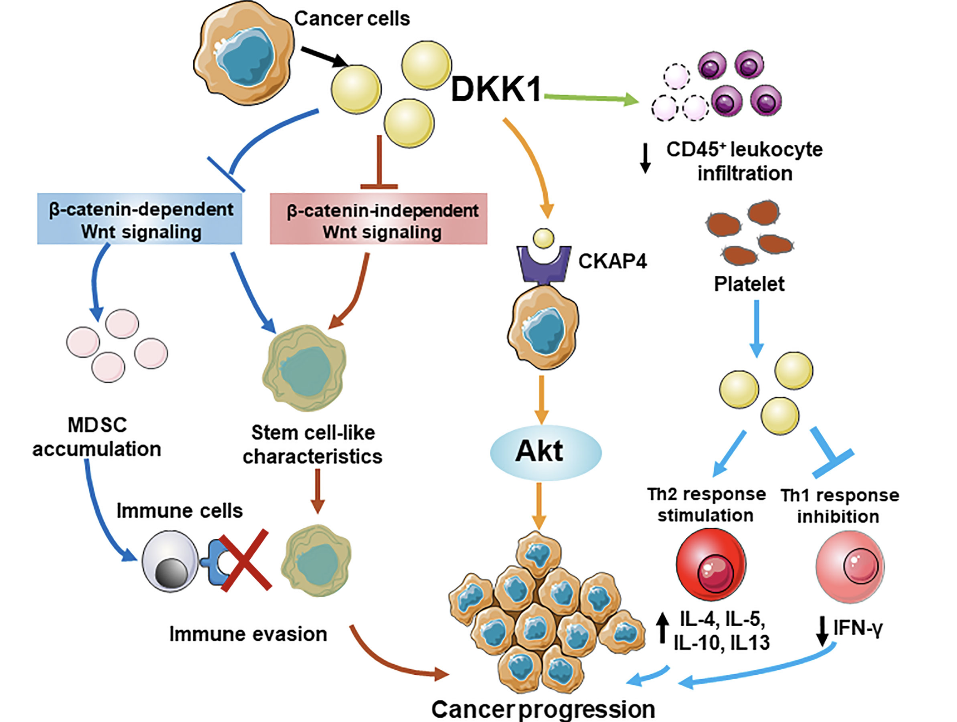
WaKING: Wnt and checKpoint INhibition in Gastric Cancer
DKN-01, a DKK1(Dickkopf-1 ) inhibitor modulates Wnt signalling

Slide 13
Other-Epidemiologic/Diagnostic/Genetic
Short Name | Sites | Opening date | Closure date | Sample Size England | England Recruits
OCCAMS: Multicentre Study Determining Predictive Biomarkers & Targets for Oesophageal Adenocarcinoma | GRH | 19/07/2010 | 31/03/2026 | 2000 | 3,814
NIHR BioResource - Rare Diseases | BRI, Salisbury, BHOC,RUH, BRHC and NBT | 13/09/12 | 30/11/24 | 22000 | 16781
Augmented biomarker response in oesophagogastric cancer | Yeovil, Salisbury | 28/02/22 | 01/07/23 | 558 | 131

Slide 14
SWAG region In Setup OG Cancer Studies 22/23
CPMS ID | Short Name |  | Site Name | Planned Opening | Closure | Sample Size UK
54723 | DisTinGuish | A Phase 2, Multicenter, Open-Label Study of DKN-01 in Combination with Tislelizumab ± Chemotherapy as First-Line or Second-Line Therapy in Adult Patients with Inoperable, Locally Advanced or Metastatic Gastric or Gastroesophageal Junction Adenocarcinoma (DisTinGuish) | Musgrove Park tbc (Emma Cattell) | 15/03/23 | 13/10/2023 | 15
Data cut: 21/03/2023
Source: ODP All Portfolio

Slide 15
PICCOS Trial-Feasibility Pressurised IntraPeritoneal Aerosolised Chemotherapy in the management of cancers of the colon, ovary and stomach: a randomised controlled phase II trial of efficacy in peritoneal metastases (PICCOS)

Slide 16
Cancer Patient Experience Survey 2021 Results - Research Question
Somerset, Wiltshire, Avon and Gloucestershire: Published July 2022.
The score shows the percentage of respondents who gave the most favourable response to a question
The expected range charts in this report show a bar with the lowest and highest score received for each question nationally. Within this bar, an expected range is given (in grey) and a black diamond represents the actual score for this Alliance.

Slide 17
Cancer Patient Experience Survey 2021 Results - Research Question
How do we increase conversations about research in your tumour site?

Slide 18
Associate PI Scheme
https://www.nihr.ac.uk/health-and-care-professionals/career-development/associate-principal-investigator-scheme.htm
A six month in-work training opportunity, providing practical experience for healthcare professionals starting their research career. People who would not normally have the opportunity to take part in clinical research in their day to day role have the chance to experience what it means to work on and deliver a NIHR portfolio trial under the mentorship of an enthusiastic Local PI.
CIs working with a CTU can register their study on the scheme
https://www.nihr.ac.uk/health-and-care-professionals/career-development/register-your-study-for-the-associate-principal-investigator-scheme.htm

Slide 19
API Scheme OG Cancer Studies open in SWAG Region
CPMS ID | Study Short Name | Sites
18432 | PLATFORM | RUH, GHFT, UHBW, Weston, Musgrove Park, Salisbury, Yeovil
20358 | SCOPE 2 | BHOC, Musgrove Park, Glos, Cheltenham
52250 | NERO | Musgrove Park
42715 | WAKING: Wnt and checKpoint INhibition in Gastric cancer | BHOC

Slide 20
NIHR ODP https://odp.nihr.ac.uk/
Open data platform. Data on performance and restart across whole CRN, including all specialty areas
NIHR Be Part of Research https://www.ukctg.nihr.ac.uk/
See which studies are open across the country
National Cancer Research Institute Portfolio Maps http://csg.ncri.org.uk/portfolio/portfolio-maps/
View current national portfolio of open, closed and ‘in set up’ cancer studies
Find a Clinical Research Study (ODP) http://csg.ncri.org.uk/portfolio/portfolio-maps/
Search for a study to fit criteria. Good for horizon scanning, eligibility criteria

Slide 21
LCRN Contacts
Research Delivery Manager
claire.matthews@nihr.ac.uk
Research Portfolio Facilitator
rebecca.pienaar@nihr.ac.uk
Sub-specialty Lead
sharath.gangadhara@nhs.net

