Slide 1
Clinical Context of Genomic Testing in UGI Cancers
Louise Medley
Consultant Medical Oncologist & Cancer Clinical Lead SW GLH
SWAG OG CAG March 24th 2023

Slide 2
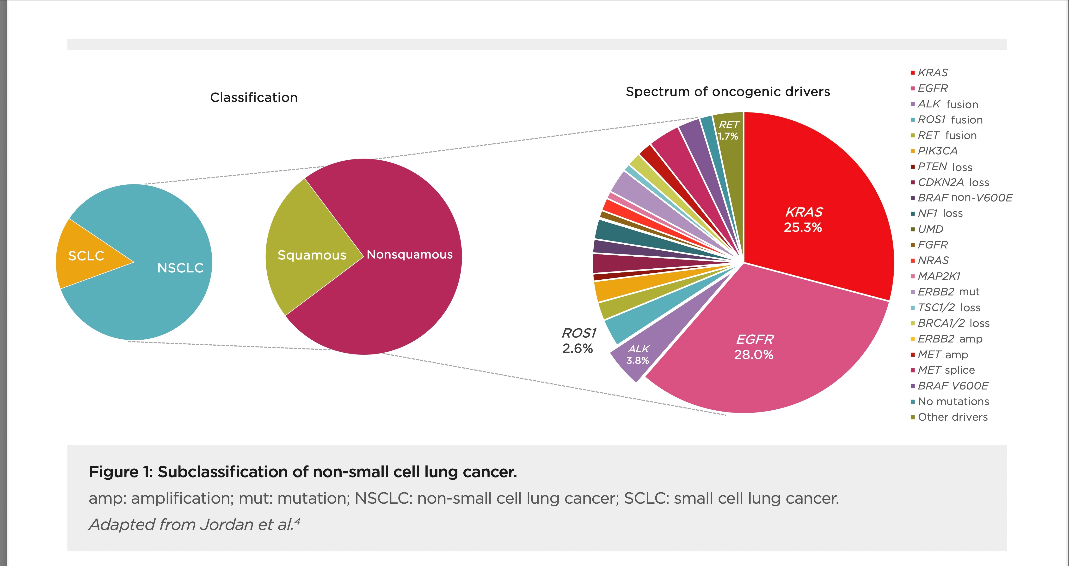
WHY?
Prevention
Early Diagnosis
Neo-adjuvant
Adjuvant
Palliative
Living with Cancer
Lung Cancer 2002 vs 2022
Notes:
Why are we keen to talk to you?
All aware rapid speed in changes in cancer management and lessons learnt during 100,000 genomes project
Know that understanding cancer more than just adeno versus squame and personalised treatments based on molecular signatures is influencing our decisions
Landscape for use of genomic signatures is infiltrating across the whole cancer pathway from prevention to living with cancer and cure

Slide 3
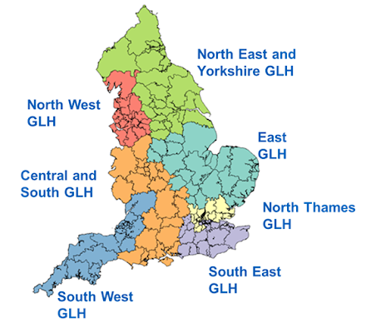
WHO?
NHS Genomic Medicine Service (GMS)
Equitable Access to technology to improve care
Genomic panel testing routinely offered to all people with cancer
National Genomic Test Directory developed
Delivered by local teams (SW GLH)
7 Regional Genomic Laboratory Hubs
Notes:
Who is behind this ?

Slide 4
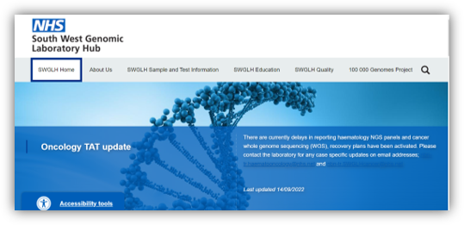
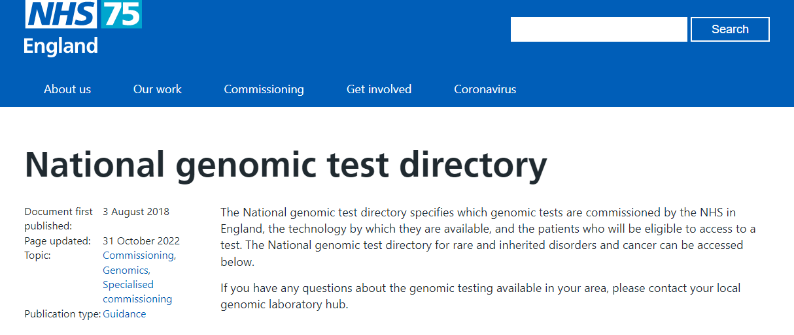
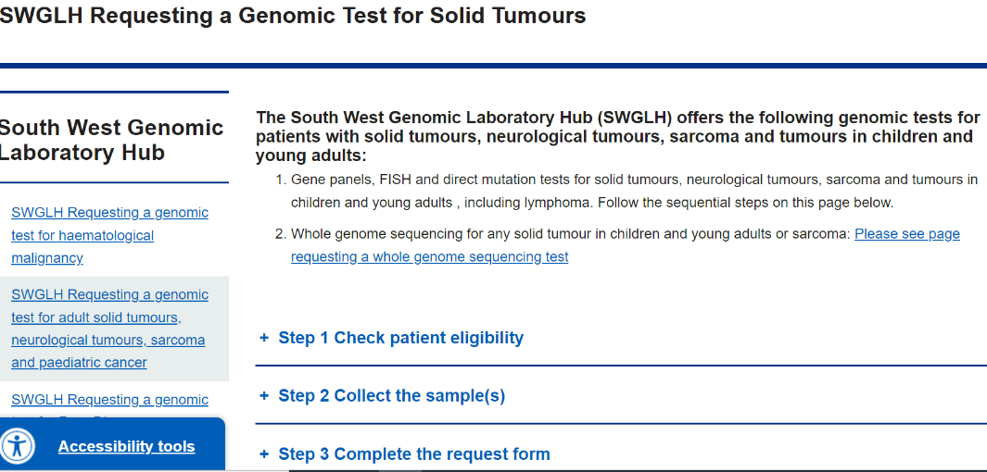
Which Patient, When and How?
South West Genomic Laboratory Hub | North Bristol NHS Trust (nbt.nhs.uk)
NHS England » National genomic test directory
National Genomic Test Directory

Slide 5
Genomic Tests for UGI Cancers
HER 2: Access to Herceptin in addition to SACT local/central IHC and FISH testing
PDL1 status: Access to Immunotherapy in addition to SACT local/central validated testing
DYPD: Identification of patients at increased risk of 5FU related toxicity GLH testing (Blood)
MMR*/MSI: Access to immunotherapy *may be delivered by local pathology teams
NTRK: Pan-tumour marker
WGS:
Oesophageal Cancer M236 | MSI Testing | Known oesophageal cancer, when MMR IHC not possible / not performed, as per NICE Guidelines for molecular testing to inform therapy choice. Delivery via pathology in some regions.
Gastric Cancer M237 | MSI Testing | Known gastric cancer, when MMR IHC not possible / not performed, as per NICE Guidelines for molecular testing to inform therapy choice. Delivery via pathology in some regions.
Solid tumour other M227.1 | Multi-target NGS panel - structural variant | NTRK1, NTRK2, NTRK3 | Patient's clinical status means they are eligible for an NTRK inhibitor in the event an NTRK rearrangement is detected.
Solid Tumour Exhausted all Standards of Care Testing and Treatment M232.1 | WGS Germline and Tumour | All including burden / signature | Molecular assessment will aid diagnosis and management

Slide 6
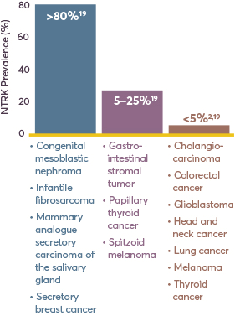
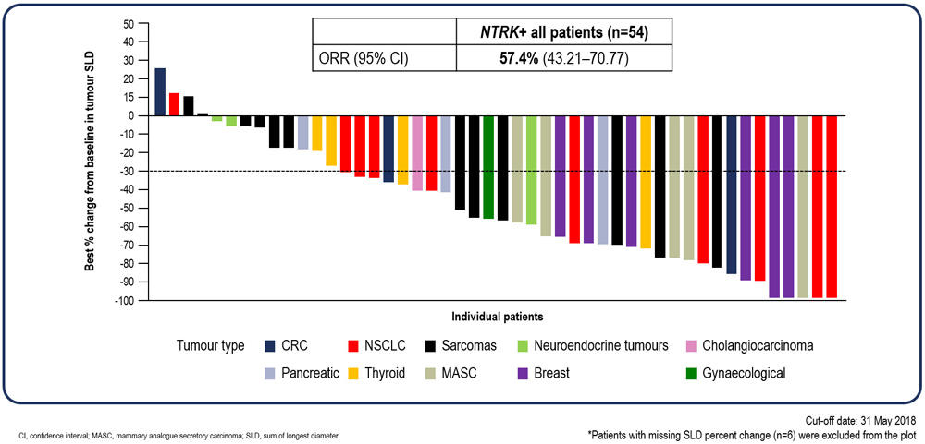
Game changing findings? Tumour Agnostic Drugs
Cancer Shrinking
Notes:
Who is behind this ?

Slide 7
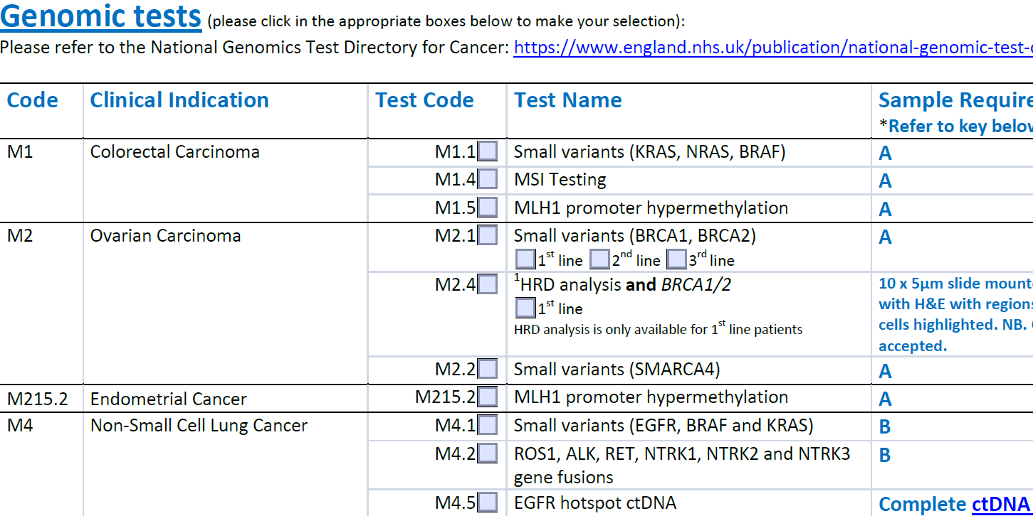
Test Request Form

Slide 8
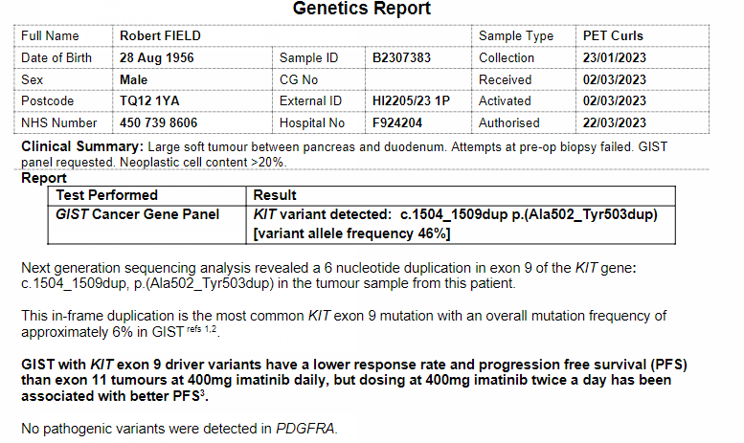
Interpreting and Integrating Genetic Reports
As NTD gets updated with new findings these tests will be added to the testing panel and any clinically relevant findings reported to the clinician
TATs
As per the NTD
Notes:
Who is behind this ?

Slide 9
Pancreatic Cancer | Multi-target NGS panel | BRCA1, BRCA2 | Patient's clinical status and local availability mean they can access a PARP inhibitor in the event a gBRCA mutation is detected
 | Multi-target NGS panel | NTRK1, NTRK2, NTRK3 | Patient's clinical status means they are eligible for an NTRK inhibitor in the event an NTRK rearrangement is detected
 | DPYD hotspot | DPYD | Patient planned to receive fluoropyrimidine treatment
 | MSI Testing | N/A | Known pancreatic cancer, when MMR IHC not possible / not performed, as per NICE Guidelines for molecular testing to inform therapy choice. Delivery via pathology in some regions.
Hepatocellular carcinoma | Multi-target NGS panel | NTRK1, NTRK2, NTRK3 | Patient's clinical status means they are eligible for an NTRK inhibitor in the event an NTRK rearrangement is detected
 | DPYD hotspot | DPYD | Patient planned to receive fluoropyrimidine treatment
Cholangiocarcinoma | Multi-target NGS panel | NTRK1, NTRK2, NTRK3,FGFR2 | Patient's clinical status means they are eligible for an NTRK inhibitor in the event an NTRK rearrangement is detected. Patient's clinical status means they are eligible for a protein kinase inhibitor therapy in the event an FGFR2 fusion is detected.
 | DPYD hotspot | DPYD | Patient planned to receive fluoropyrimidine treatment
 | MSI Testing | N/A | Known cholangiocarcinoma carcinoma, when MMR IHC not possible / not performed, as per NICE Guidelines for molecular testing to inform therapy choice. Delivery via pathology in some regions.
 | Multi-target NGS panel -small variant (IDH1) | IDH1 | Molecular assessment will aid diagnosis or management
Gastrointestinal Stromal Tumour | Multi-target NGS panel - small variant | KIT, PDGFRA |  | This is first-line testing unless strong suspicion of germline predisposition
 | Multi-target NGS panel - structural variant | NTRK1, NTRK2, NTRK3 |  | Patient's clinical status means they are eligible for an NTRK inhibitor in the event an NTRK rearrangement is detected
Small Bowel Cancer | MSI Testing | N/A |  | Known small bowel cancer, when MMR IHC not possible / not performed, as per NICE Guidelines for molecular testing to inform therapy choice. Delivery via pathology in some regions.
 | DPYD hotspot | DPYD |  | Patient planned to receive fluoropyrimidine treatment
Cancer of Unknown Primary | Multi-target NGS panel - structural variant | NTRK1, NTRK2, NTRK3 |  | Patient's clinical status means they are eligible for an NTRK inhibitor in the event an NTRK rearrangement is detected
 | DPYD hotspot | DPYD |  | Patient planned to receive fluoropyrimidine treatment
 | WGS Germline and Tumour | All including burden / signature |  | Both adult and paediatric patient with Cancer of Unknown Primary (CUP) are eligible for WGS. Can be performed at any stage of presentation (e.g. diagnosis, progression, relapse).
Notes:
Who is behind this ?

Slide 10
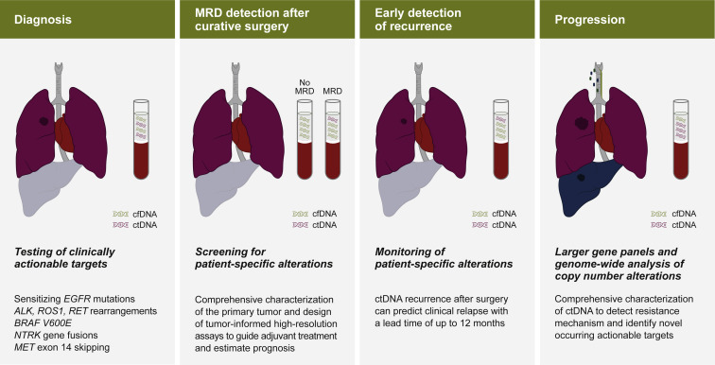
Consolidation of Genomic Testing Reducing Inequality and Increasing Opportunity
Local Site
SWGLH
NHS GMS up to date testing
Commissioned Nationally (Free to the trust)
Research Opportunities (CRUK)
Site 1
Site 2
Site 3
Notes:
Why are we keen to talk to you?
All aware rapid speed in changes in cancer management and lessons learnt during 100,000 genomes project
Know that understanding cancer more than just adeno versus squame and personalised treatments based on molecular signatures is influencing our decisions
Landscape for use of genomic signatures is infiltrating across the whole cancer pathway from prevention to living with cancer and cure

Slide 11
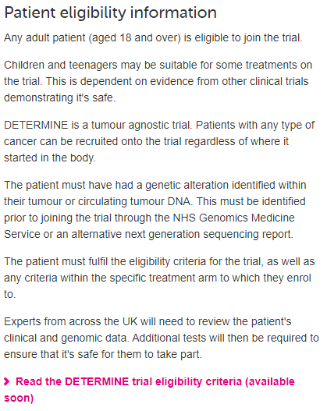
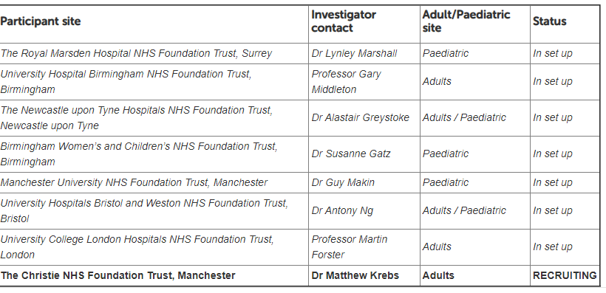
Notes:
Why are we keen to talk to you?
All aware rapid speed in changes in cancer management and lessons learnt during 100,000 genomes project
Know that understanding cancer more than just adeno versus squame and personalised treatments based on molecular signatures is influencing our decisions
Landscape for use of genomic signatures is infiltrating across the whole cancer pathway from prevention to living with cancer and cure

Slide 12
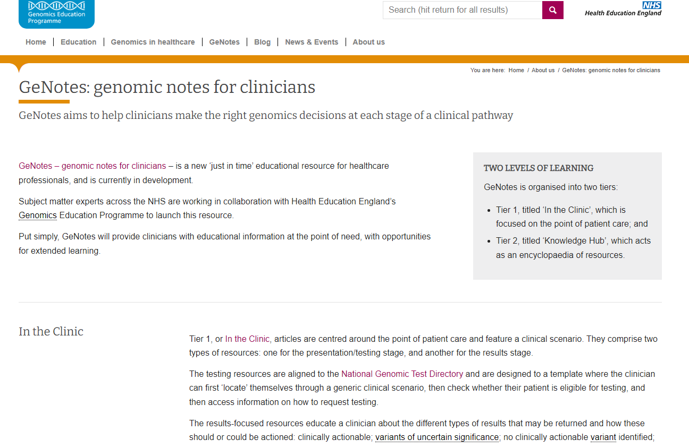
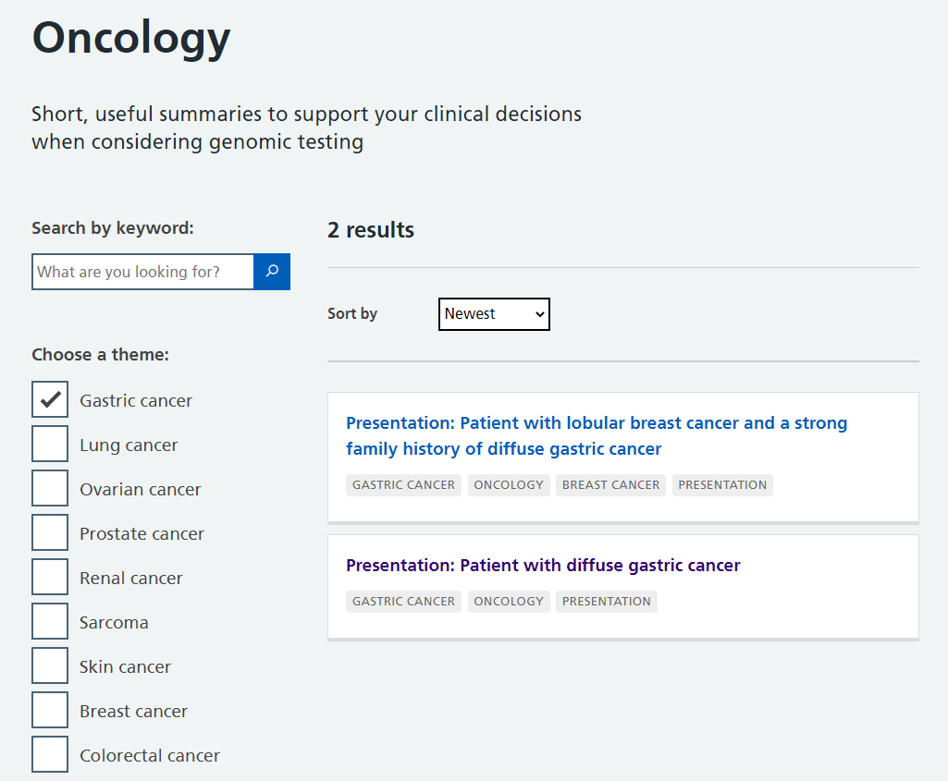
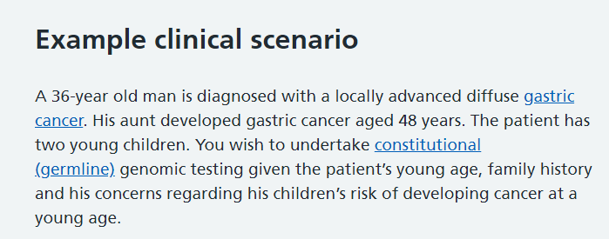
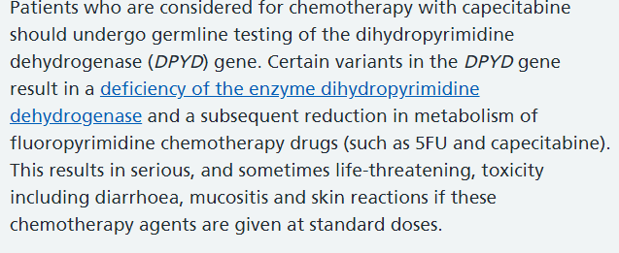
Information
Notes:
Why are we keen to talk to you?
All aware rapid speed in changes in cancer management and lessons learnt during 100,000 genomes project
Know that understanding cancer more than just adeno versus squame and personalised treatments based on molecular signatures is influencing our decisions
Landscape for use of genomic signatures is infiltrating across the whole cancer pathway from prevention to living with cancer and cure

Slide 13
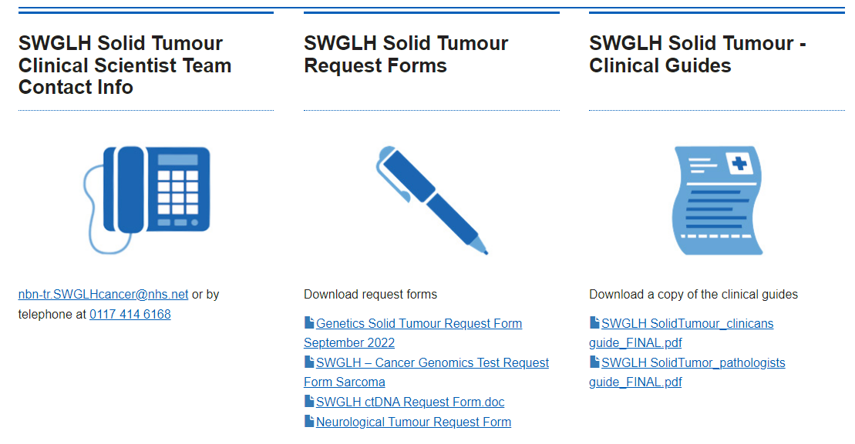
Thank you

