Slide 1
SWAG Cancer Alliance
Targeted Lung Health Check Programme (TLHC)
Dr Anna Bibby
30/11/2022

Slide 2
Lung cancer screening
Screening for lung cancer with low dose CT scans:
Increases lung cancer detection
With a stage shift towards treatable disease
Reduction in lung cancer mortality¹ ²
Alberle et al, NEJM, 2011 2. De Koning et al, NEJM, 2020

Slide 3
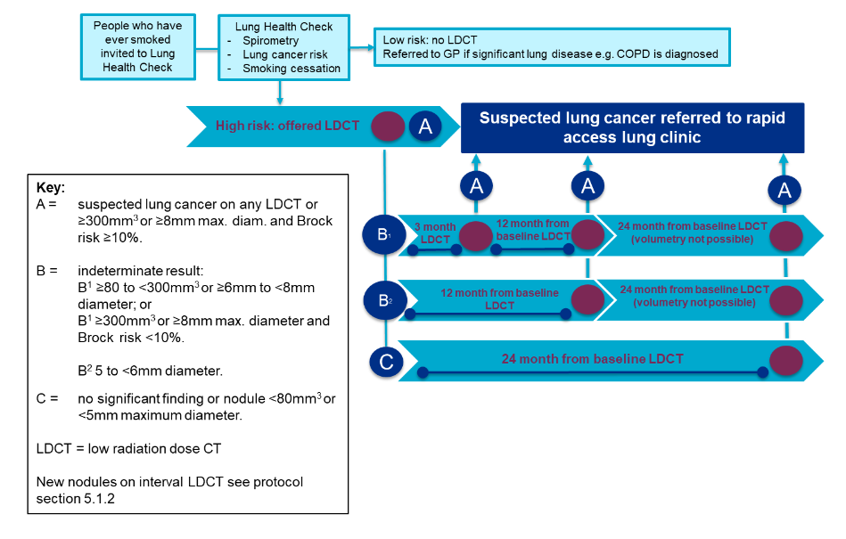

Slide 4
National TLHC programme
Pilot schemes/Trials – 2017/2018
Phase 1 – 2019 – 10 sites
Phase 2 – 2021 – 15 additional sites (based on lung cancer mortality)
Phase 3 – 2022 – pilot in every cancer alliance (including SWAG)
Notes:
.

Slide 5
Notes:
Overall uptake 38%
1100 cancers

Slide 6
SWAG alliance
4 ICBs
7 acute trusts
63 PCNs
Total population 2.4 million
Eligible TLHC screening population
(ever smokers, aged 55-74) = 366,500
TLHC commissioned for 27,000 (7.3%)
Notes:
Comment on heterogeneity of region in terms of deprivation

Slide 8
Benefits of a whole-alliance approach
Sharing good practice
Expansion
Sharing the load
Tackling health inequalities
Knowledge-sharing and lessons-learning across whole alliance footprint
Aids learning for fellow pilots as they upscale across alliance with national pilot programme expands
Distributing downstream impact: spreading the impact across many PCNs and Trusts
Opening up the opportunity to populations across all four CCGs so that those for whom the programme would have the most impact are invited.

Slide 10
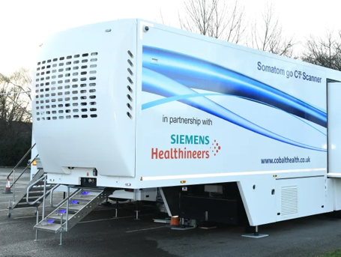
BRI
Gloucester
HLH CLOUD PACS AI + REPORT
Taunton
SWAG TLHC
SRM
NBT
RUH

Slide 12
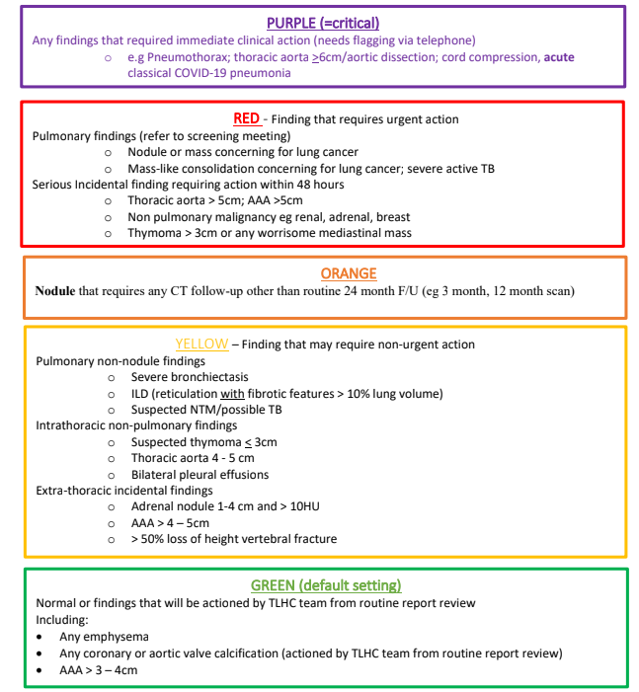

Slide 13
Screening Review Meeting
Weekly virtual meeting
Review all Red, and (initially) Orange, and Amber reports
Attended by:
SWAG TLHC radiologist (Anthony Edey)
SWAG TLHC clinician (Vidan Masani)
SWAG TLHC Clinical Director (Anna Bibby)
SWAG TLHC Lead Nurse (Esther Buckley)
SWAG TLHC SRM coordinator (Nadine Rash)
‘Local’ clinician (rotational – dependent upon location; AL, SF, HS, AJ, VM)

Slide 14
Screening Review Meeting
Acts as an ‘accelerator MDT’ for suspected lung cancers
Onward tests requested by Local Clinician
Feed into Trust lung cancer clinics/MDTs with results
TLHC Lead Nurse telephones patient
TLHC program informs GP of referral
Non-lung cancer actionable findings
Reported back to patient and primary care by TLHC team
Recommendations provided for further investigations/ future action
All onward referrals actioned at SRM

Slide 15
BSW progress
22nd July 2022 – 15th Nov 2022
7468 participants invited to tel TLHC
3483 tel appts completed
47% uptake
1189 people invited to a F2F appt
1014 attended - 958 CT scans
85% attendance
190 people referred to smoking cessation services

Slide 16
Secondary care impact
256 cases discussed at 11 screening review meetings
23 suspected lung cancers referred to RUH 2WW clinic
13 confirmed cancers so far ~ 1.4% detection rate
All bar 1 referred for radical treatment
Rest include nodules under surveillance, benign conditions
165 nodule findings
154 for surveillance scanning within TLHC
11 nodules downgraded as long-standing on review of historic imaging
58 incidental findings
4 cancers elsewhere
21 dilated aortas
11 benign renal, adrenal or liver lesions

Slide 17
Primary care impact
Coronary artery calcification ~58%
Radiological emphysema ~40%
Spirometry not currently offered but in progress
Letters written to participants with info sheet on condition
Advice to participants and GP based on severity, symptoms and current medication

Slide 18
Learning to date
Communication is key
With primary care
With community services
With participants
Subjective experience is different
For participants
And clinicians
Alliance-wide model is complex
But should help with future expansion
Existing IT links
Local experts at each site

Slide 19
What next?
Notes:
Launch date first week Dec

Slide 20
Longer term?

Slide 21
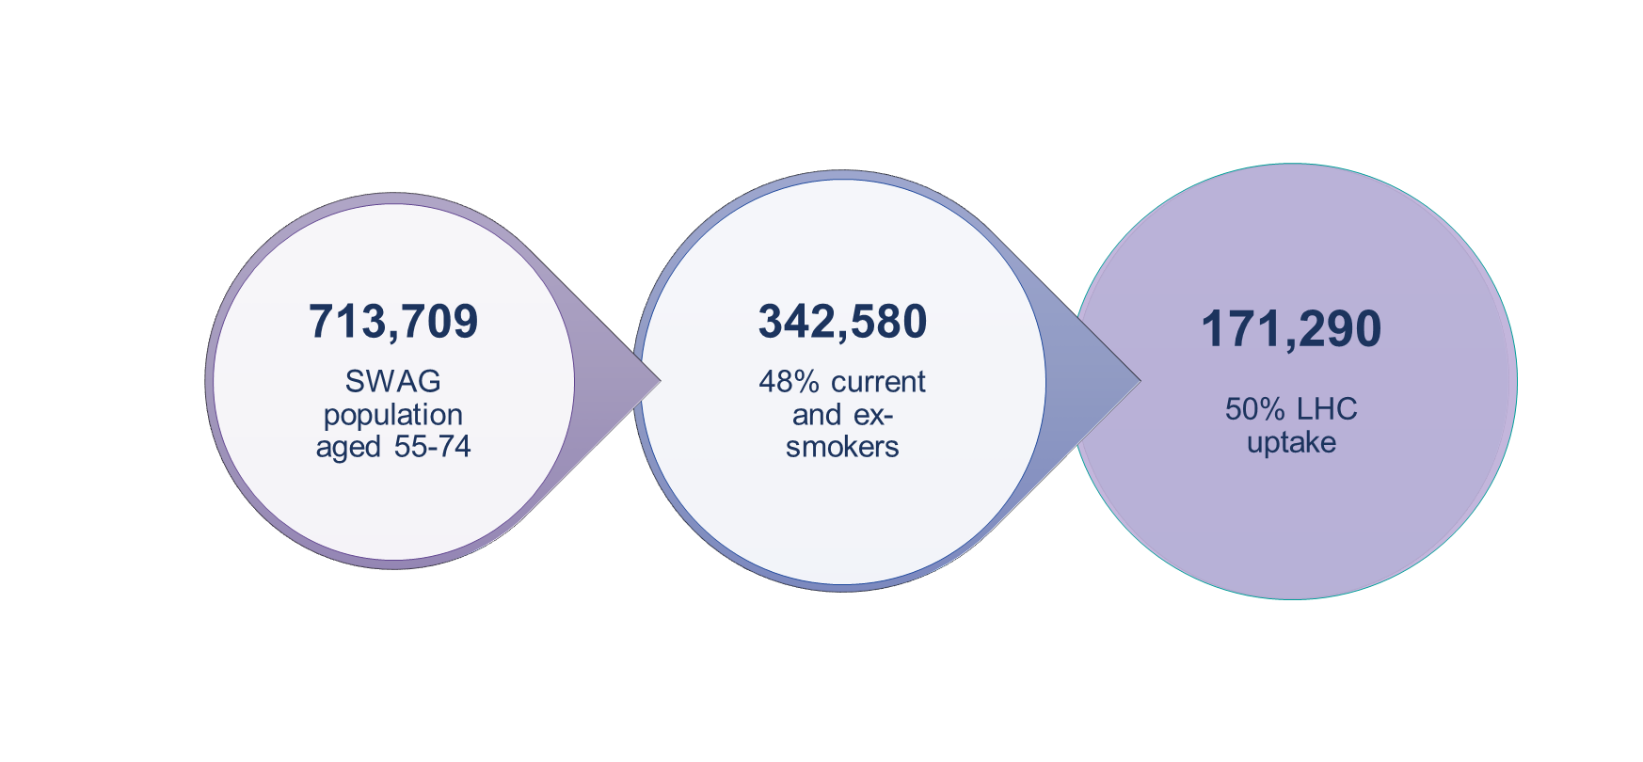
Proportion of eligible population invited in pilot | 2023/24 | 2024/25 | 2025/26 | 2026/27
<15% | 25% | 50% | 75% | 100%

Slide 22
Thank you Questions?
swaglunghealthcheck.nhs.uk

