Slide 1
SWAG Network Sarcoma Cancer
Clinical Advisory Group
Research Update - Claire Matthews
18/10/2022

Slide 2
National Sarcoma Cancer Research Recruitment
Apr 21 - Mar 22
Apr 22 - Sep 22
Notes:
In March, on behalf of the Department of Health and Social Care, the NIHR set up a mechanism (UK-wide portal) for applying for funding and/or prioritised support for urgent public health research into COVID-19.
The goal was to gather the necessary clinical and epidemiological evidence to inform national policy and enable new diagnostics, treatments and vaccines to be developed and tested.
The set-up and delivery of UPH studies is expedited by all necessary organisations across the research, health and social care systems including the HRA.
There is a commitment to ensure that research findings and data relevant to COVID-19 from UPH research are shared rapidly and openly.
Currently there are 67 UPH studies, 47 of which are running in CRN WE.
Restart framework was introduced in May with the aim of
Restoring a fully active portfolio of NIHR research
Continuing to support COVID-19 NIHR research
Providing a structure to guide the restarting of a full range of NIHR research
Work in close collaboration with key stakeholders, regulators, HRA, MHRA, patients and the public, and health and care research organisations to support the pace and coordination of this Restart and to ensure coordinated UK-wide working
2nd wave guidance:
The NIHR issued guidance to protect both COVID-19 and non-COVID-19 research during a ‘second wave’ of high COVID-19 activity.
The guidance makes very clear that research staff funded by NIHR should not be deployed to front line duties except in exceptional circumstances. This is in contrast to the ‘first wave’ when numerous staff were deployed to the clinical front line.
Dr William van't Hoff, CEO of the NIHR Clinical Research Network (CRN) and Senior Responsible Officer for the Restart Programme, said: “As the number of people with COVID-19 starts to rise again, it is imperative that our research staff focus on priority COVID-19 studies including vaccine studies. But we also need our teams to continue to support the restart of non-COVID-19 research, both commercial and non-commercial, in tandem with the restoration of NHS routine clinical services. The impact of research being paused in the Spring has been severe and we will make every effort to maintain recruitment rates across the portfolio.”

Slide 3
National vs Regional Recruitment
National
WE region

Slide 4
Sarcoma Cancer Studies - open and in seet up in SWAG region
CPMS Study ID | Short Name | Sites | Opening | Closure | Sample Size Eng | England Recruits
49536 | BI Trial 1403-0008 | SAL | 29/07/2022 | 29/11/2023 | 19 | 1
42490 | FaR-RMS | MUS, BHOC, RUH, BRHC | 17/09/2020 | 28/02/2029 | 310 | 81
42003 | RAGNAR - 42756493CAN2002 | BRHC, BHOC | 05/01/2020 | 15/11/2026 | 21 | 24
41346 | ICONIC |  | 25/10/2019 | 02/06/2023 | 134 | 165
33914 | SPECTA (EORTC 1553) | BRHC | 07/06/2018 | 30/09/2027 | 288 | 122
17239 | rEECur | BHOC, BRHC | 18/12/2014 | 30/09/2022 | 135 | 132
15941 | NIHR BioResource - Rare Diseases | SAL, BHOC, NBT, RUH, BRHC, | 13/09/2012 | 30/11/2022 | 22000 | 15,386
51601 | Paediatric (2-21Years)EWS | BHOC - in set up | 29/07/2022 | 03/12/2023 | - | In set up
Notes:
In March, on behalf of the Department of Health and Social Care, the NIHR set up a mechanism (UK-wide portal) for applying for funding and/or prioritised support for urgent public health research into COVID-19.
The goal was to gather the necessary clinical and epidemiological evidence to inform national policy and enable new diagnostics, treatments and vaccines to be developed and tested.
The set-up and delivery of UPH studies is expedited by all necessary organisations across the research, health and social care systems including the HRA.
There is a commitment to ensure that research findings and data relevant to COVID-19 from UPH research are shared rapidly and openly.
Currently there are 67 UPH studies, 47 of which are running in CRN WE.
Restart framework was introduced in May with the aim of
Restoring a fully active portfolio of NIHR research
Continuing to support COVID-19 NIHR research
Providing a structure to guide the restarting of a full range of NIHR research
Work in close collaboration with key stakeholders, regulators, HRA, MHRA, patients and the public, and health and care research organisations to support the pace and coordination of this Restart and to ensure coordinated UK-wide working
2nd wave guidance:
The NIHR issued guidance to protect both COVID-19 and non-COVID-19 research during a ‘second wave’ of high COVID-19 activity.
The guidance makes very clear that research staff funded by NIHR should not be deployed to front line duties except in exceptional circumstances. This is in contrast to the ‘first wave’ when numerous staff were deployed to the clinical front line.
Dr William van't Hoff, CEO of the NIHR Clinical Research Network (CRN) and Senior Responsible Officer for the Restart Programme, said: “As the number of people with COVID-19 starts to rise again, it is imperative that our research staff focus on priority COVID-19 studies including vaccine studies. But we also need our teams to continue to support the restart of non-COVID-19 research, both commercial and non-commercial, in tandem with the restoration of NHS routine clinical services. The impact of research being paused in the Spring has been severe and we will make every effort to maintain recruitment rates across the portfolio.”

Slide 5
Associate PI Scheme
https://www.nihr.ac.uk/health-and-care-professionals/career-development/associate-principal-investigator-scheme.htm
A six month in-work training opportunity, providing practical experience for healthcare professionals starting their research career.
People who would not normally have the opportunity to take part in clinical research in their day to day role have the chance to experience what it means to work on and deliver a NIHR portfolio trial under the mentorship of an enthusiastic Local PI.
FaR-RMS: An overarching study for children and adults with Frontline and Relapsed RhabdoMyoSarcoma
Open 17/09/2020 - 28/02/2029
Currently no APIs signed up in our region

Slide 6
PRES 2021/22
Report Summary

Slide 7
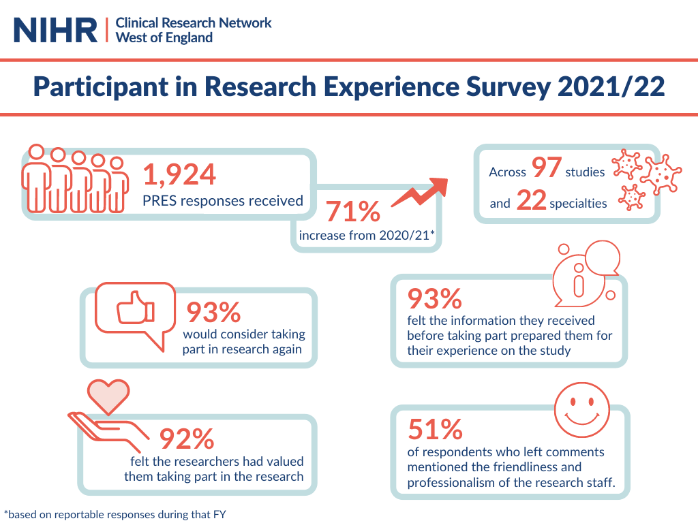
Notes:
We saw responses from across all seven Trusts in the region and four Primary Care sites.

Slide 8
What was positive about your research experience?

Slide 9
Recommendations and next steps
Key themes from this year's feedback include:
Communication with participants
Results to individual tests.
Clear information about how to get in contact with the study team.
Explore how participants can be offered more diverse clinic times, including out-of-hours and weekends.
Discussions with participants and research staff about the areas that are most important.
Projects which aim to improve the participant experience.

Slide 10
NIHR ODP
Open data platform. Data on performance across whole CRN, including all specialty areas
NIHR Be Part of Research
See which studies are open across the country
National Cancer Research Institute Portfolio Maps
View current national portfolio of open, closed and ‘in set up’ cancer studies
Find a Clinical Research Study (ODP)
Search for a study to fit criteria. Good for horizon scanning, eligibility criteria

Slide 11
Research Delivery Manager
claire.matthews@nihr.ac.uk
Research Portfolio Facilitator
rebecca.pienaar@nihr.ac.uk
Sub-specialty Lead
adam.dangoor@uhbw.nhs.uk

