Slide 1
National Lynch Syndrome project
Sarah John and Siobhan John SW Nurse facilitators
Notes:
Thanks for inviting us to speak to you about the National Lynch Syndrome project
We’re Sarah John and Siobhan John (no relation!)
Both having over 20 yrs experience working in locally as colorectal nurse specialists.
For the next year we’re working within SWGMSA facilitating this project across both this cancer alliance and Peninsula

Slide 2
Why worry about Lynch?
Each year, 1,100 colorectal cancers are caused by Lynch syndrome, making it the most common form of hereditary colorectal cancer.
An estimated 175,000 people have Lynch syndrome in the UK, but fewer than 5% of individuals know they have the condition (Bowel Cancer UK).
Notes:
1,100 CRC cases are caused by Lynch each year, this is about 3% of all cases of CRC.
It is estimated that there are 175,000 people with Lynch in the UK, but currently fewer than 5% of individuals know that they have it
Since 2017, in the UK NICE has recommended universal testing for Lynch Syndrome in all newly diagnosed colorectal cancers
But currently in the SW this is not always happening

Slide 3
When should we test?
A dMMR can affect cancer treatment options, certain tumours are more responsive to particular chemotherapy agents as well as new immunotherapy drugs called check point inhibitors.
It is therefore important that the initial tumour test is done in time to inform treatment options
Notes:
So when should we test:-
In June 2021, NICE recommended the use of a checkpoint inhibitor immunotherapy drug, pembrolizumab, for people with untreated metastatic colorectal cancer with high microsatellite instability (MSI) or dMMR, including people with Lynch syndrome.
It is therefore important that the initial tumour is tested for MSI or dMMR in time to inform their treatment options

Slide 4
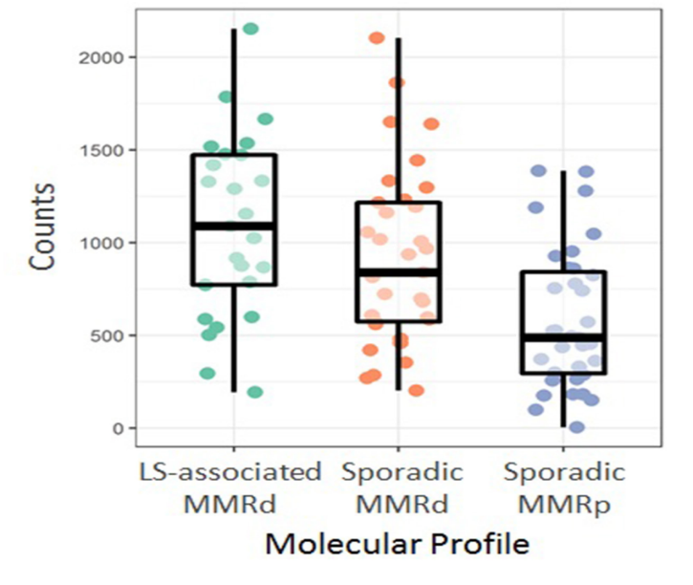
Immunotherapy in Lynch Syndrome
Notes:
This slide shows how a cancer which has a dMMR gene is far more responsive to the immunotherapy drug, pembrolizumab which is a check point inhibitor, than a proficient MMR gene.
This is the case even if the cancer is due to a sporadic mutation, rather than Lynch and the testing (in theory) can be completed within 10-14 days.
If the initial biopsy can be sent for testing reflexing after a cancer is found, this information will be available before commencing treatments

Slide 5
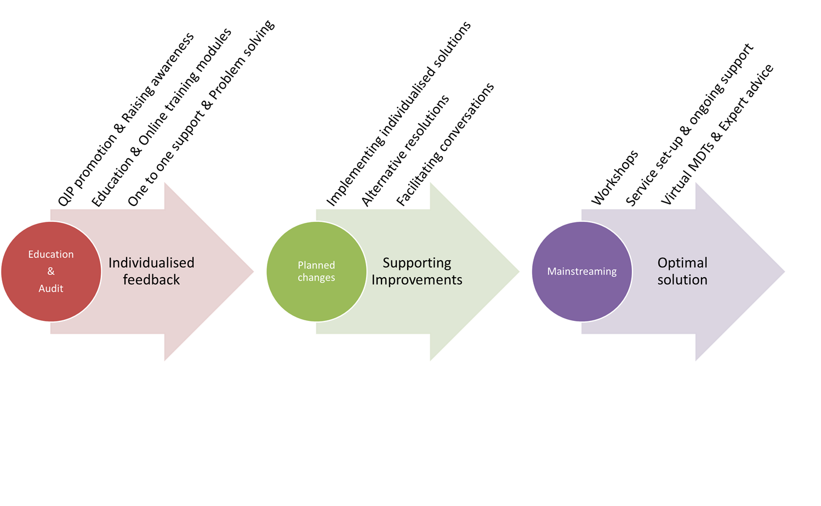
Improving diagnostic pathways
Notes:
Delivery of this project includes education using the electronic resources provided through RM Partners with personalised feedback
The baseline audit is key to assessing the LS diagnostic pathway in each MDT. This also helps the LS champion and their team to identify gaps within the diagnostic pathway, problem solving and finding solutions together.
These discussions will need to be followed up by the team with the Lynch champion to assess if the changes are effective. Solutions will be individualised and may require facilitating conversations with different team members and external bodies.
Currently involved in a pilot for mainstreaming which will begin in Exeter and then will extend from there,
For teams wishing to to mainstreaming, additional support is provided with educational workshops, and, support and advice on how to set-up their service.
Bespoke workshops can be delivered every 2 weeks and last for 2 hours each. Generally teams require between 3 to 6 workshops to complete the mainstreaming training

Slide 6
Example of completed baseline audit
Notes:
As said in the previous slide:-
MDT’s in the region are being encouraged to complete the baseline audit ASAP.
This is an example of a completed audit, following. We have now analysed the results to be able to give feedback to the MDT re: what is working and what isn’t.
Completing this audit could be an ideal task for any enthusiastic junior, it takes only a few hours to identify
a sample of 30 recent colorectal cancer patients who have undergone treatment

Slide 7
Analysis of Audits
 | Trust A | Trust B
IHC/MSI | 97 % | 95%
Colon biopsies | 39% | 9%
Methylation/BRAF | 100% | 100%
Discussion at MDT | 75% | 0%
Referral Genetics | 60% | NA
Notes:
It is reassuring to see that both Trusts are routinely testing for potential Lynch with either IHC or MSI. This is a vast improve from 2017 when Bower Cancer UK found that 30% of UK hospitals were not routinely testing.
However we are not doing so well at testing the initial colonic biopsies. Something that needs to be improved upon if we are to reach a situation when treatment options are personalised depending on gene mutations.
Discussions with Trust B indicate that lack of pathology resources are key to biopsies not being tested.
As more trusts complete audits, it will reveal if this is a regional problem or local.
It’s reassuring to see that both trusts are automatically sending samples for methylation / BRAF as appropriate
Trust B is not discussing these results at MDT, however we would assume that this was because no cases audited needed referral to genetics.
It was initially concerning that Trust A had not documented whether referrals had been made to genetics when needed in 40% of cases. ON investigation it was seen that these 40% of cases had swapped to the private sector and it is hoped that referreals were made from there, this will be checked.
Of concern however, it was noted that patients under 40 yrs at diagnosis are not always being referred to genetics immediately, regardless of gene mutations – this will be taken back to the trusts in order to ensure it becomes reflex.

Slide 8
Our Role
To support trusts across to the south west to ensure patients with colorectal and endometrial cancers are routinely tested for lynch at diagnosis.
To ensure patients are on the correct surveillance pathway and they are added to the regional database.
Doing this Through supporting trusts to audit their current provision and highlighting good and bad practice
Implementing mainstream germline testing
Notes:
We will support trusts on what changes are needed to ensure all patients with colorectal and endometrial cancers are routinely tested for lynch at diagnosis.
Thereby ensuring that they will be able to be offered all treatment options now available
Moving forward, we need to ensure patients are on the correct surveillance pathway and they are added to the regional database. A regional co-ordinator should be in post by the end of the year
Support trusts to audit their current provision and highlighting good and bad practice
Additionally, there will be support and training for hospitals that wish to be able to offer mainstream germline testing
Thank you

