Slide 1
SIRT Steve Falk Consultant Clinical Oncologist
dd/mm/yyyy

Slide 2
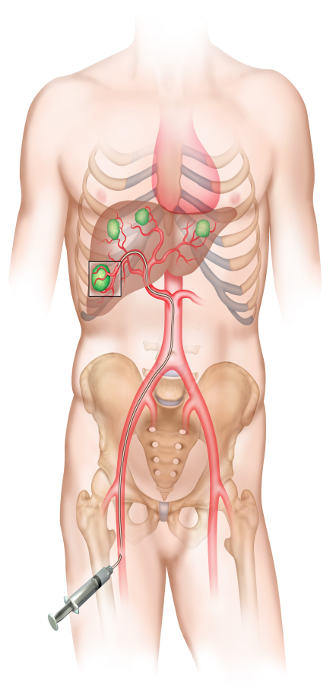
Selective Internal Radiation Therapy (SIRT)
SIRT employs Yttrium-90 (Y-90) labelled resin microspheres as a liver-directed therapy ⁽¹⁾
Hepatic artery injection
Delivers a single large radiation dose to liver tumours
SIRT/Y-90: Beta radiation from Y-90, penetrates ~2500 microns from solid tumour blood vessels.
Radiation deposited over 3 weeks
FDA approved in 2002 for unresectable CRCLMs ⁽²⁾
Kennedy A et al. Int J Radiat Oncol, Biol Phys 2007;68:13–23.
Colorectal cancer liver metastases.
Van Hazel et al. J Surg Oncol 2004;88:78–85.
Sharma et al. J Clin Oncol 2007;25:1099–106.
Gibbs P et al. Presented at 2015 ASCO Annual Meeting; J Clin Oncol 2015; 33 (Suppl): Abs 3502.
118-EUA-0615

Slide 4
Options for non resectable disease
Ionising Radiation
Catheter directed
SIRT
Chemo-embolization
Chemotherapy
Percutaneous
Cryosurgery
Thermal ablation
Radiofrequency ablation
Microwave

Slide 5
SIRT Indications until 2021

Slide 6
BSI/Regulatory review 2021
Used in
HCC
Cholangiocarcinoma
NET
Colorectal liver mets
Breast liver mets
Pancreas liver mets
‘Due to the significant methodological and statistical heterogeneity between studies, and the large variety of treatment combinations, it is difficult to make concrete recommendations on the best locoregional and systemic treatment options for advanced or unresectable HCC, ICC and secondary liver metastases. Essentially, additional large randomized controlled trials are needed to validate the positive therapeutic outcomes portrayed in the reviewed systematic reviews and meta-analyses’

Slide 7
BSI/Regulatory review 2021 NICE guidance
IPG672 March 2020. ‘Evidence on the safety of selective internal radiation therapy (SIRT) for unresectable colorectal metastases in the liver shows there can be serious complications, but these are well recognised and infrequent.
In people who cannot tolerate chemotherapy or have liver metastases that are refractory to chemotherapy, there is evidence of efficacy but this is limited, particularly for important outcomes such as quality of life. Therefore, in these people, this procedure should only be used with special arrangements for clinical governance, consent, and audit or research.
In people who can have chemotherapy, evidence on overall survival and quality of life is inadequate in quality. Therefore, in these people, this procedure should only be used in the context of research.
Commissioning limited to 5 or less metastases, <25% liver volume
= 0 referrals….

Slide 8
BSI/Regulatory review 2021 NICE guidance
ID1276 The selective internal radiation therapy (SIRT) SIR-Spheres is recommended as an option for treating unresectable advanced hepatocellular carcinoma (HCC) in adults, only if:
• used for people with Child-Pugh grade A liver impairment when conventional transarterial therapies are inappropriate
NICE 2018 Current evidence on the safety of selective internal radiation therapy (SIRT) for unresectable primary intrahepatic cholangiocarcinoma shows that there are well-recognized, serious, but rare safety concerns. Evidence on its efficacy is inadequate in quantity and quality. Therefore, this procedure should only be used in the context of research

Slide 9
HCC

Slide 10
SIRT in the intermediate stage

Slide 11
SIRT in the intermediate stage HCC: SIRT versus TACE
Similar Outcomes¹
Similar mOS²⁻¹⁰: 6.0 to 30 months versus 6.0 to 48 months
Similar mPFS¹⁰: 180 days versus vs 216 days
Similar ORR^{7,8,12}: ~20% versus ~12%
Similar outcomes in meta-analysis
Less interventions & hospitalisation times
1 or 2 SIRT versus > 3 TACE^{9,10}
Mean hospitalisation time: 0.5 versus 3.5 days⁴
Similar toxicity and no deleterious effect of SIRT on QoL¹²
Even in TACE refractory patients¹¹
mOS: 14.8 months
ORR: 36.7%
1 Gardini AC et al. Onco Targets Ther 2018; 11: 7315–7321.
2 Facciorusso A et al. World J Hepatol 2016; 8: 770–778.
3 Kooby DA et al. J Vasc Interv Radiol 2010; 21: 224–230.
4. Lance C et al. J Vasc Interv Radiol 2011; 22: 1697–1705.
5 Ludwig JM et al. Eur Radiol 2017; 27: 2031–2041.
6 Paprottka KJ et al. Eur J Nucl Med Mol Imaging 2017; 44: 1185–1193.
7 She WH et al. Hepatobiliary Surg Nutr 2014; 3: 185–193.
8 Floridi C et al. Med Oncol 2017; 34: 174.
9 Soydal C et al. Nucl Med Commun 2016; 37: 646–649.
10 Pitton MB et al. Cardiovasc Intervent Radiol 2015; 38: 352–360.
12 Klompenhouwer EG et al. Cardiovasc Intervent Radiol 2017; 40: 1882–1890.
12 Kolligs F et al. Liver Int 2015; 35: 1715–1721

Slide 12
SIRT in the intermediate stage: patient selection
As alternative to TACE in BCLC B patients
For various tumour situations
Bilobar
Multinodular
Large
For patients contraindicated to TACE
Tumour > 5 cm and or > 5 nodules
Bilobar disease
Tumorous portal vein thrombosis

Slide 13
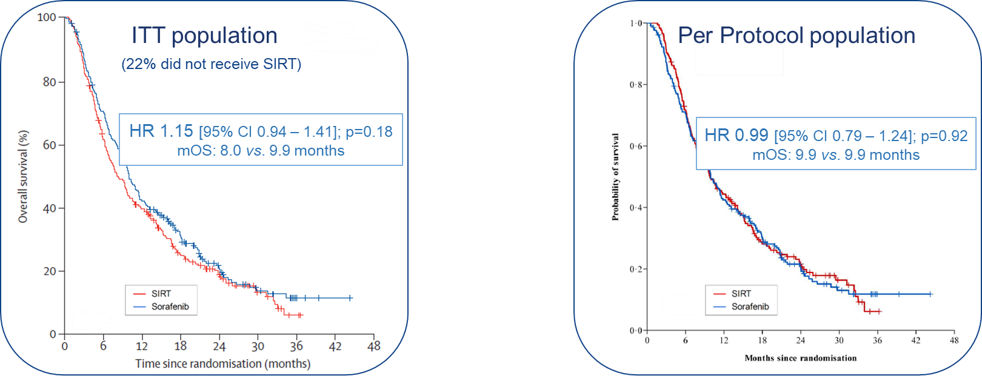
SIRT in the advanced stage: SARAH study
467 patients SIRT v Sorafenib
SARAH - Overall survival
Vilgrain V et al. Lancet Oncol 2017; 18: 1624–36.
Bouattour M et al. Ann Oncol 2017; ESMO 19th WCGIC, Abs. LBA-001.

Slide 14
SIRT in the advanced stage: Safety
SARAH
Treatment-related adverse events Safety population
p<0.001
p<0.001
3000
2837
Sorafenib
(n = 216)
SIR-Spheres Y-90 resin microspheres (n = 226*)
2500
56%
less
2000
*Includes 26 patients receiving only sorafenib instead of SIRT
Treatment-related AEs, n
1500
1000
1297
500
46% less
411
230
0
Any grade
Grade ≥3
Vilgrain V et al. Lancet Oncol 2017; 18: 1624–36.
Bouattour M et al. Ann Oncol 2017; ESMO 19th WCGIC, Abs. LBA-001.

Slide 15
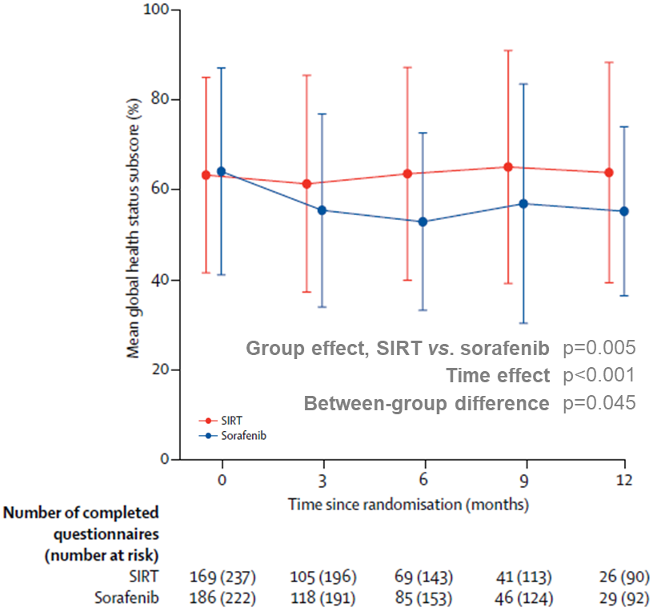
SIRT in the advanced stage: QoL
SARAH
Quality of Life by Global Health Status sub-score of EORTC QLQ-C30 ITT population
Similar outcomes in two Asian studies
Vilgrain V et al. Lancet Oncol 2017; 18: 1624–36.
Bouattour M et al. Ann Oncol 2017; ESMO 19th WCGIC, Abs. LBA-001.

Slide 21
SIRT in the advanced stage: Patient Selection
SIRT with SIR-Spheres may be considered in patients with:
Local vascular invasion
Absence of extrahepatic disease
Prior to systemic treatment
Alternative to systemic treatments
Intolerant to systemic treatments
Where systemic treatments are contraindicated
Progressive disease with systemic treatment
Tumours > 5cm
Multiple nodules (>3-5)
Bilobar disease
TACE contraindicated or poor response

Slide 22
SIRFLOX: Randomized phase III trial comparing first-line mFOLFOX6 (+bevacizumab) versus mFOLFOX6 (+bevacizumab) + selective internal radiation therapy (SIRT) in patients with metastatic colorectal cancer
Peter Gibbs ⁽¹⁾, Volker Heinemann, Navesh K. Sharma, Michael P. N. Findlay, Jens Ricke, Val Gebski, Mark Van Buskirk, Guy A. van Hazel, on behalf of the SIRFLOX Study Group
⁽¹⁾ The Royal Melbourne Hospital, Melbourne, Australia
Gibbs P et al. Presented at 2015 ASCO Annual Meeting; J Clin Oncol 2015; 33 (Suppl): Abs 3502.
118-EUA-0615

Slide 23
Study Design
Prospective open-label RCT
Primary endpoint: Progression-Free Survival
Eligible patients
Non-resectable liver-only or liver-dominant mCRC
No prior chemo for advanced disease
WHO performance status 0–1
Stratified by
Presence of extra- hepatic metastases
Degree of liver involvement
Intended use of bevacizumab
Institution
n = 263 enrolled
mFOLFOX6 (+ bevacizumab) ⁽¹⁾
Randomized
1:1
n = 530
n = 267 enrolled
mFOLFOX6 (+ bevacizumab) ⁽¹⁾
SIRT
ANZ: 280 (53%)
EME: 191 (36%)
US: 59 (11%)
1. Bevacizumab allowed at investigator’s discretion, per institutional practice
ANZ: Australia, New Zealand; AP: Asia Pacific; EME: Europe & Middle East; US: United States
Gibbs P et al. Presented at 2015 ASCO Annual Meeting; J Clin Oncol 2015; 33 (Suppl): Abs 3502.
118-EUA-0615

Slide 24
Patient Characteristics in the ITT Population
Characteristic | FOLFOX (+ bev) (n = 263) | FOLFOX (+ bev) + SIRT (n = 267)
Age, years, median (range) | 63 (23 – 89) | 63 (28 – 81)
Sex Female Male | 88 (34%) 174 (66%) | 85 (32%) 182 (68%)
WHO performance 0 status 1 | 175 (67%) 87 (33%) | 176 (66%) 90 (34%)
Extra-hepatic metastases | 104 (40%) | 108 (40%)
Primary tumour not removed | 121 (46%) | 119 (45%)
Synchronous metastases | 233 (89%) | 241 (90%)
Disease already outside of the liver

Slide 25
Progression-Free Survival at Any Site
1.00
n Events Median
FOLFOX (+ bev) 263 225 10.2 months
FOLFOX (+ bev) + SIRT 267 217 10.7 months
HR: 0.93 (95% CI: 0.77–1.12), p=0.43
0.75
Proportion Not Progressing
0.50
0.25
0.00
0
12
24
36
48
60
Time from Randomization (months)
Number at risk
FOLFOX 263 96 29 9 5 2
FOLFOX + SIRT 267 106 33 11 5 2
Gibbs P et al. Presented at 2015 ASCO Annual Meeting; J Clin Oncol 2015; 33 (Suppl): Abs 3502.
118-EUA-0615

Slide 26
Progression-Free Survival in the Liver
0.7
0.6
0.5
n Median
FOLFOX (+ bev) 263 12.6 months
FOLFOX (+ bev) + SIRT 267 20.5 months
HR: 0.69 (95% CI: 0.55–0.90), p=0.002
0.4
Probability of Hepatic Progression
0.3
0.2
7.9 month improvement in median PFS in the liver
0.1
31% reduction in risk of disease progression in the liver
0.0
0
12
24
36
48
60
Time from Randomization (months)
Number at risk
FOLFOX 263 96 29 9 5 2
FOLFOX + SIRT 267 106 33 11 5 2
Gibbs P et al. Presented at 2015 ASCO Annual Meeting; J Clin Oncol 2015; 33 (Suppl): Abs 3502.
118-EUA-0615

Slide 33
Summary and conclusions
SIRT evidence base is poor
Effectively unusable in UK in NHS in CRC metastases
Definite place in HCC
Local MDT selection will be key
Important part of our regional service.
If commissioned means we have a national full house of available therapies

