Slide 1
Primary Care Update
Dr Glenda Beard
BNSSG ICB Clinical Lead for Cancer
GP Whiteladies Medical Group

Slide 2
What services are Primary Care contracted to provide?
Essential services are mandatory for a practice to deliver to registered patients and temporary residents in its practice area. They include the identification and management of illnesses, providing health advice and referral to other services. GPs are required to provide their essential services during core hours, which are 8.00am–6.30pm Monday to Friday, excluding bank holidays.
Out-of-hours services are those provided outside core working hours. A practice is assumed to provide these by default but can opt out. Where a practice opts out, as most practices do, commissioners have the responsibility for contracting a replacement service to cover the general practice area population.
Additional services include specific other clinical services that a practice is assumed to provide but can opt out of, for example, minor surgery.
Enhanced services are nationally agreed services that holders of almost all GP contracts (GMS/PMS/APMS) can also provide if they choose to opt in. Services specified for 2020/21 include some vaccination programmes and a health check scheme for people with learning disabilities. Primary care networks (PCNs) (see box below) have also been established via an enhanced service agreement.
Locally commissioned services are locally set services that practices can also opt in to. Unlike other GP services, these might also be commissioned by non-NHS organisations such as local authority public health departments. Examples include services for people who are sleeping rough or mental health support programmes.
GP funding and contracts explained | The King's Fund (kingsfund.org.uk)

Slide 3
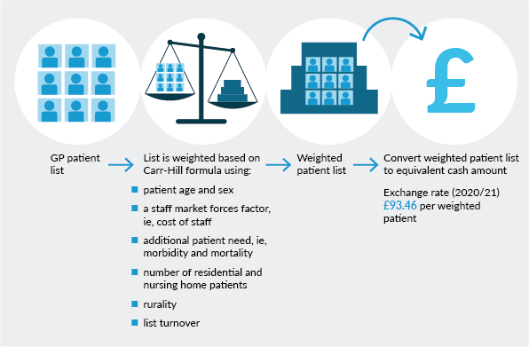
GP Contract
GP funding and contracts explained | The King's Fund (kingsfund.org.uk)

Slide 4
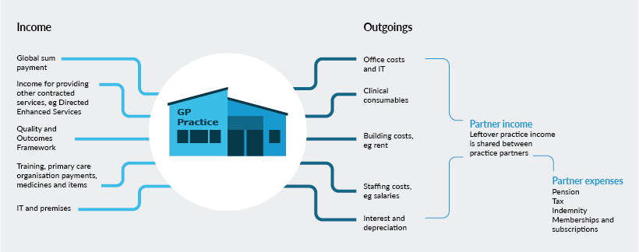
GP funding and contracts explained | The King's Fund (kingsfund.org.uk)

Slide 5
Specific GP Contract requirements for cancer
Three aspects
the Quality and Outcomes Framework (QOF)
Investment and Impact fund (IIF)
Primary Care Network Direct Enhanced Service Contract (PCN DES)
GP Contract 2022/23 and cancer | Macmillan Cancer Support

Slide 6
QOF requirements for cancer
Quality and Outcomes Framework (QOF) requirements
Indicator
CAN001 maintain a register of patients with cancer
CAN004 cancer care review within 12 months of diagnosis
CAN005 offer of support within 3months of diagnosis

Slide 7
PCN Directly Enhanced Service 2022/23
Review Referral Practice
Improve uptake of Bowel and Cervical Cancer Screening Programs
qFit testing
Teledermatology
Prostate Cancer Case Finding
Non Site Specific Symptom Service
PCN DES requirements
B1357_PCN-ECD-Guidance-SUPPORT-PACK-FINAL_March-2022.pdf (england.nhs.uk)

Slide 8
Investment and Impact Fund (IIF)
The Investment and Impact Fund (IIF) is an incentive scheme that rewards Primary Care Networks for delivering objectives set out in the NHS Long Term Plan and GP contract agreement.
INDICATOR
CAN-01 – Percentage of lower gastrointestinal two week wait (fast track) cancer referrals accompanied by a faecal immunochemical test result, with the result recorded either in the seven days leading up to the referral, or in the fourteen days after the referral

Slide 9
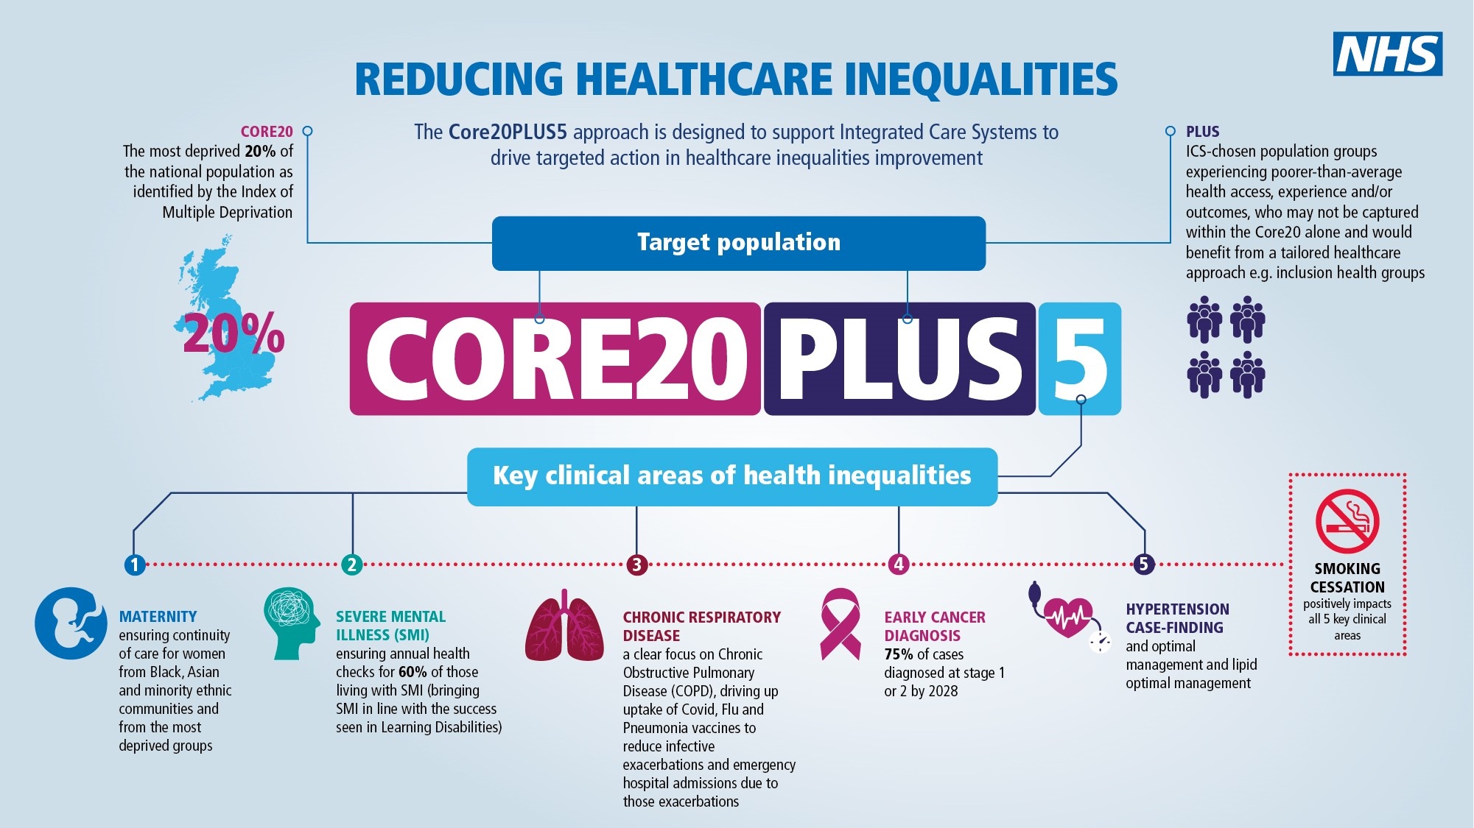

Slide 10
Latest GP statistics show intensity of working in general practice ‘unsustainable and unsafe’ for patients and staff (rcgp.org.uk)
Despite repeated promises to boost GP numbers, today’s figures show that we have more than 1,500 fewer qualified, full-time equivalent GPs than we did five years ago. The result is a chronically over-stretched and under-resourced general practice service, with GPs and their teams working to their absolute limits to deliver increasingly complex care to the ever-rising number of patients that need it.

Slide 11
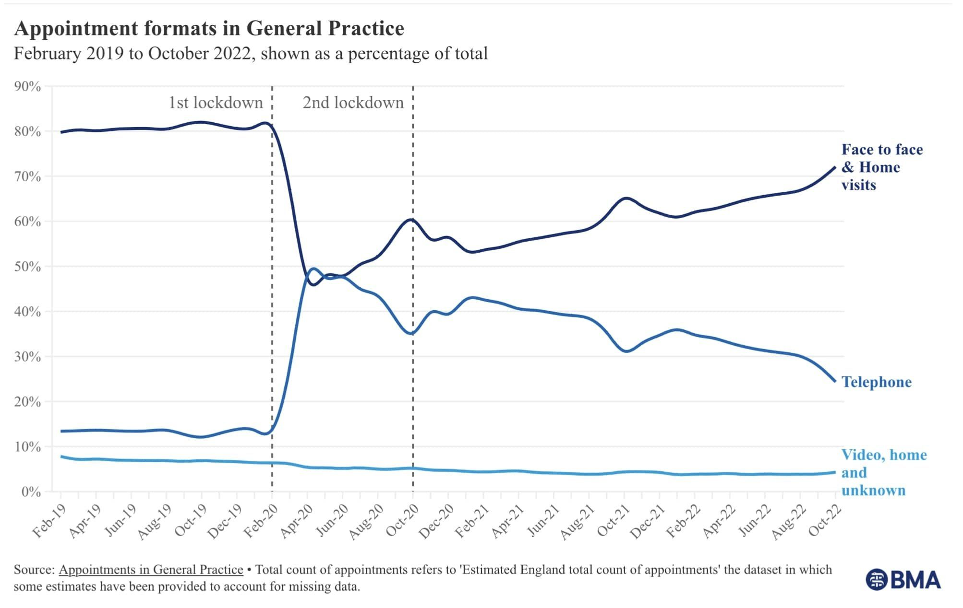
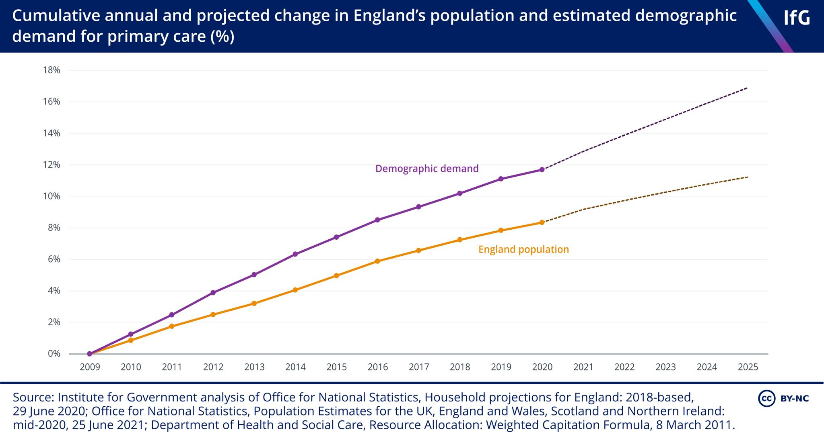

Slide 12
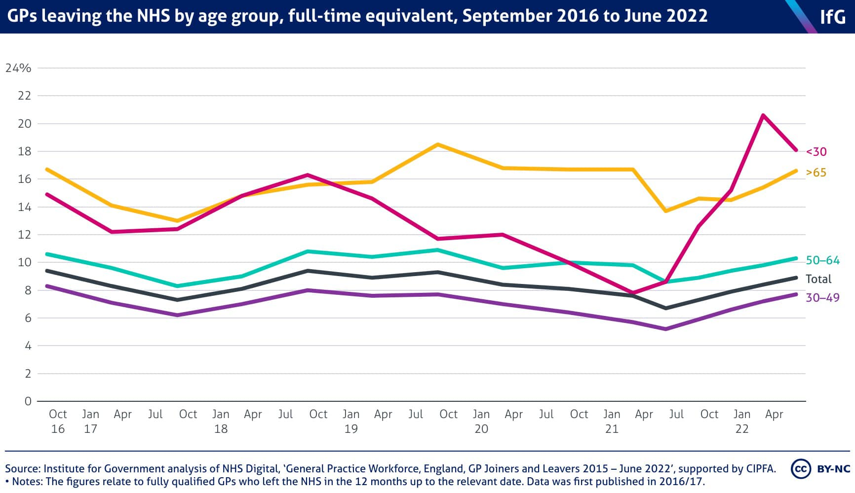

Slide 13
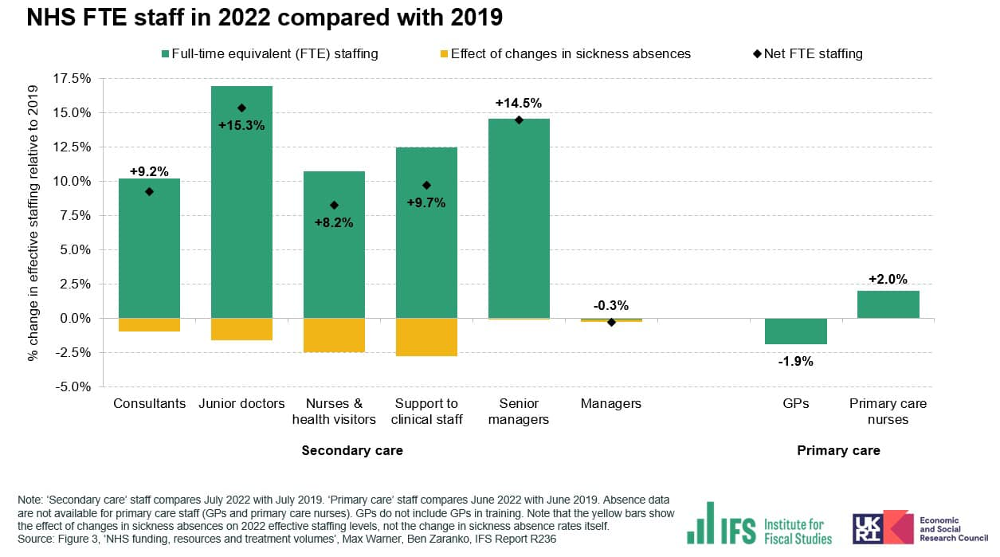

Slide 14
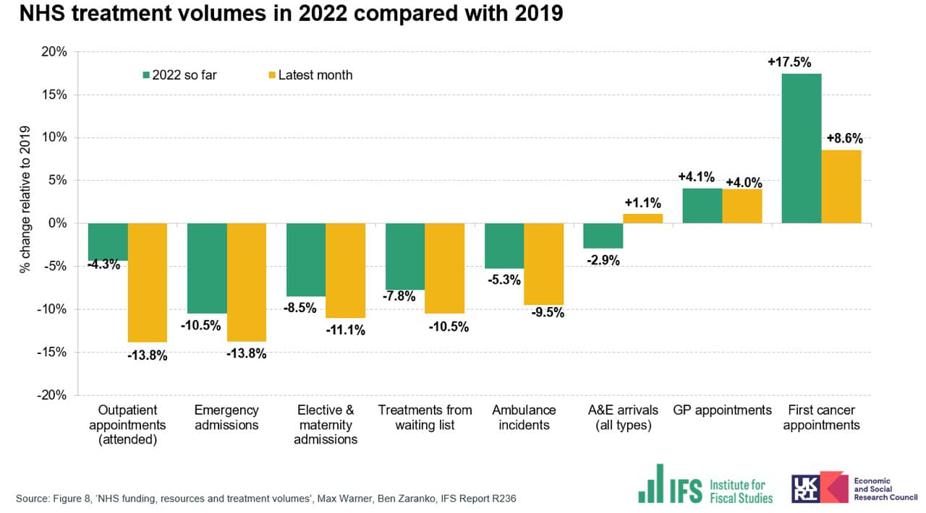

Slide 16
The Changing Primary Care Workforce
Reception Staff = Care Navigators
Care Coordinators
Growing ANP workforce
Additional Roles
- Pharmacists, Physios, Physicians Associates, Mental Health Practitioners

