Slide 1
Prehab – a snapshot of our service for lung cancer patients
Aimee Leadbetter
Respiratory ST4, Gloucestershire Hospitals NHS Foundation Trust

Slide 2
Retrospective review of data
24 week period
1/5/22 – 10/10/22
55 patients
46
87
75

Slide 3
Cancer stage
54%

Slide 4
Performance status

Slide 5
Treatment

Slide 6
PS0 - treatment
Notes:
“other” = ongoing Ix or active monitoring

Slide 7
PS1 - treatment

Slide 8
PS2 - treatment
Notes:
Surgery = dark blue (2 patients) – one of these will present in more detail shortly

Slide 9
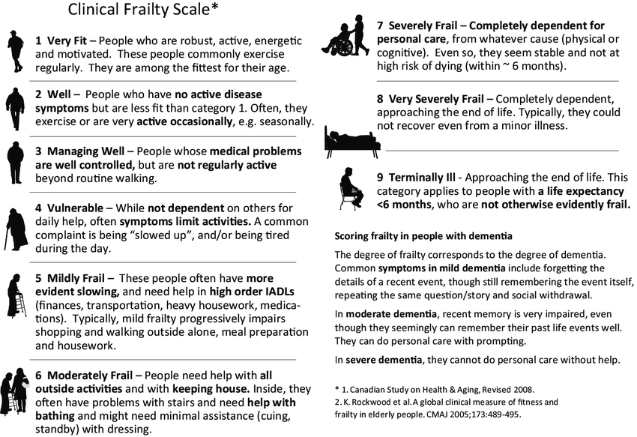
Rockwood Clinical Frailty Scale (CFS)

Slide 10
PS0
PS1

Slide 11
PS2

Slide 12
PS2
Notes:
Of those that were PS2, 8% (2 patients), went on to have surgery
Interestingly, one of these patients was Rockwood 3, one was Rockwood 4

Slide 13
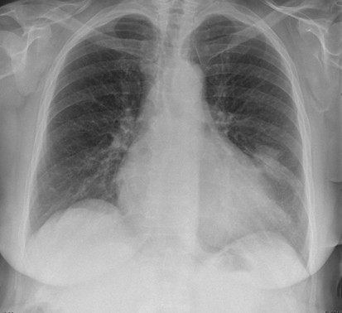
Mrs A
75F
Initial 2WW appt 6/7/22
PMHx:
AF
COPD
T2DM
CKD3
Ex-smoker (stopped 4 years prior)
Referred with cough + brief haemoptysis
Abnormal CXR and CT
Notes:
One such patient (anonymised) is Mrs A

Slide 14
Mrs A
“gets breathless after about 150 yards”
“breathlessness has been slightly worse recently”
In AF, rate ~90
PS2
Rockwood 4

Slide 15
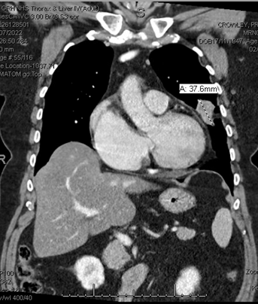
Lung function: FEV1 1.6 (79%), DLCO 79%
Echo: normal LV syst Fx, EF 58%. Impaired LV relaxation. Normal RV size + syst Fx.
PET CT 25/7/22: avid L lung mass. If confirmed malignant, PET/CT staging = T2aN0M0
Commenced on bisoprolol + furosemide
Referred cardiology
Referred to prehab
CT guided biopsy – confirmed adenocarcinoma
Referred cardiothoracic surgeons

Slide 16
Prehab
Initial telephone assessment 8/7/22:
“Physical activity: limited. Very SOBOE. Does housework”
11/7/22 – 12/8/22
5x weekly sessions
Group exercise classes (45 mins)
Aerobic, strength and mobility exercises
5/8/22
“improving SOBOE”
“able to engage for longer duration and increased intensity”
12/8/22
“improving subjective fitness, patient able to exercise for longer bouts during session”
2/9/22 – 16/9/22
2x fortnightly sessions
Weights with strengthening exercises
Notes:
Midway through prehab, was reviewed F2F by cardiothoracic surgeons, “Mrs A can walk about a mile on the flat and can do 2 flights of stairs with difficulty”. Mrs A said she is successfully engaging in a pre-hab programme and feels her performance status is getting better”. Consented for a L VATS lingulectomy or upper lobectomy pending fitness and anatomy

Slide 17
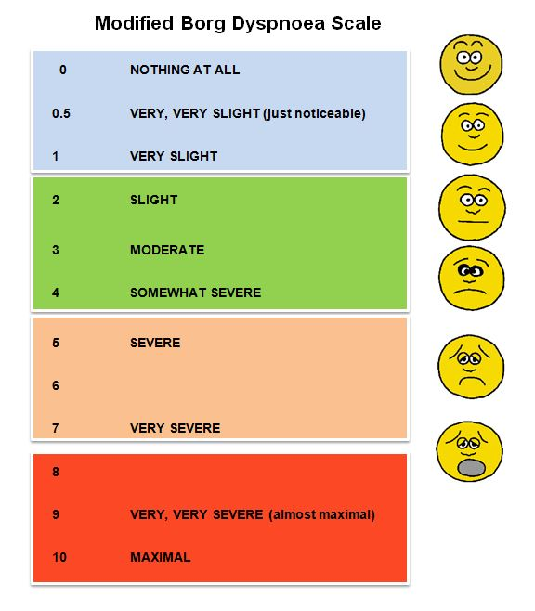
Outcomes
 | 11/07/22 | 16/09/22 | 23/09/22
Handgrip Mean Score | 10.6 Kg | 11.8 Kg | N/A
30 Sec Sit to Stand / Borg scale PRE | 7 STS 4 PRE | 10 STS 5 PRE | 13 STS 3 PRE
Notes:
Several controversial studies linking handgrip strength and health have suggested that low handgrip strength in older adults may be related to health problems and have investigated whether there is a minimum handgrip strength level associated with reduced mortality
Meta-analysis 2019 - 194,767 older adults
Higher handgrip strength was associated with an 18% decrease in all-cause mortality. Lower handgrip strength was associated with increased all-cause mortality. The minimum handgrip strength in older women that did not increase all-cause mortality was 18.21 kg. Increased handgrip strength showed a decreased all-cause mortality, whereas decreased handgrip strength was associated with increased all-cause mortality. Strengthening the handgrip may help improve disease-specific mortality in older adults. (J Lee 2019)

Slide 18
Outcomes cont.
28/9/22
VATS left upper lobectomy
Elective HDU admission
Good recovery
PS at 1st outpatient appointment = 2
PS at time of treatment = 1
02/11/22 – f/u appt
Making good recovery
Managing to get out for short walks around garden

Slide 19
Summary
Retrospective review
Prehab programme successfully implemented
Rockwood CFS may help to provide extra information into which patients may be suitable for SACT than PS alone
Case of clear success in prehab programme improving PS
Plan to look at specific factors that may influence suitability for surgery

