Slide 1
Somerset, Wiltshire, Avon and Gloucestershire (SWAG) Cancer Services
National Cancer Patient Experience Survey Results (2021)
Head and Neck Cancer Clinical Advisory Group
Tuesday 8th November 2022

Slide 2
NCPES Introduction
Annual survey, commissioned & managed by NHS England (since 2010)
last mandatory NCPES 2019 (due to pandemic)
new design for 2021, therefore break in series data & limited comparison
Picker - responsible for designing, running & analysing the survey
Designed to:
Monitor progress in cancer care
Provide information to drive local quality improvements
Assist commissioners and providers of cancer care
Inform the work various charities and stakeholder groups, supporting cancer patients

Slide 3
NCPES Methodology
Provider survey samples
Adults (16 and over), with a confirmed diagnosis of cancer
Discharged from NHS Trust (after an inpatient or day-case attendance for cancer related treatment) in April, May and June 2021.
Survey fieldwork Oct. 2021 – Feb. 2022
Reports published July 2022 (National, Alliance, ICS, Trust)

Slide 4
Cancer Alliance report
Report reflects experience of people referred from within CA footprint (not all those treated by that CA’s Providers)
‘referring’ CA report - based on patient home postcodes
According to ONS postcode mapping
Based on April 2021 STP / ICS position
(full new ICB / ICS mapping introduced from July 2022)

Slide 5
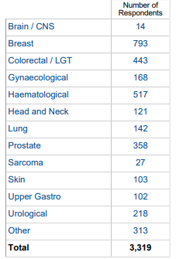
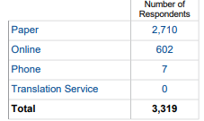
NCPES SWAG responses

Slide 6
Head and Neck responses
Total SWAG Head and Neck responses: 121
People ‘’referred’ with a SWAG postcode, who responded to the survey
Individual Trusts | responses
University Hospitals Bristol and Weston NHS FT | 37
Gloucestershire Hospitals NHS FT | 30
Somerset NHS FT | 23
Royal United Hospital Bath NHS FT | 17
Salisbury NHS FT | 1
North Bristol NHS Trust | 0
Yeovil District Hospital NHS FT | 0
TOTAL: | 108
4 answers supressed, as responses were <11
0 - not applicable
56 - a % score given as > 11 respondents for that question

Slide 7
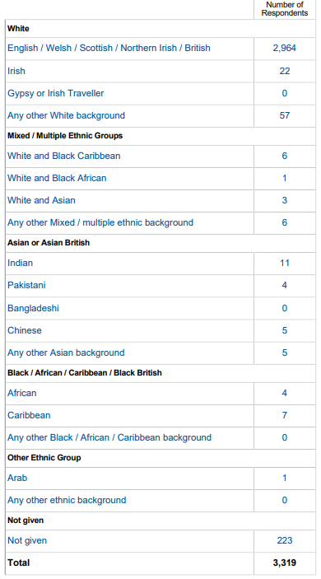
All SWAG respondents by Ethnicity
89%
91.5 % (3043)
1.5 % (53)
7%

Slide 8
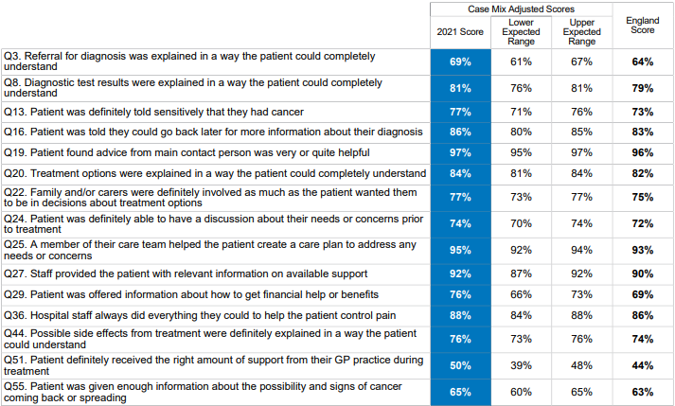
SWAG Summary
SWAG overall ‘rating of care’ 9.0
(national average 8.9)
SWAG Head and Neck overall ‘rating of care’ 9.1
15 questions were above the expected range (all others were in line with the national average)

Slide 9
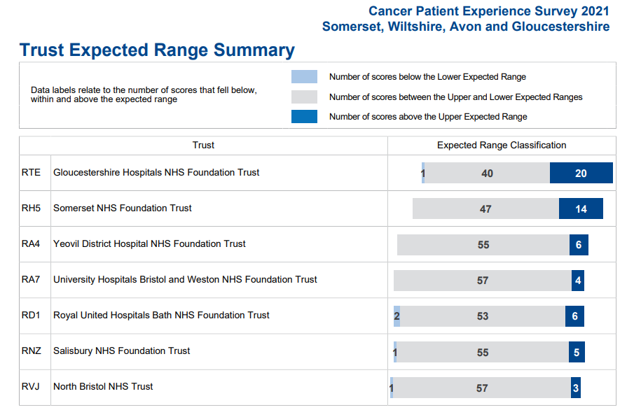
Trust Summary

Slide 10
Variations by tumour site
Comparison between tumour sites
Some significant variation in scores (e.g. >30%)
Significant variation in numbers of responses
Caution in making these comparisons and interpreting results
NCPES discussion at SWAG Clinical Advisory Groups (CAGs) and local MDTs
Alliance, ICS and Trust level scrutiny and pathway planning

Slide 11
SWAG Head and Neck highest scores ≥ 90%
 | Question | H&N SWAG | SWAG average | National average
19 | Patient found advice from main contact person was very or quite helpful | 98 | 97 | 96
26 | Care team reviewed the patient’s care plan with them to ensure it was up to date | 98 | 99 | 99
5 | Patient received all the information needed about the diagnostic test in advance | 95 | 93 | 93
18 | Patient found it very or quite easy to contact their main contact person | 95 | 87 | 85
25 | A member of their care team helped the patient create a care plan to address any needs or concerns | 95 | 95 | 93
9 | Enough privacy was always given to the patient when receiving diagnostic test results | 93 | 95 | 94
56 | The whole care team worked well together | 93 | 92 | 91
17 | Patient had a main point of contact within the care team | 92 | 91 | 92
27 | Hospital staff provided the patient with relevant information on available support | 92 | 92 | 90
36 | Hospital staff always did everything they could to help control pain | 90 | 88 | 86
37 | Patient was always treated with respect and dignity while in hospital | 90 | 90 | 89
46 | Patient was given information about support in dealing with immediate side effects from treatment | 90 | 87 | 86

Slide 12
SWAG Head and Neck lowest scores ≤ 60%
 | Question | H&N SWAG | SWAG average | National average
52 | Patient had had a review of cancer care by GP practice | 15 | 19 | 18
53 | After treatment, the patient definitely could get enough support at home from community and voluntary services | 33 | 35 | 32
58 | Cancer research opportunities were discussed with patient | 36 | 42 | 44
51 | Patient definitely received the right amount of support from their GP practice during treatment | 38 | 50 | 44
23 | Patient could get further advice or a second opinion before making decisions about their treatment options | 57 | 55 | 52
12 | Patient was told they could have a family member, carer or friend with them when told diagnosis | 60 | 71 | 71
50 | During treatment, the patient definitely got enough care and support at home from community or voluntary services | 60 | 56 | 51
55 | Patient was given enough information about the possibility and signs of cancer coming back or spreading | 60 | 65 | 63

Slide 13
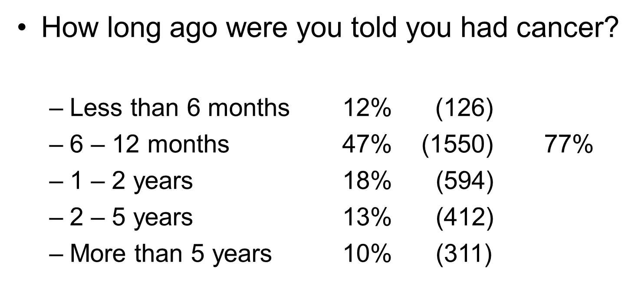
Cancer context – 3319 responses

Slide 14
Cancer context cont.
Who told you that you had cancer?
Specialist doctor / consultant 79% (2567)
Specialist cancer nurse 11% (348)
Someone at your GP practice 5% (161)
Another member of the hospital team 3% (90)
Someone else / can’t remember 2% (69)

Slide 15
Cancer context cont.
During the last 12 months, have you had
Surgery 60% (1941)
Chemotherapy 50% (1570)
Radiotherapy 33% (1075)
Hormone therapy 20% (640)
Immunotherapy 12% (396)
None of these 7 % (218)

Slide 16
Patient comments
Patients were asked……
How would you describe your care and treatment?
Was there anything that could have been improved?
Any other comments
Analysis presented by topic and sentiment
Trust level thematic ‘comments’ reports
Not able to filter comments by ‘tumour site’ this year

Slide 17
Somerset NHS FT
Key 2021 Trust NCPES message – despite high pressures in the system and COVID care received by Cancer patients on the whole remained of a high standard at SFT, both within the Beacon Centre and on general wards.
Area of success – information provision, especially during diagnostic part of pathway, patients reported not only communication to be of a high standard but also individuals and teams went out of their to provide high quality care and maintain their dignity at all times.
Prioritised area for improvement - Inter-organisation communication – ensuring key information regarding patient pathway is clear, keeping patient informed clearly of progress, changes and intentions throughout. How the patient interacts with their GP was often commented upon – so how we can as an organisation and a provider support this through information sharing, smarter working is being explored where possible – PCS treatment summaries, Holistic Needs Assessments, Cancer Support Workers etc.
“Musgrove Park Hospital is a wonderful hospital I was treated with care and consideration throughout my family was included and if they wanted to speak to someone an appointment could have made easily. I had only moved here a few months before my diagnosis so I knew no one the staff from nurses to consultation made everything so much better I cannot praise them highly enough. The same can be said when I was moved to outpatients at the Beacon Centre.”

Slide 18
Yeovil District Hospital NHS FT
A great set of results , a good care range of positive outliers and no negative outliers, with an above national average on both overall response with rate of 61% and with patients rating their overall cancer care from the Trust at 9.1 /10
As questions slightly different this year have looked at themes and moreover the comments that we as a trust rely on for better site-specific information are not so accessible. However, as question responses are now given for > 11, for the first time we have some smaller sites such as lung specific information. Notably for us the continued effect of the pandemic but also the significant impact Cancer Support Workers by working with the site specialties were very evident within these results.
Main positives : patients receiving details on financial support, privacy when receiving results, staff providing information on the relevant support available, care planning was up to date, support continued through Covid pandemic with the move to off site oncology treatment area, knew main contact and could easily access them, good overall team working and family and carers were supported and given all the information they needed.
Points for wider-teams review and consideration are to continue to review and improve patient communication and ensure Personalised care and support (PCS) embedded across all the cancer sites, such as increasing virtual wellbeing clinics, increasing access and scope of supportive information for living with cancer and managing any longer term effects; so likely focus will be:
Patient communication from our Trust in improving the communication for our patients and from regional Trusts used by our patients or other organisations. We acknowledge a lot of administration upheavals in the last couple of years due to Covid with often short cancellations of clinics given to patients but we could be more patient centric and streamlined in our communication and opportunistic with other methods, i.e. not just rely on letters.
Targeting Information around different treatments e.g. increasing use of immunotherapy , support services, long term effects and living with cancer after the treatment is completed. Using the site-specific information to have more targeted approaches to information whether this is in the nuances of treatments or the supportive care such as long term side effects and lastly how we improve primary and secondary care sharing communication
“In spite of the hospital having difficulty appointing a new consultant after mine moved on, I never felt as though I wasn't being monitored or looked after. In fact, my specialist nurse went above and beyond the call of duty to make sure nothing was missed. She was exceptional. I have complete confidence in the systems used and the way staff use them to give patients the very best care. I cannot commend Yeovil District Hospital highly enough.”

Slide 19
University Hospitals Bristol and Weston NHS FT
585 responses (55%): 87% white British, 65% IMD quintiles 4&5, 10% (56) <45yrs 9/10 for ‘overall experience of care’
Key message – positive reflection of 2021 experience, especially with context of the pandemic. Commitment to gathering feedback from a wider demographic.
Successes – impact of Personalised Care & Support (e.g. access to support, care plan); information giving; waiting times for treatment and in clinic; multiple comments describe positive staff attributes, care quality and treatment.
Priorities for improvement
Access to support from GP practice and community services
Communication supporting shared care
Specific information for long term side-effects, immunotherapy, hormone treatment and getting a second opinion.
“Not just first class – it was world class. I cannot praise everyone involved enough and I will never be able to thank them enough. Their care, skill and medical excellence enabled my treatment, recovery and healing to progress efficiently and effectively.”

Slide 20
North Bristol NHS Trust
At NBT Patients scored the Trust 9 out of 10 for the 'overall experience of care' question. Nationally, patients gave an average rating for overall experience of care of 8.92.
470 patients took the time to complete the survey, providing over 800 free text comments about their experience which are data rich and analysis in progress.
Areas of success include evidence that personalised care and support is making a difference.
The free text comments provide insight into the patient experience in relation to communication and information identifying areas for improvement:
Co-ordination of appointments
Communication between hospital – GP
Consistency of HCP
‘”The care I have and continue to receive from the Cancer Team is excellent both in terms of quality of delivery from the consultant and her team, and, the continuity of care. I have been fortunate to have had consultations, face to face and on the telephone, with the same consultant each time. This has given huge reassurance and consistency of information / advice, during a time of anxiety having been given a diagnosis of cancer”.

Slide 21
Royal United Hospitals Bath NHS FT
531 responses with a 60% response rate
Free text responses overwhelmingly acknowledging the difficulties of Covid, but thankful that despite the pandemic, cancer services continued and praise for staff.
Successes- access to support and advice from a main point of contact, together with patients receiving clear information regarding diagnostic investigations, surgery and radiotherapy , access to staff who provide information on support and create plans of care. Patients felt treated with dignity and respect
Areas of focus for development- to provide clear and understandable advice on the management of side effects both immediate and long term, To ensure patients are kept informed regarding progress of their treatment.
“I felt the care & treatment I received was brilliant! I was well informed and looked after every step of the way. I couldn't have asked for any more.”

Slide 22
Salisbury NHS FT
339 patients were invited to complete the survey, 212 patients responded. The Trust response rate was 63% compared to national average of 55% receiving 420 comments.
Trust score for Overall patient experience and care was 8.8 compared to a national average of 8.9.
The Trust received 5 positive outliers and 1 negative outlier.
Areas of Success
Financial support highlighting the success of CSW across all tumour sites
Involvement of family with treatment decisions
Prioritised Areas for Improvement
Help from ward staff, with post operative care, medications, information and advice- Plan for Macmillan to fund Practice Educator in Cancer Care for ward education.
Information availability- Plan for Macmillan to fund information centre
“I have had fantastic treatment from the NHS trust where I received my diagnosis and treatment. Every department I have had contact with has been full of caring and compassionate staff which has made the whole experience so much easier. I was referred immediately into the 2 week wait clinic by my GP where I received all the tests I needed straight away - within 45 mins of my appt. Time I had a discussion with the consultant who was able to tell me that they were fully certain I had cancer, I had surgery within 2 weeks of this and chemo started within 6”.

Slide 23
Gloucestershire Hospitals NHS FT
Unable to provide an update at present, due to changes in personnel.
This will now be picked up by the newly appointed GHFT Lead Cancer Nurse.

Slide 24
Initial SWAG observations
‘Personalised Care and Support’ (PCS) is making a tangible difference – need to continue to expand access
Theme of low scores relating to
communication and shared care, between care providers, Trusts, departments
Information giving (including side effects, immunotherapy)
access to support from community & primary care services
Younger patients, females, all BAME groups and patients from the least deprived areas tend to report a less positive patient experience
Positive reflection of many services, given the context of the pandemic

Slide 25
Clinical Advisory Group - Next Steps
Discuss and agree SWAG Head and Neck patient experience improvement priorities, including areas of lowest scores (Slide 12)
to be collated and fed back to SWAG Cancer Board
Next steps / timeline
Nominated lead
Recognition of areas of good practice
Consider / plan additional in-year Head and Neck-specific patient experience activity to gain further insight

Slide 26
SWAG next steps
Further analysis and discussion
By ethnicity, deprivation, tumour site
At Trust level
Across shared ICS pathways
Across shared SWAG pathways (at Alliance CAGs)
Further embed and expand access to PCS
Triangulation with ongoing QoL survey results

