Slide 1
National Lynch Syndrome project Team Update
Sarah John and Siobhan John
SWGMSA Nurse facilitators
Notes:
Hi,
Our names are Sarah John and Siobhan John (no relation!)
We both have over 20 yrs experience working in Bristol and Bath as colorectal nurse specialists.
However for the next year we’re working within SWGMSA facilitating the Lynch Syndrome project in the region

Slide 2
Why worry about Lynch?
At least 260 endometrial cancers are caused by Lynch syndrome each year (The Eve Appeal)
More than half of women with metachronous colorectal and gynae cancers, present with endometrial 1st (Lu et al, 2005)
175,000 people have Lynch syndrome in the UK, less than 5% know this (Bowel Cancer UK).
NICE recommends testing at diagnosis
Notes:
Each year in England, at least 260 endometrial cancers are caused by Lynch, that’s 2-3 % of all cases making it the most common hereditary endometrial cancer
In a study in 2005, a gynecological cancer precedes was diagnosied 1st in more than 50% of patients with LS making gynecological cancer a “sentinel cancer” for LS
It is estimated that there are 175,000 people with Lynch in the UK, but currently fewer than 5% of individuals know that they have it
Since 2017, in the UK NICE has recommended universal testing for Lynch Syndrome in all newly diagnosed colorectal cancers
More recently since 2020 testing in endometrial cancers is recommended as well.

Slide 3
How does Lynch occur?
A germline pathogenic mutation occurs in 1of 4 DNA mismatch repair genes resulting in a dMMR gene.
It is autosomal dominant, so a child of a lynch parent has a 50:50 chance of inheriting the condition as well.
Notes:
Lynch Syndrome occurs when there is a germline pathogenic variant (mutation) in 1 of 4 DNA mismatch repair genes, this is termed a deficient MMR gene. Additionally the EPCAM gene has been found to deactivate the MMR gene called MSH2
It is autosomal dominant, and so a child who has a parent with Lynch has a 50:50 chance of inheriting it

Slide 4
LS predisposes to certain cancer types:
The main concerns are:
Colorectal 20%-80% risk
Endometrial 24% - 51% risk
Other less frequent cancers:
Ovarian 2%-17% (av 8%)
Urinary tract 1%-18%
Gastric 1%-13%
Small intestine 1%-6%
Hepato-biliary and pancreatic 1%-4%
Sebaceous gland (and adenoma) 1%-2%
Central Nervous System 1%-3%
Notes:
People who have Lynch Syndrome have a significantly increased risk of developing cancer due to the mutation in the mis match repair gene, rendering it unable to function and correct errors occurring in gene replication.
The likelihood of developing a cancer depends on which of the 4 MMR genes is deficient
As you can see here, overall, the most common cancers to occur are colorectal with a life time risk of between 20% and 80% but the risk of endometrial cancers is between 15% and 60% depending on which gene is deficient
There is also a predisposition to several other cancers such as ovarian which at an average of *% is significantly higher than the 1.$% in the general population

Slide 5
Incidence of endometrial and ovarian cancers
 | Endometrial | Ovarian
Normal | 2% | 2%
MLH1 | 34% | 11%
MSH2 | 51% | 17%
MSH6 | 49% | 11%
PMS2 | 24% | 2%
Notes:
Breaking it down further, you can see that the incidence of developing an endometrial or ovarian cancers by the age of 705yrs, varies depending on which LS gene is deficient
The risk of endometrial cancer begins to rise around the age of 40yrs in all dMMR genes except PMS2, which is about 10 years later.
The risk of ovarian cancer is raised if MLH1, MSH2 or MSH6 are deficient, however bilateral oopherectomy is not necessary if PMS2 is deficient

Slide 6
When should we test?
dMMR can affect cancer treatment options, certain tumours are more responsive to particular chemotherapy agents as well as new immunotherapy drugs called check point inhibitors.
It is important that the initial tumour test is done in time to inform treatment options
Notes:
So when should we test:-
In June 2021, NICE recommended the use of a checkpoint inhibitor immunotherapy drug, pembrolizumab, for people with untreated metastatic colorectal cancer with high microsatellite instability (MSI) or dMMR, including people with Lynch syndrome. Currently NICE hasn’t issued similar guidance in endometrial cancers
It is therefore important that the initial tumour is tested for IHC in time to inform their treatment options, be that the chemo / immune therapies offered or the surgery offered – colonic resection at the same time as TAH +(BSO if a patient is MLH1, MSH2 deficient)

Slide 7
How do checkpoint inhibitors work?
Checkpoint proteins are found in T cells in our immune system.
A cancer cell makes high levels of the proteins which switch off the T calls when the should be fighting cancer.
Checkpoint inhibitors stop the proteins on the cancer cells from pushing the stop button.
A GAME CHANGER!
Notes:
I’ll attempt to explain this very simply, so apologies for any experts in the room!
The T cells in our immune system have some proteins on them that turn on an immune response and other proteins that turn it off. These are called checkpoint proteins
Cancer cells with dMMR appear to make high levels of the proteins, which switch off the T cells, when they should be attacking the cancer.
But giving checkpoint inhibitors, stop the proteins on the cancer cells from pushing the stop button.
Thereby allowing our T cells in our immune system to fight the cancer
Therefore the immune system remains switched on and is able to fight the cancer
This is a game changer regarding the treatment of cancer.

Slide 8
Immunotherapy in Lynch Syndrome
Notes:
In a nut shell, this slide demonstrates how successful the check point inhibitor can be.
A cancer which has a dMMR gene (shown on the left hand and middle graph) is far more responsive to the check point inhibitor / immunotherapy drug, pembrolizumab, than a proficient MMR gene.
This is the case even if the gene is deficient due to a sporadic mutation, rather than Lynch. IHC testing (in theory) can be completed within 10-14 days.
So if the initial biopsy is automatically sent for IHC after a cancer is found, this information should be available before commencing treatments

Slide 9
Our Role
Audit the current provision in all trusts to highlight good and bad practice
Support trusts to ensure patients are routinely tested for Lynch at diagnosis.
Ensure patients are on the correct surveillance pathway and are added to the regional database.
Notes:
So what are our plans for the next year:-
Encourage trusts to audit their current provision so highlighting good and bad practice.
In order to be able to help trusts improve their pathway, it is essential that Lynch champions complete the audit soon in order that we can analyse what is happening and offer support in order to improve
Following this we will support trusts on what changes are needed, to ensure all patients with both colorectal and endometrial cancers are routinely tested for lynch at diagnosis.
Gynae are currently doing better here than colorectal, but your pathway is simpler!
By doing this we will ensure that patients can be offered all the treatment options now available
Furthermore, we need to ensure patients are on the correct surveillance pathway and they are added to the regional database, which we hope will be set up within this financial year. This will ensure that all LS patients in the region are offered appropriate surveillance in the form of colonoscopy and a one time OGD.
Additionally all patients with LS should be offered aspirin, currently most people are advising 150mg or 300mg OD depending on wt.
This is based on the CaPP trial started in 2011 which showed that long term use of aspirin (600mg) can reduce LS cancers by 60%.
In women, as there is no recognised screening programme, risk reducing surgery should be discussed with patients; the timing and type of surgery will depends on the gene involved. MLH1 + MSH2 deficiencies having the higher risks.
Additionally, there will be support and training for hospitals to be able to offer mainstream germline testing for Lynch in a very similar manner to which you are now doing for BRACA.
Please email me if you do not have a copy of the LS audit, once completed and sent back to us, Sarah or I will arrange to meet with you to review how things are going, and what needs to change and how.

Slide 10
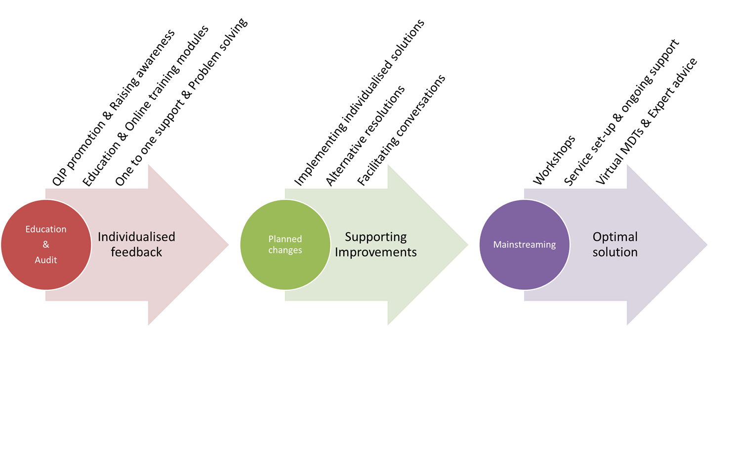
Improving diagnostic pathways
Notes:
We will implement this by offering education both locally, and by using the electronic resources provided through RM Partners who are leading on the National Transformation pathway for Lynch
The baseline audit is key to assessing the LS diagnostic pathway in each MDT. This also helps the LS champion and their team to identify gaps within the diagnostic pathway, problem solving and finding solutions together.
These discussions will need to be followed up by the team with the Lynch champion to assess if the changes are effective. Solutions will be individualised and may require facilitating conversations with different team members and external bodies.
For teams wishing to go all the way to mainstreaming, additional support is provided with educational workshops, and, support and advice on how to set-up their service.
Bespoke workshops can be delivered through RM partners, every 2 weeks and last for 2 hours each. Generally teams require between 3 to 6 workshops to complete the mainstreaming training

Slide 11
https://rmpartners.nhs.uk/lynch-syndrome-early-diagnosis-pathway-endometrial Siobhan.John@nhs.net Sarah.John@nbt.nhs.uk
Notes:
Additionally, we do encourage all members of the MDT to undertake this simple on line training, it takes less than an hour to complete and aims to ensure that everyone looking after a potential LS patient is offered the correct plan of care for them.

